Slide 1
Objects in Linux
Trust us, we know what we are doing...
Greg Kroah-Hartman
gregkh@linuxfoundation.org

Slide 2
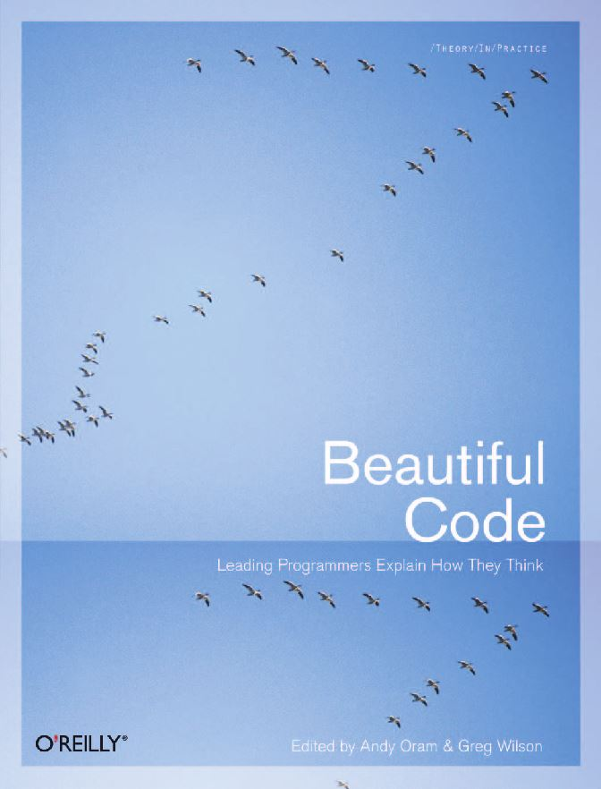
Notes:
Talk based on a chapter I wrote for “Beautiful Code – Leading Programmers Explain How They Think”
Edited by Andy Oram and Greg Wilson
O'Reilly
2007

Slide 3
Early 2000's
“Unify all Linux devices”
Pat Mochel – OSDL
Greg K-H - IBM
Notes:
Pat wanted this for power management and suspend/resume
I wanted this for persistant device naming.
All devices and subsystems were islands
Both tasks needed a way to see all devices in the system, suspend/resume wanted to know which device to suspend in which order.
Naming needed a way to assign a character or block device to a specific hardware device

Slide 4
struct device {
struct list_head node;
struct list_head children;
struct device *parent;
char name[DEVICE_NAME_SIZE];
bus_id[BUS_ID_SIZE];
spinlock_t lock;
atomic_t refcount;
struct driver_dir_entry *dir;
struct device_driver *driver;
void *driver_data;
void *platform_data;
u32 current_state;
unsigned char *saved_state;
};
2.6.20 to 2.6.24-rc8
Notes:
We came up with 'struct device'
All busses in the kernel were changed to create a structure based on this one. It was passed to the new driver core, and the driver core created a hierarchy of everything in the kernel.
This can be seen in sysfs (which used to be called driverfs)

Slide 5
struct device {
struct list_head node;
struct list_head children;
struct device *parent;
char name[DEVICE_NAME_SIZE];
bus_id[BUS_ID_SIZE];
spinlock_t lock;
atomic_t refcount;
struct driver_dir_entry *dir;
struct device_driver *driver;
void *driver_data;
void *platform_data;
u32 current_state;
unsigned char *saved_state;
};
2.6.20 to 2.6.24-rc8
Notes:
We came up with 'struct device'
All busses in the kernel were changed to create a structure based on this one. It was passed to the new driver core, and the driver core created a hierarchy of everything in the kernel.
This can be seen in sysfs (which used to be called driverfs)

Slide 6

github.com/gregkh/presentation-kref
Notes:
Obligatory Penguin Picture

Slide 8
“Publicly making fun of people is half
the fun of open source programming.
In fact the main reason to eschew
programming in closed environments
is that you can't embarrass people in
public.”
– Linus Torvalds
2.6.20 to 2.6.24-rc8
Notes:
Linus said this after I wrote a small rant about some truly horrible Linux kernel driver code that I found online.
It had all sorts of "this code is never to be included in the Linux kernel" warnings all over it, despite it being a Linux kernel driver. And in reading the code, it was obvious why the author never wanted it in the kernel, it was one of the worse things I had ever seen, and that says a lot. After I complained about it, I felt bad, as someone had obviously spent a lot of time on it, but Linus replied with the above quote.
And as always, it turns out that Linus is right.

Slide 9
“Publicly making fun of people is half
the fun of open source programming.
In fact the main reason to eschew
programming in closed environments
is that you can't embarrass people in
public.”
– Linus Torvalds
2.6.20 to 2.6.24-rc8
Notes:
If that author had ever thought that the code would have been posted publicly, they wouldn't have written such crap. That's what maintainers and public code review is really for in the end, keeping the crap out of the Linux kernel, which benefits everyone involved.
So while it seems that we kernel developers can be a real harsh bunch of people, it is because of that harshness that Linux is as good as it is.
You want us to be tough, because it makes you better programmers in the end, knowing you will have to defend your code.
And that is why I love doing this work, it makes everyone involved produce the best possible code, which in the end, is what matters the most.

