Slide 1

Linux Kernel Release Model
(and security stuff)
Greg Kroah-Hartman
gregkh@linuxfoundation.org
github.com/gregkh/presentation-release-model
Notes:
I'm going to discuss the how fast the kernel is moving, how we do it all, and how you can get involved.

Slide 2
60,000 files
24,767,000 lines
Kernel release 4.13.0
Notes:
This was for the 4.11 kernel release, which happened April 30, 2017.

Slide 3
4,316 developers
519 companies
Kernel releases 4.8.0 – 4.13.0
August 2016 – September 2017
Notes:
This makes the Linux kernel the largest contributed body of software out there that we know of.
This is just the number of companies that we know about, there are more that we do not, and as the responses to our inquiries come in, this number will go up.
Have surpassed 400 companies for 4 years now.

Slide 4
10,000 lines added
2,500 lines removed
2,100 lines modified
Kernel releases 4.8.0 – 4.13.0
August 2016 – September 2017

Slide 5
10,000 lines added
2,500 lines removed
2,100 lines modified
Every day
Kernel releases 4.8.0 – 4.13.0
August 2016 – September 2017

Slide 6
8.5 changes per hour
Kernel releases 4.8.0 – 4.13.0
August 2016 – September 2017
Notes:
This is 24 hours a day, 7 days a week, for a full year.
We went this fast the year before this as well, this is an amazing rate of change.
Interesting note, all of these changes are all through the whole kernel.
For example, the core kernel is only 5% of the code, and 5% of the change was to the core kernel. Drivers are 55%, and 55% was done to them, it's completely proportional all across the whole kernel.

Slide 7
9.7 changes per hour
4.9 & 4.12 release
2.6.20 to 2.6.24-rc8
Notes:
4.9 was the “largest” in number of changes that we have ever accepted. After 4.9, things went down a bit for 4.10 and 4.11, but 4.12 is getting very big.
Now this is just the patches we accepted, not all of the patches that have been submitted, lots of patches are rejected, as anyone who has ever tried to submit a patch can attest to.

Slide 8
4.12 release July 7th?
2nd largest release
2.6.20 to 2.6.24-rc8
Notes:
4.12 should be released on July 7th and is on track to be the 2nd largest release by number of changes we have ever done.
And the first largest on number of lines of code we have added, due to some very large drivers being added to the tree.

Slide 9
Old release model
2.2 – January 1999
2.4 – January 2001
2.6 – December 2003
2.6.20 to 2.6.24-rc8

Slide 10
“New” release model
Release every 2-3 months
All releases are stable
2.6.20 to 2.6.24-rc8

Slide 11
“Cambridge Promise”
Will not break userspace.
2.6.20 to 2.6.24-rc8
Notes:
Kernel summit 2007 in Cambridge England
All kernel developers agreed that this is what we will do, in order to give users a reason to feel comfortable upgrading their kernels.

Slide 12
“Cambridge Promise”
Will not break userspace,
knowingly.
– July 2007
2.6.20 to 2.6.24-rc8
Notes:
Well, we do not knowingly break userspace, we accidentally do it all the time, we are just human.
But we will work very hard to fix the issue.
Note, if no one notices userspace is broken, it isn’t.

Slide 13
Version numbers
mean nothing
2.6.20 to 2.6.24-rc8
Notes:
They only mean that one is newer than another.

Slide 14
2.6.x → 3.x 2011
2.6.20 to 2.6.24-rc8
Notes:
Big numbers seem to increment “smaller” over time than small numbers (brains are wierd)
LinuxCon Japan 2011
I bribed Linus with whisky
Kernel developers drank the bottle within minutes at the after-party.

Slide 15
3.x → 4.x 2015
2.6.20 to 2.6.24-rc8
Notes:
Big numbers seem to increment “smaller” over time than small numbers (brains are wierd)
2015

Slide 16
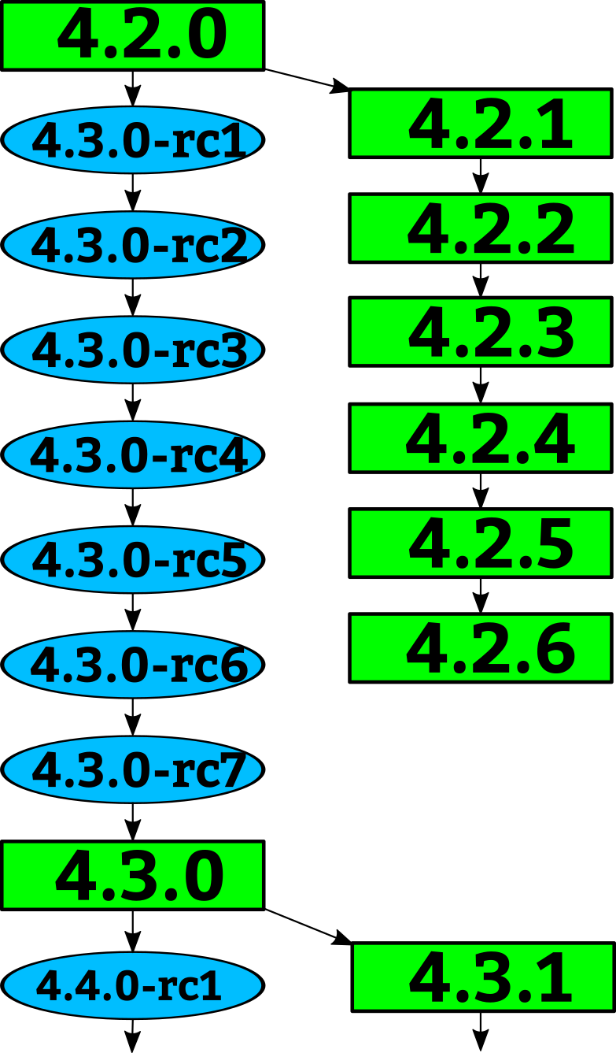
Notes:
How a kernel is developed.
Linus releases a stable kernel
- 2 week merge window from subsystem maintainers
- rc1 is released
- bugfixes only now
- 2 weeks later, rc2
- bugfixes and regressions
- 2 weeks later,rc3
And so on until all major bugfixes and regressions are resolved and then the cycle starts over again.

Slide 17
Notes:
Greg takes the stable releases from Linus, and does stable releases with them, applying only fixes that are already in Linus's tree.
Requiring fixes to be in Linus's tree first ensures that there is no divergence in the development model.
After Linus releases a new stable release, the old stable series is dropped.
With the exception of “longterm” stable releases, those are special, the stick around for much longer...

Slide 18
Stable rules
– Bugfix
– Less than 100 lines
– New ids or quirks
– Must be in Linus’s tree
https://www.kernel.org/doc/html/latest/process/stable-kernel-rules.html
2.6.20 to 2.6.24-rc8
Notes:
They only mean that one is newer than another.

Slide 19
“Longterm kernels”
One picked per year
Maintained for at least 2 years
4.4 4.9 4.14
2.6.20 to 2.6.24-rc8
Notes:
I pick one kernel release per year to maintain for longer than one release cycle. This kernel I will maintain for at least 2 years.
This means there are 2 longterm kernels being maintained at the same time.
4.4 and 4.9 are the longterm kernel releases I am currently maintaining
The LTSI project is based on the longterm kernels.

Slide 20
4.4 9 changes / day
4.9 13 changes / day
4.12 10 changes / day
2.6.20 to 2.6.24-rc8
Notes:
Lots of changes are getting backported
3.10 – averaging 4.5 a day
3.18 – 5 / day
3.16 – 2 / day (debian is tough work...)

Slide 21
Every release is stable
Decade old guarantee
Always update your kernel
2.6.20 to 2.6.24-rc8
Notes:
Wait what? Why update?

Slide 22
Can’t update your kernel?
Blame your SoC provider...
2.6.20 to 2.6.24-rc8
Notes:
SoC kernels suck ass.

Slide 23
“Popular” SoC kernel tree
6171 files changed 2837180 insertions(+), 42568 deletions(-)
2.6.20 to 2.6.24-rc8
Notes:
SoC kernels suck ass.

Slide 24
“Popular” SoC kernel tree
6171 files changed 2837180 insertions(+), 42568 deletions(-)
Image.lz4 – 3.2 million lines
Linux “like”
2.6.20 to 2.6.24-rc8
Notes:
SoC kernels suck ass.

Slide 25
Kernel Security
Notes:
Let’s talk about kernel security.

Slide 26
Kernel Security
Almost all bugs can be a “security” issue.
Notes:
Anything that goes wrong in the kernel can usually be turned into a “security” problem.
Be it a DoS, or a reboot, or local root exploit, or worst case, a remote root exploit (very rare, thankfully.)

Slide 27
Kernel Security
Almost all bugs can be a “security” issue.
Fix them as soon as possible.
Notes:
Because it’s really hard to determine if a bug is a “security” issue, our response is that we fix all bugs as soon as possible once we learn about them.
TTY bug in RH

Slide 28
Kernel Security
Averaging 13 fixes per day.
Notes:
If you look at the number of patches flowing into the stable tree, we are averaging 13 patches a day, every single day.
Now not all of them are “security” fixes. But some small percentage is.
This is for the latest kernel release, the 4.4 kernel is averaging 9 fixes a day, and 4.9 is still running at 13 fixes a day!

Slide 29
“If you are not using a stable /
longterm kernel, your machine
is insecure”
– me
Notes:
Your infrastructure HAS to support updating the kernel. If you can’t do that, you are insecure.
Even the “enterprise” kernels aren’t keeping up with this rate of change, the exception being Debian.
If you use these kernels, you HAVE to keep up to date.
Android example.

Slide 30
“The kernel needs airbags”
– Konstantin Ryabitsev
slides.com/mricon/giant-bags-of-mostly-water#/
Notes:
kernel.org sysadmin, in charge of the LF sysadmin team, Fedora infrastructure developer.
Great presentation on how you, as a sysadmin, can implement secure practices for your network. Full checklist and guide has been published.
But, even with those practices, we need low-level changes in order to save ourselves from the accidents that will happen.
We need “airbags” in the kernel, and elsewhere.
Things like SELinux, grsec, openwall we need them.

Slide 31
“We will always have bugs,
we must stop their exploitation”
– Kees Cook
outflux.net/slides/2015/ks/security.pdf
Notes:
Kees Cook, kernel security developer, presentation at kernel summit last year.
We need to start doing things to make the kernel more “robust” from a security standpoint.
Even if it makes things harder for the developers.
Everyone agreed.

Slide 32
Kernel Hardening
kernsec.org/wiki/index.php/Kernel_Self_Protection_Project
Core Infrastructure Initiative
Notes:
Kernel hardening project.
New security features are being added in each release, but if you don’t upgrade, you don’t get those features, and protection.
CII is helping to fund this, if you want to work on it, we need developers, and we will pay for it.

Slide 33
“Ceaseless change is the only
constant thing in Nature.”
– John Candee Dean
Notes:
1911 astronomer.
If your operating system isn’t constantly changing, then it is dead. The world doesn’t stop changing, learn to embrace the change in order to survive.
“static systems” die.

Slide 34

github.com/gregkh/kernel-development
Notes:
Obligatory Penguin Picture

Slide 36
Getting involved
Run the kernel.org release on your machine
2.6.20 to 2.6.24-rc8
10,900 lines added
5,500 lines removed
2,200 lines modified
per day 2008 - 2009

Slide 37
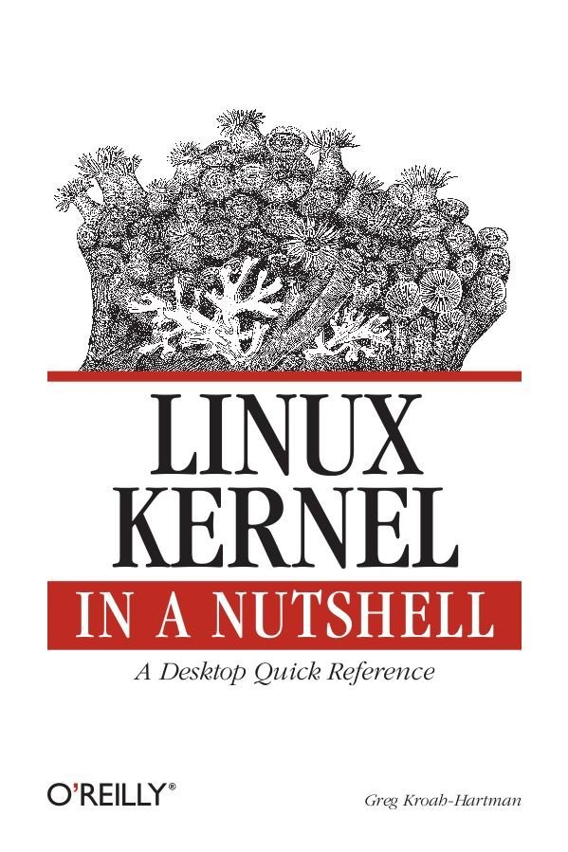
Getting involved
2.6.20 to 2.6.24-rc8
10,900 lines added
5,500 lines removed
2,200 lines modified
per day 2008 - 2009
Notes:
This book tells you how to build and install a kernel on your machine.
Free online

Slide 38
Getting involved
Documentation/HOWTO
Documentation/development-process
2.6.20 to 2.6.24-rc8
Notes:
These documents in the kernel source directory are the best place to start if you want to understand how the development process works, and how to get involved.
The HOWTO file has links to almost everything else you ever wanted..

Slide 39

Getting involved
kernelnewbies.org
2.6.20 to 2.6.24-rc8
Notes:
http://www.kernelnewbies.org

Slide 40
Getting involved
Google “write your first kernel patch”
2.6.20 to 2.6.24-rc8
Notes:
This is a video of a talk I gave at FOSDEM, going through the steps, showing exactly how to create, build, and send a kernel patch.

Slide 41
Getting involved
kernelnewbies.org/KernelJanitors/Todo
2.6.20 to 2.6.24-rc8
Notes:
So you know how to create a patch, but what should you do? The kernel janitors has a great list of tasks to start with in cleaning up the kernel and making easy patches to be accepted.

Slide 42
Getting involved
Linux Driver Project
drivers/staging/*/TODO
2.6.20 to 2.6.24-rc8
Notes:
The staging tree also needs a lot of help, here are lists of things to do in the kernel for the drivers to be able to move out of the staging area.
Please always work off of the linux-next tree if you want to do these tasks, as sometimes they are already done by others by the time you see them in Linus's tree.

Slide 43
Getting involved
Eudyptula Challenge
(little penguin)
http://eudyptula-challenge.org/
2.6.20 to 2.6.24-rc8
Notes:
Google “Linux kernel challenge” to find the site, if you can't remember Eudyptula.
It is a series of programming challenges, all run through email that starts out with a “Hello World” kernel module, and gets more complex from there. Over 4000 people are currently taking the challenge, and is a lot of fun if you don't know where to start out.
You need knowledge of C, but that's about it.

Slide 44
Product Development
time
Design Bringup Integration Testing Release

Slide 45
Product Development
time
Design Bringup Integration Testing Release
Kernel code
submission
Kernel code
accepted
Ideal

Slide 46
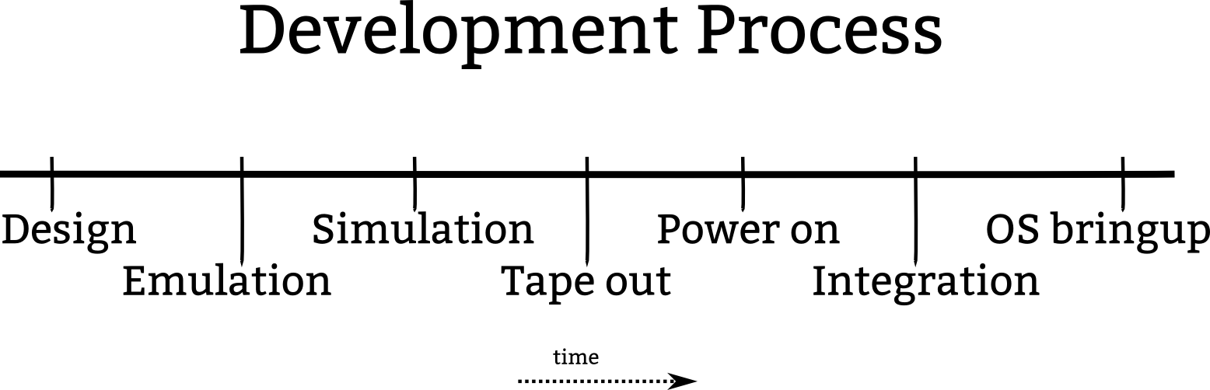

Slide 47
Kernel code
submission
Kernel code
accepted
Ideal

Slide 48
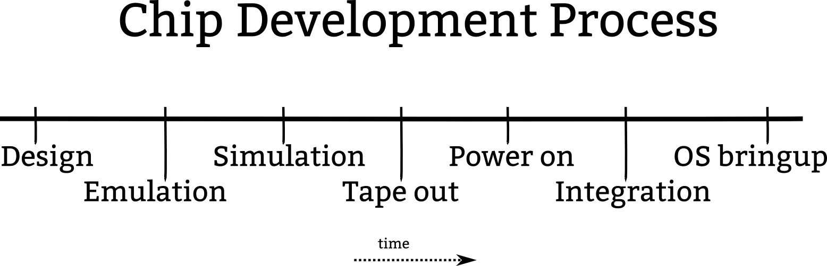

Slide 49
Kernel code
submission
Today

Slide 50
Kernel code
submission
Kernel code
accepted
Today

Slide 51
Kernel code
submission
Ideal

Slide 52
Kernel code
submission
Kernel code
accepted
Ideal

