Slide 1

“Patches carved into stone tablets”
i.e. why we use email to develop the kernel
Greg Kroah-Hartman
gregkh@linuxfoundation.org
github.com/gregkh/presentation-stone-tools
Notes:
I'm going to discuss the how fast the kernel is moving, how we do it all, and how you can get involved.

Slide 2
Because it is faster
than anything else.
Notes:
It’s simple.
4000 developers a year
450+ companies a year
We must be doing something right, right?
There is also another reason why we do this, but I’ll wait until the end to let you know.

Slide 3
7-8 changes per hour
Notes:
Our average pace, slowly constantly going up.
Faster than any other project out there.

Slide 4
75 maintainers took over 364 patches
Kernel releases 4.2.0 – 4.7.0
Notes:
We review lots and lots of patches

Slide 5
Kernel reviewers
Greg Kroah-Hartman 9781
David S. Miller 6658
Mark Brown 2815
Andrew Morton 2444
Ingo Molnar 2332
Daniel Vetter 2223
Mauro Carvalho Chehab 2029
Arnaldo Carvalho de Melo 1697
Kalle Valo 1598
Linus Walleij 1447
Doug Ledford 1307
Rafael J. Wysocki 1273
Thomas Gleixner 1219
Kernel releases 4.2.0 – 4.7.0
Notes:
13 developers reviewed, and accepted, over 1000 patches last year.
I average only accepting 1/3 of the patches sent to me.

Slide 6
“It’s a poor craftsman that blames his tools.”
Notes:
We review lots and lots of patches

Slide 7
“An expert crafstman knows how to choose excellent tools.”
– Jeremy Bowers
https://news.ycombinator.com/item?id=2380679
Notes:
We review lots and lots of patches

Slide 8
GitHub
Bitbucket
GitLab
etc.
Notes:
The most popular ones first

Slide 9
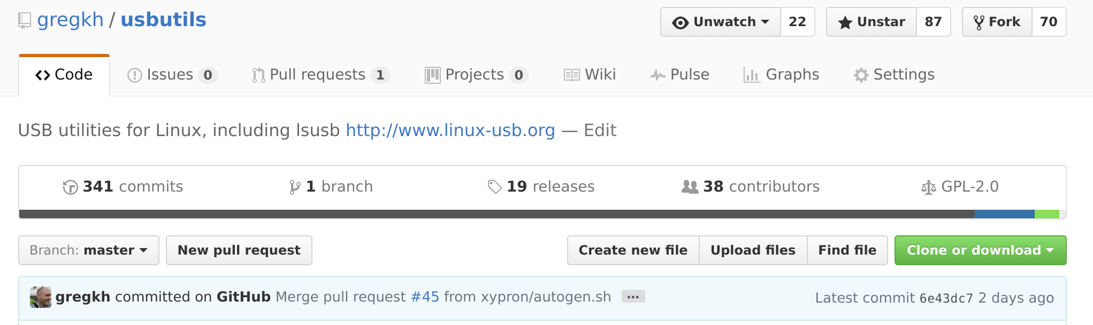
GitHub - pros
Notes:
It’s beautiful
Really beautiful.
Easy to use, simple interface, unlimited bandwidth, great stuff.
Easy to get drive-by-patches
Use it for small to medium projects.
Good backend testing hooks
Free!!!

Slide 10
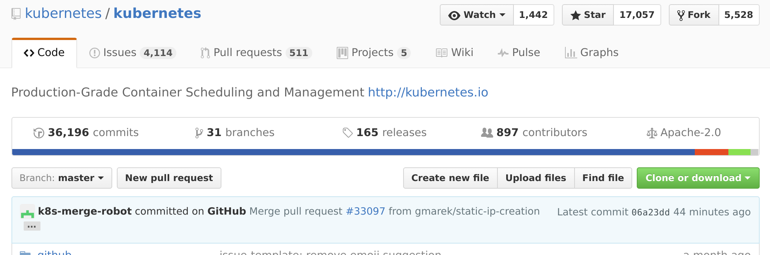
GitHub - cons
Notes:
Does Not Scale!
Pull requests disjoint from mailing list
Discussion happens in odd threads almost like email, but not quite
Local testing difficult
Issue tracking is a pain in the rear end
Constant merge commits
Requires online access
Delay between patches

Slide 11
gerrit
reviewboard
etc.
Notes:
Company patch review systems

Slide 12
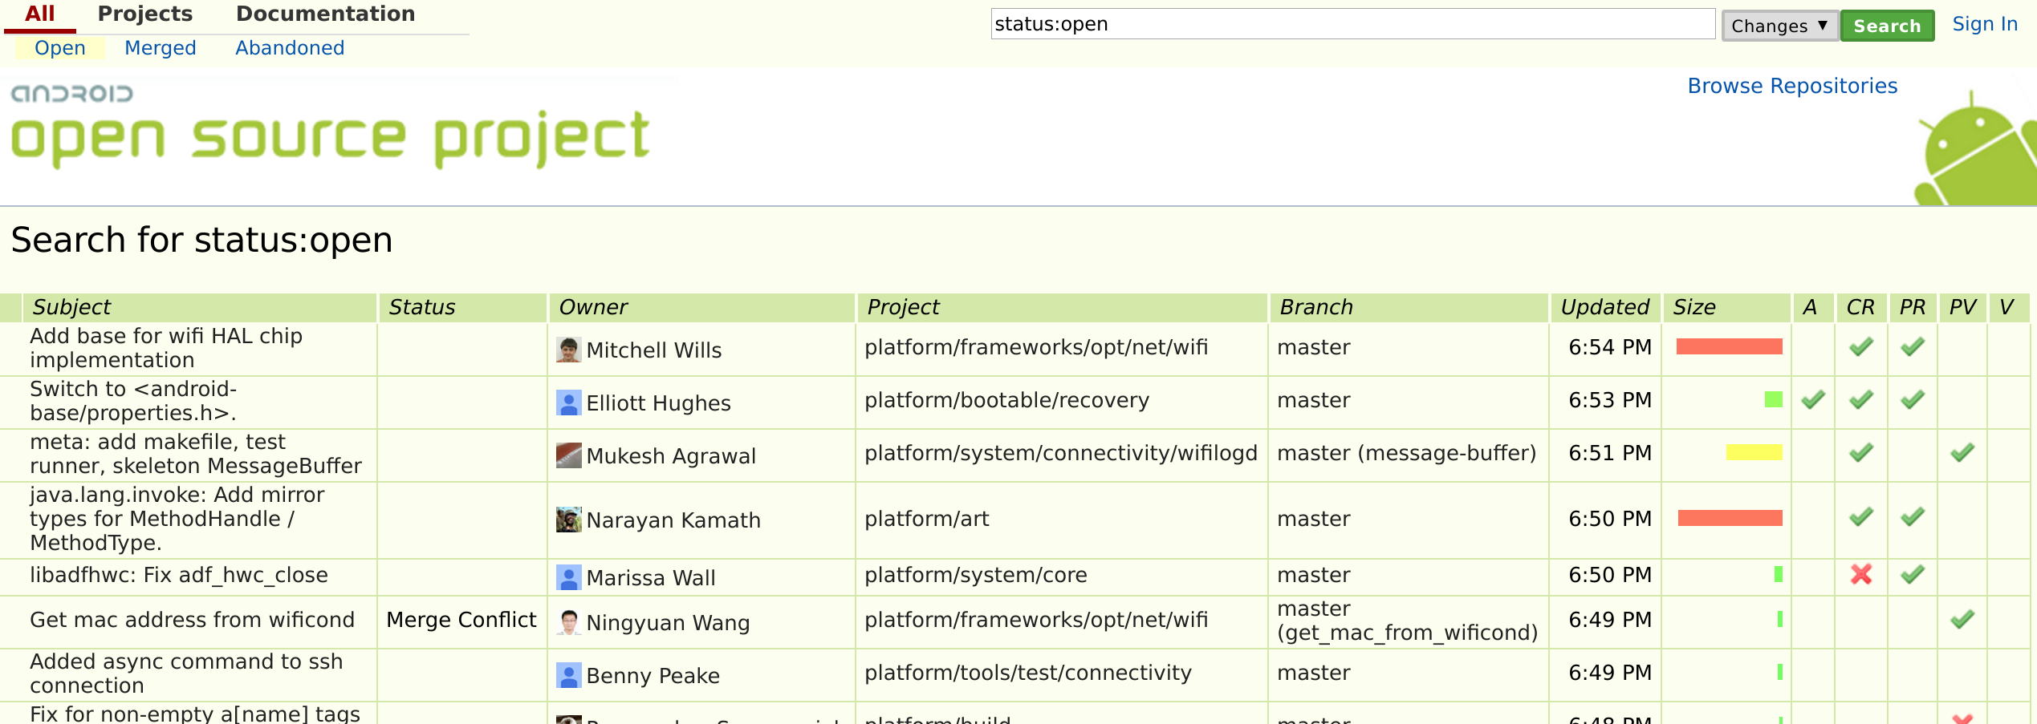
gerrit - pros
Notes:
Ugh, none..
Project Managers like it
Sometimes can be scripted
Lots of people are used to it.
Horrid horrid horrid

Slide 13
gerrit - cons
Notes:
Where to start…
Patch submission difficult
Patch series requires topic branches
Can not see full patch all at once! One click per file!
Delay in seeing individual patches
Local testing difficult
Impossible to set up and admin

Slide 14
Plain text email
Notes:
This is what the Linux kernel developers use.
Simple, quaint, been around for forever.
Works really really well.

Slide 15
email - pros
Notes:
This is what the Linux kernel developers use.
Simple, quaint, been around for forever.
Works really really well.

Slide 16
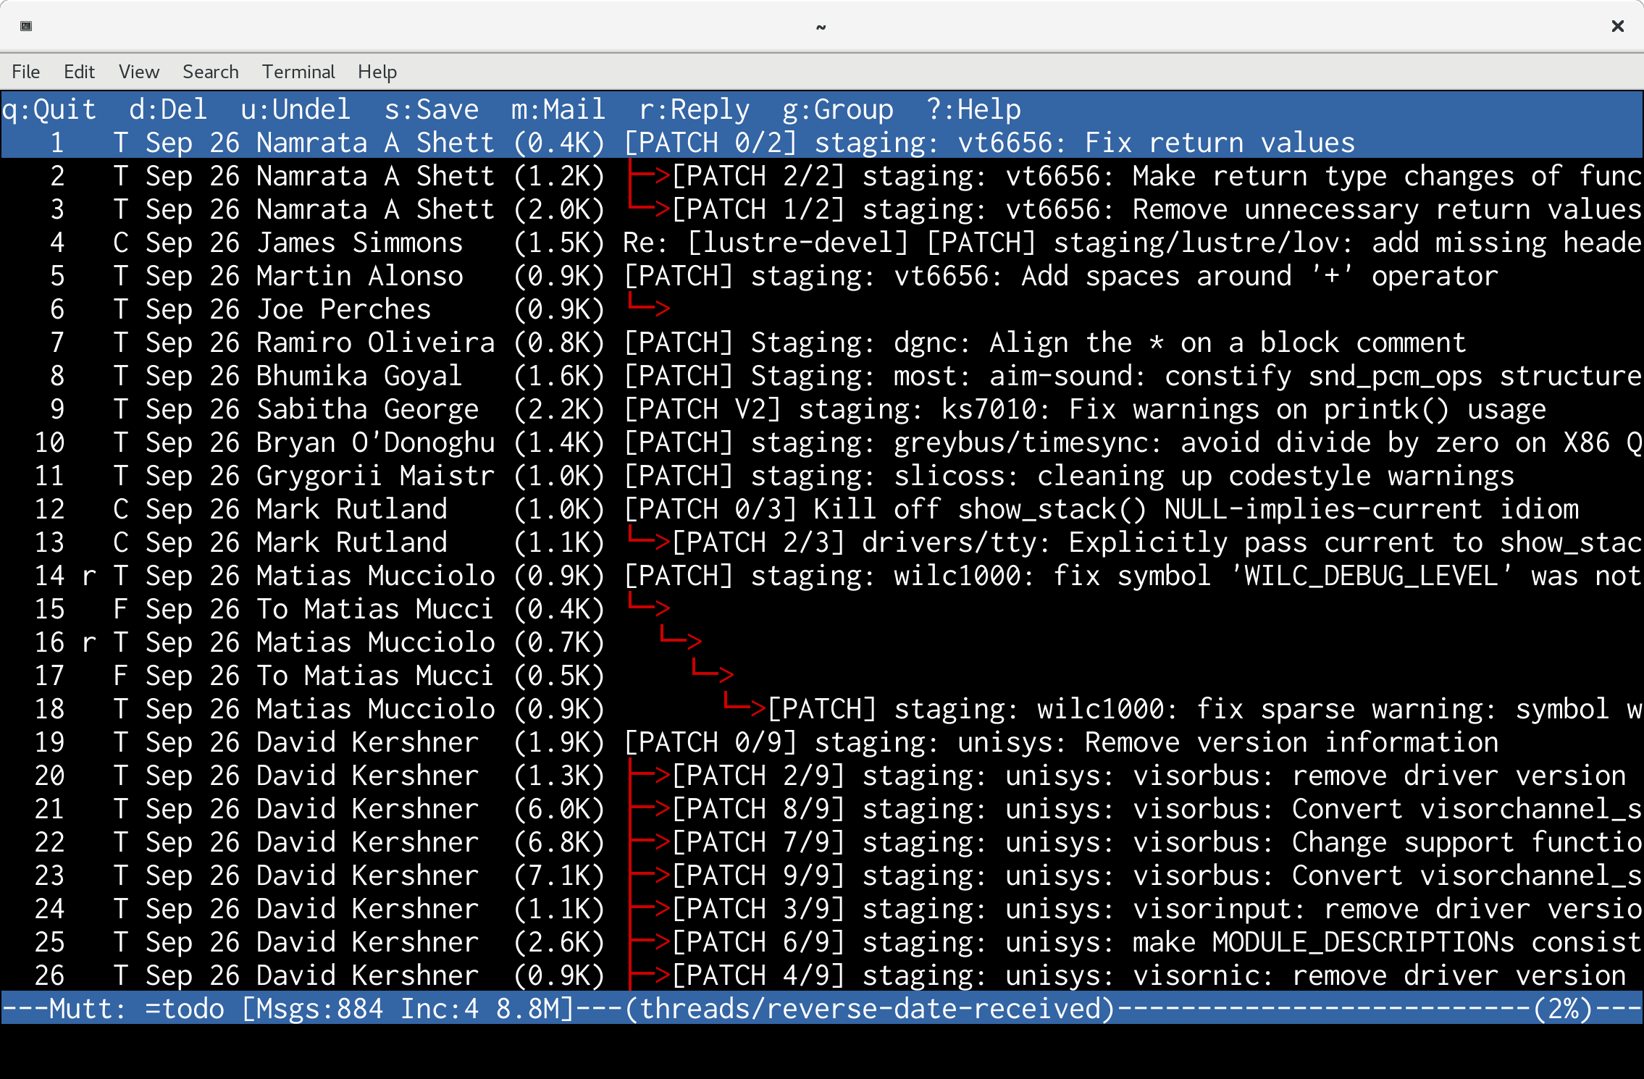
email - pros
Notes:
Everyone in the world has it
Online access not required
Non-native language supported
Accessability built-in
Fast patch review
Local testing easy
Remote testing possible
Everyone can see what happens!
Loads of email clients out there that work well
My favorite, mutt.
Other command line clients:
Pine/alpine

Slide 17
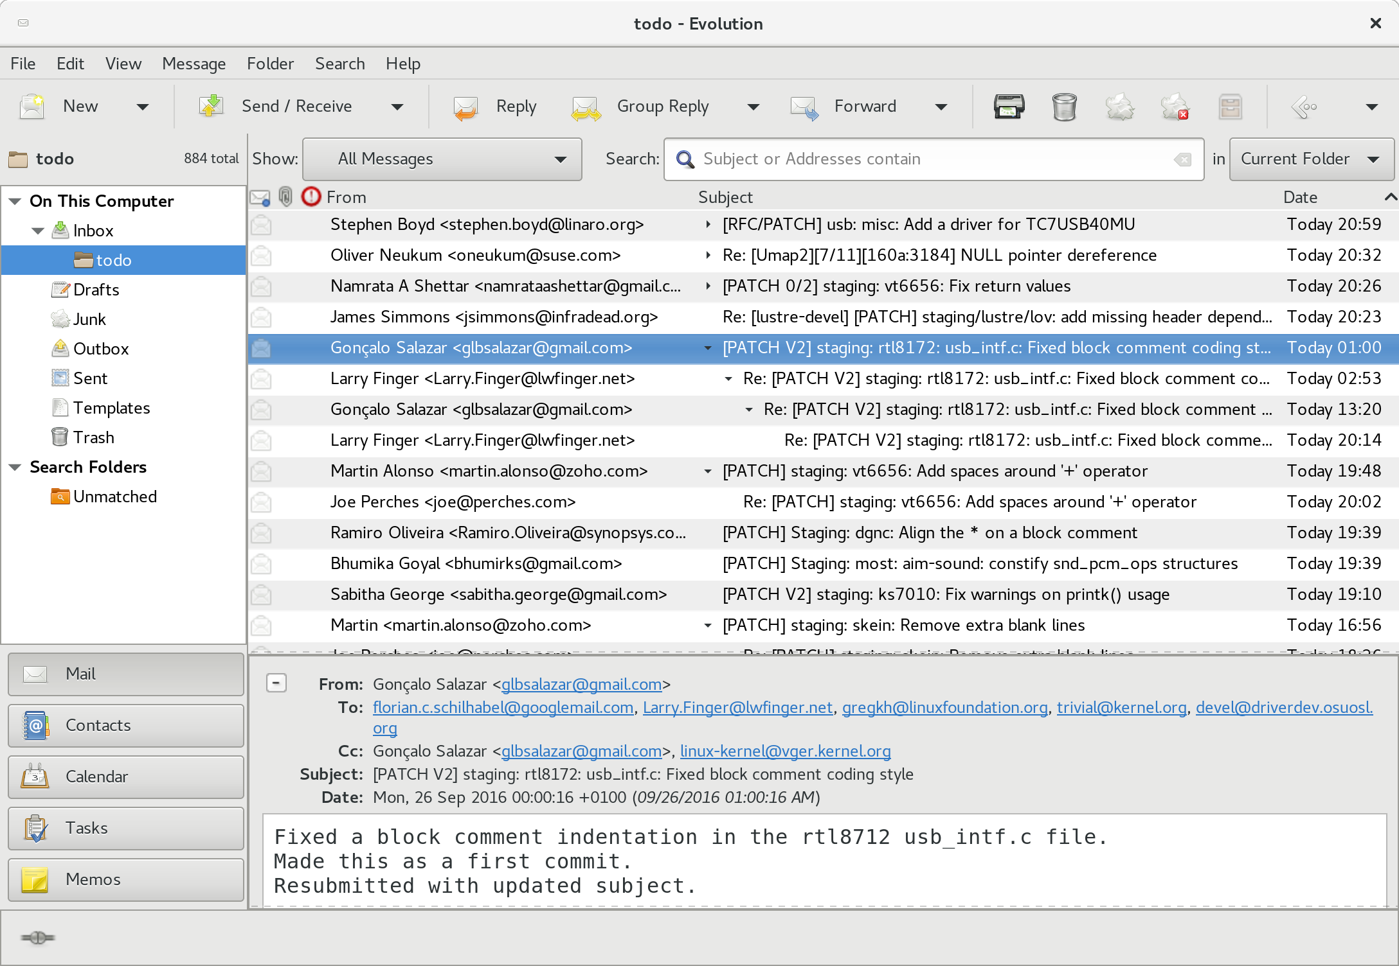
Notes:
If you like gui’s there are loads of them, this is Evolution.
There’s also:
kmail
thunderbird
claws
cylpheed
Tkrat
Loads of them.
Just don’t use a web client for patches.

Slide 18
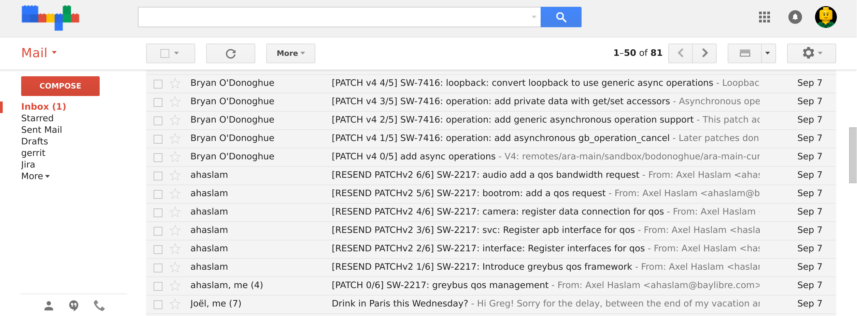
email - cons
Notes:
PMs hate it (solution later on...)
eLots suck:
Outlook/Exchange
OS-X Mail
Groupwise
Lotus Notes
Gmail web interface
Almost any web interface
Almost all Linux companies have a box in the corner to send email out without it touching exchange/notes (Intel, IBM, Microsoft, etc.)

Slide 19
Documentation/email_clients.txt
Notes:
How to configure a good email client to handle patches properly.

Slide 20

Notes:
Every 3 months, when the merge window opens up, everything gets sent to Linus from the subsystem maintainers and Andrew Morton.
The merge window is 2 weeks long, and thousands of patches get merged in that short time.
All of the patches merged to Linus should have been in the linux-next release, but that isn't always the case for various reasons.
Linux-next can not just be sent to Linus as there are things in there that sometimes are not good enough to be merged just yet, it is up to the individual subsystem maintainer to decide what to merge.

Slide 21
git + email
git am
Notes:
People forget that git was built to apply patches from email, that was it’s primary goal in the beginning
Email client integration, one keypress to apply a patch to the local repo.

Slide 22
git + email
.muttrc:
macro index A '| git am -s'
Notes:
People forget that git was built to apply patches from email, that was it’s primary goal in the beginning
Email client integration, one keypress to apply a patch to the local repo.

Slide 23
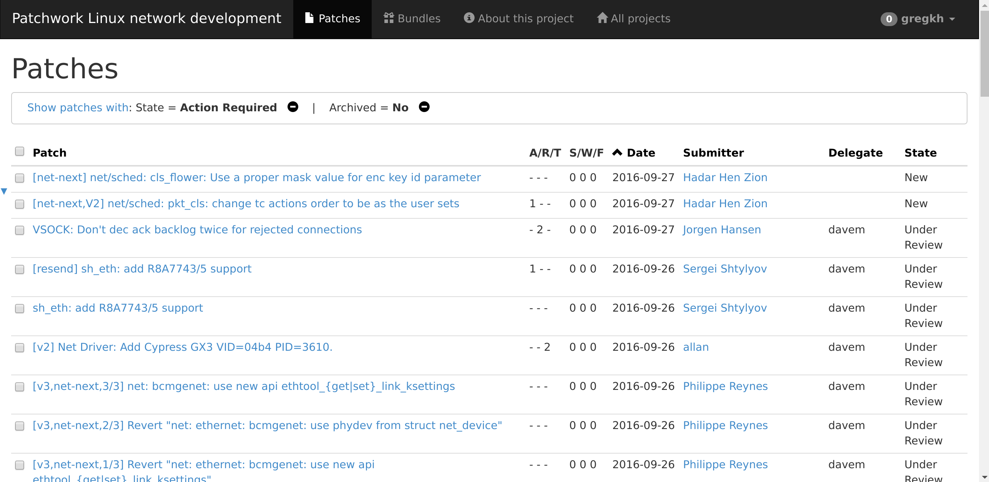
Notes:
Patchwork is great
- suppliments a mailing list does not replace it
- provides current status of all posted patches
- shows who is reviewing it, what is left to be done, etc.
- maintainers can use it to apply and manage patches
Hooks into CI tools, handles patch series, versions, everything!
Think of it as gerrit for a mailing list.

Slide 24
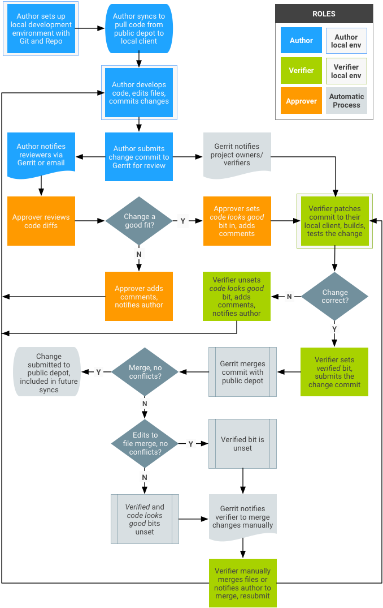
Notes:
Android’s “life of a patch” flowchart
Gerrit is only one tiny part in the middle
Replace that one part with email, and everything still works, and goes faster.

Slide 25
Notes:
Android’s “life of a patch” flowchart
Gerrit is only one tiny part in the middle
Replace that one part with email, and everything still works, and goes faster.

Slide 26
Why email matters
Notes:
You want your developers to grow, putting reviews in front of everyone where they can’t ignore them allows them to learn and grow faster than anything else.
Your community growes faster this way, use email if you want your project to be sustainable.

Slide 27
Why Linux uses email
Simple
Widest audience
Scalable
Grows the community

Slide 28
Why Linux uses email
Simple
Widest audience
Scalable
Grows the community
No project managers

Slide 29
Pick an excellent tool for your project, use email, it’s still better than anything else.

Slide 30

github.com/gregkh/presentation-stone-tools
Notes:
Obligatory Penguin Picture

Slide 32
4,054 developers
450 companies
Kernel releases 4.1.0 – 4.6.0
June 2015 – May 2016
Notes:
This makes the Linux kernel the largest contributed body of software out there that we know of.
This is just the number of companies that we know about, there are more that we do not, and as the responses to our inquiries come in, this number will go up.
Have surpassed 400 companies for 2 years now.

Slide 33
11,600 lines added
5,800 lines removed
2,000 lines modified
Kernel releases 4.1.0 – 4.6.0
June 2015 – May 2016

Slide 34
11,600 lines added
5,800 lines removed
2,000 lines modified
Every day
Kernel releases 4.1.0 – 4.6.0
June 2015 – May 2016

Slide 35
8.9 changes per hour
4.6 release
2.6.20 to 2.6.24-rc8
Notes:
This past 3.16 release was the fastest we have ever created. That number shows just how well the Linux kernel development model is working. We are growing in developers and in how fast we are developing overall.
Now this is just the patches we accepted, not all of the patches that have been submitted, lots of patches are rejected, as anyone who has ever tried to submit a patch can attest to.

