Slide 1
Cyclist: Improving bike-sharing
Author: Gregorio Lobo
Data updated: Nov 20th, 2023

Slide 2
Background setting
Cyclist is a Chicago-based, bike-sharing company. Started operations in 2016.
Cyclist has grown to a fleet of over 5,800 bikes and 692 stations.
Flexible pricing plans: single-ride pass, full-day pass, annual membership.
Annual members are more profitable than casual riders.
Increase the number of members from the casual riders rather than aim to all-new customers.

Slide 3
Marketing Scenario
How do annual members and casual riders use Cyclist bikes differently?
Why would casual riders buy Cyclist annual memberships?
How can Cyclist use digital media to influence casual riders to become members?

Slide 4
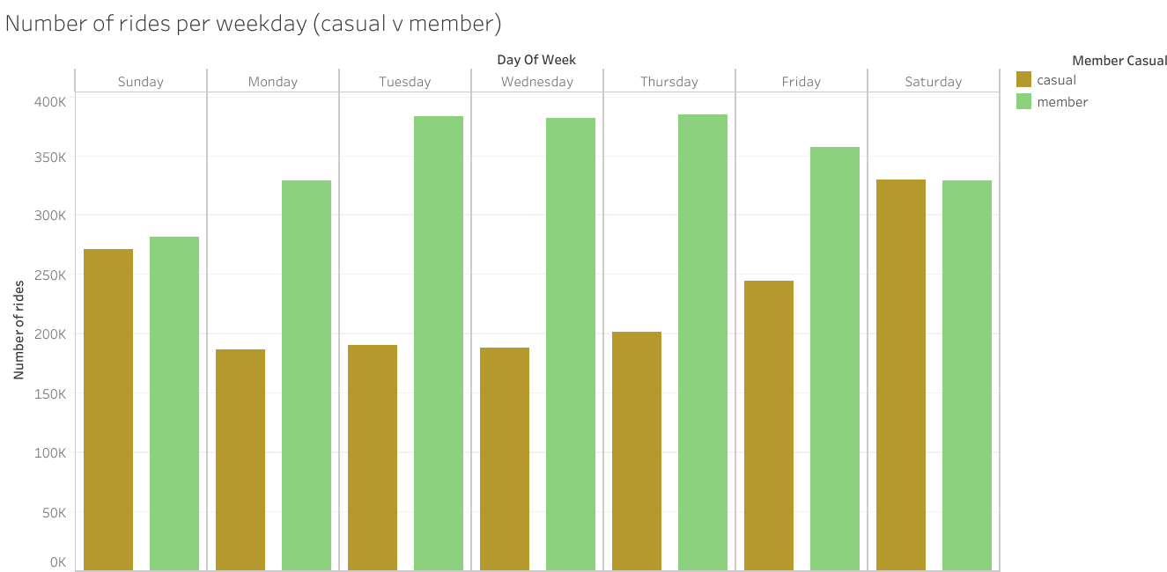
Casual Riders v Annual Members
Notes:
We can notice that members have a higher use of the bikes on weekdays, while casual riders tend to use it more on weekends, difference on leisure rides as to work commute

Slide 5
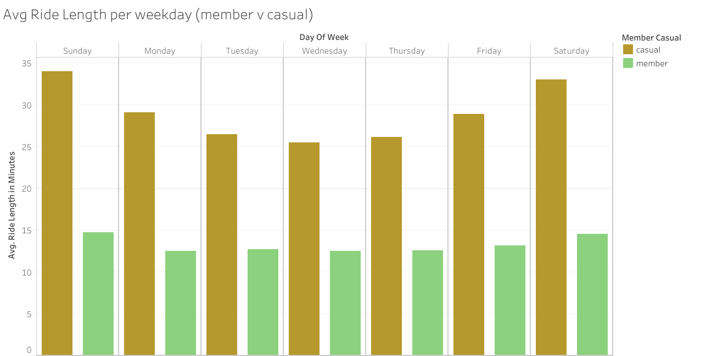
Casual Riders v Annual Members
Notes:
Casual riders tend to have higher ride times with an increase on weekends, while member rides are usually short and don’t vary much between weekends and weekdays

Slide 6
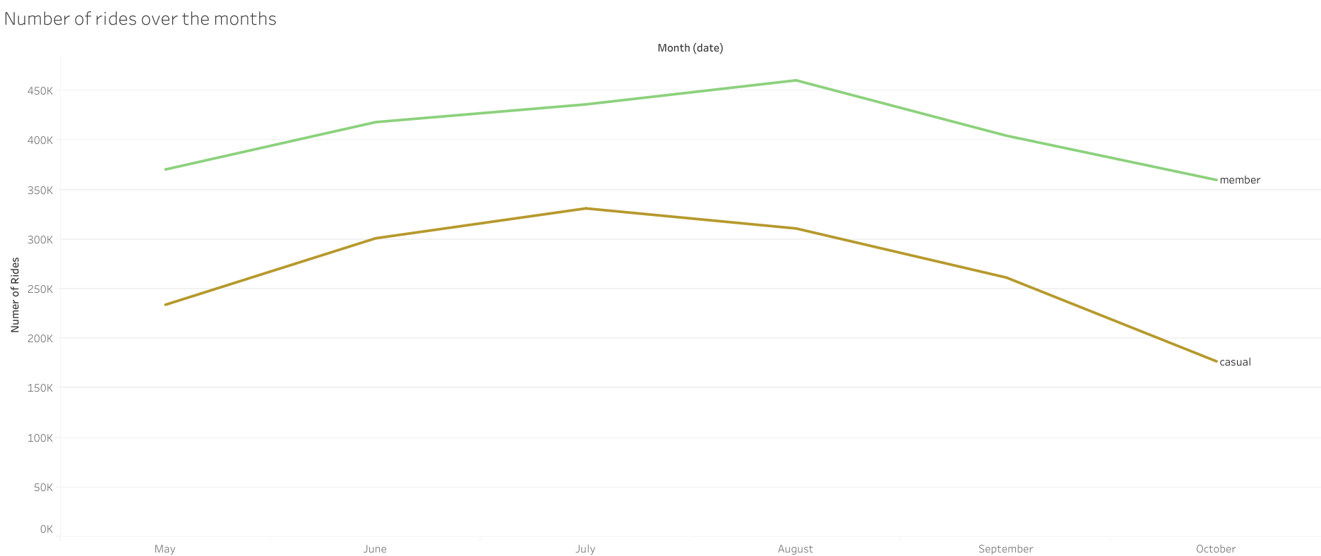
Casual Riders v Annual Members
Notes:
There is a very marked trend of hotter months against colder months

Slide 7
Key Findings
Casual riders tend to use the bikes more on weekends than weekdays, probably leisure riding. Alternatively, members tend to use it more on weekdays, presumably for commuting.
Casual riders usually have longer times than members, with a trend of increasing over weekends. Reinforcing the assumption that members use the bikes mostly for commute and casual riders for leisure.
Seemingly, there is an increase on the number of rides of both casual and members from July to August. Most likely due to an increase in temperature in a usually cold and windy city.

Slide 8
Recommendations
Basing on the insights obtained from the data, our marketing team should design their strategies on weekend offers which are the preferred days of casual riders.
Casual riders tend to go on longer trips so there could be a way to convince casual riders into buying a membership by offering something extra for longer trips.
All marketing efforts should be directed on summer months in which there is a noticeable increase of users on both casual and member systems.

