Slide 1



A forking presentation for developers
UNIX-FU:
https://github.com/gregmalcolm/unix_for_programmers_demo
https://gist.github.com/1241642
@gregmalcolm
πP
Notes:
Most rubyists develop for a unix platform. Unix as a platform is designed with programmers in mind. Today I’ll cover a little bit about how to get the most from it.

Slide 2

1969 - UNIX is Born
1972 - Rewritten in C
1977 - BSD UNIX
1981 - IBM PC
1983 - Richard Stallman founds FSF
1991 - Linus Tovalds starts Linux
TIMELINE
Notes:
1969 - Unix was invented at Bell Labs starting with Ken Thompson and shortly followed by Dennis Ritchie who invented C. Over 40 years ago!
1983 - US Goverment breaks up Bell System, FSF founded

Slide 3
PHILOSOPHY
Doug McIlroy (inventer of unix pipeline):
“This is the Unix philosophy:
Write programs that do one thing and do it well.
Write programs to work together.
Write programs to handle text streams,
because that is a universal interface.”
Notes:
Doug McIlroy’s take on the Unix Philisophy sums it up very nicely

Slide 4
PHILOSOPHY
Doug McIlroy (inventer of unix pipeline):
“This is the Unix philosophy:
Write programs that do one thing and do it well.
Write programs to work together.
Write programs to handle text streams,
because that is a universal interface.”
Notes:
Doug McIlroy’s take on the Unix Philisophy sums it up very nicely

Slide 5
PHILOSOPHY
Mike Gancarz (part of X Windows team):
“ 1. Small is beautiful.
  2. Make each program do one thing well.
  3. Build a prototype as soon as possible.
  4. Choose portability over efficiency.
  5. Store data in flat text files.
  6. Use software leverage to your advantage.
  7. Use shell scripts to increase leverage and portability.
  8. Avoid captive user interfaces.
  9. Make every program a filter. “
Notes:
I also like Mike Gancarz’s version.

Slide 6


Slide 7

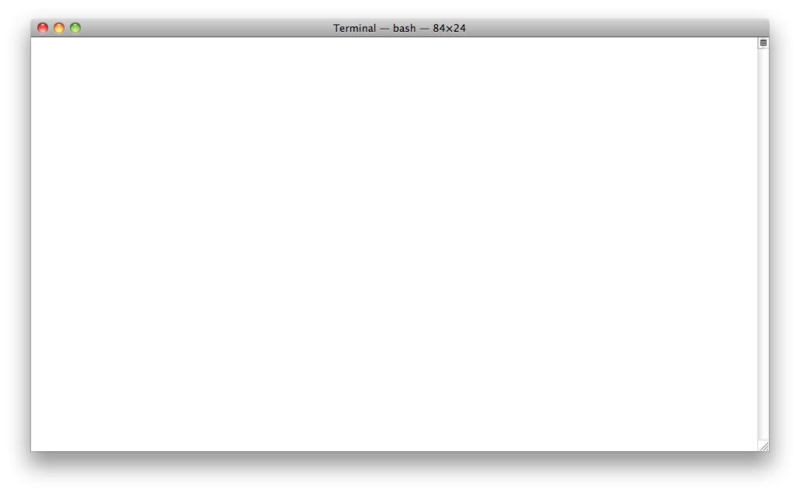
STREAMS
File Streams
$
>>>
python
>>>
f = open('file1.out', 'w')
f.write("Some text")
>>>
f2 = open('file2.in', 'r')
>>>
f.fileno()
3>>>
f2.fileno()
4>>
> f2.read()
'Sample input\n'
Notes:
Firstly, theres file streams. I’ll open a couple here, one for output, one another for input. Fairly basic stuff. Each file has a file descriptor. Here is how I can print them from ruby.
Now, why does the number start from 3? Answer is on the next page

Slide 8
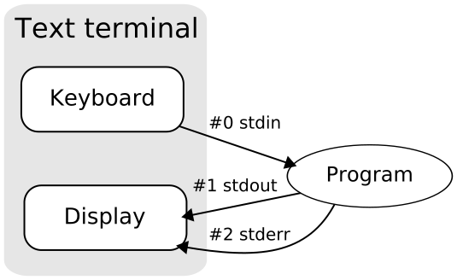
STREAMS
Input/Output Streams
Notes:
There are 3 specials streams available in unix, STDIN, STDOUT and STDERR. These streams are never closed and use up File Descriptors 0, 1 and 2.
STDIN by default is for input (keyboard). STDOUT is for program output, usually going to the console. STDOUT also defaults to outputing to the console, but it is easy to redirect to an error log.

Slide 9
STREAMS
STDIN
$
wc -l
green
eggs
and
ham
<CTRL+D>
4
$
Notes:
STDIN is usually inputted through the keyboard.
In this example I’m asking running the word count command. The -l tells it to report how many lines. Ctrl+D acts as an end of stream indication.

Slide 10
STREAMS
STDOUT
$
ls
README monitor.sh sample_in.text$
Notes:
STDOUT by default outputs to the console. For example, if I run ls I'll get output to the console.

Slide 11
STREAMS
STDERR
$
python make-presentation-for-me
python: can't open file 'make-presentation-for-me': [Errno 2] No such file or directory$
Notes:
Standard Error also outputs to the console by default. For example, if I run ruby with a bad option the message is sent via STDERR.

Slide 12
STREAMS
Redirecting STDIN
$
cat seuss.text
one fish
two fish
red fish
blue fish
$
wc -w <seuss.text
8
$
Notes:
We can override the default streams through use of redirections. In this example we redirect to the Dr Seusse text into STDIN.
By the way, this time we’re using the -w option with wc to count words.

Slide 13
STREAMS
Redirecting STDOUT and STDERR
$
echo “Redirect stdout to a file” >file.text
$
cat file.text
Redirect stdout to a file
$
$
echo “Redirect and append stdout” >>file.text
cat file.txt
Redirect stdout to a file
Redirect and append stdout
$
$ python “Redirect stderr to a file” 2>err.text
$
$
python “or append to a file” 2>>err.text
Notes:
For stdout we can use > to redirect to a file. Or >> if we just to append to an existing file.
Similarly we can redirect to STDERR with 2> or 2>> (ruby doesn't know how to parse the argument)
Note you can stick a 1 in front of STDERR redirctions and a 0 in front of STDIN, but its only when it comes to STDERR that you really have a need.
Btw, if you used << for STDIN it actually does something a bit different. cat << ENDWORD will accept text until the word "ENDWORD" is encountered.

Slide 14
STREAMS
Redirecting to File Descriptors
$
echo "ERROR: Out of jello" >&2
Error: Out of jello
$
$
exec 3> file.out # like f=open() in python
$
echo 'Armadillos!' >&3
$
3>&- # f.close in python
$
cat file.out
Armadillos!
$
Notes:
You can also redirect to open file descriptors.
To redirect an STDOUT to STDERR use >&2 (ie redirect from File Descriptor #1 to File Descriptor #2)
On line 4 we open File.out into File Descriptor no 3. In this instance, using the word exec is like saying "For output in this current process...", so "For output in this current process redirect FD3 to fileout".
3>&- is kind of saying "Don't redirect FD3 to anything." In other words, close FD3.

Slide 15

Notes:
Whenever you create a new process in UNIX you actually fork off from the current process. Meaning create a clone of the current process as a child process.

Slide 16




$
wait 2012
PID = 1998
<Targets FD=34>
<Oracle FD=39>
<TeddyBear FD=41>
$
exec csi_duty.rb
PID = 2012
<InappropiateCommentsAboutTheBody FD=43>
Notes:
Illustration of how forking works: We start off with the Agent Smith program which we want to fork off from. We do so and end up with a child process which is an exact clone. Because its a clone it even has access to the same open File Descriptors. This can prove very useful! On forking we load a new program into memory over the top of the old Agent Smith program. So Agent Smith becomes Horace from CSI Miami by running "exec csi_duty.rb". Remember exec from the previous example? running a command through exec causes it to replace the current program with a new one. Eventually Horace will finish his work and exit. The process will actually close down, but there is still an entry in the process table. When in this state it is referred to as a Zombie Process (or a Rob Zombie process in this case?). Meanwhile while Horace has been doing his thing Agent Smith has been completing his work and will eventually call "wait" to wait for the event of a child process exiting. When he finds that Horace has exited and retrieved the exit status the zombie process is cleared away.

Slide 17

print "Parent pid is {0}".format(os.getpid())
if (not os.fork()):
print "In child process. Pid is now {0}" \
.format(os.getpid())
sys.exit(42)
child_pid = Process.wait
print "Child (pid {0}) terminated with status {1}" \ .format(child_pid, exit_status >> 8)
Parent PID 14724
print "Parent pid is {0}".format(os.getpid())
if (not os.fork()):
print "In child process. Pid is now {0}" \
.format(os.getpid())
sys.exit(42)
child_pid = Process.wait
print "Child (pid {0}) terminated with status {1}" \
format(child_pid, exit_status >> 8)
Child PID 14725
$ ./fork_it.py
Parent pid is 14724
In child process. Pid is now 14725
Child (pid 14725) terminated with status 42
Notes:
This is a simulation of running fork_it.py (code available in https://github.com/gregmalcolm/unix_for_programmers_demo)

Slide 18

SOURCES
http://mij.oltrelinux.com/devel/unixprg/
http://www.faqs.org/docs/artu/
http://en.wikipedia.org/wiki/Pipeline_%28Unix%29
http://whynotwiki.com/Ruby_/_Process_management
http://www.unix.com/unix-dummies-questions-answers/100737-how-do-you-create-zombie-process.html
http://www.myelin.co.nz/post/2003/3/13/
http://cheezburger.com/
http://en.wikipedia.org/wiki/Unix_philosophy
http://vimeo.com/11202537
http://cheezburger.com/
https://github.com/gregmalcolm/unix_for_programmers_demo
https://gist.github.com/1241642
@gregmalcolm
πP

