Slide 1
Kaggle ML project
House Prices: Advanced Regression Techniques
Team FightingMongooses: Billy Fallon, Gregory Brucchieri, Adrian Phillips-Samuels

Slide 2
Introduction
Data:
79 Features
Target variable: SalePrice
1460 observations in training set, 1459 in test set
Mix of numerical, categorical, ordinal
28 continuous
51 categorical/ordinal

Slide 3
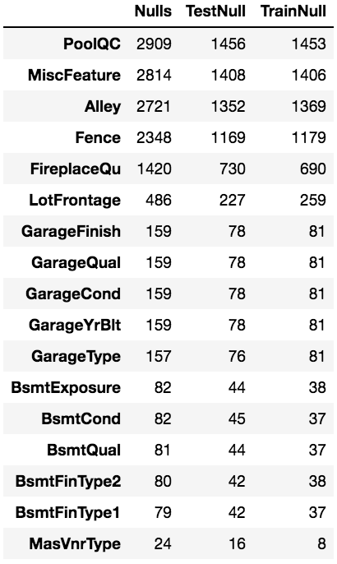
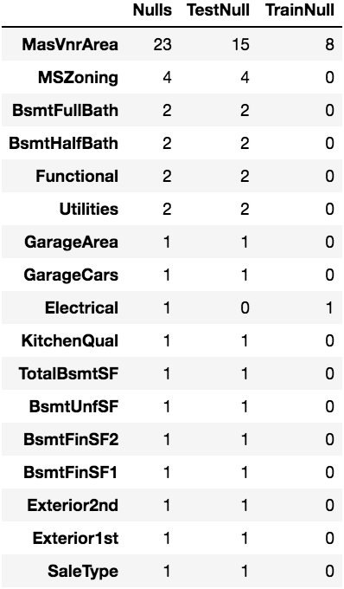
MISSINGNESS
34 features missing some data
We used various techniques for handling missingness

Slide 4
Handling Missingness
Garage Year Built = (oldest house year -1)
Electrical = “unknown”
Zone, exterior, sale type: missing values in the test set: imputed by comparison to similar properties in neighborhood
LotFrontage = mean
Others: 0 or None as appropriate

Slide 5
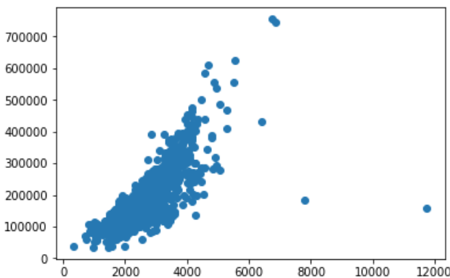
Processing data
Treated features as ordinal whenever possible:
PavedDrive, GarageFinish, Functional, BsmtFinishType1,2, BsmtExposure, LandSlope, Utilities, LotShape, Alley, Street, CentralAir
Observed two outliers
Unusual Price/TotalSF ratio
Chose Robust Scaling for this reason

Slide 6
Engineering features
Calculated TotalSF
Calculated PorchSF
Converted Porch type to dummies
Replaced remodel year with a Boolean value “Remodeled”
‘Normalization – used Robust Scalar
Transformation: Log(SalePrice), Log(LotArea)
Tried:
Recession dummy – 1 if Sale Dec2007-June2009, else 0
Total Baths
Years old vs. Year build

Slide 7
Models USED
Linear Regression (Standard, Ridge and Lasso)
Random Forest
Gradient Boosting Regression
XGBoost

Slide 8
Model 1 – Random forest
Parameters: bootstrap=False, max_features='sqrt', min_samples_leaf=1, min_samples_split=2, n_estimators=800
Top Features:
TotalSF
Overall Quality
Gross Living Area
Exterior Quality
RMSE: 0.0192
KAGGLE: 0.14294

Slide 9
Model 2 – gradient boost
Parameters: alpha=0.9, learning_rate=0.01, max_depth=5, max_features='sqrt', min_samples_leaf=1, min_samples_split=10, n_estimators=1200
Top Features:
Overall Condition
Total SF
Lot Area
Gross Living Area
RMSE: 0.0148
KAGGLE: 0.12707

Slide 10
Model 3 – XGBoost
Parameters: base_score=0.5, booster='gbtree’, gamma=0.3, learning_rate=0.1, max_depth=3, n_estimators=800, subsample=0.6
Top Features:
Total SF
Overall Condition
Lot Area
Overall Quality
RMSE: 0.0179
KAGGLE: 0.13783

Slide 11
Model4 – Linear Regression
Parameters: Nothing Interesting
Top Features:
Standard Linear Regression outperformed Ridge slightly, and Lasso massively.
First ensemble attempt combined Linear Regression and Random Forest (2:1) and yielded a 0.1295
RMSE: 0.0353
KAGGLE: 0.13691

Slide 12
ensembling
Simple Average improved upon all single model results 0.12671
Stacked Regression produced impressive CV scores, and AWFUL Kaggle Scores
Severe Overfit?
Implementation Failure?
Weighted Averages improved upon the Kaggle Score
60-30-10 weighting of top three models (GBM, Regression, XGB) produced best Kaggle Score: 0.12320

Slide 13
Conclusions/Next steps
Feature Engineering allows for infinite permutations, and will make or break the outcome
Would like to experiment further with other scalars with this data sets, and neighborhood specific modelling
Iterative Kaggle submission is addicting – should come with a food pellet

