Slide 1
Kaggle ML project
House Prices: Advanced Regression Techniques
Team FightingMongii: Billy Fallon, Gregory Brucchieri, Adrian Phillips-Samuels

Slide 2
Introduction
Data:
79 Features
Target variable: SalePrice
1460 observations in training set, 1459 in test set
Mix of numerical, categorical, ordinal
28 continuous
51 categorical

Slide 3
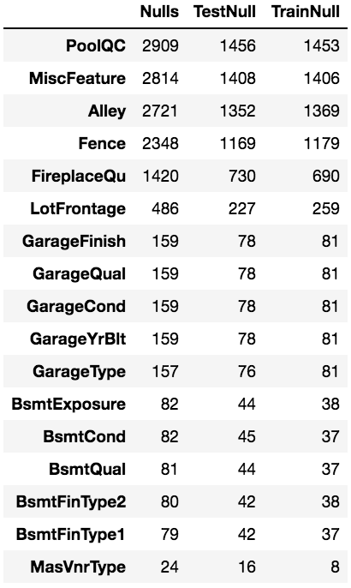
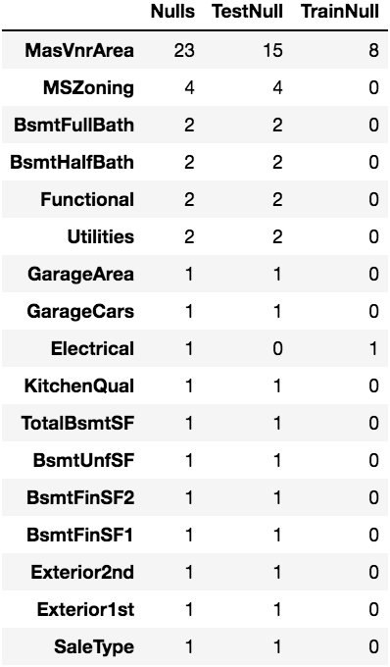
MISSINGNESS
34 features missing some data
We used various techniques for handling missingness

Slide 4
Handling Missingness
Garage Year Built = (oldest house year -1)
Electrical = “unknown”
Zone, exterior, sale type: missing values in the test set: imputed by comparison to similar properties in neighborhood
LotFrontage = median, grouped by neighborhood
Others, imputed 0 or None as appropriate

Slide 5
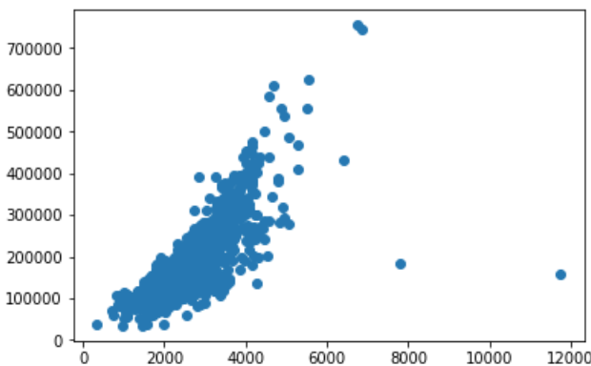
Processing data
Treated features as ordinal whenever possible:
PavedDrive, GarageFinish, Functional, BsmtFinishType1,2, BsmtExposure, LandSlope, Utilities, LotShape, Alley, Street, CentralAir
Removed two outliers
Unusual Price/TotalSF ratio

Slide 6
Engineering features
Calculated TotalSF
Calculated PorchSF
Converted Porch type to dummies
Replaced remodel year with a Boolean value
Normalization – used Robust Scalar
Transformation: Log(SalePrice), Log(LotArea)
Tried:
Recession dummy – 1 if Dec2007-June2009, else 0
Total Baths
Years old vs. Year build

Slide 7
Models USED

Slide 8
Model1 – OLS Linear Regression

Slide 9
Model 2 – elastic net

Slide 10
Model 3 – gradient boost

Slide 11
Model 4 – random forest

Slide 12
ensemble

Slide 13
conclusions

