Slide 1
Kaggle ML project
House Prices: Advanced Regression Techniques
Team FightingMongii: Billy Fallon, Gregory Brucchieri, Adrian Phillips-Samuels

Slide 2
Introduction
Data:
Number of features, categorical, ordinal etc.

Slide 3
DaTA
We used various techniques for handling the data
Imputing values:
Treatment of ordinal and categorical

Slide 4
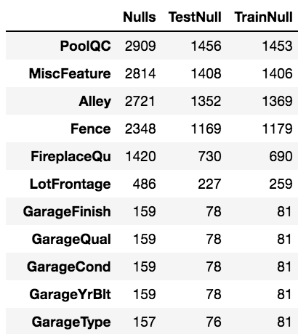
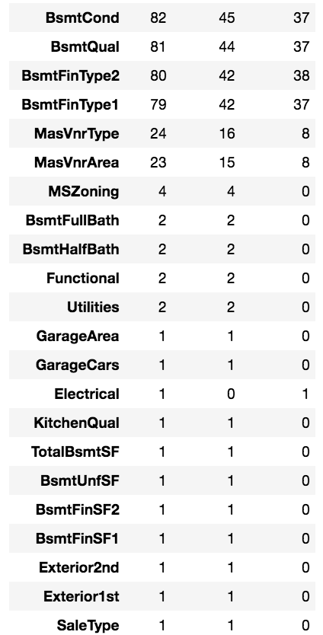
MISSINGNESS

Slide 5
Handling missingness

Slide 6
Feature selection

Slide 7
Engineering features

Slide 8
OUTLIERS

Slide 9
Models USED

Slide 10
Model1 – OLS Linear Regression

Slide 11
Model 2 – elastic net

Slide 12
Model 3 – gradient boost

Slide 13
Model 4 – random forest

Slide 14
ensemble

Slide 15
conclusions

