Slide 1



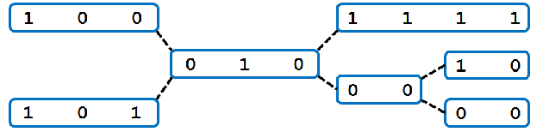
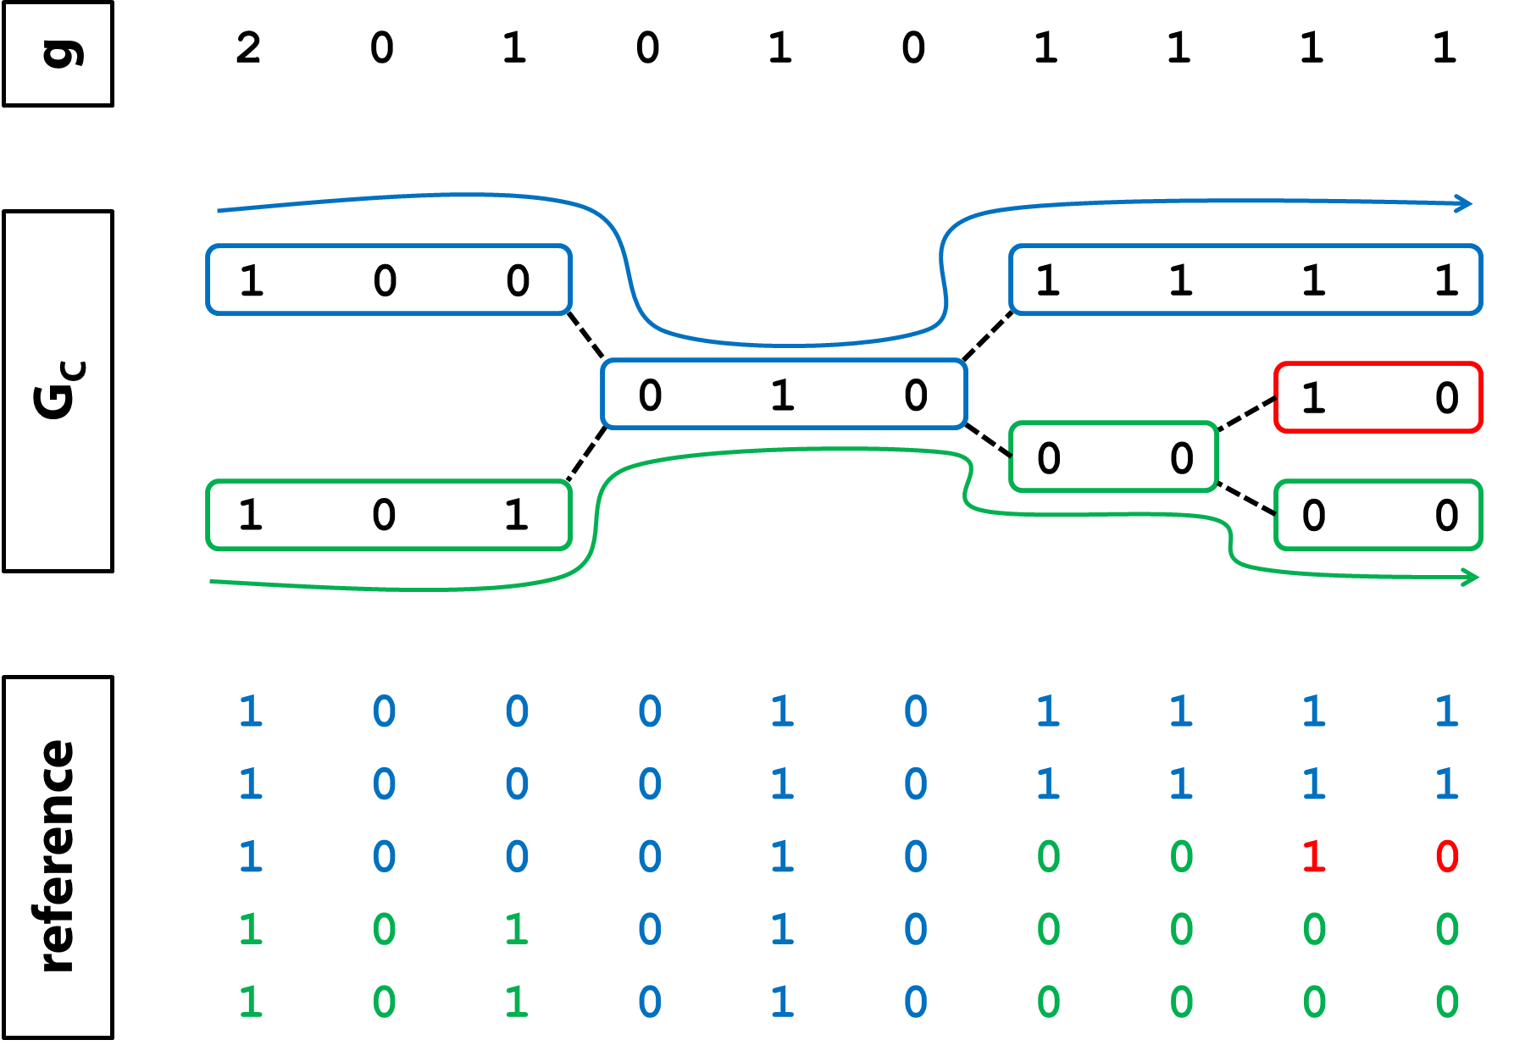
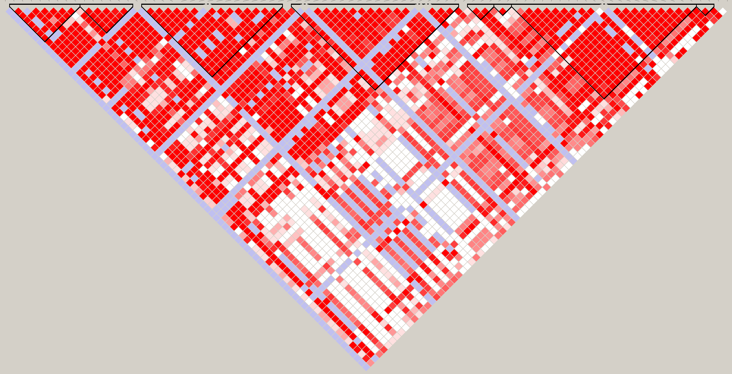
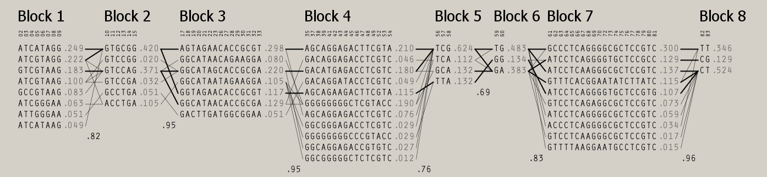
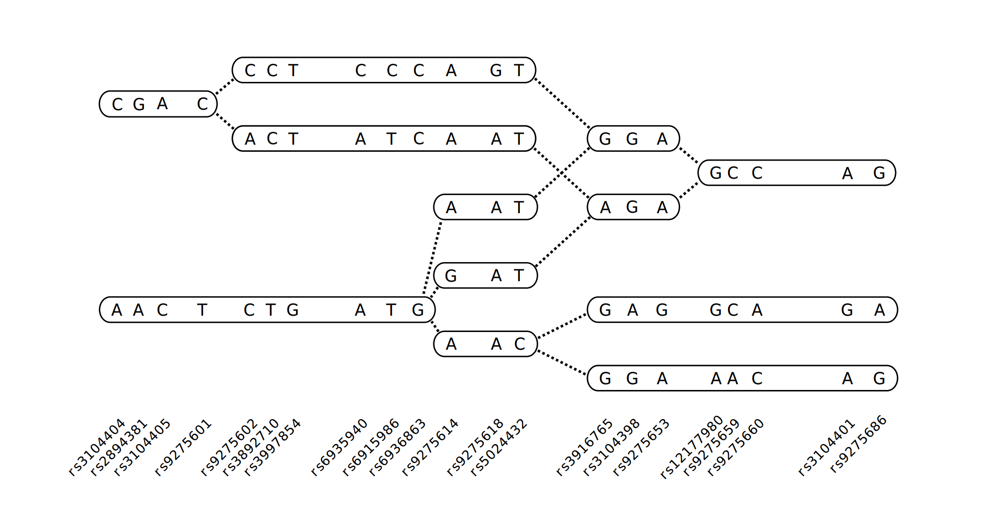
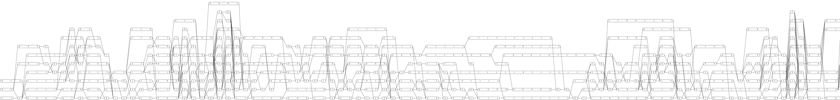


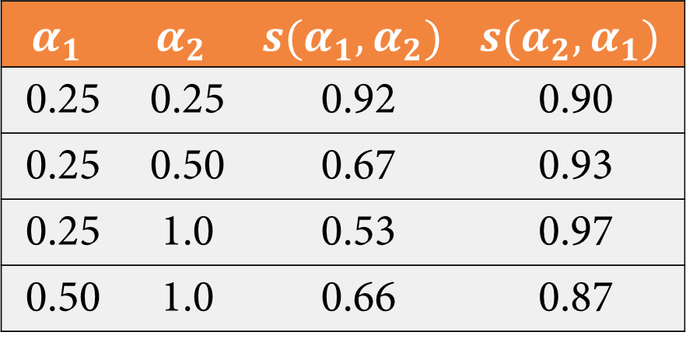
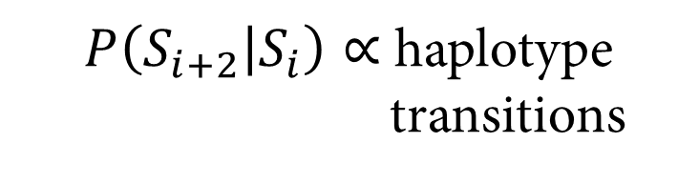
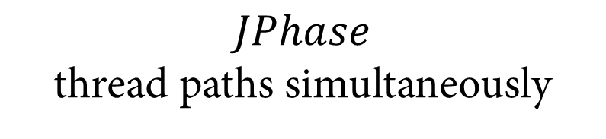
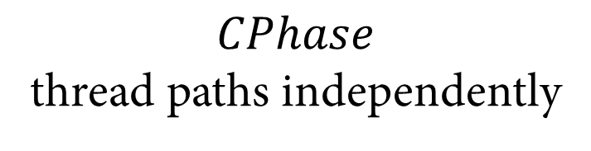
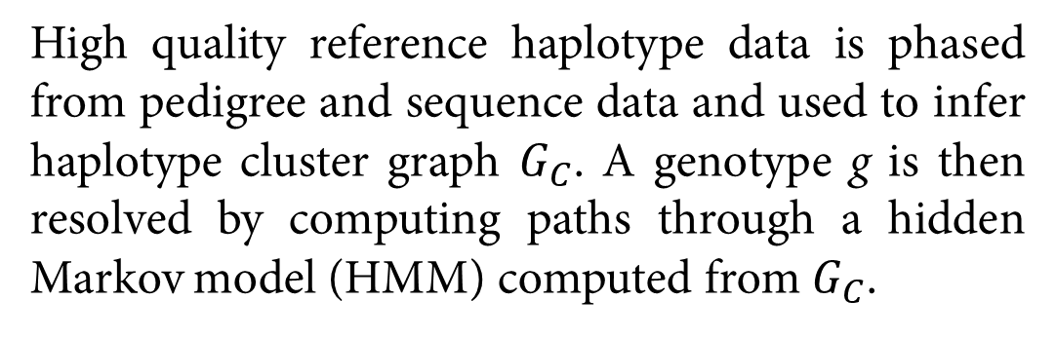








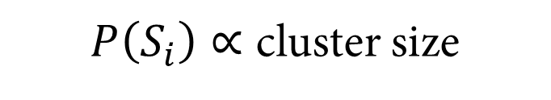
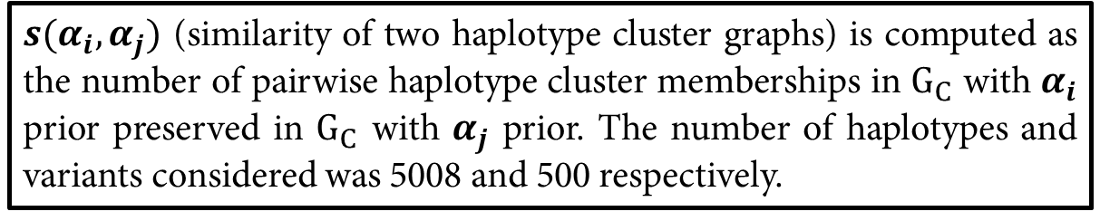
A statistical framework for modeling genetic data as haplotype cluster graphs with application to haplotype phasing, association mapping, and whole-genome compression
Derek Aguiar¹, Lloyd T. Elliott², Yee Whye Teh², Barbara E. Engelhardt¹ ¹ Princeton University, Department of Computer Science, Princeton, NJ; ² University of Oxford, Department of Statistics, Oxford, United Kingdom
ABSTRACT
HAPLOTYPE PHASING
Haplotypes are key for understanding relationships between variation and disease, for example, chromosome-specific genetic regulation of traits or compound heteroyzgosity.
But, haplotype based analyses suffer from two problems which reduce their efficacy in genomics:
(1) they are often agnostic to the particular haplotype sequences but instead use them as a proxy for the latent genealogy and
(2) methods for their acquisition are unscalable, expensive, or employ overly inexpressive models
These haplotype-based analyses would greatly benefit from a representation that captures the rich coalescent ancestry of the sample in a scalable and computationally tractable framework.
We present a statistical framework based on Bayesian nonparametric fragmentation-coagulation processes (FCP) [1] that explicitly models coalescent processes and haplotype demography.
haplotype threading
construct haplotype cluster graph G_{C}
Mean switch error for chromosome 22, 1000 Genome Project data, across all populations
High quality reference haplotype data is phased from pedigree and sequence data and used to infer haplotype cluster graph $G_{C}$. A genotype g is then resolved by computing paths through a hidden Markov model (HMM) computed from $G_{C}$.
HMM on $GC$
$P\left(S_{i}\right)∝$ cluster size
$P\left(S_{i+2} | S_{i}\right)∝$ haplotype
transitions
$$S_{i}$$
1 | 0 | 0
BACKGROUND AND APPROACH
$$S_{i+1}$$
1 | 0 | 1
0 | 1 | 0
$$S_{i+2}$$
The genetic signatures of common ancestry are found in
the statistical association between alleles
Compute phasing of $g$ on $GC$
Each point denotes 100 MCMC runs. The average number of errors made decreases exponentially with more samples.
$$CPhase$$
thread paths independently
$$JPhase$$
thread paths simultaneously
Linkage disequilibrium (LD)
Limited haplotype diversity within LD regions
ASSOCIATION MAPPING
Can we infer this structure without a known shared ancestry?
(1) test each cluster independently for association
(2) infer a distribution of ARGs from $G_{C}$ and test mutation and recombination events for association
haplotype cluster graph informs ancestry
ancestral recombination graph
1 | 0 | 0 | 0 | 0 | 0
Our Bayesian nonparametric FCP statistical framework captures the full complexity of haplotype structure among genomic samples by inferring a haplotype cluster graph from high quality reference data. Inference relies on (1) Markov Chain Monte Carlo for exact inference; and (2) Maximization Expectation for approximate inference.
1 2 2.5 3 4 5 6 position
3,4,5,6
2
1 | 0 | 0 | 0 | 0 | 0
3→2 →1 →0
2 →1 →0
1 | 1 | 0 | 0 | 0 | 0
5
1 | 1
1 | 1 | 1 | 1
1 | 0 | 1 | 1 | 1 | 1
1 | 1 | 0 | 0 | 1 | 0
2 →1 →0
2.5
marginal partitioning
~$ESF (α)$
Haplotype cluster graph G_{C}
Learned from high quality reference sequence data [2]
1 | 0
0 | 0
1 | 0
1 | 1 | 0 | 0 | 0 | 0
2.5
1 | 0 | 1 | 1 | 1 | 1
fragmentation
3→2 →1
4 → 3→2 →1
0 | 0
1 | 1 | 0 | 0 | 0 | 0
1 | 1 | 1 | 1 | 1 | 1
1 | 0 | 1 | 1 | 1 | 1
1 | 0 | 0 | 0 | 1 | 0
1 | 1 | 0 | 0 | 1 | 0
1 | 0 | 0 | 0 | 0 | 0
coagulation
2 →1
partition-valued
WHOLE-GENOME COMPRESSION
overlapping blocks
Statistical framework learns
The number of clusters at each locus
Strength of dependence between adjacent markers
Rates of fragmentation and coagulation
Similarity between haplotype cluster graphs
$α_{prior}\sim Γ\left(1,\frac{1}{2}\right)$, $α→\sim 0.29$
$$α_{1}$$ | $$α_{2}$$ | $${s(α}_{1},α_{2})$$ | $${s(α}_{2},α_{1})$$
0.25 | 0.25 | 0.92 | 0.90
0.25 | 0.50 | 0.67 | 0.93
0.25 | 1.0 | 0.53 | 0.97
0.50 | 1.0 | 0.66 | 0.87
Advantages to existing methods
No model selection; parameters are learned from the data
Exchangeable model; removes the unwelcome feature of the PAC model [3] where results are dependent on the haplotype sampling order
Marginal clustering of loci distributed according to Ewens’ sampling formula (ESF)
Produces a biologically useful latent structure of the evolutionary relationships between haplotypes, namely, a haplotype cluster graph
Haplotype clusters may overlap
Compression of haplotypes enables efficient haplotype phasing, association mapping and storage
$α_{prior}\sim Γ\left(1,\frac{1}{4}\right)$, $α→\sim 0.19$
$s(α_{i},α_{j})$ (similarity of two haplotype cluster graphs) is computed as the number of pairwise haplotype cluster memberships in $G_{C}$ with $α_{i}$ prior preserved in $G_{C}$ with $α_{j}$ prior. The number of haplotypes and variants considered was 5008 and 500 respectively.
ACKNOWLEDGEMENTS
REFERENCES
YWT's research leading to these results has received funding from the Gatsby Charitable Foundation and the ERC under the EU FP7/2007-2013 grant agreement no. 617411.
DA and BEE were supported by the Genotype-Tissue Expression (GTEx) consortium under the NIH grant (R01) MH101822.
L. T. Elliott and Y. W. Teh. Scalable imputation of genetic data with a discrete fragmentation-coagulation process. Advances in neural information processing systems, 2012, pages 2852–2860.
1000 Genomes Project Consortium, et al. A map of human genome variation from population-scale sequencing. Nature, 467(7319):1061–1073, 2010.
N. Li and M. Stephens. Modeling linkage disequilibrium and identifying recombination hotspots using single-nucleotide polymorphism data. Genetics, 165(4):2213–2233
daguiar@cs.princeton.edu

