Slide 1

Inferring Movie Characteristics from Dialogue
Gregory McCord
Princeton University ’20
gmccord@princeton.edu

Slide 2
Abstract
ML algorithms used to cast actors for House of Cards [1]
However, no studies have drawn inference for a movie’s labeled or latent characteristics using only its script
This study uses several methods to understand the properties of a movie using a bag-of-words representation of its dialogue
Labeled methods – predict well-defined characteristics of movie
Unlabeled methods – infer latent structure of movie

Slide 3
DATA OVERVIEW
Kaggle dataset (from Cornell researchers) containing dialogue excerpts [2]
617 movies represented
220,579 unique conversations
Over 300,000 total sentences
Metadata includes:
Release year
Genres
IMDb statistics (review rating and number of votes)

Slide 4
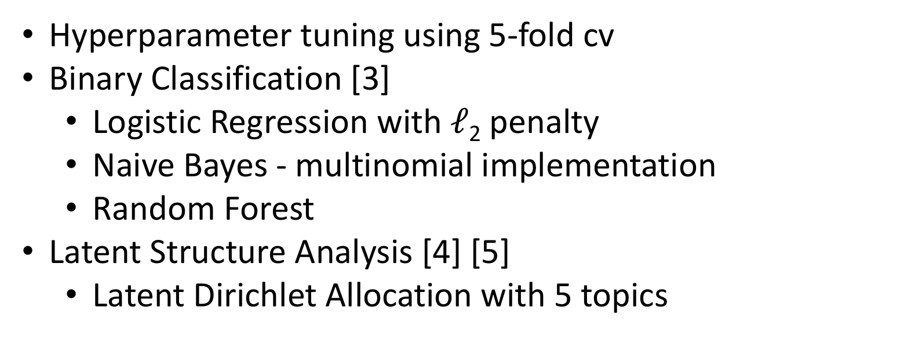
Analysis Methods
Hyperparameter tuning using 5-fold cv
Binary Classification [3]
Logistic Regression with $ℓ$₂ penalty
Naive Bayes - multinomial implementation
Random Forest
Latent Structure Analysis [4] [5]
Latent Dirichlet Allocation with 5 topics

Slide 5
Era Classification Results

Slide 6
Genre Classification Results

Slide 7
Confusion Matrix

Slide 8
Top Terms

Slide 9
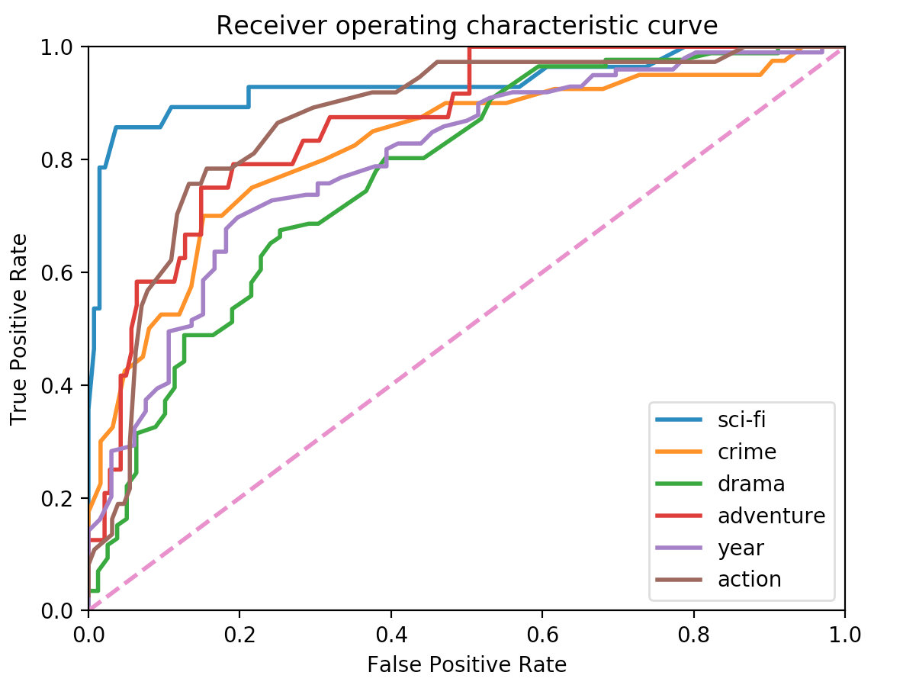
Plots

Slide 10
Inferred Latent Structure

Slide 11
References
Greg Petraetis. How netflix built a house of cards with big data, Jul 2017.
Cristian Danescu-Niculescu-Mizil and Lillian Lee. Chameleons in imagined conversations: A new approach to understanding coordination of linguistic style in dialogs. In Proceedings of the Workshop on Cognitive Modeling and Computational Linguistics, ACL 2011, 2011.
Pedregosa F, Varoquaux G, Gramfort A, Michel V, Thirion B, and et al. Grisel O. Scikit-learn: Machine learning in python. Journal of Machine Learning Research, 12:2825–2830, 2011.
Andrew Kachites McCallum. Mallet: A machine learning for language toolkit, 2002.
Radim Rehurek and Petr Sojka. Software Framework for Topic Modelling with Large Corpora. In Proceedings of the LREC 2010 Workshop on New Challenges for NLP Frameworks, pages 45–50, Valletta, Malta, May 2010. ELRA. http://is.muni.cz/publication/ 884893/en.

