Slide 1
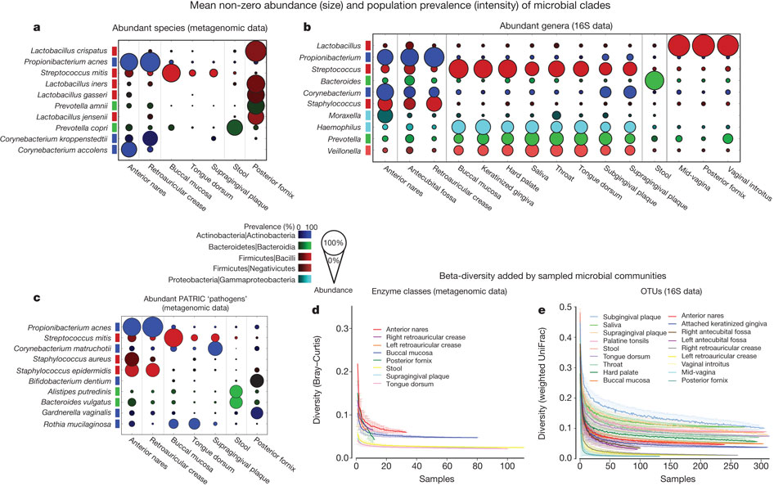

Abundant taxa in the human microbiome that have been
metagenomically and taxonomically well defined in the HMP population.
C Huttenhower et al. Nature 486, 207-214 (2012) doi:10.1038/nature11234

