Slide 1
Road Runner C# -> C++ ->Delphi Code Conversion Project
Totte Karlsson

Slide 2
Involved Code Libraries
LibSBML
Systems Biology Markup Language
Format for computer models of biological processes.
Reads SBML files (XML)
C++
(Delphi) Interface (wrapper) to libSBML.
One single .h and .cpp file
One global ‘model’ object:
Model* _oModelCPP = NULL; allocated as
SBMLReader oReader;
_oSBMLDocCPP = oReader.readSBMLFromString(arg);
_oModelCPP = _oSBMLDocCPP->getModel();
NOMLib
libStruct
C/C++ library for analyzing the structural properties of
stoichiometric networks
Sundials
Collection of C libraries. Sundials stands for
SUite of Nonlinear and DIfferential/Algebraic
equation Solvers.

Slide 3
Road Runner
Simulation environment for SBML models
Library is written in C# (the one to be converted)
Need previously mentioned libraries at link time
Testing
SBW Inspector Module application
Visual Studio IDE
RoadRunner-vs2010
(service)
Socket Connection
LibRoadRunner-vs2010
Call functions in RoadRunner Lib from inspector.
Trigger breakpoints set in Visual Studio IDE,
e.g. loadSBML(sbml…)

Slide 4
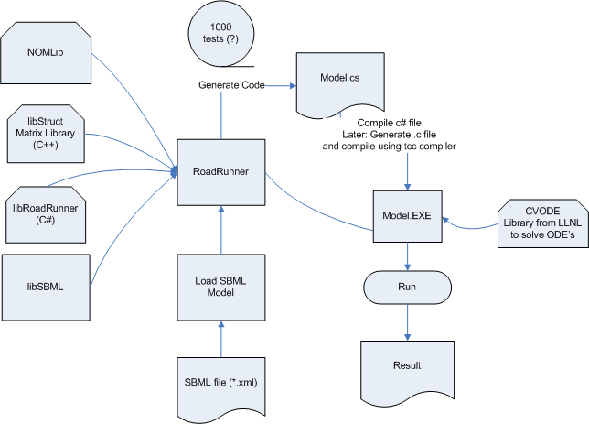
Data flow

Slide 5
Tools
A subversion repository for this work was created at: https://code.google.com/p/roadrunnerwork/
Libraries, libSBML, NOM, libstruct, SBW core are brought into the repository as externals
CMake – tool to generate build files for various platforms and compilers.
Visual Studio and CodeGear to compile C#, C++ and Delphi

Slide 6
Progress
Got all external libraries compiling, using Cmake, both with Visual Studio and Codegear
Added a new CMake project for NOMlib, to link against the latest libSBML.
Created initial RoadRunner application that will replicate current data flow. Stuck at reading xml file (feedback.xml).

