Slide 1
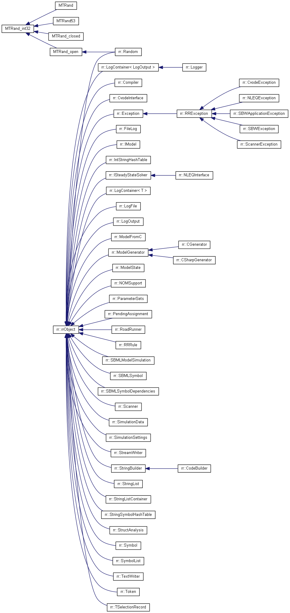
Doxygen documentation

