Slide 1
Road Runner
“A simulation environment for computer models representing chemical and biological processes”

Slide 2
Content
RoadRunner overview
Dependencies: 3rd Party libs
Source code core
How to manage: SVN, CMake, Swig
CMake
Project preparation/setup
CMake concepts
Instructions on how to build Roadrunner from scratch
Clapack
Sundials
LibSBML
RoadRunner
How to make Roadrunner (or any library) useful and accessible
The API
Swig
Improving RoadRunner

Slide 3
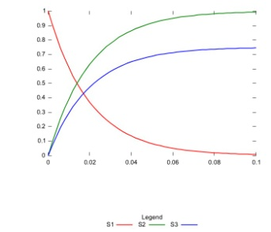
RoadRunner Overview
SBML
Semantics
(XML)
Input
Output
RoadRunner
Parameters&
Settings

Slide 4
more details
Create internal model representation
model.xml
model.h model.c
C-Code source Files
Compile model representation to DLL using tcc compiler
Load dll and simulate
Data output
model.csv
model.dll

Slide 5
RoadRunner Dependencies
RoadRunner
(C++)
libSBML
(C++)
libStruct
(C++)
libXML2
Iconv
Zlib
… + others
clapack
(C)
blas
f2c
lapack
Sundials
(C)
cvode
kinsol
nvector
NOMSupport
(C++)
(libSBML)
C/C++ library for analyzing the structural properties of
stoichiometric networks
API for libSBML
C++ library that handles
SBML semantics
SUite of Nonlinear and DIfferential/Algebraic
equation Solvers

Slide 6
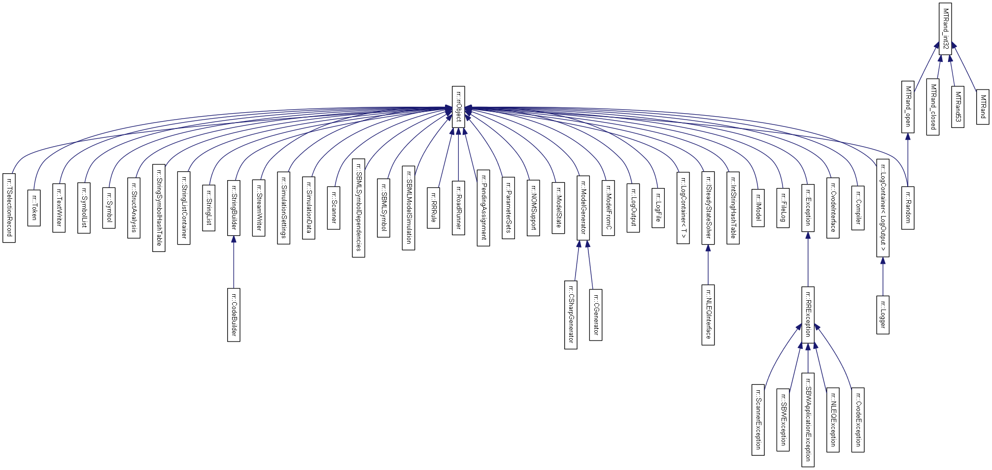
RoadRunner Conversion
About 50 classes was translated.
Added quite a few new ones
C#
C++

Slide 7
Main C++ class - RoadRunner
Hundreds of properties and methods, e.g
Properties
Compiler
CVodeInterface
ModelGenerator
Functions
LoadSBML()
CreateModelSourceCode()
Simulate()
Other characteristics
Lot of code/functionality
Complex
Many dependencies
libSBML
cvode
tcc
clapack etc..
How to manage?

Slide 8
Manage RoadRunner Library
Use conventional software management tools
Subversion (svn)
Keep track of changes and allow anyone to improve the library
CMake (Cross-platform Make)
Automate generation of build files on various platforms and using various compilers
Automate other software management tasks, such as document generation (Doxygen), and setup.exe installers
Automate generation of front-end language API’s using swig.
Swig
Create API wrappers for languages, such as Python, C#, Delphi etc..

Slide 9
RoadRunner sandbox url: https://roadrunnerwork.googlecode.com/svn/trunk
/trunk
/Apps
/Doxygen
/src
RoadRunner C++ Header and Source files
/ThirdParty
/Wrappers
/Examples
/Docs
/rr
/libSBML
/sundials
/clapack
/C
/Python
/Examples
/libStruct

Slide 10
CMake and RoadRunner
What is it?
Tool to generate build files for various compilers, e.g. Visual Studio, Borland, Cygwin etc.
Encourages a ‘software management philosophy’
Integrates into the development cycle
Replaces GNU auto tools ? (GNU auto hell as read somewhere)
How to implement and use it
Each folder in a CMake project contain a CMakeLists.txt file, defining what to do in that particular folder
TopFolders “includes” subfolders
CMake integrate CPack, allowing the creation of a “setup.exe” target automatically.

Slide 11
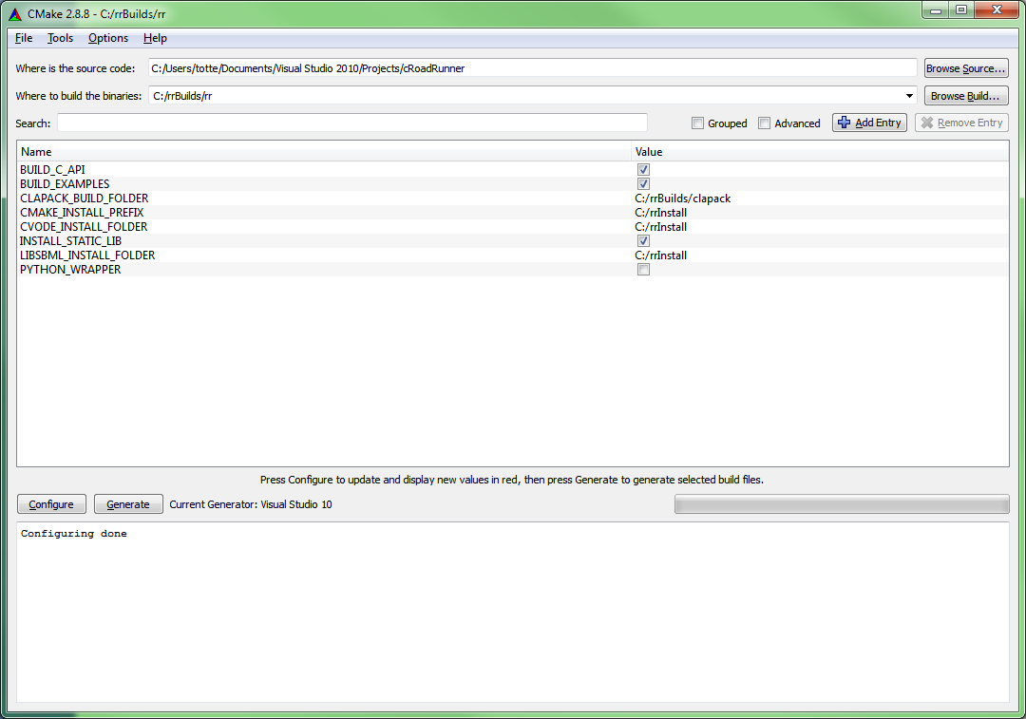
CMake UI
1
2
3
4
5
5
Generates .sln files for the project in the ‘Where to
Build the binaries folder’ (if using Visual Studio)

Slide 12
Setting up RoadRunner development
Suggestion of a build folder
structure
C:\rrBuild
\Sundials
\clapack
\libSBML
\rr
\VS
\XE
\clapack
\sundials
….

Slide 13
Setting up more
CMAKE_INSTALL_PREFIX is the ‘final’ folder for installing anything worth
delivering to the end user, such as
.h .lib .dll, as well as documentation files
In setting up a RoadRunner development platform it is encouraged to have all
deliverables using the same (root) folder, i.e the same setting for
CMAKE_INSTALL_PREFIX, for all 3rd party libs and roadrunner itself
C:\rrInstall
\Sundials
\include
\libSBML
\lib
\VS
\XE
\include
\lib
\bin
\clapack
Contains all .lib files
\bin
Contains all vs binary files (.dll, .exe)
\rr

Slide 14
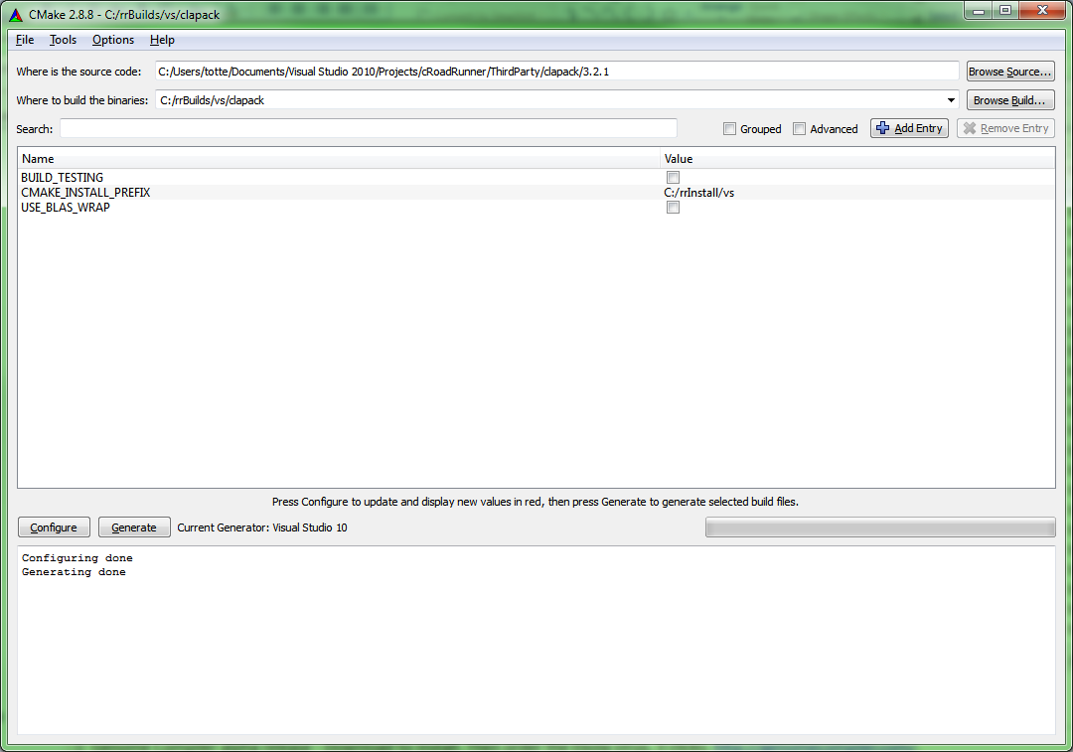
CMake - Clapack (3.2.1)

Slide 15
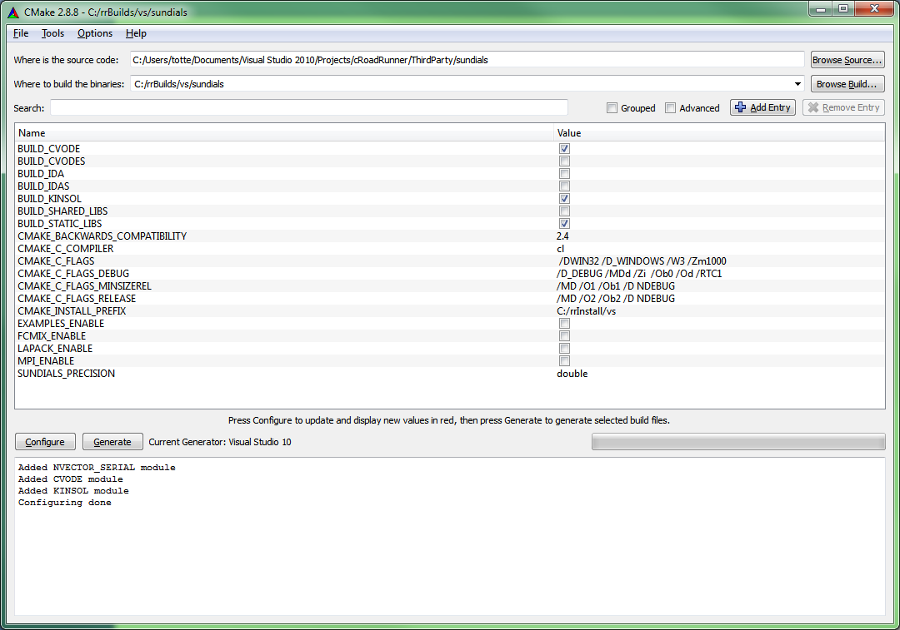
CMake - Sundials
RoadRunner seem only to need
BUILD_CVODE and BUILD_KINSOL

Slide 16
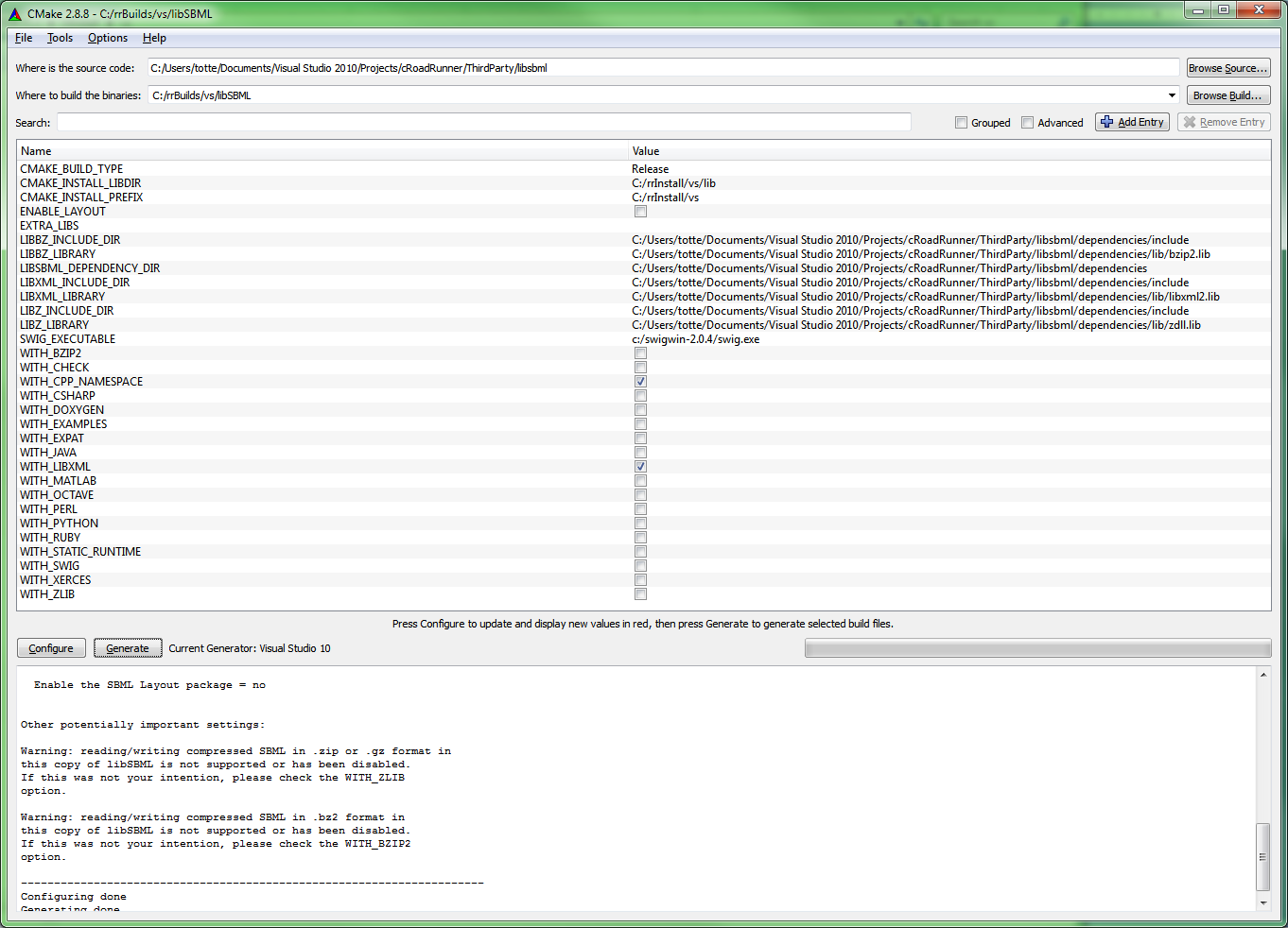
Cmake - libSBML
Setup CMAKE_INSTALL_LIBDIR
Uncheck all, except WITH_CPP_
NAMESPACE and WITH_LIBXML

Slide 17
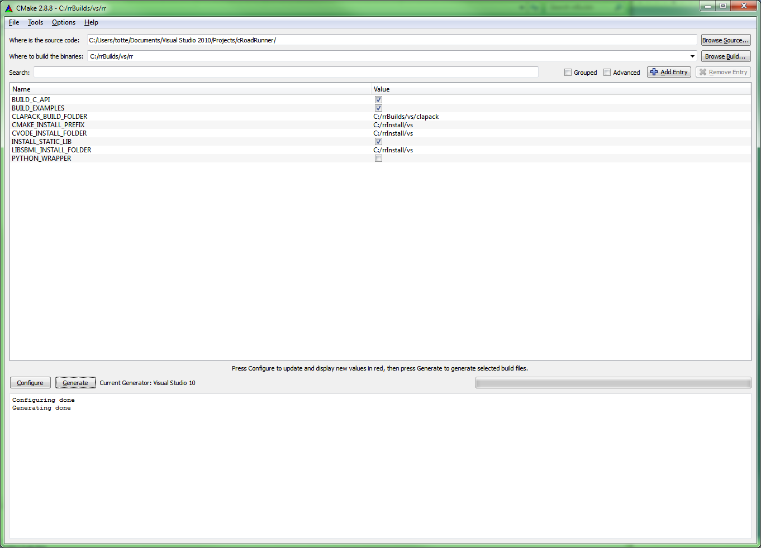
CMake - RoadRunner
Setup clapack build folder
and CVODE, LIBSML install folders

Slide 18
After setting up using CMake UI
Open Visual Studio solution files in build folders, or for command line compilers cd into the actual build folder and type ‘make install’
Compile the ‘All’ target.
Compile the ‘Install’ target -> copies all deliverables to the “install” folder.
(Clapack don’t have an install target)
RoadRunner also have a PACKAGE target -> creates a roadrunner installer

Slide 19
How to make the RoadRunner (or any) library useful?
Application
Programming
Interface
Create an API
Hide complexity
Make the API OS platform independent
Expose the API to any programming
language

Slide 20
API creation
RoadRunner
(C++)
libSBML
(C++)
libStruct
(C++)
libXML2
Iconv
Zlib
… + others
clapack
(C)
blas
f2c
lapack
Sundials
(C)
cvode
kinsol
nvector
NOMSupport
(C++)
(libSBML)
loadSBMLFromFile(fileName)
Simulate()
GetResult()
Hundreds of functions and attributes
Fewer functions
Can be distributed as one single
pre-built library
Building/Compiling/Managing
all this is complex

Slide 21
Improving RoadRunner
Aim for a C- API deliverable having only one shared library.
Would requires to build libSBML with no ‘shared’ dependencies (not easy ?)
Cmake
Create bindings for Python, Delphi(?), C#(?)
Incorporate 3rd party build file generation into RoadRunners CMake system.
Then one build, builds all in one go.
The Core
Still need work to conform to libSBML specifications and to pass
libSBML test cases.

