Slide 1
RoadRunner C# -> Delphi Conversion Project
Totte Karlsson

Slide 2
Background
Ph.D. in Physical Chemistry, Stockholm University, Sweden Did a lot of simulations of Solid State NMR Experiments
Post Doc at UW 2000-2003 in Gary Drobnys group, Chemistry Dep.
Software developer at research company in San Diego for 4 years.
Independent Software Developer since 2007 – many different projects in various disciplines.
Main working with C++, C# and familiar with other languages.

Slide 3
Conversion Project
Quite complex – several ‘large’ libraries
libSBML - C/C++ library to read SBML files
NOMLib - Delphi interface to libSBML
libStruct – Matrix library
RoadRunner – library to convert fromC# -> Delphi

Slide 4
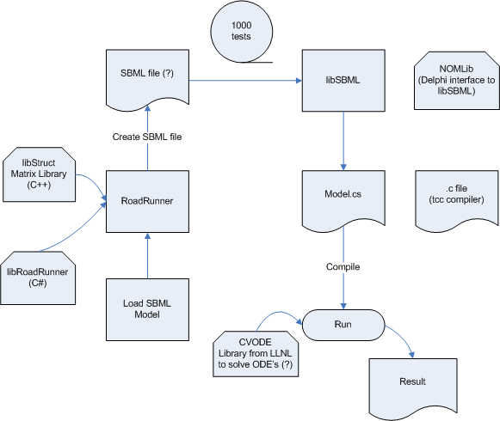
Data flow

Slide 5
Libraries and Tools
Subversion used to host and gather external libraries – libSBML, libStruct, NOMLib, RoadRunner.
A repository for this work was created at: https://code.google.com/p/roadrunnerwork/
CMake – tool to generate build files for various platforms and compilers
Visual Studio and CodeGear to compile C#, C++ and Delphi
Work started to convert C# first to C++, and then Delphi.

Slide 6
Progress
Got all external libraries compiling (not straight forward)
Added a Cmake project for NOMlib, to link against the latest libSBML
Started conversion of C# to C++:
Interesting conversions, C# to C++, this far:
C# delegate corresponds to a C++ function pointer
C# ‘params’ will need to use ‘…’ syntax (variable argument list)

