Slide 1
Interim Presentation
Graph neural networks for pavement deterioration prediction and network-aware maintenance planning
MPhil ISMM Cambridge
Gregoire Dambre

Slide 2

Problem Statement
From isolated road sections to coordinated maintenance decisions at network scale
Traditional pavement management predicts one section at a time; this dissertation asks how local deterioration, traffic, and dependencies can be linked to network-wide maintenance planning.

Slide 3
Results Storyline
What the results now support most clearly
Local history is strong, but graph information adds value when the graph semantics are well designed.
On HPMS16, the strongest in-domain benchmark is the Stacked MLP ensemble (R² = 0.5356).
A refined pavement-aware graph now reaches almost the same level on HPMS16 (R² = 0.5329).
On MEPDG, the best absolute score is the refined R-GCN with materials + weight sweep (R² = 0.5582).
Geographic transfer remains weak out-of-domain, which supports local recalibration rather than one universal model.

Slide 4
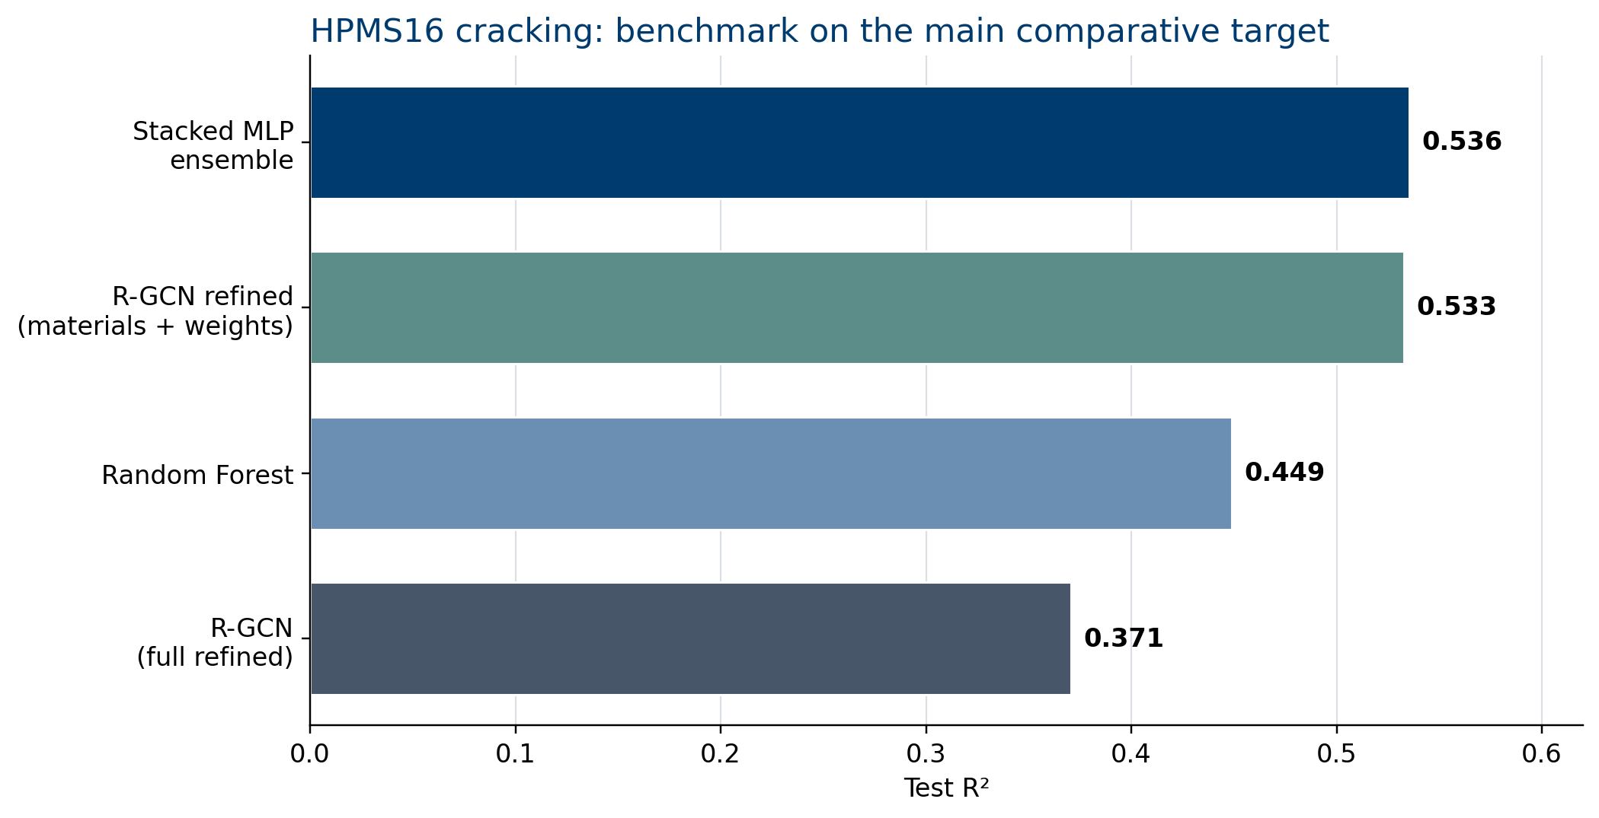
Core Benchmark on HPMS16
RF local: 0.4489
R-GCN full refined: 0.3708
Refined R-GCN with materials + weights: 0.5329
Stacked MLP ensemble: 0.5356
Message: graph information matters most when it is either combined with strong local history, or encoded through a richer pavement similarity definition.

Slide 5
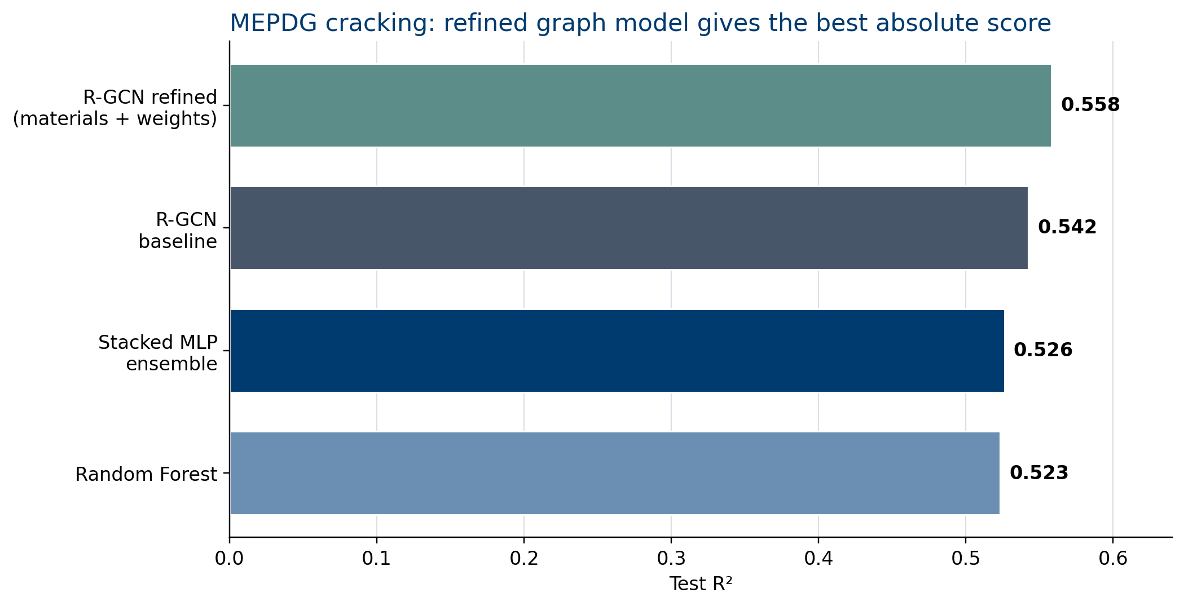
Specialist Target: MEPDG Cracking
RF local: 0.5233
R-GCN baseline: 0.5424
Stacked MLP ensemble: 0.5263
Refined R-GCN: 0.5582
Message: on MEPDG, the graph model itself is already stronger than RF, and the best score comes from refined graph semantics rather than ensembling.

Slide 6
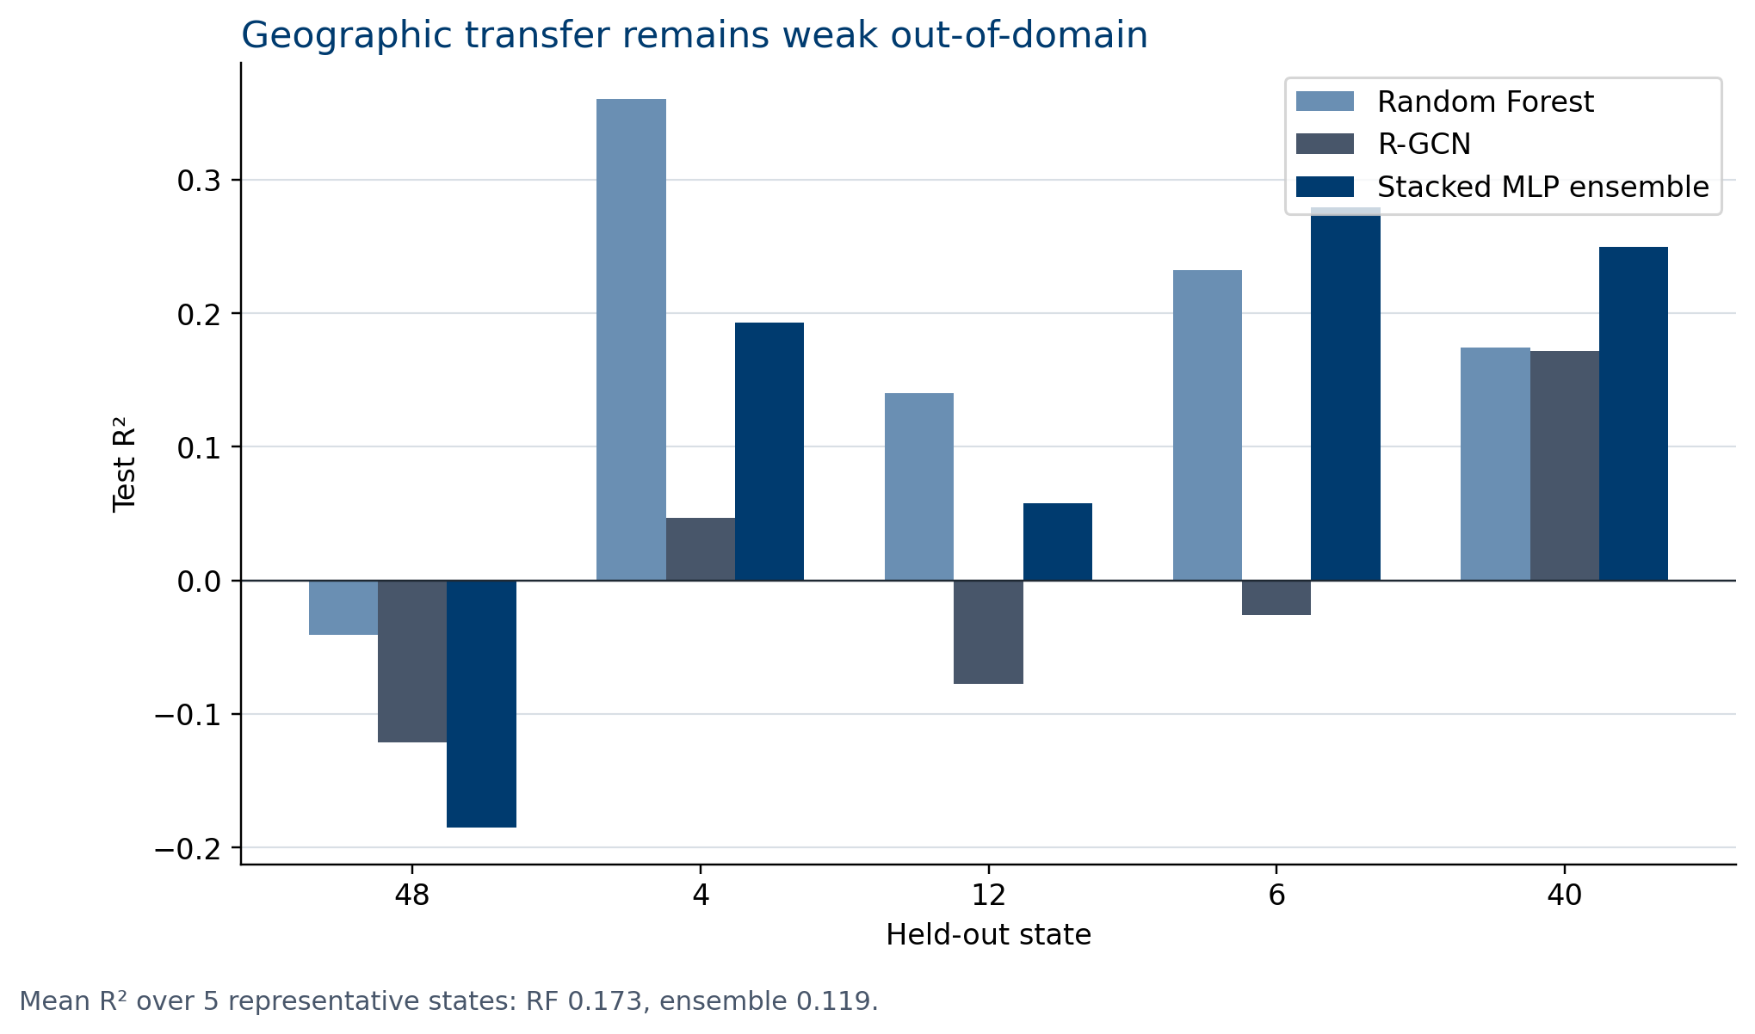
Robustness: Geographic Transfer
Subset analysis on 5 representative held-out states
Mean OOD R²: RF = 0.173
Mean OOD R²: ensemble = 0.119
Ensemble beats RF on only 2/5 states
Message: the ensemble is a strong in-domain result, but it does not resolve state-to-state transfer. The signal remains region-specific.

Slide 7
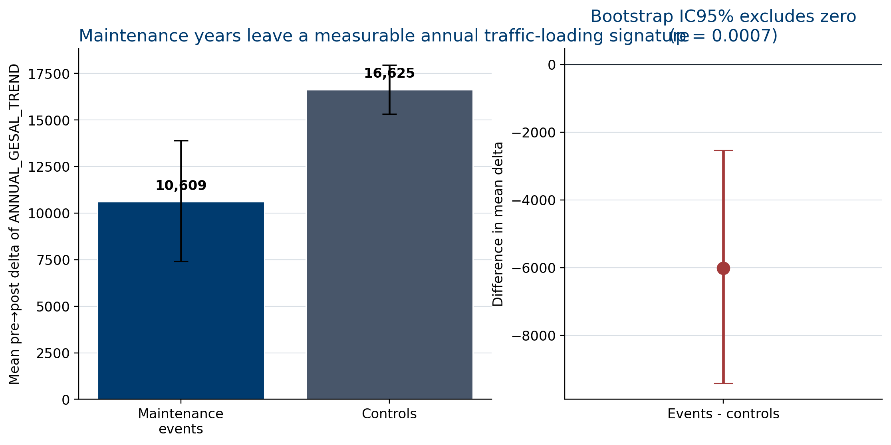
Bridge to Phase 2: Traffic Sensitivity
n events = 4,627
n controls = 55,436
Diff = -6,016
95% CI = [-9,415 ; -2,536]
Welch p = 0.0007
Message: even with annual traffic-loading proxies, maintenance years leave measurable signatures that motivate the optimisation stage.

Slide 8
Takeaways
Best comparative HPMS16 result: Stacked MLP ensemble, R² = 0.5356.
Best absolute cracking result: refined R-GCN on MEPDG, R² = 0.5582.
New result: refined pavement similarity also lifts HPMS16 strongly, to R² = 0.5329.
Key limitation: geographic transfer remains weak, so local recalibration matters.
Next step: translate these predictive and network signals into maintenance scheduling under disruption constraints.

