Slide 1
Collocated co-simulation using probability aggregation
Grégoire Mariethoz¹
Philippe Renard¹
Roland Froidevaux²
¹Centre for Hydrogeology
University of Neuchâtel
²FSS Consultants

Slide 2
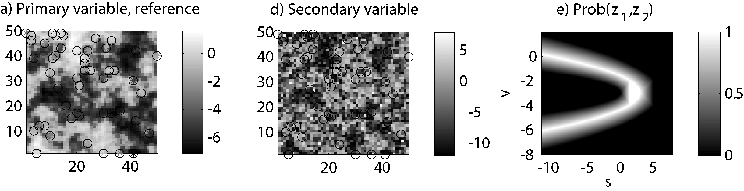
A real problem: Sur, Oman
Karstified coastal aquifer, with clay deposits
Correlation is non-linear and non-univoque.
Karstic conduit + salt water
But it is known.
Hydraulic conductivity
Karstic conduit + fresh water
Its description is non-parametric.
Clay
This knowledge should be used.
Electric resistivity

Slide 3
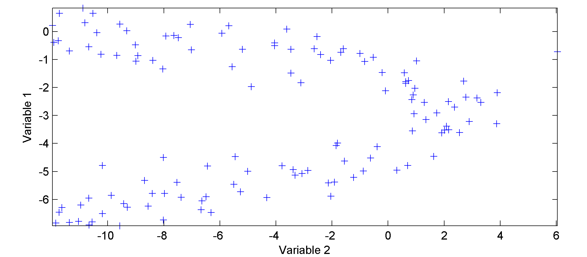
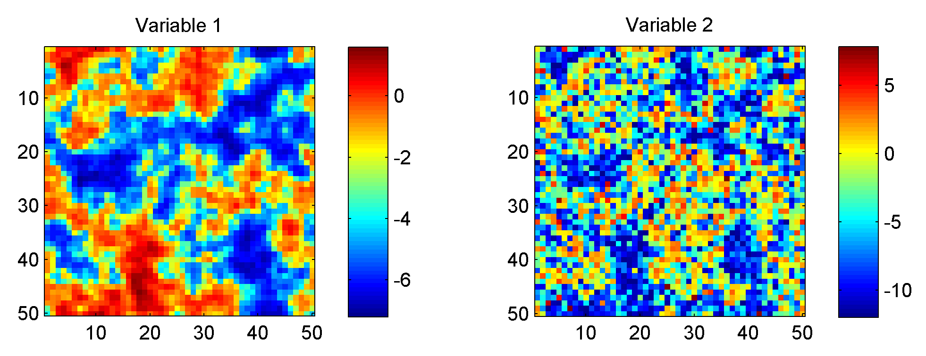
Complex correlation
How to make the best use of this information?
Correlation?

Slide 4
A widespread problem
Exhaustive secondary information is often available, but can be difficult to integrate in geostatistical simulations.
For example:
Geophysical surveys
Satellite images
Land use maps
Topography
Expert’s opinion
Etc
Sometimes, real-world complex physical phenomena yield complex correlations.

Slide 5
Acknowledging non-linearity
Traditional ways of including secondary information assume a linear correlation model (e.g. co-kriging).

Slide 6
Non-parametric models
Complex correlations functions can be described in a non-parametric way.
For example, using kernel smoothing on scatter plots.
These non-parametric bivariate models cannot be used with most approaches.
Exception: « cloud transform » technique (Bashore, et al., 1994; Leuangthong and Deutsch, 2003).

Slide 7
Different sources of information
There are (at least) two sources of information at a given location z(u). They can be expressed as two different ccdfs:
Information given by the values z(u_{i}) at the neighboring locations:
Information from the bivariate distribution, conditioned to the secondary attribute s(u):

Slide 8
Aggregating information I
Bordley, R. E. (1982), A multiplicative formula for aggregating probability assessments, Management Science, 28, 10, 1137-1148.
Originates from management science: combining expert’s opinions.
Provides a framework for combining pdfs.
Is at the base of different approaches developped later:
  tau and nu models (Journel, 2002; Krishnan, 2005; Polyakova and Journel, 2007)
  probability conjunction (Tarantola, 2005)

Slide 9
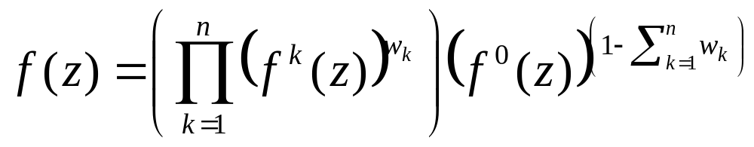
Aggregating information II
Bordley, R. E. (1982), A multiplicative formula for aggregating probability assessments, Management Science, 28, 10, 1137-1148.
weights
Aggregated pdf
n pdfs to aggregate
Marginal pdf

Slide 10
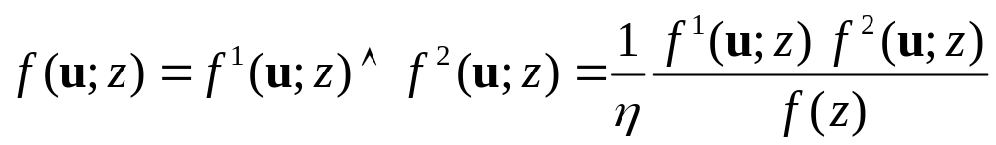
Simplified version
Tarantola, A. (2005), Inverse Problem Theory and Methods for Parameter estimation, Society for Industrial and Applied Mathematics.
Degenerated case, with only 2 pdfs and all weights=1

Slide 11
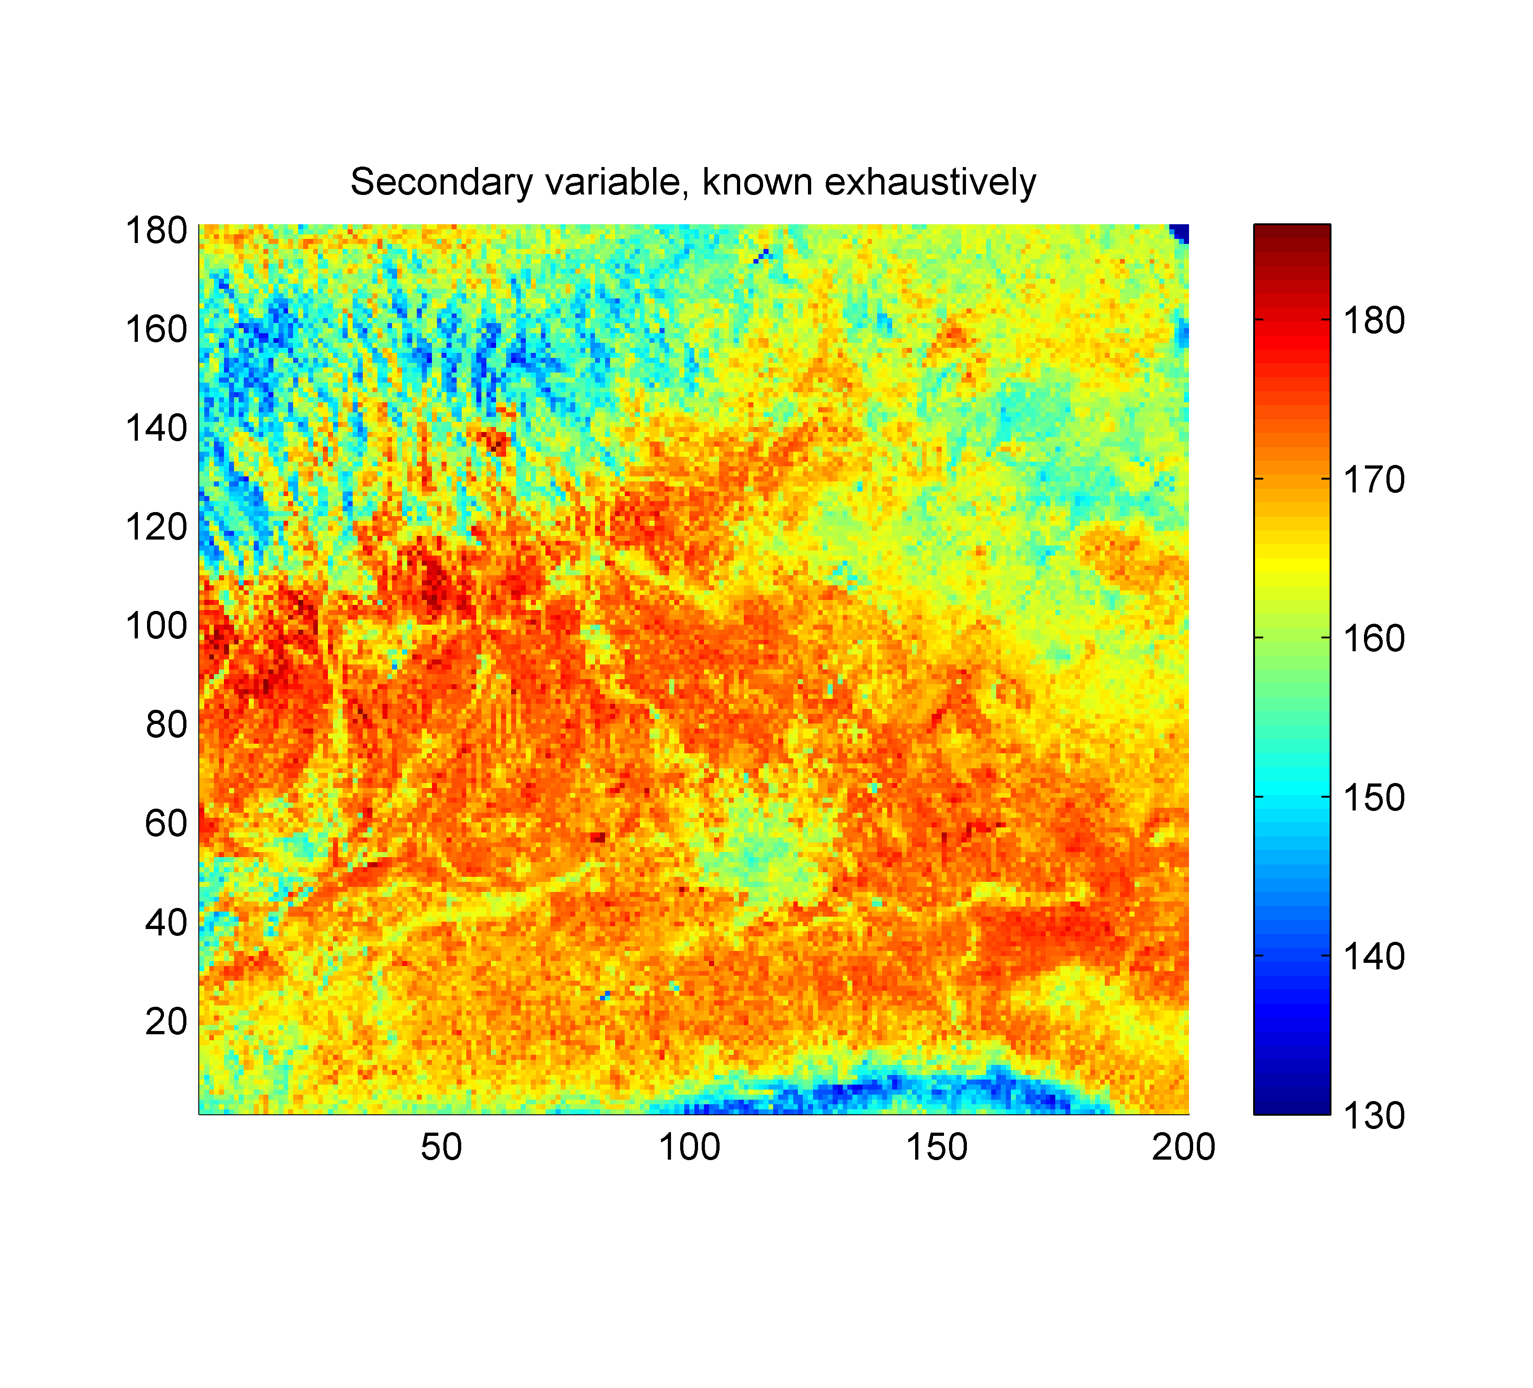
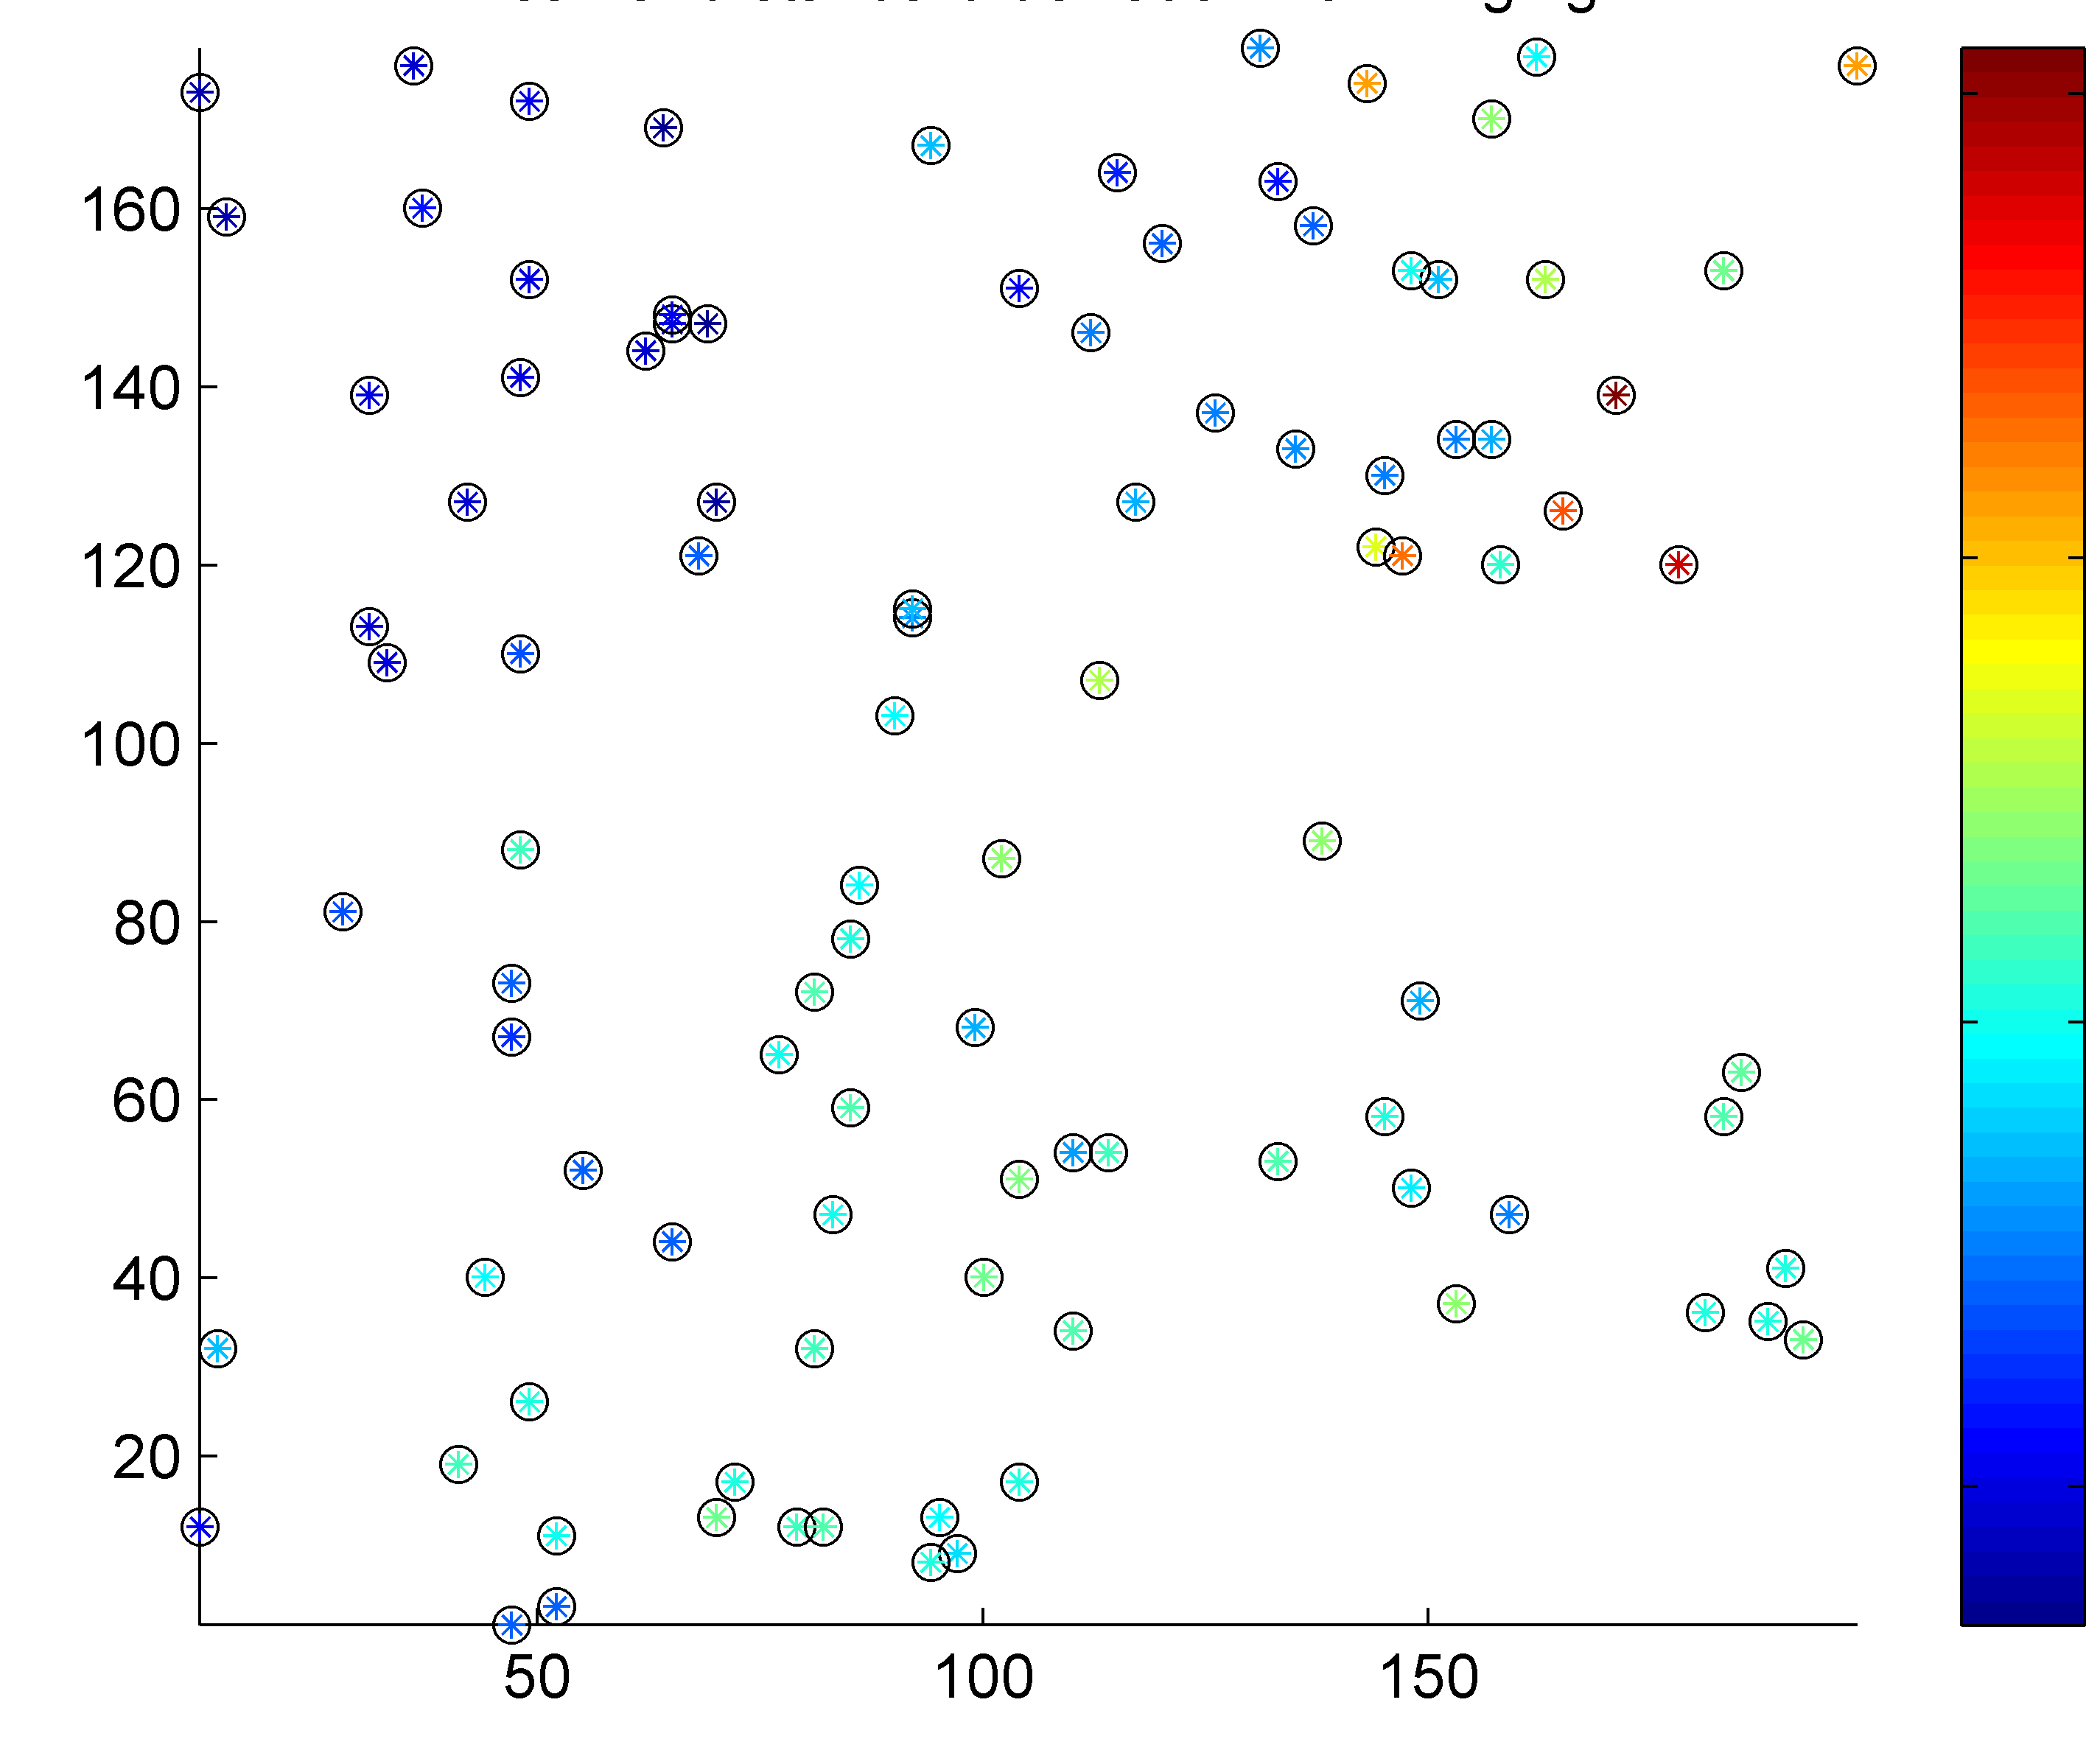

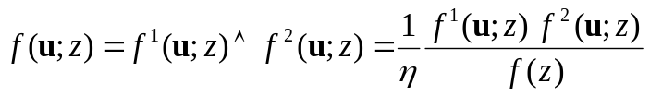

Aggregating information: demo
Secondary variable
Primary variable
1
-1
1
0
-1
-2
-3
-4
-5
-6
-7
-8
Primary variable
?
Secondary variable

Slide 12
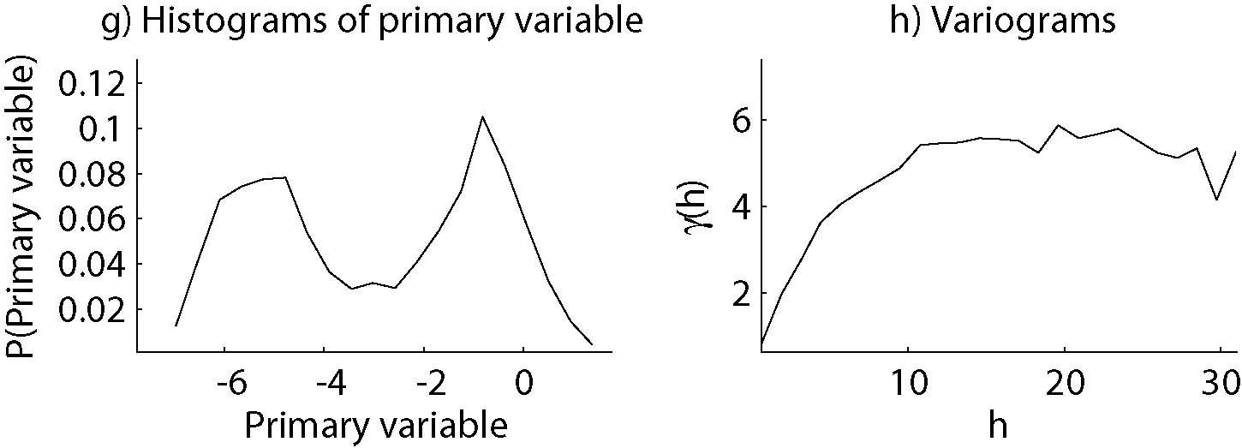
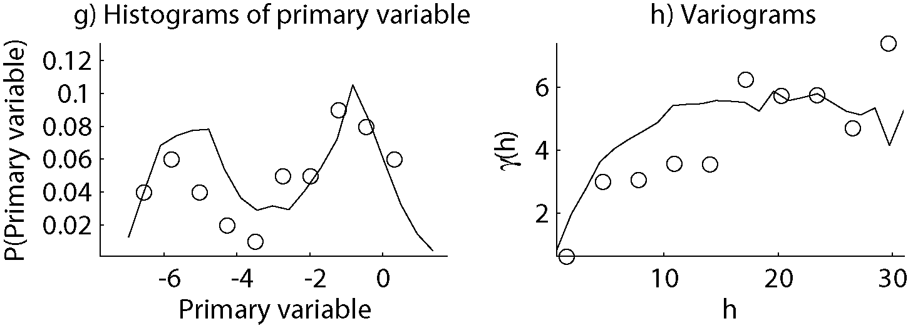
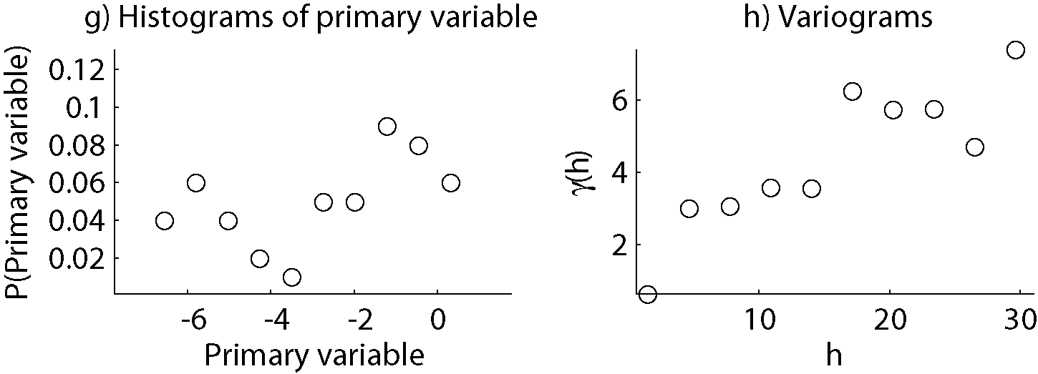
Synthetic example
Available data
?

Slide 13
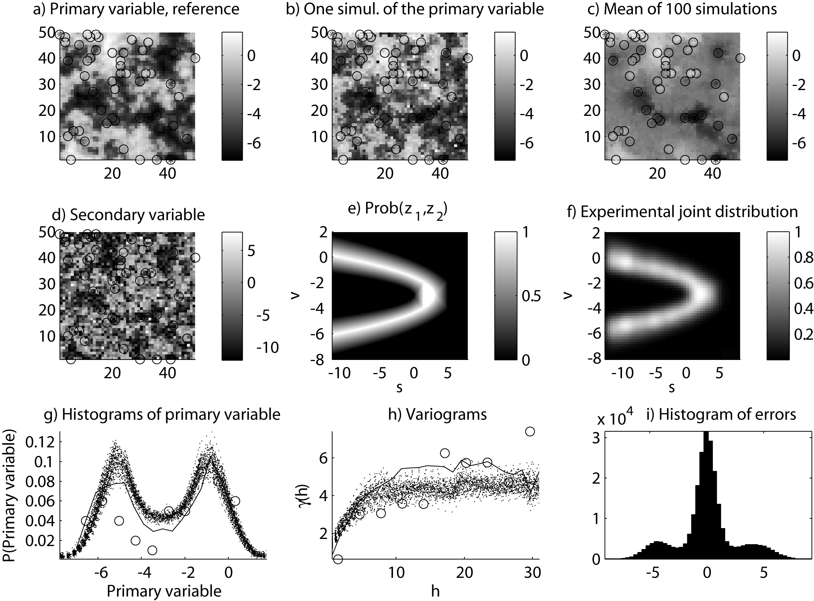
Results - simulations
Even where no conditionning data are present
Features preserved

Slide 14
Results - statistics

Slide 15
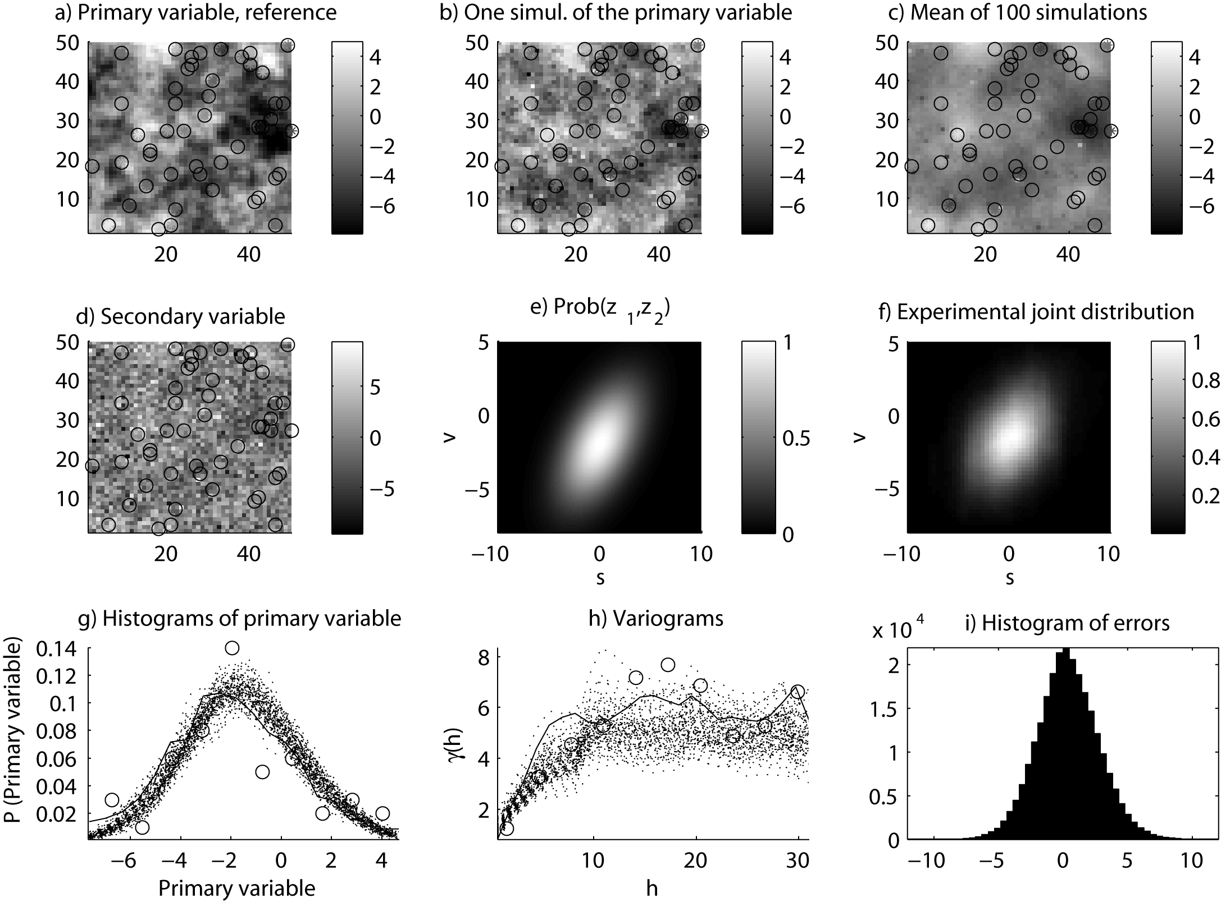
Also works for linear correlations

Slide 16
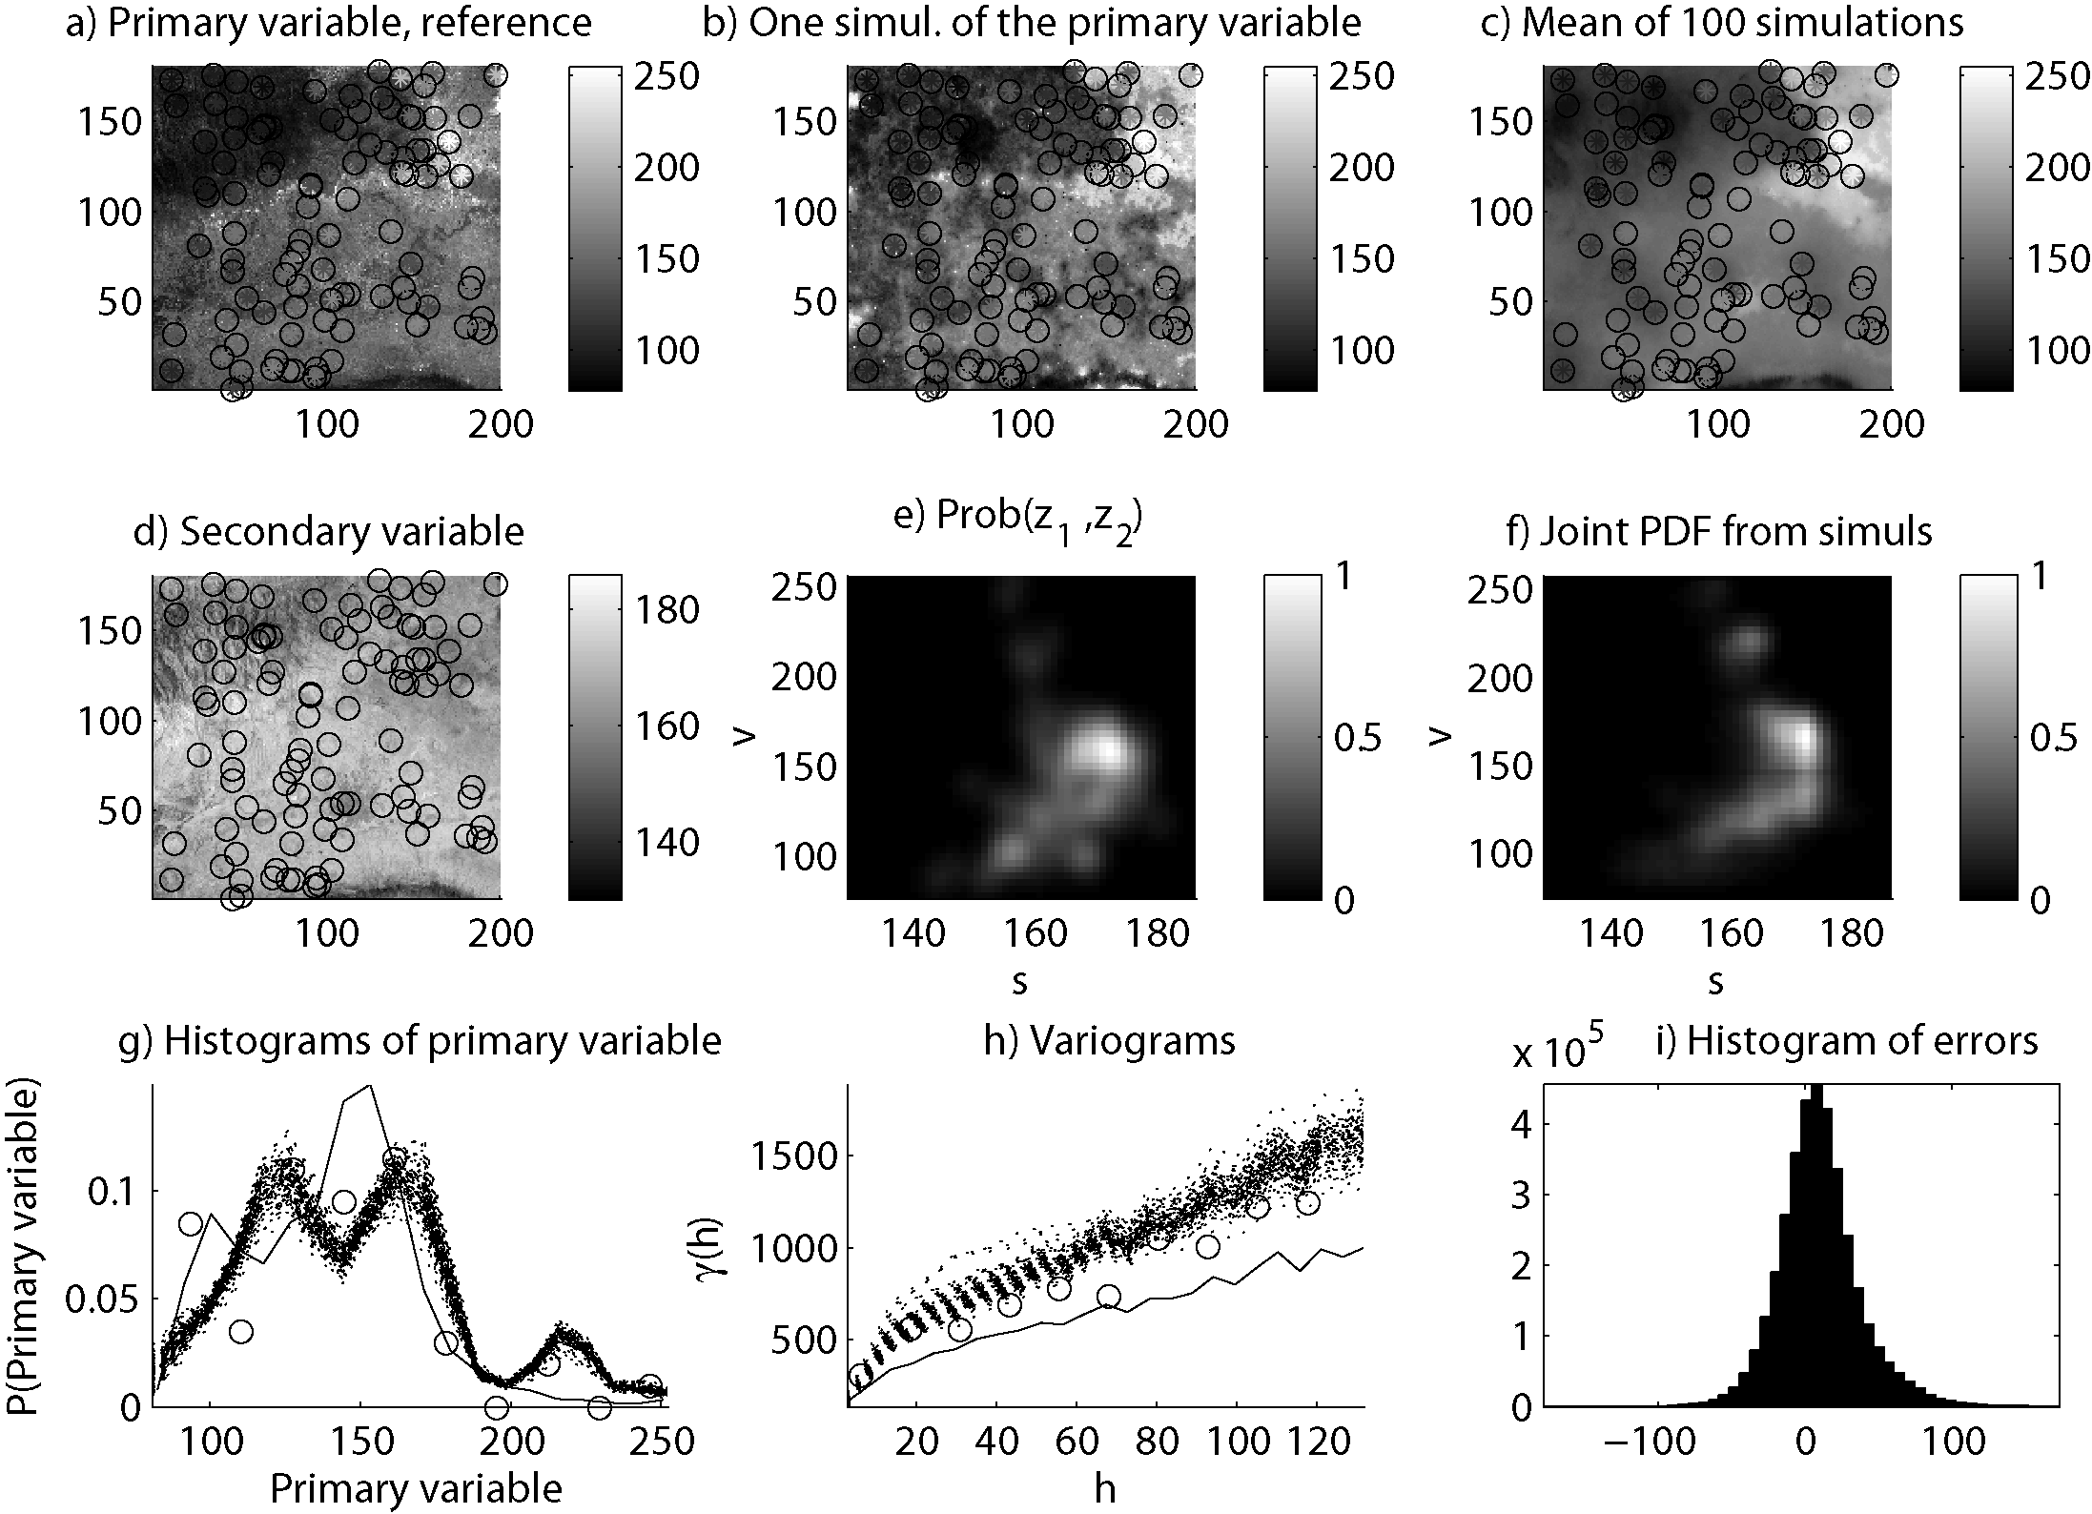
Real case using satellite images

Slide 17
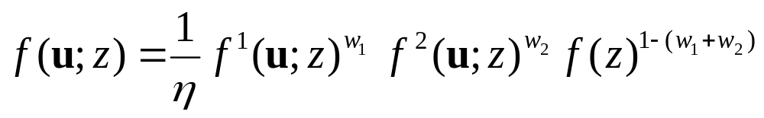
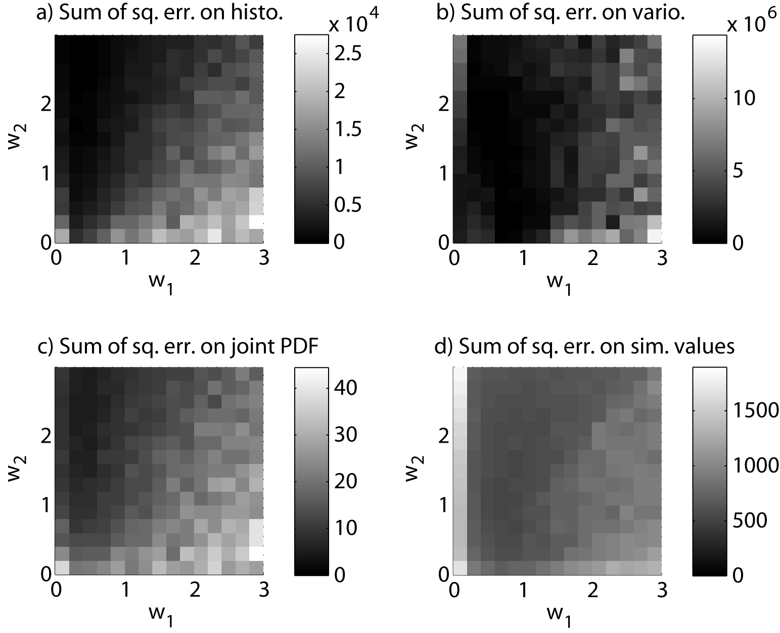
How to adjust the weights?

Slide 18
Conclusions
Efficient method for co-simulation with complex correlation.
Also works with linear correlation.
Versatile: f ¹(u ; z) can be estimating using any simulation method (kriging, MPS, MCS, etc).
Possible to use the same framework for several auxiliary attributes.
Adjustment of weights is still awkward.
Does not (yet) consider spatial cross-correlation between primary and secondary variable.

Slide 19
Thank you for your attention
Funding for this work was provided by the Swiss National Science Foundation (contract PP002-1065557).
We want to thank:
  Denis Allard (INRA) for his constructive comments.
  Albert Tarantola (Institut de Physique du Globe de Paris) for enlightening lessons.
  François Bertone (BCEOM Engineering) for initiating this project by giving us a real-case problem.

