Slide 1
Commercial Auto Risk Scoring
Case Study

Slide 2
Summary & Objective
Commercial auto insurance covers multi-vehicle enterprise fleets. Commercial fleets represent high-exposure risk pools.
Primary Objective:
Estimate the continuous probability of claim occurrence (claim > 0) for each policy_id using binary classification.
Approach:
Create an end-to-end ML pipeline predicting policy claim incidence (claim > 0) to prioritize triage and optimize loss ratios.

Slide 3
Problem Formulation & Key Assumptions
Claims are rare events (12.3% in this scenario)
The classes (claim / no claim) are very imbalanced
Accuracy may be misleading in this scenario
  returning high accuracy in identifying the 'no claim' policies and we may miss the 'claim' scenarios
Binary classification vs. continuous probability
  as loss is rare continuous probability may add more value / be more descriptive
The aim is to train the model rather to better identify these 'outlier' situations – to minimize the loss.

Slide 4
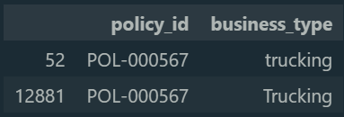
Exploratory Data Analysis & Data Integrity
Real data vs. Train dataset
  column inconsistencies: 'has_safety_program'
Data leakage prevention
  excluded from features
    columns determined by target column 'claim_count'
    missing column in real dataset: 'has_safety_program'
Deduplication
  exact row-level
  primary key 'policy_id'
Data types
  mixed types / data in single columns: n/a
  column's data type update: datetime
  case formatting: business_type

Slide 5
Exploratory Data Analysis & Data Integrity
Outliers and anomalies
  replaced:
    'business_type': 'agriculture' with 'other' (1 row)
  dropped:
    chronological anomalies: expiration date < effective date (10 rows)
    negative annual premiums (maybe cancellations): 'annual_premium' < 0 (5 rows)
    ghost fleets: 'total_vehicles' = 0 with active drivers or mileage > 0 (2 rows)
Null (missing) values
  'prior_loss_amount'
    strategy: if 'prior_apd_claim_count' and 'prior_al_claim_count' = 0 then 0.0 else median
  'payment_frequency'
    quite balanced cross categories; strategy: 'unknown'
Snapshot date
  all records: during time when the policy is still open
  77 rows: 'snapshot_date' == 'policy_effective_date' --> elapsed time = 0
    11 rows: where 'claim_count' > 0

Slide 6
Feature engineering
exposure_ratio = elapsed_days / policy_length_days
  elapsed_days = snapshot_date - policy_effective_date
  policy_length_days = policy_expiration_date - policy_effective_date
mileage_per_vehicle = 'prior_year_mileage_000'/'total_vehicle_count'
  total_vehicle_count = 'vehicle_count' + 'num_heavy_vehicles'
loss_per_claim
  = if total_prior_claims > 0 then prior_loss_amount / total_prior_claims else 0.0
has_large_prior_loss = prior_loss_amount > 50000
risk_score_external_isna = True/False - risk_score_external

Slide 7
Preprocessing & improvements
Evaluate: use "X_test" / "y_test" instead of train data
Cleanup of training / real data
Feature engineering – adding new columns + remove target ones
train_test_split data
Create Pipeline
  after train_test_split
  define steps for imputation / encoding / scaling
  0 for all numeric values may not describe the reality
Try various models
  Selected: XGBoost
Metrices
  Accuracy may not be suitable in this case
  Imbalanced classes

Slide 8
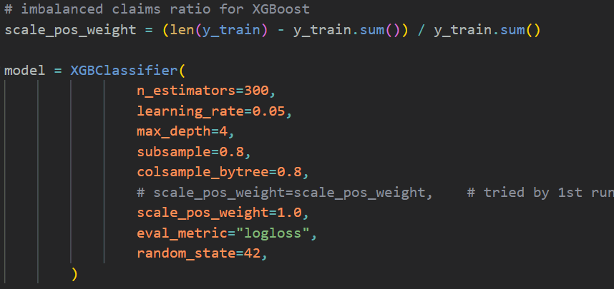
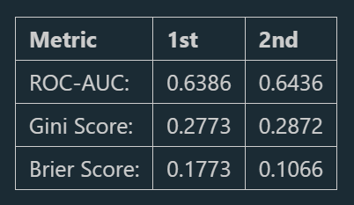
Modeling Strategy & Validation
Model: XGBoost
  Captures non-linear operational
  interactions without manual feature
  combinations
  should be more resilient to skewness
  and outliers
  Native handling of sparse features and
  missing values.
Metrics Tracked:
  ROC-AUC & Gini: Evaluates risk rank-ordering.
  Brier Score: Assesses probability calibration accuracy.

Slide 9
Production Readiness Improvements
file preparation / refactoring
  remove unnecessary imports / prints
  move functions into separate file(s)
  put the code into .py file instead of ipynb
  separate credentials into .env file - avoid hardcoding
  include requirements.txt file (for compatibility)
separate the flow:
  file(s) for EAD
  file(s) for preprocessing data
  file(s) for training the model
  file for model prediction
  save model and all its parameters to file
implement source schema validation
add tests and logging

Slide 10
Production Readiness Roadmap
code review
prepare documentation
commit to github
orchestration of the jobs
files (if any) save to cloud / official storage location
  check rights
after deployment
  monitor the performance
  re-train if needed or conditions have been changed

