Slide 1

Modularized CAP CAP Java SDK
Marc Becker, Adrian Görler, SAP
May 15, 2020

Slide 2
Agenda
CAP Java SDK – Next Generation
Demo – CAP Java sample application
Modularization – Building Blocks
Demo – Modularization Examples
Modularization – Platform Features

Slide 3
CAP Java SDK Next Generation

Slide 4
Why a Next Generation Java Stack?
OData protocol only
No uniform QL
old SDK for Service Development
No Service Consumption API
Fiori
Markup
Fiori UIs
Local Service API
OData centric runtime
OData
Service Definitions
EDMX-based Runtime
Custom Request Handler
request handling only
CDS
No Messaging
as views on
HSQL/CQL
Data Models
HANA
lock in to HANA
No native Spring Support

Slide 5
Protocol/Datasource Adapters
CQN
Canonical CDS Query Notation
Protocol Adapter
Handles incomming requests
Translates protocol to CQN
Serializes/deserializes data according to protocol
Data Source Adapter
Translates CQN to query language of data source
Executes queries against data source
EDMX Model
OData Adapter
Fiori UIs
Protocol Adapter
CDS Model
R
R
CQN
OData
CDS Service Layer
Custom Handler
R
SQL
R
CQN
HANA
HANA Adapter
Data Source Adapter
HANA Model

Slide 6
Protocol/Datasource Adapters
EDMX Model
Fiori UIs
REST Client
…?
R
OData
R
REST
R
?
OData Adapter
REST Adapter
…? Adapter
Protocol Adapter
CDS Model
R
CQN
R
CQN
R
CQN
CDS Service Layer
Custom Handler
R
CQN
R
CQN
R
CQN
…? Adapter
Service Adapter
DB Adapter
Data Source Adapter
DB Model
…?
Other Service
DB

Slide 7
Demo CAP Java Sample Application https://github.com/SAP-samples/cloud-cap-samples-java
Notes:
Show DB model
Show AdminService and CatalogService models
Show Fiori UI
Show Fiori Draft
Show deep search
Show localization
Show custom action
Show application code -> CatalogServiceHandler
Typed access to entities
(typed) Query Builder API
Spring integration -> @Autowired
Show test code
Spring Mock MVC -> Run API integration tests
It’s easy to implement plain old simple event handler unit tests
Show application configuration -> Leveraging Spring profiles

Slide 8
Modularization Building Blocks

Slide 9
Protocol/Datasource Adapters
EDMX Model
Fiori UIs
REST Client
…?
R
OData
R
REST
R
?
OData Adapter
REST Adapter
…? Adapter
Protocol Adapter
CDS Model
R
CQN
R
CQN
R
CQN
CDS Service Layer
Custom Handler
R
CQN
R
CQN
R
CQN
…? Adapter
Service Adapter
DB Adapter
Data Source Adapter
DB Model
…?
Other Service
DB

Slide 10
Services
Active Component
Defined by
Which events handled by the Service
How events are handled
Service Definition can be captured by CDS Model
Service
Dispatches Events to Event Handlers
Generically Handles CRUD + Queries
Augmented with Custom Handlers
Orchestrates Event Handlers
Consumer
R
CQN
Event
Event Handler
CDS Model
Service
Downstream

Slide 11
Event-handler Architecture
Odata Client
REST
…?
R
OData
R
R
Protocol Adapter
OData Adapter
REST Adapter
…? Adapter
R
Event
R
Event
R
Event
CDS Service
Event Handler
Event
Downstream Services
…? Service
Event
Handler
Persistence Service
Event Handler
…?
DB

Slide 12
CDS QL - Query Language
Captures CRUD Operations and Queries
Styles
SQL Style – SELECT FROM Books { id, title } WHERE year = 2020
Xpath Style – SELECT FROM Orders[id = 17].items { amount, product { name, price } }
Representations
CDS Query Language (CQL)
CDS Query Notation (CQN)
In Memory Representation (CqnStatement)
APIs in Java SDK
Query Builder API (fluent)
CQN Parser

Slide 13
Modularization Demos

Slide 14

Demo GraphQL Protocol Adapter
Notes:
Show GraphQL Configuration -> Standard GraphQL OSS library + Spring-Integration
1. Step: Turn CDS Model into GraphQL schema
Service entities become GraphQL types
For each service entity two queries are generated: get<Entity>ById(<Keys>) and get<Entity>
2. Step: A generic data fetcher is registered, which translates GraphQL Queries to CQN Select statements
Arguments result in path filter expressions
SelectionSet is turned into columns with expands
Show GraphQL example requests

Slide 15
What is GraphQL?
„GraphQL is a query language for APIs and […] provides a complete and understandable description of the data in your API [and] gives clients the power to ask for exactly what they need and nothing more”
query {
getBooks {
title
price
currency {
code
}
}
}
{
"data": {
"getBooks": [
{
"title": "Wuthering Heights",
"price": 11.11,
"currency": {
"code": "GBP"
}
}
]
}
}
type Currencies {
code: String
name: String
descr: String
symbol: String
}
type Query {
getBooks: [Books]
}
type Books {
ID: ID
title: String
descr: String
author: String
price: Float
currency: Currencies
stock: Int
}
Notes:
GraphQL queries <-> CQN Queries
GraphQL schema <-> CDS Model

Slide 16
GraphQL Protocol Adapter
EXAMPLE
Key takeaways:
Protocol adapters act as service clients and transform protocol-dependent requests into CQN
All business functionality (e.g. localization, authorization, custom business logic) is hidden behind protocol-agnostic services
Protocol adapters automatically inherit this business functionality
Advantages
Hexagonal architecture: Clear distinction between your business core and how this business core is accessed

Slide 17

Demo S/4 OData Service consumption
Notes:
Add a shipping address selection to the Order UI, with shipping addresses coming from S/4
Download EDMX from https://api.sap.com/api/API_BUSINESS_PARTNER
cds import --no-save srv/external/API_BUSINESS_PARTNER.edmx
We can tailor the service to our needs, reference it in our own CDS Model and get a local representation of it
By default CAP serves services from the default data source -> We can easily override this and direct this to a remote S/4 system
Show ApiBusinessPartnerHandler
Only run this code, if a destination is available -> Allows us during local development to mock the service using our own database
Columns are translated into a $select query parameter
Where conditions are translated into a $filter query parameter
When Fiori queries our local representation of Addresses, we need to forward it to the Business Partner API
Show AdminServiceAddressHandler
Where condition for matching businessPartner is added to the Select
Local testing -> No S/4 available
Provide CSV with data for S/4 entities
Deploy database schema with mocks -> package.json
Run application with default profile
Remote testing -> Add destination with S/4 system
Deploy database schema without mocks (cds deploy --to hana)
Run application with cloud profile

Slide 18
S/4 OData Service consumption
SAP Labs Preview
Key takeaways:
Event Handler API can be flexibly used to define the behaviour of a service
Advantages
One Query API: Consuming services are not coupled to the underlying infrastructure
Local Development: The remote service can be easily mocked
We are currently working on providing this capability out-of-the-box

Slide 19

Demo mongoDB Datasource Adapter

Slide 20
mongoDB Datasource Adapter
What is mongoDB?
MongoDB is a general purpose, document-based, distributed database built for modern application developers and for the cloud era.
How does it differ from HANA?
NoSQL
no schema
document oriented
query by example / BSON
distributed
Complexity
EXAMPLE
 | HANA | mongoDB
easy | views joins projections | compositions path expressions $expand deep insert cascading delete
complex | compositions path expressions $expand deep insert cascading delete | associations views

Slide 21
Modularization Platform Capabilities

Slide 22
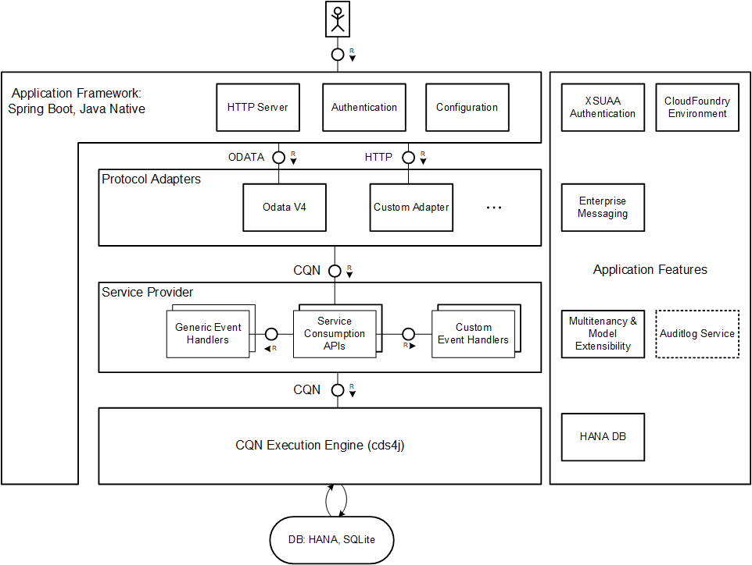
Generalizing Platform Capabilities: Features
What are features?
Optional components
Integrate services provided by the platform running the app
CAP provides implementations for local development
Protect investments into the core of the CAP framework
Examples
Authentication
Service Bindings
Messaging

Slide 23
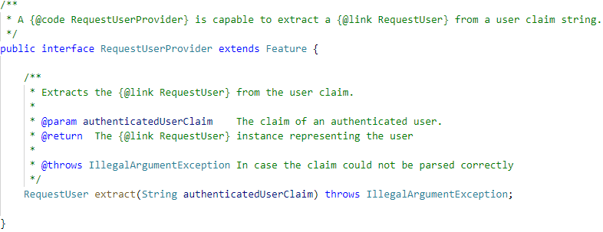
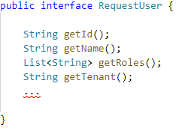
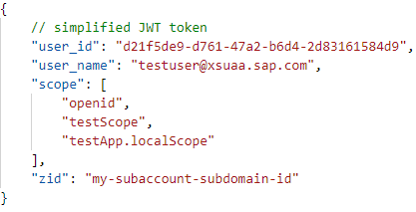
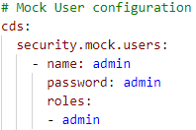
Example: Authentication
Java APIs not yet public and finalized!
SAP Labs Preview

Slide 24
Thank you.

