Slide 1
CAP Java SDK Query API Data API
Matthias Schur

Slide 2
Disclaimer
The information in this document is not a commitment, promise, or legal obligation to deliver any material, code, or functionality. All forward-looking statements are subject to various risks and uncertainties that could cause actual results to differ materially from expectations. Readers are cautioned not to place undue reliance on these forward-looking statements, and they should not be relied upon in making purchasing decisions.

Slide 3

CDS Query Builder
The CDS Query Builder API allows to fluently construct CDS QL statements.
CDS MODEL
entity Books {
key ID : UUID;
title : localized String; year : Integer;
author : Association to Authors;
}
entity Authors {
key ID : UUID;
name : String;
books : Composition of many Books;
}
This CQL query
SELECT from Books { title, author.name }

Slide 4
CDS Query Builder
The CDS Query Builder API allows to fluently construct CDS QL statements.
CDS MODEL
entity Beers {
key ID : UUID;
style : localized String; year : Integer;
brewery : Association to Breweries;
}
entity Breweries {
key ID : UUID;
name : String;
beers : Composition of many Beers;
}
This CQL query
SELECT from Beers { style, brewery.name }
can be constructed in Java by
Select.from("Beers")
.columns("style", "brewery.name");
or using Java Lambda expressions
Select.from("Beers")
.columns(b -> b.get("style"), b -> b.get("brewery.name"));
Select.from("Beers")
.columns(b -> b.get("style"), b -> b.get("brewery.name").as("brewery"));

Slide 5
CDS Query Builder - Filtering
CQL: SELECT from Beers where ID = "123e4567…"
CDS MODEL
entity Beers {
key ID : UUID;
style : localized String; year : Integer;
brewery : Association to Breweries;
}
entity Breweries {
key ID : UUID;
name : String;
beers : Composition of many Beers;
}
Query by Id
Select.from("Beers").byId("123e4567…");

Slide 6
CDS Query Builder - Filtering
CQL: SELECT from Beers where brewery.name = "Braustüb'l" and style = "Märzen"
CDS MODEL
entity Beers {
key ID : UUID;
style : localized String; year : Integer;
brewery : Association to Breweries;
}
entity Breweries {
key ID : UUID;
name : String;
beers : Composition of many Beers;
}
Query by example
Map<String, Object> example = new HashMap<>(); example.put("brewery.name", "Braustüb'l"); example.put("style", "Märzen");
Select.from("Beers").matching(example);

Slide 7
CDS Query Builder - Filtering
CQL: SELECT from Beers where brewery.name = "Vogelbräu" and style != "Pils"
CDS MODEL
entity Beers {
key ID : UUID;
style : localized String; year : Integer;
brewery : Association to Breweries;
}
entity Breweries {
key ID : UUID;
name : String;
beers : Composition of many Beers;
}
Query where
Select.from("Beers") .where(b -> b.get("brewery.name").eq("Vogelbräu") .and(b.get("style").ne("Pils")));
Query search
Select.from("Pocket").search("Door Keys");

Slide 8
CDS Query Builder - Static Model
For
design time checks
code completion
type safe construction of predicates
more compact code
a static model can be used
generated by cds4j-maven-plugin.
Dynamic usage
Select.from("Beers") .columns(b -> b.get("style"), b -> b.get("brewery.name").as("brewery")) .where(b -> b.get("alcohol").lt(4));
Static usage
Select.from(BEERS) .columns(b -> b.style(), b -> b.brewery().name().as("brewery")) .where(b -> b.alcohol().lt(4));

Slide 9
Query API CAP Java SDK Data API

Slide 10
Data API - Motivation
Requirements
Typed access for business logic
Plain Old Java Objects
class Beer {
private String style;
public String getStyle() { return style; }
public void setStyle(String style) { this.style = style; }
}

Slide 11
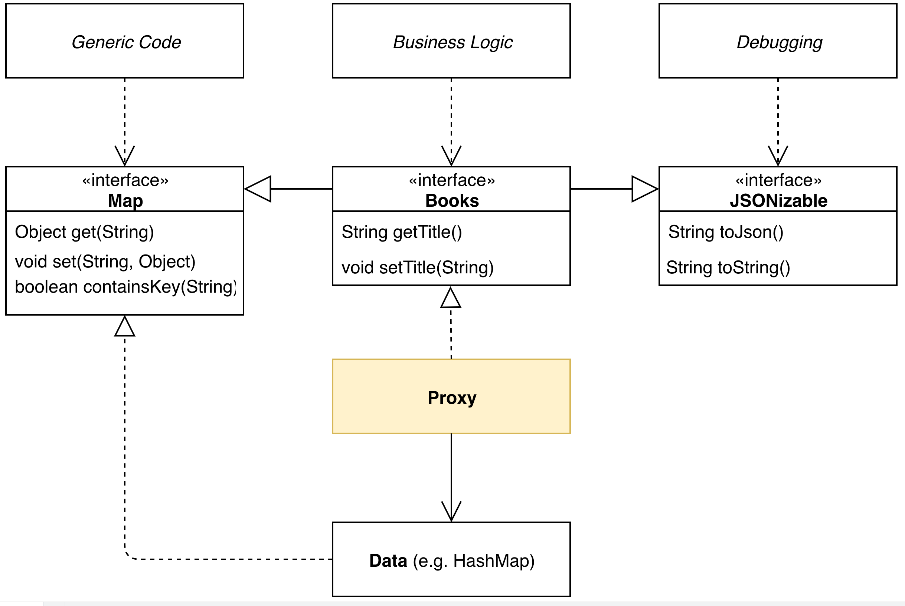
Data API - Motivation
Requirements
Typed access for business logic
Extensibility
Dynamic access for generic code
Interoperability with other APIs
Convertability to other formats
No expensive conversion
=> POJO interfaces that proxy a Map

Slide 12
Typed Data Access - Usage
Assuming this data
Map<String, Object> data = new HashMap<>();
data.put("ID", "123e4567…");
data.put("style", "Hefeweizen");
you can acces the data typed
Beer beer = access(data).as(Beer.class);
String style = beer.getStyle();
beer.setAlcohol(4.8);
and this consumption interface
interface Beer {
@CdsName("ID") String getId();
String getStyle(); void setStyle(String style);
BigDecimal getAlcohol(); void setAlcohol(BigDecimal alcohol);
}
as well as dynamically
style = (String) beer.get("style");
beer.put("alcohol", 4.8);

Slide 13
Typed Data Access - Result Handling
Select.from(BEERS).columns(b -> b.style(), b -> b.brewery().expand());
You also get typed acess to your query result Beer beer = result.single(Beer.class);
Optional<Beer> beer = result.first(Beer.class);
List<Beer> beers = result.listOf(Beers.class);
Stream<Brewery> breweries = result.streamOf(Beer.class) .map(Beer::getBrewery);

