Slide 1
re: cap
May 2020
Daniel Hutzel

Slide 2
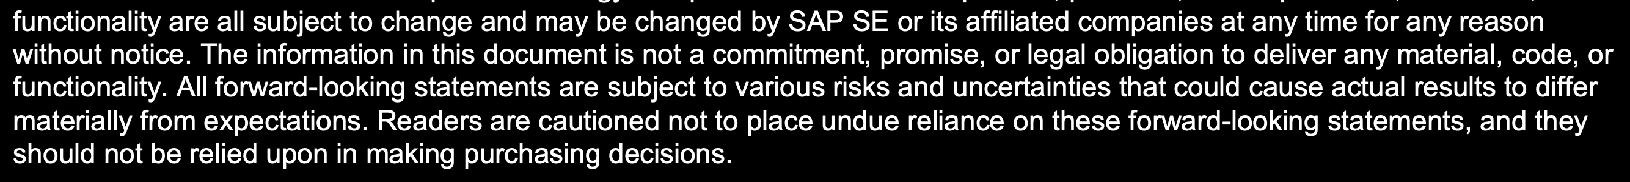
Disclaimer
→ i.e. all you see and here from us today are just fakes and lies.

Slide 3
Agenda
Recent Focus, ongoing: Quality + Modularity
Features Recap + Previews, … hidden Gems?
Focus on Modularity
Roadmap / Outlook 2020

Slide 4
capire
http://cap.cloud.sap

Slide 5
cap/samples
Simplified Monorepo
Vue.js app
Genres
Verticalization
Tests & Pipeline
…
https://github.com/sap-samples/cloud-cap-samples

Slide 6
Streamlined and Evolutionary Development
Jumpstart w/ cds init
Accelerate w/ cds watch
Integrate w/ cds import
Using sqlite –-in-memory
Parallelize –-with-mocks
Deploy only when required w/ cds deploy
Grow as you go w/ cds add
Reuse and extend w/ standard npm dependencies

Slide 7
CDS Language and Compiler
Auto-exposed and auto-redirected Association Targets
Extending with named Aspects → Verticalizaztion, Extensibility, CDS is AOP
Extending Projections → crucial for SaaS-level extensions
Association Filters → avoid JOINs! CDS complements SQL with paths
Documentation Comments → /** your docs go here */
Modularized Compiler → cds --parse, cds --clean
Streamlined Compiler → up to 10 times speed up + less memory
Managed Compositions → focus on domain and going NoSQL even more
Structured OData → focus on APIs, specifically for A2X scenarios

Slide 8
Aspects
using { cuid, managed } from '@sap/cds/common';
entity Foo @bar : cuid, managed { bar:Car; }
// Equivalent to Foo:
entity Boo {}
extend Boo with cuid;
extend Boo with managed;
extend Boo with { bar:Car; }
annotate Boo with @bar;
// Equivalent to above:
entity Moo {}
extend Moo with Boo;
type Car : String;
annotate Car with @car;

Slide 9
focus on modularity
@sap/cds 4.0

Slide 10
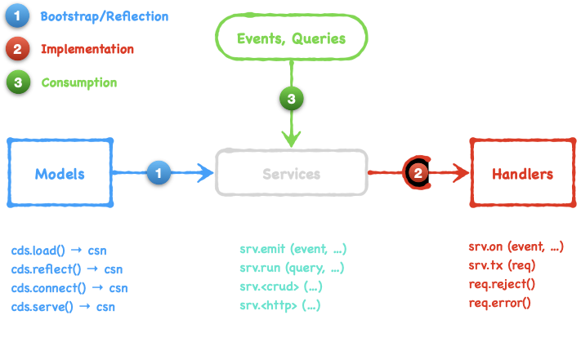
Key Concepts
https://cap.cloud.sap/docs/about/#core-concepts

Slide 11
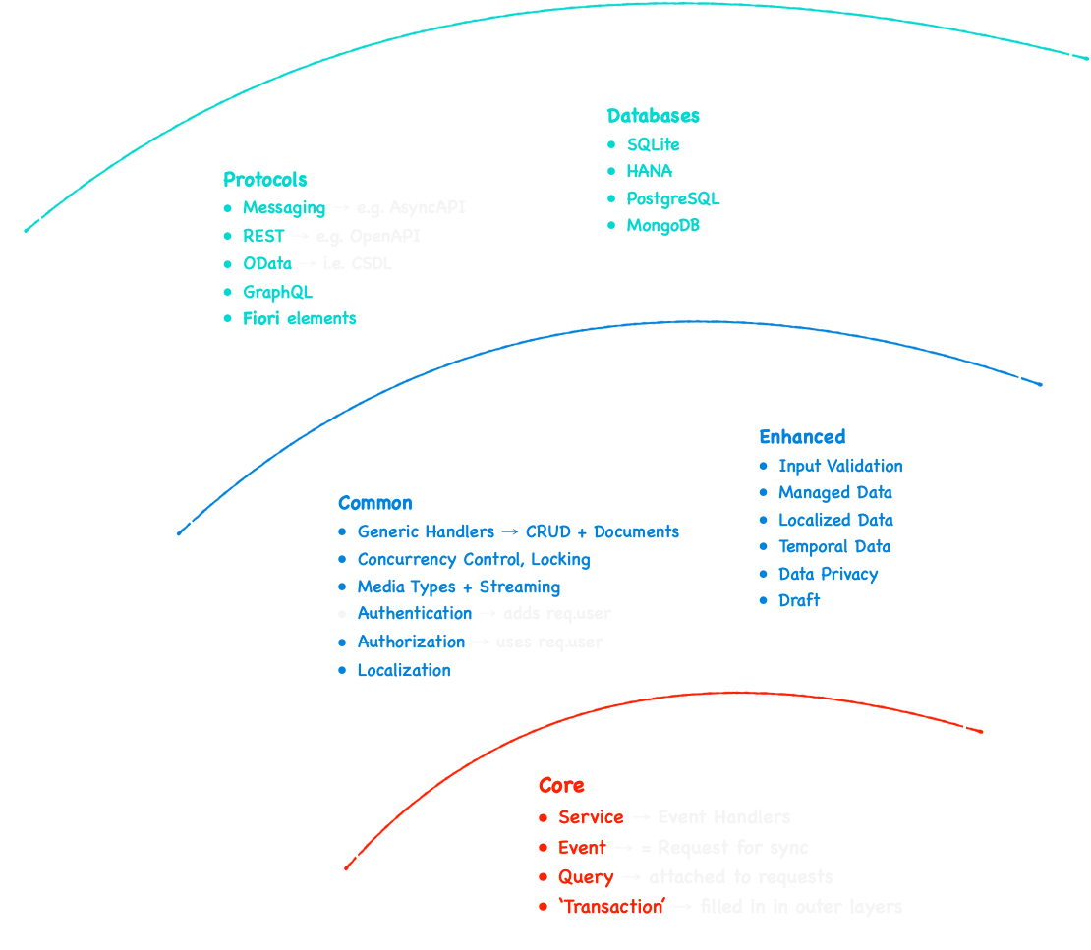
Scalable Design
Periphery
Common
Core

Slide 12
cap/matters
http://link-to-our-internal-roadmap...

Slide 13
thank you

