Slide 1


Service Consumption Messaging and Eventing
David Kunz, SAP
May 15, 2020

Slide 2
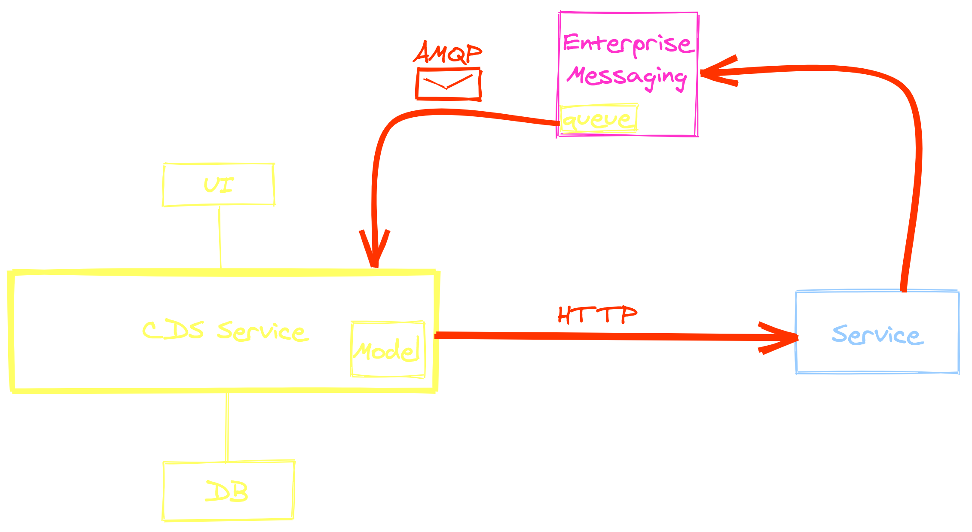

Slide 3
Thank you.
Contact information:
David Kunz
david.kunz@sap.com

