Slide 1


GoTrash
Go Trash
or Go Home

Slide 2
Sommaire
Communication Strategy
Train Strategy
Questions

Slide 3
Communication strategy Management
Communication
Measurement
Engagement
Metrics
Celebration
Acknowledgement
Feedback

Slide 4
Training strategy Management
Denial
Resistance
Exploration
Commitment

Slide 5
COmmunication plan
Why this changes ?
Put forward the advantages of the changes
Involve the users to the changes
Make a super demo plan
Get the feedback from employees

Slide 6
Training strategy management
Meetings
Teaching
Interviews

Slide 7
Train Strategy
Subject Matter Experts or SMEs
Coaches
Training sessions
Reinforcement
Training Plan

Slide 8
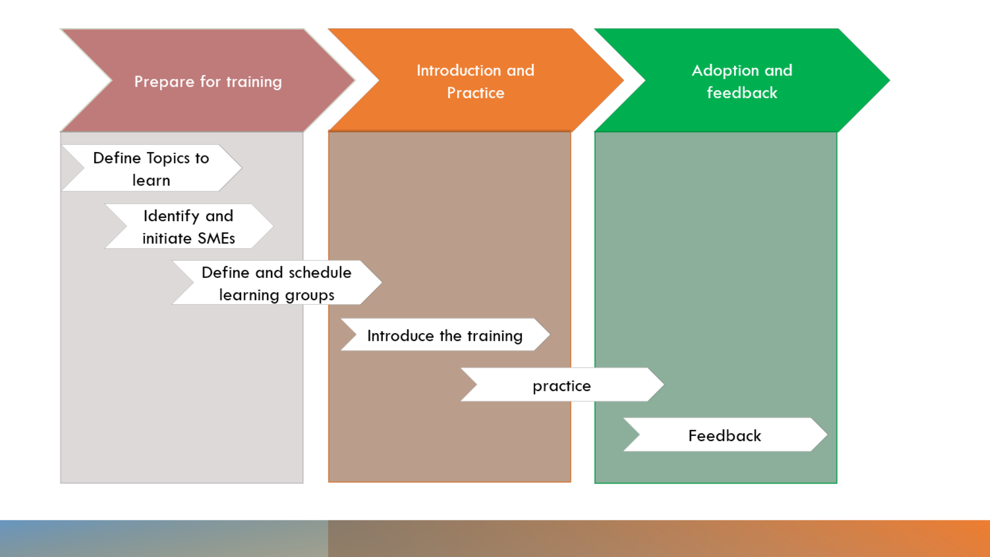
Train Strategy
Training Diagram

Slide 9

Questions

Slide 10

THANKS FOR YOUR ATTENTION

