Slide 1
Feasability study
A preliminary stage for developping innovation projects

Slide 2
Types of Feasibility Study
As the name implies, a feasibility analysis is used to determine the viability of an idea, such as ensuring a project is legally and technically feasible as well as economically justifiable. It tells us whether a project is worth the investment—in some cases, a project may not be doable. There can be many reasons for this, including requiring too many resources, which not only prevents those resources from performing other tasks but also may cost more than an organization would earn back by taking on a project that isn’t profitable.

Slide 3
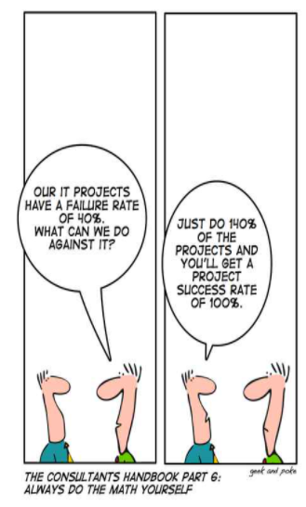

Slide 4
What are we discussing?
Before investing, starting a new business or developing an existing activity, finding the answer of two questions is essential.
Is your business activity justifiable?
What is your practical business plan for turning a business idea into a business activity?
The answer to the first question will be given to you through Feasibility Studies.
(The answer to the second question will be given to you by a business plan.)

Slide 5
There are five types of feasibility study—separate areas that a feasibility study examines, described in this presentation

Slide 6
Technical Feasibility
This assessment focuses on the technical resources available to the organization. It helps organizations determine whether the technical resources meet capacity and whether the technical team is capable of converting the ideas into working systems. Technical feasibility also involves the evaluation of the hardware, software, and other technical requirements of the proposed system.
As an exaggerated example, an organization wouldn’t want to try to put Star Trek’s transporters in their building—currently, this project is not technically feasible.

Slide 7
Technical Feasibility: examples of questions
Is the proposed technology or solution practical?
Do we currently possess the necessary technology?
Do we possess the necessary technical expertise…and is the schedule reasonable for this team?
Is relevant technology mature enough to be easily applied to our problem?
What kinds of technology will we need?
Some organizations like to use state-of-the-art technology
…but most prefer to use mature and proven technology.
A mature technology has a larger customer base for obtaining advice concerning problems and improvements.
Is the required technology available “in house”?
If the technology is available:
…does it have the capacity to handle the solution?
If the technology is not available:
…can it be acquired?

Slide 8
Economic Feasibility
This assessment typically involves a cost/ benefits analysis of the project, helping organizations determine the viability, cost, and benefits associated with a project before financial resources are allocated. It also serves as an independent project assessment and enhances project credibility—helping decision-makers determine the positive economic benefits to the organization that the proposed project will provide.

Slide 9
Economic Feasibility: examples of questions
Can the bottom line be quantified yet?
Very early in the project…
… judgement of whether solving the problem is worthwhile.
Once specific requirements and solutions have been identified…
…the costs and benefits of each alternative can be calculated
Cost-benefit analysis
Purpose - answer questions such as:
Is the project justified (I.e. will benefits outweigh costs)?
What is the minimal cost to attain a certain system?
How soon will the benefits accrue?
Which alternative offers the best return on investment?
Examples of things to consider:
Hardware/software selection
Selection among alternative financing arrangements (rent/lease/purchase)
Difficulties
benefits and costs can both be intangible, hidden and/or hard to estimate
ranking multi-criteria alternatives

Slide 10
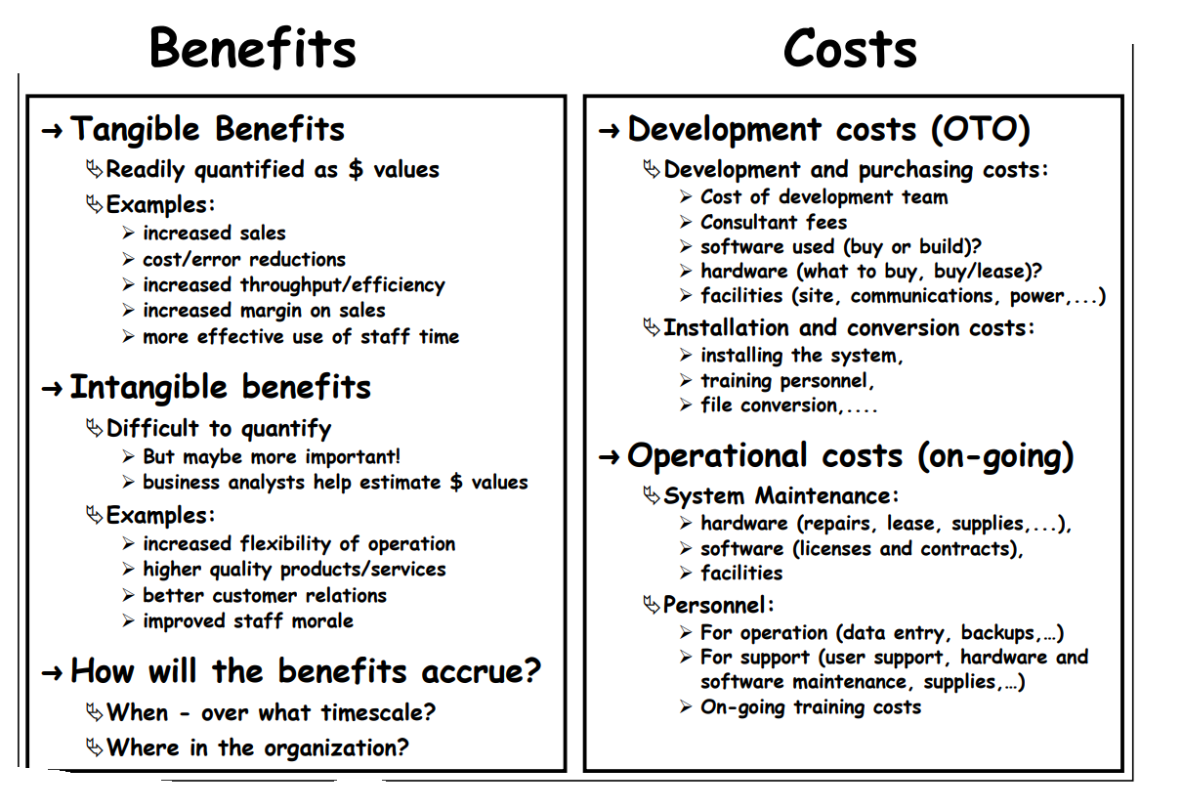

Slide 11
Legal Feasibility
This assessment investigates whether any aspect of the proposed project conflicts with legal requirements like zoning laws, data protection acts or social media laws. Legal feasibility study is to know if the proposed project conform the legal and ethical requirement. It is important that the project or business is following the requirements needed to start a business or a project including business licenses, certificates, copyrights, business insurance, tax number, health and safety measures, and many more.
Let’s say an organization wants to construct a new office building in a specific location. A feasibility study might reveal the organization’s ideal location isn’t zoned for that type of business. That organization has just saved considerable time and effort by learning that their project was not feasible right from the beginning.

Slide 12
Is this plan legal?
Does your organization meet all of the requirements, laws, and regulations to complete this project?
It’s a complete nonstarter if your project doesn’t meet the legal threshold for completion, which includes anything from data protection laws to building requirements.
Otherwise, you’ll make it halfway through your project before you realize that your team isn’t meeting some overlooked regulation that’ll waste more time and resources to rectify later.

Slide 13
Legal and Contractual Feasibility
Legal feasibility determines whether the proposed system conflicts with the legal requirement or not. A project may face legal issues after completion if this factor is not considered at the first stage.
The European Union has taken quite a different tack from American's market-driven approach to online privacy. The EU's 1998 Data Protaction Directive basically allows individuals to decide how their collected data can be used. Thus, if a European consumer provieds personal information such as an address when buying from an online store, the store cannot legally send an ad to the purchaser without first seeking permission. The directive also prohibits the transfer data to countries outside the European Union that do not have "adequate" privacy rules." (McAdams, Neslund N., and Neslund K.)
Today's software can track every keystroke, file download, and Internet page that appear on an employee's computer screen. In a recent survey of 840 U.S. companies by the American Management Association, 60 percent said they now use some type of software to monitor their employees' coming and outgoing e-mail, up from 47 percent in 2001. Therefore, companies may adopt some of these strategies to protect themselves from lawsuits. Employers wishing to implement the monitoring program should advise their employees of that fact and have all employees sign an acknowledgment so there is no question about whether an employee has any expectation of privacy on computer systems. (McAdams, Neslund N., and Neslund K.)

Slide 14
Operational Feasibility
This assessment involves undertaking a study to analyze and determine whether—and how well—the organization’s needs can be met by completing the project. Operational feasibility studies also examine how a project plan satisfies the requirements identified in the requirements analysis phase of system development.

Slide 15
Operational Feasibility: examples of questions
How do end-users and managers feel about…
…the problem you identified?
…the alternative solutions you are exploring?
You must evaluate:
Not just whether a system can work…
… but also whether a system will work.
Any solution might meet with resistance:
Does management support the project?
How do the end users feel about their role in the new system?
Which users or managers may resist (or not use) the system?
People tend to resist change.
Can this problem be overcome? If so, how?
How will the working environment of the end users change?
Can or will end users and management adapt to the change?

Slide 16
Scheduling Feasibility
This assessment is the most important for project success; after all, a project will fail if not completed on time. In scheduling feasibility, an organization estimates how much time the project will take to complete.
When these areas have all been examined, the feasibility analysis helps identify any constraints the proposed project may face, including:
Internal Project Constraints: Technical, Technology, Budget, Resource, etc.
Internal Corporate Constraints: Financial, Marketing, Export, etc.
External Constraints: Logistics, Environment, Laws, and Regulations, etc.

Slide 17
Schedule Feasibility: example of questions
How long will it take to get the technical expertise?
We may have the technology, but that doesn't mean we have the skills required to properly apply that technology.
May need to hire new people
Or re-train existing systems staff
Whether hiring or training, it will impact the schedule.
➲ Assess the schedule risk:
Given our technical expertise, are the project deadlines reasonable?
If there are specific deadlines, are they mandatory or desirable?
If the deadlines are not mandatory, the analyst can propose several alternative schedules.
What are the real constraints on project deadlines?
If the project overruns, what are the consequences?
Deliver a properly functioning information system two months late…
…or deliver an error-prone, useless information system on time?
Missed schedules are bad, but inadequate systems are worse!

Slide 18
Importance of Feasibility Study
The importance of a feasibility study is based on organizational desire to “get it right” before committing resources, time, or budget. A feasibility study might uncover new ideas that could completely change a project’s scope. It’s best to make these determinations in advance, rather than to jump in and to learn that the project won’t work. Conducting a feasibility study is always beneficial to the project as it gives you and other stakeholders a clear picture of the proposed project.
Below are some key benefits of conducting a feasibility study:
Improves project teams’ focus
Identifies new opportunities
Provides valuable information for a “go/no-go” decision
Narrows the business alternatives
Identifies a valid reason to undertake the project
Enhances the success rate by evaluating multiple parameters
Aids decision-making on the project
Identifies reasons not to proceed

Slide 19
More to it…
Apart from the approaches to feasibility study listed above, some projects also require other constraints to be analyzed -
Internal Project Constraints: Technical, Technology, Budget, Resource, etc.
Internal Corporate Constraints: Financial, Marketing, Export, etc.
External Constraints: Logistics, Environment, Laws, and Regulations, etc

Slide 20
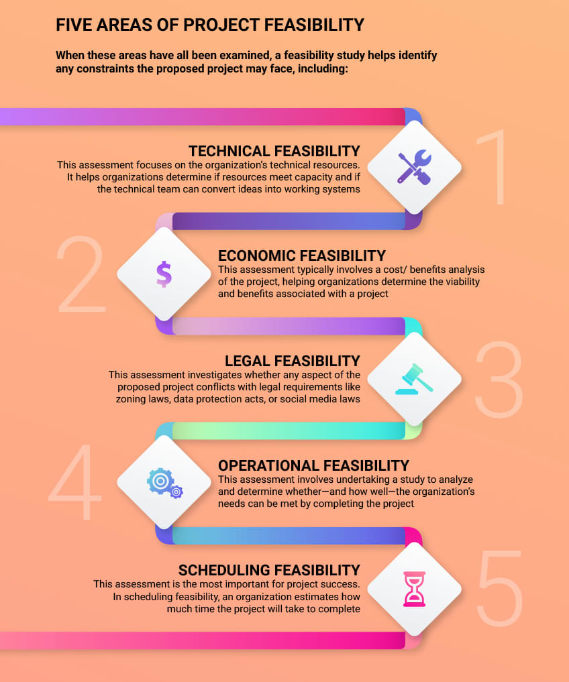

Slide 21
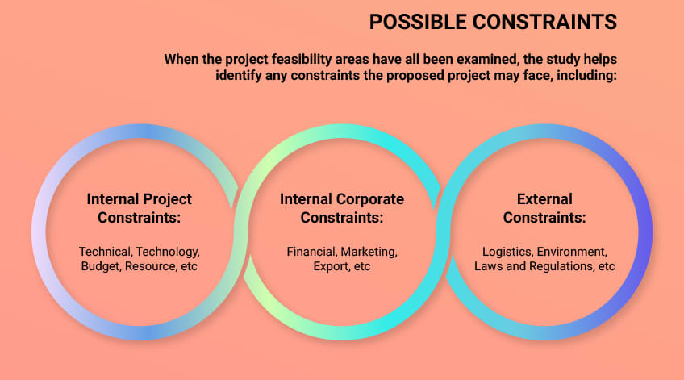
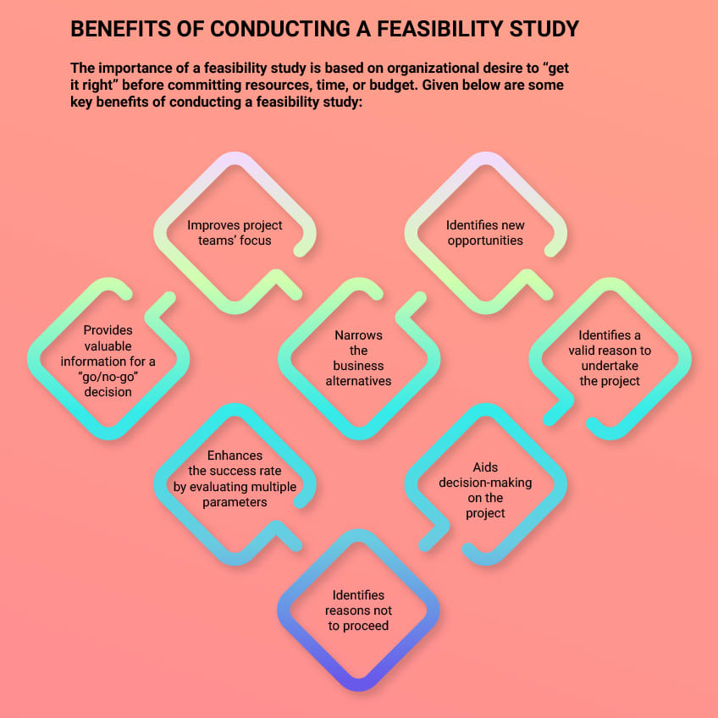

Slide 22
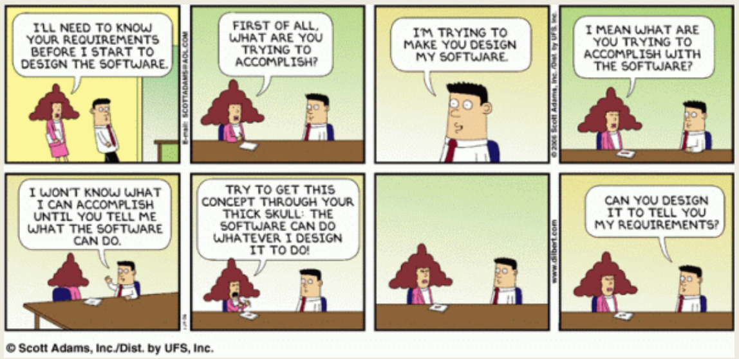
Why are Feasibility Studies Difficult?
Uncertainty
• Clients may be unsure of the scope of the project.
• Benefits are usually very hard to quantify.
• Approach is usually ill-defined.
• Estimates of resources and timetable are very rough.
• Organizational changes may be needed.
Therefore, feasibility studies rely heavily on the judgment of experienced people.
Mistakes made at the beginning of a project are the most difficult to correct.

Slide 23
HOW TO?
Simply put, a feasibility study is an assessment of the practicality of a proposed plan or method. Just as the name implies, the study answers the question, “Is this project feasible?”
To determine this, start by answering the who, what, when, when, and how of your project. Conduct an analysis to determine who needs to be involved in the project, what needs to be done, when it needs to be completed, and how everything will come together to make the project successful. This process of evaluation is at the core of a feasibility study, a common process to complete when results are uncertain and stakes are high.
You may be interested in this short sum-up video:

Slide 24
Example of Feasibility study for software development:
Company A is looking to invest in a new software-as-a-service (SaaS) solution. First, the stakeholders in the investment will analyze what technology or workflow problem the investment will address. The team will also take contractual or subscription costs into account, plus what resources will be required for training and implementation. The study may also need to gauge what kind of change management will be required to gain buy-in. Those conducting the study evaluate all the project data, as well as pros and cons. Finally, they can make an informed decision on whether the investment is a go.
Other generic examples here

Slide 25
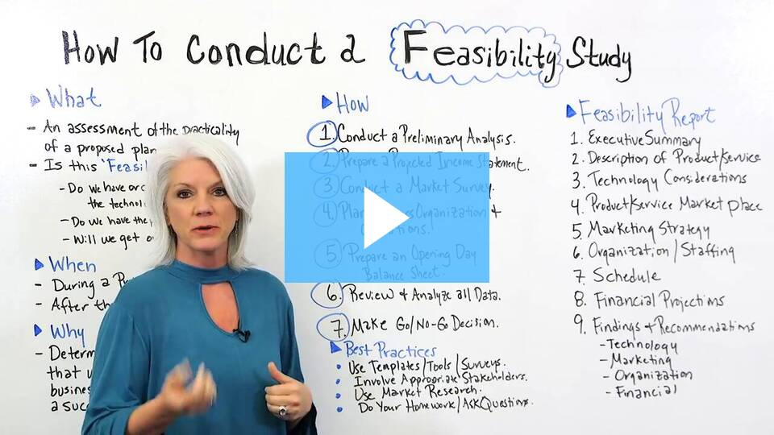
How to conduct a Feasibility study
You may be interested in this short sum-up video:

Slide 26
A tool: the « P.I.E.C.E.S. » framework
Performance: Does the current system or operation offer adequate flow and response time? It also relates to the maximum amount of processing that the system can perform.
Information: Does the current operation provide stakeholders with correct, useful, and timely information? Is the information organized and easily found?
Economy: does the current operation offer information services such as cost/efficiency suitable for the organization? Can there be cost savings? How to increase profit?
Control: involves security. How to manage information security to prevent fraud or potential breaches of privacy, but without bureaucratizing or creating controls that delay operation.
Efficiency: analyze activities that waste time, mainly caused by redundancy. How are resources being used?
Services: how accurate is the system? Do you offer reliable services?

Slide 27
Let’s have an exercise to train of this notion
You would like to create an app to help charities supporting homeless people do their job more easily.
You spent some time with them, and went around discussing with the stakeholders: it appears to you that the main pain point is time waste. Indeed, volunteers spend a lot of time looking for the homeless who are in need of assistance (need a doctor, need clothes, need food…).

Slide 28
Your idea
For you, the answer -within you field of expertise - is to create an app, to which the homeless can connect to, by using their phones (you know for sure that homeless people do have smartphones, and that they use public locations’ wi-fi connections).
The charities will have a dedicated space in which they will store the info, so that they know specifically if a homeless person has a health condition that needs peculiar attention, for example, or if a couple has kids and needs regular cloth changes.
You’d also like to have municipalities and public services to access this app, so that they can make shelters easily available.

Slide 29
Conduct a very light feasibility study
Meditate the project, and write down 5 questions for each category, that you should investigate before launching the project.
Insist on the legal study some more: is that feasible?

Slide 30
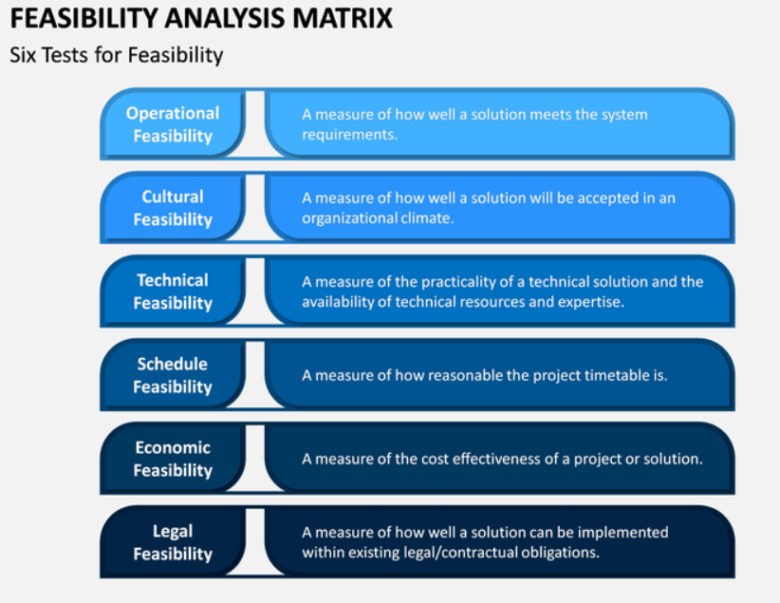
A matrix you can use as a guide
Use the categories as a guideline to think out your questions and find relevant questions to ask yourself (the question is more important than the actual answer, in this exercise)

Slide 31
To go further: For your own projects in the IT field
When discussing the feasibility study, we are at the inception phase which has high risk because of the unknowns. Almost all SDLCs (including Agile) suggest a methodological approach should be taken to determining project feasibility and eliciting requirements.
Project feasibility is about addressing major risk leading catastrophic failure of effort. Project feasibility considers internal and external factors to analysis and identify overall project risk, suggest methods to mitigate unknowns, make a "go" / "no go" recommendation of the project. Project feasibility is based on:
technical feasibility -- can we actually create the software system?
economic feasibility -- can we afford the software system -- development, infrastructure, and ongoing costs?
operational feasibility -- can the system operate within the organizational constraints and processes?
team and project feasibility -- do we have skills, tools, and resources (including people) to create / maintain the system?
legal / regulatory feasibility -- will the developing or operating the system create liabilities?
and others ....

Slide 32
Tools: How can you investigate such questions for your projectS?
After feasibility, we need to begin to identify the details of the system -- what are we expected to develop? Software developers during this analysis phase need to interact with stakeholders to elicit and validate project requirements. From a tactical sense, we can use a variety of different elicitation methods such:
Review of existing systems including documents, papers, forms, reports, process flow
Formal ("focus groups") and informal interviews
Surveys and questionnaires
Mock-ups and prototypes
Formal ("usability studies") and informal observation
Joint application development (JAD) and JAD sessions
Group synergy such as brainstorming sessions, fish-bone analysis, etc.
Ethnography
Viewpoint Analysis
The benefits and costs associated will each different method should be considered along with expected value of method in providing real requirements for this type of project.

Slide 33
All in all…
A feasibility study is a study made before committing to a project and leads to a decision:
go ahead
do not go ahead
think again
In production projects, the feasibility study often leads to a budget request.
A feasibility study may be in the form of a proposal.

Slide 34
If you’re interested in this topic…
https://horticulture.ucdavis.edu/information/d-lab-toolkit-teaching-feasibility-studies
https://www.geeksforgeeks.org/types-of-feasibility-study-in-software-project-development/
http://depts.washington.edu/cssinfo/gcsdd-self-assessment/506/css506-class-project-02-feasibility.htm
https://www.cs.toronto.edu/~sme/CSC340F/2005/slides/07-feasibility.pdf
https://www.geeksforgeeks.org/types-of-feasibility-study-in-software-project-development/#:~:text=Legal%20Feasibility%20%E2%80%93&text=This%20includes%20analyzing%20barriers%20of,conform%20legal%20and%20ethical%20requirements.
https://relevant.software/blog/software-feasibility-study/
https://www.umsl.edu/~sauterv/analysis/F08papers/Katimuneetorn_Feasibility_Study.html
http://www.cs.cornell.edu/courses/cs5150/2018sp/slides/4-feasibility.pdf
https://www.fool.com/the-blueprint/feasibility-study/

