Slide 1
STORYMAP
STEP BY STEP GUIDE

Slide 2
THE STORY MAP, AN EFFECTIVE TOOL FOR VIEWING AND ORGANIZING THE REALIZATION OF A NEW PRODUCT.

Slide 3
STORY MAP
The objective of this Jarviss is to introduce you to the STORY MAP tool and to guide you step by step towards its realization.

Slide 4
What is it?
A STORY MAP
is a tool allowing you to visually map all the new functionalities of a product and collectively plan their realization.

Slide 5
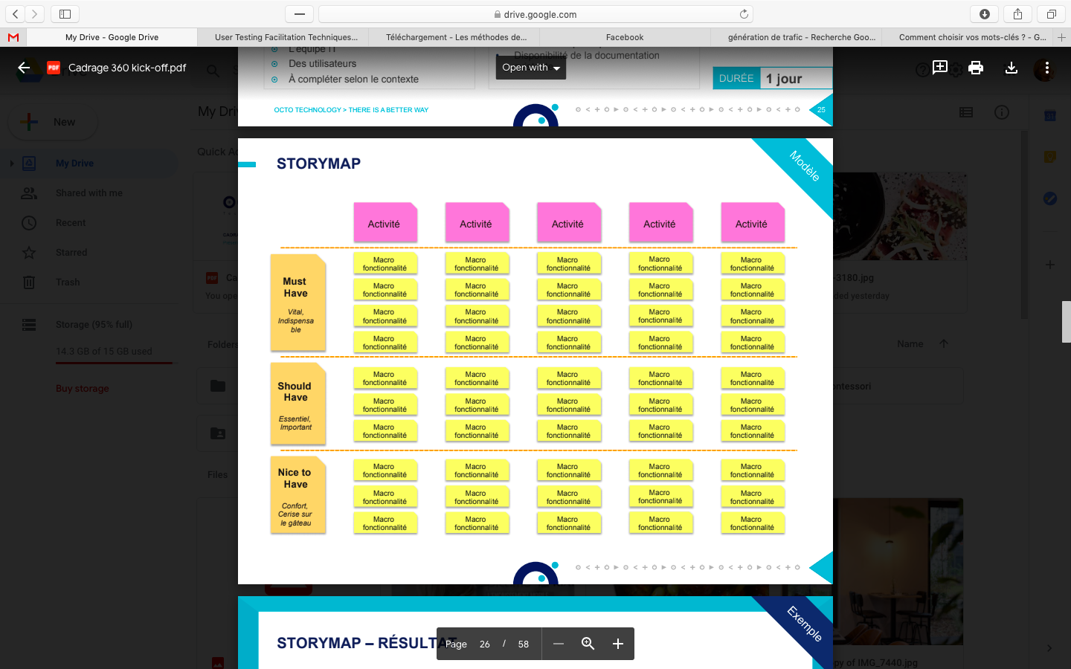
What does it look like?

Slide 6
What is it used for?
STORY MAP
Used by agile teams at the start of a project, User Story Mapping is a tool that allows you to visually organize and prioritize the long list of tasks to be performed, called User Stories, to create a new product.
It is a great user-centric task prioritization tool that allows the team to ask themselves 3 important questions when choosing features:
Why is this feature important for business?
What value will it bring to our user?
Is it technically feasible?
It is a particularly effective tool in the workshop for making people understand where the pain and satisfaction points are in a user journey.

Slide 7
Objective
The goal is to have an overview of the subject to be framed, categorized and prioritized by the whole team.

Slide 8
01> EVERYTHING STARTS WITH THE SHARING OF THE USER JOURNEY

Slide 9
User path
First, as a team, build the customer journey of your targets in contact with your future product and sequence the main stages of the journey in activity.
More details in the Jarviss CUSTOMER JOURNEY

Slide 10
02> Write the activities

Slide 11
Writing the activities
Collectively, the objective is to describe the main steps the user will take through the solution. We will call them activities.
Write the activities making up the user journey on post-it notes (1 post-it per activity). Always start with a verb in the infinitive.
Arrange them in chronological order on a first line
Example for a sports club site:
Find a match date
Buy my tickets
Collect my tickets

Slide 12
Writing the activities
Examples of ACTIVITIES for a ready-to-wear website:
- View a product category
See the detail of a product
- Know the delivery information
- Find out about current offers
- Pay
- Track a package

Slide 13
03> Write the tasks

Slide 14
Write the macro functionalities or "tasks"
Example for the activity “see a product in detail” (product sheet):
- Read the material and composition description of the product
- See product zoom
- Read reviews
- See complementary products
- See additional photos
- Watch a product video
- Add to Cart
- Share to a friend….

Slide 15
04> REVIEW OF THE STORYMAP PATH

Slide 16
Path of the storymap
Once the team achieves a satisfactory result, they should take a step back and review all the tasks in order to see if it makes sense based on the user journey.
Reread all the tasks in order
Reorder tasks if necessary
Add the elements that we could have forgotten
Think about alternative routes and add tasks or activities accordingly
eg in the case of our ready-to-wear site: "I return a product from my customer area"

Slide 17
05> PRIORITIZE TASKS

Slide 18
PRIORITIZE
To the left of the post-it notes, draw 2 horizontal lines. In the first third, they are the MUST HAVE post-it notes, in the 2nd third they are the SHOULD HAVE post-it notes, in the 3rd third they are the NICE TO HAVE.
Prioritize tasks, column by column (this means moving the post-it vertically).
In the end, we have our storymap which is categorized and prioritized.

Slide 19
Prioritize
Example with the tasks identified above from our ready-to-wear site:
MUST HAVE
Read the material and composition description of the product
Add to Cart
SHOULD HAVE
See product zoom
Read reviews
See complementary products
See additional photos
NICE TO HAVE
Watch a product video
Share to a friend
Warning: there is not just one right answer. It's just a choice of the team at a specific moment.

Slide 20
06> NEXT

Slide 21
Next step
And don't forget your storymap is an AGILE tool! It evolves every day (modification, deletion, addition of tasks). Between theory and practice, there is a gap.
The next step is prototyping. The designers will then be able to create the first models by relying only on the MUST HAVE post-it notes. This will allow us to project more simply into the future solution (and precisely analyze this gap between what we imagine and what we actually do).

Slide 22
THE STORY MAP, AN EFFECTIVE TOOL FOR VIEWING AND ORGANIZING THE REALIZATION OF A NEW PRODUCT.

