Slide 1

Computer Networking: The Past, Present and Future
Chidera Anichebe
Computer Society Chair, FUTO SB
dera@ieee.org

Slide 2
The Computer Society
IEEE Computer Society is a global network of technology professionals which provides computing and IT professionals with trusted, high quality, state-of-the art information on an on-demand basis.
Computer Society members network in 168 Countries with 221 chapters.

Slide 3
Who we are?
Computer Society Members Work In:
Industries, Academia, Governments and can also be self employed
Computer Society Members are responsible for:
Software Development/ Design Engineering
Cloud Computing
Systems Engineering
Security & Privacy
Embedded Systems Development
Data Analytics
IS/IT/ICT
Mobile Application Development
High Performance Computing
Big Data
Internet of Things
UI Design/Development
Website/Applications/ Development
AI
Quality Assurance
Multi-Core Programming
Computer Graphics and Applications
Green Computing
Games and Simulation
Smart Grid

Slide 4
What we offer?
Provide Information Learning Career Growth
Trusted content from 33 magazines and transactions
More than 9,000 conference publications
Standards Development
Online learning with more than 45 Professional Development Hours available
Learn, collaborate and network at 225 international conferences, 350+ worldwide chapters and 40 technical communities
Beginner and Advanced Software Developer Certifications
Deep discounts on all conferences and events
Leadership opportunities, including the opportunity to lead, publish and speak.

Slide 5
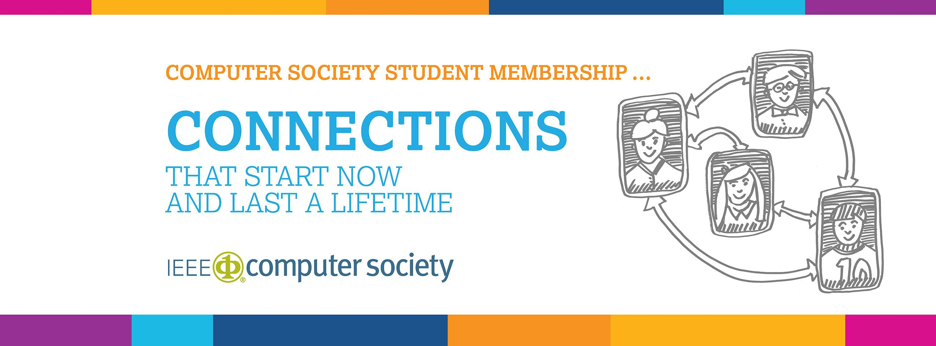
IEEE Computer Society Student Membership

Slide 6

Student Membership
IEEE + Computer Society
50% off membership. Use promo code “FUTURE50”
IEEE member = $60.00
IEEE Student Member = $8.00
Non-IEEE member = $157.00
Full member benefits
Includes Full Access to Computer Society Digital Library

Slide 7
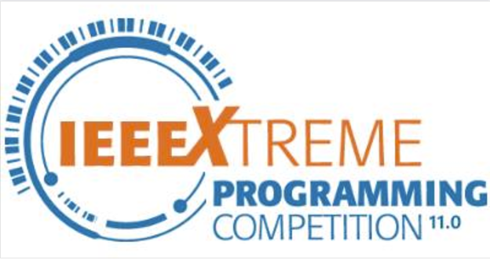
IEEE Products and Services
GoogleApps@IEEE
A unique IEEE email address (e.g., John.A.Doe@ieee.org)
Mail forwarding or email inbox (Gmail)
30 gigabytes of shared storage (Gmail and Google Drive)
99.9 percent up time guaranteed by Google
Advertisement-free Gmail
Storage of files in the cloud for easy sharing and access from anywhere via Google Drive
Use Google Hangouts for messaging, voice and video calls
Sign up for GoogleApps@IEEE service
24-hour global programming contest
IEEE student members teams up proctored by an IEEE member to solve programming challenges

Slide 8
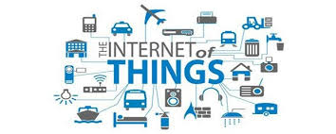
What is Computer Networking?
Computer networking refers to connected computing devices (such as laptops, desktops, servers, smartphones, and tablets) and an ever-expanding array of IoT devices (such as cameras, door locks, doorbells, refrigerators, audio/visual systems, thermostats, and various sensors) that communicate with one another in other to share information and resources

Slide 9
Features of a Computer Network
What characteristics should a computer network have?
Communication speed
File sharing
Easy back up and roll back
Software and Hardware sharing
Security
Scalability
Reliability

Slide 10
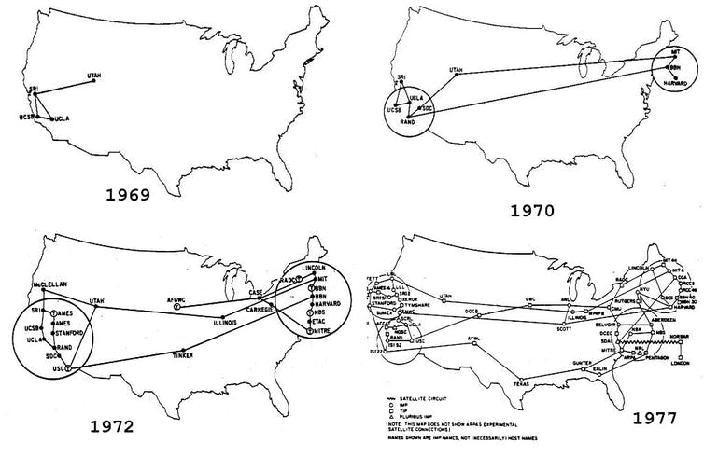
Computer Networking: The past
The birth of the first computer network
The history of modern computer networking dates back to 1969, when ARPANET (Advanced Research Projects Agency Network) became the first connected computer network. It implemented the TCP/IP protocol suite, which later became the Internet. ARPANET was developed by the Advanced Research Projects Agency (ARPA), a subset of the United States Department of Defense
Its initial purpose was to link computers at Pentagon-funded research institutions over telephone lines
At the height of the Cold War, it was used to keep lines of communication open if the USA and USSR decided to exchange nuclear devices
Initial nodes of the ARPANET
University of California, Los Angeles (UCLA)
Stanford Research Institute (SRI)
University of California-Santa Barbara (UCSB)
University of Utah

Slide 11
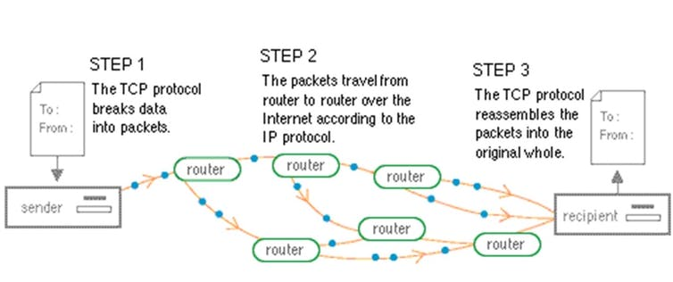
What is Packet Switching?
Hot-potato routing: a packet of data
The ARPANET arose from a desire to share information over great distances without the need for dedicated phone connections between each computer on a network. As it turned out, fulfilling this desire would require “packet switching.”
Packet Switching transmits data across digital networks by breaking it down into blocks or packets for more efficient transfer using various network devices. Each time one device sends a file to another, it breaks the file down into packets so that it can determine the most efficient route for sending the data across the network at that time. The network devices can then route the packets to the destination where the receiving device reassembles them for use.

Slide 12
The history of the ARPANET
…paving the way for a digital world
October 29, 1969 ARPANET, the forerunner of the modern internet, goes live.
1972 The first email program, written by Ray Tomlinson, becomes a killer app on the fledgling ARPANET, which by the end of the years had expanded to connect 24 sites.
1973 Satellite links to Hawaii, the University College of London in England, and the Royal Radar Establishment in Norway established. ARPANET goes international across 37 sites.
1974 Vint Cerf and Bob Kahn publish a paper, A Protocol for Packet Network Intercommunication (PDF), that outlines the design for a Transmission Control Program (TCP).
1980 ARPANET suffers its first outage on grinds October 27. The problem is traced to an accidentally propagated status-message virus.
1983 Switch over from the host-to-host Network Control Protocol (NCP) to TCP/IP, as the underpinning network technology. The ARPANET is split with the creation of a military-only (MILNET) and civilian sections.
1986 NSFNET established with a backbone speed of 56 Kbps.
1990 ARPANET is retired with most university systems moved onto NSFNET.
*Timeline adapted from Hobbes’ Internet Timeline

Slide 13
The rise of the Internet
ARPANET, the precursor to the modern internet
January 1, 1983 is considered the official birthday of the Internet. Prior to this, the various computer networks did not have a standard way to communicate with each other. A new communications protocol was established called Transmission Control Protocol/Internet Protocol (TCP/IP).
This allowed different kinds of computers on different networks to "talk" to each other. ARPANET and the Defense Data Network officially changed to the TCP/IP standard on January 1, 1983, hence the birth of the Internet. All networks could now be connected by a universal language.

Slide 14
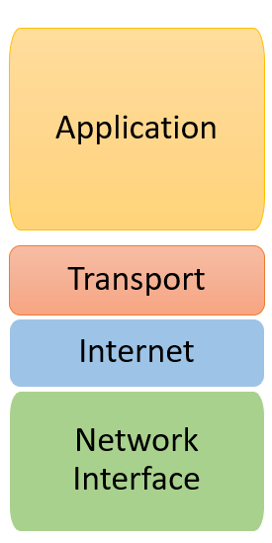
The TCP/IP stack
TCP/IP short for “Transmission Control Protocol/Internet Protocol” is a model designed and developed by the United States Department of Defense in the 1960s
The TCP/IP stack is a concise form of the OSI model. It contains four layers, unlike the seven layers of the OSI model. These layers are:
Application layer
Transport layer
Internet layer
Network Interface layer
Some common TCP/IP protocols include: TCP, IP, HTTP, SMTP, DNS, Telnet

Slide 15
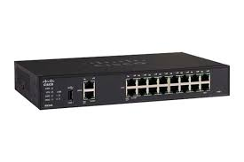
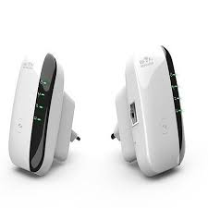
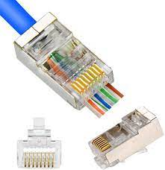
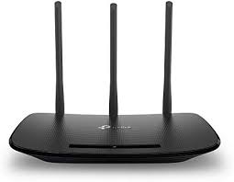
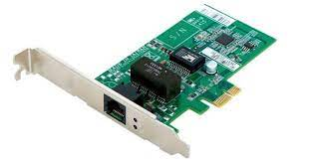
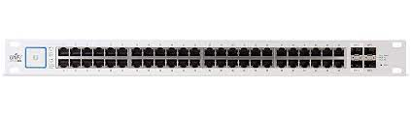
Modern Networking Devices
the key links for modern computing
Hardware devices that are used to connect computers, printers, fax machines and other electronic devices to a network are called network devices.
These devices transfer data in a fast, secure and accurate manner over same or different networks. Network devices may be inter-network or intra-network. Some devices are installed on the device, like NIC card or RJ45 connector, whereas some are part of the network, like router, switch, etc.

Slide 16
IEEE 802.11 WiFi
Wireless networking

Slide 19


Slide 20
Thank you!
dera@ieee.org

