Slide 1
Assignment 00: Martian Squirrel City Simulator
Jackson Gregory
gregoryj17@asmsa.org

Slide 2
Approach
Scans a simplified version of the terrain map (100x100)
If a section is “good enough,” randomly selects whether to use it
If no section is chosen by the end, chooses the best section it found
Builds the city then fills dirt around it
Checks to confirm that the city is safe

Slide 3
Prelim Results (Run 1)
Time elapsed: 55.186701106 seconds
Total cost: 6,331,415 acorns
City X: 1200
City Y: 1500
(Position based on top-left corner)

Slide 4
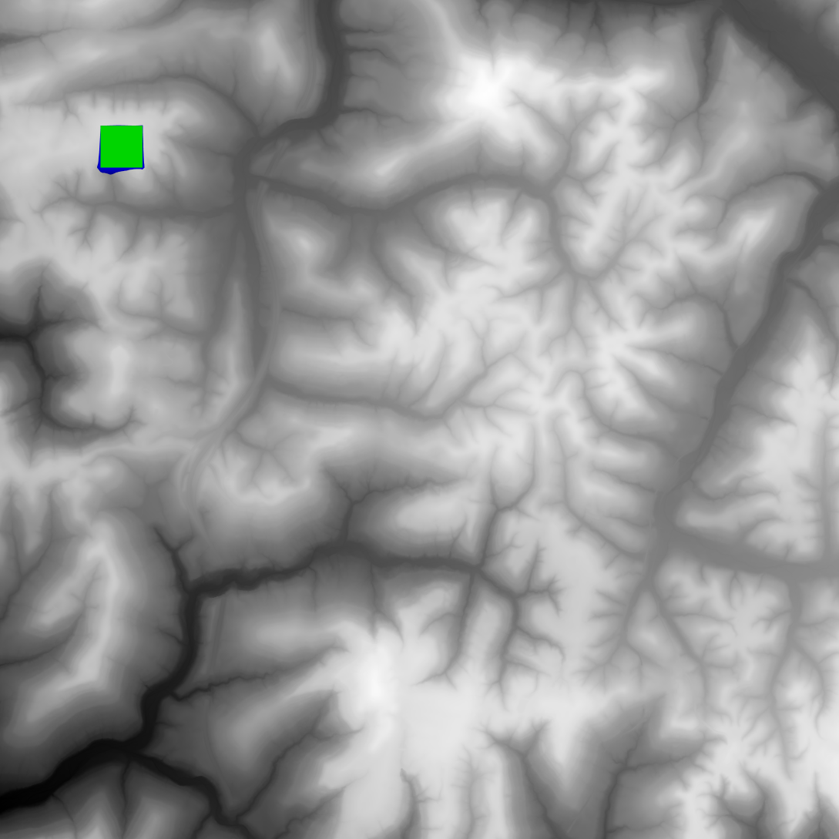
Prelim Results (Run 1)

Slide 5
Prelim Results (Run 2)
Time elapsed: 50.147363199 seconds
Total cost: 4,620,896 acorns
City x: 1200
City y: 3200

Slide 6
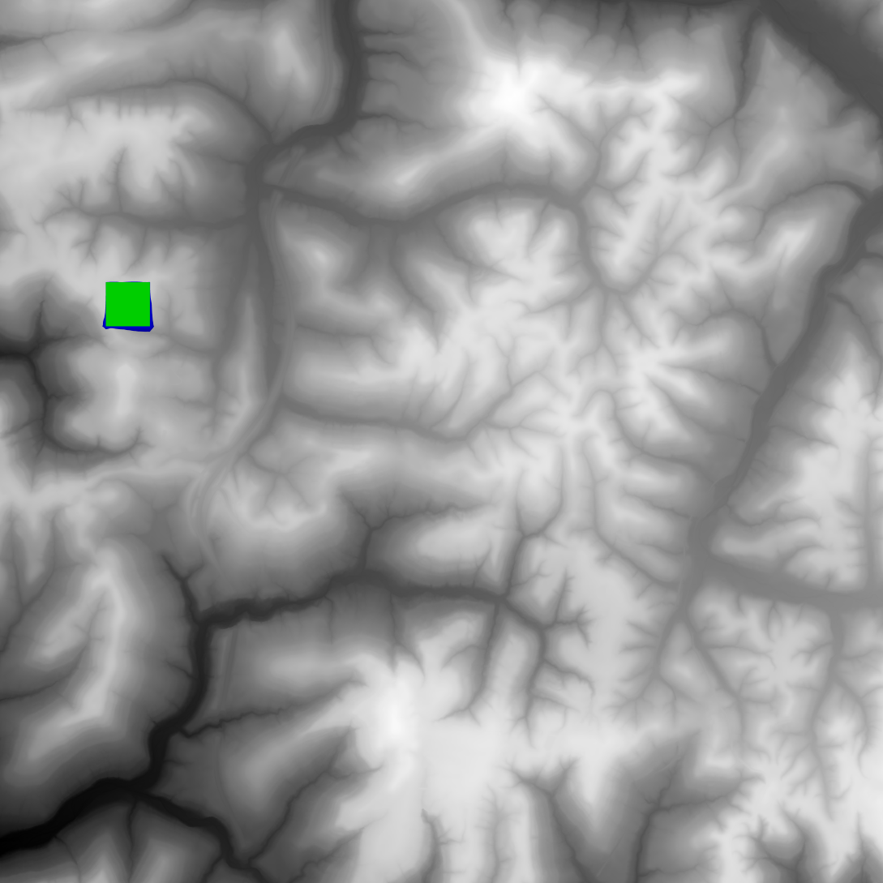
Prelim Results (Run 2)

Slide 7
Future Ideas
Actually use the cost map
Check the map more thoroughly (e.g. check every tenth pixel instead of every hundredth)
Occasionally build downward instead of always building upward

