Slide 1
Predicting Bill Passage in the U.S. Senate
Gregory Adams

Slide 2
5 Steps
Data Collection
Text Classification
Network Analysis + Classification
Integration of predictions
Evaluation
Data Collection
Text Classification Pipeline:
Feature Generation, Temporal Cross-Validation
Integration:
Voting
Evaluation
Network Analysis:
On-Line, Measures of Centrality, Classification pipeline

Slide 3
Data Collection
Scraping Congress.gov for bills from 109th Senate
Issues: Rate-limiting, Time, Few missing bills
Types of Data:
Text of Bills
Sponsorships and Cosponsorships
4122 Bills
337 Passed
Varying lengths
Varying numbers of sponsors and cosponsors
101 Senators (Jon Corzine resigned; Bob Menendez replaced him)

Slide 4
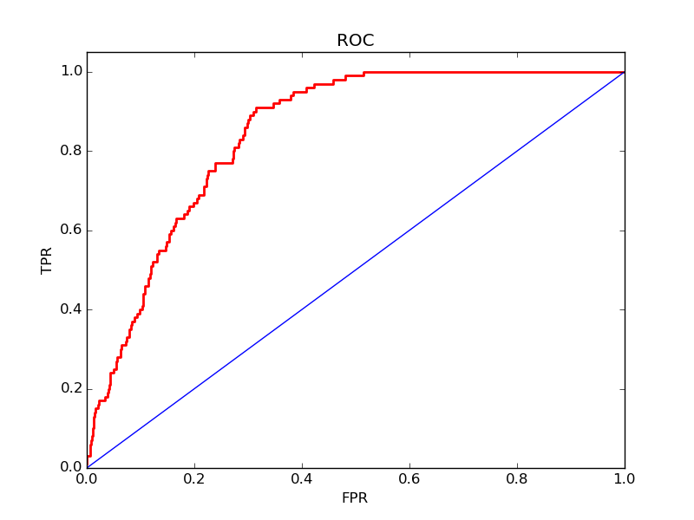
Text Classification
Grid Search Pipeline to Choose Classifier
Possible with information leakage during model selection
Temporal cross-validation for selected classifier (Naive Bayes)
Different feature types tested in pipeline, including counts, TFIDF, normalization, ngram range, etc.
AUROC = 0.828

Slide 5
Most influential words
Passed:
'title', 'defense','striking', 'plan', 'amended', 'date', 'department', 'national', 'program', 'public', 'fiscal', 'code', 'federal', 'military', 'amount'
Failed:
'grant', 'bills', 'part', 'necessary', 'energy', 'qualified', 'read', 'indian', 'individuals', 'established', 'director', 'application', 'administrator'

Slide 6
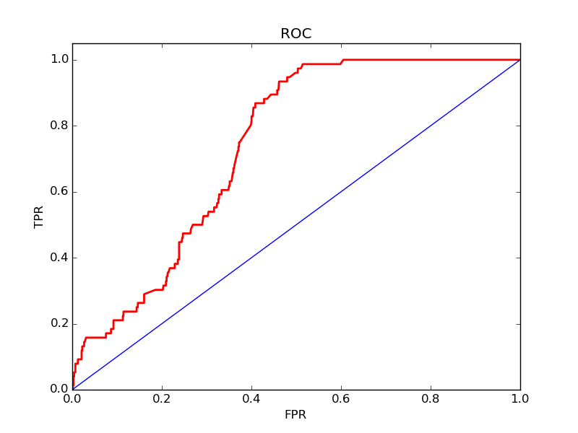
Network Analysis
On-line centrality measurements
Directed and undirected
Fed Centrality measurements into Classification Pipeline
Temporally Cross-validated selections
AUROC = 0.73
Notes:
False-Pos vs recall

Slide 7
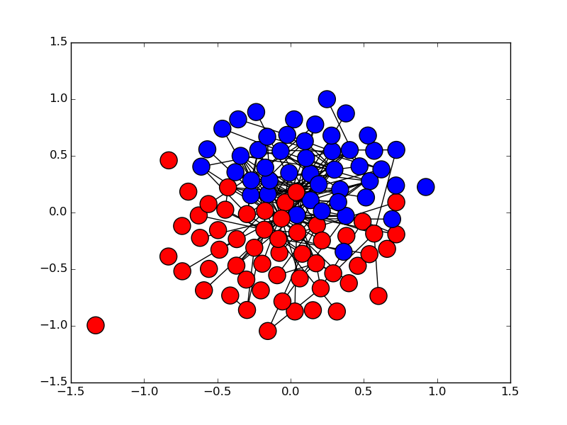
109th Congress
Undirected Network
Each node is a Senator
Each edge represents 4 co-sponsorships (either direction)
Arlen Specter (Switched Parties in 2009)

Slide 8
Most influential Senators
Senator | PageRank Score
Sen. Feinstein, Dianne [D-CA] | 0.0412638413532
Sen. Ensign, John [R-NV] | 0.0323493905534
Sen. Grassley, Chuck [R-IA] | 0.0323492905534
Sen. Santorum, Rick [R-PA] | 0.028477628844
Sen. Snowe, Olympia J. [R-ME] | 0.024648933823
Sen. Smith, Gordon H. [R-OR] | 0.0239087819792
Sen. Craig, Larry E. [R-ID] | 0.0232469293138
Sen. Inouye, Daniel K. [D-HI] | 0.0229804867133
Sen. Bingaman, Jeff [D-NM] | 0.020606808936
Sen. Levin, Carl [D-MI] | 0.0202426748915
Directional Network
PageRank averaged across all bills sponsored at time of sponsorship

Slide 9
Integration and Evaluation
Voting based on top classifiers’ predictions
Also considered averaging prediction probabilities, combining features
Improves F1 score ~0.1 points, to 0.976
Validation
Score is suspiciously high, may need to clean data better
Reselect/retrain on smaller subsets holding out validation data
Searching for information leakage
Extensions
Ranking Senators
Clustering on bill topics, integrating into network analysis
Causal inference (who should sponsor a given bill to increase its chances of passage?)

Slide 10
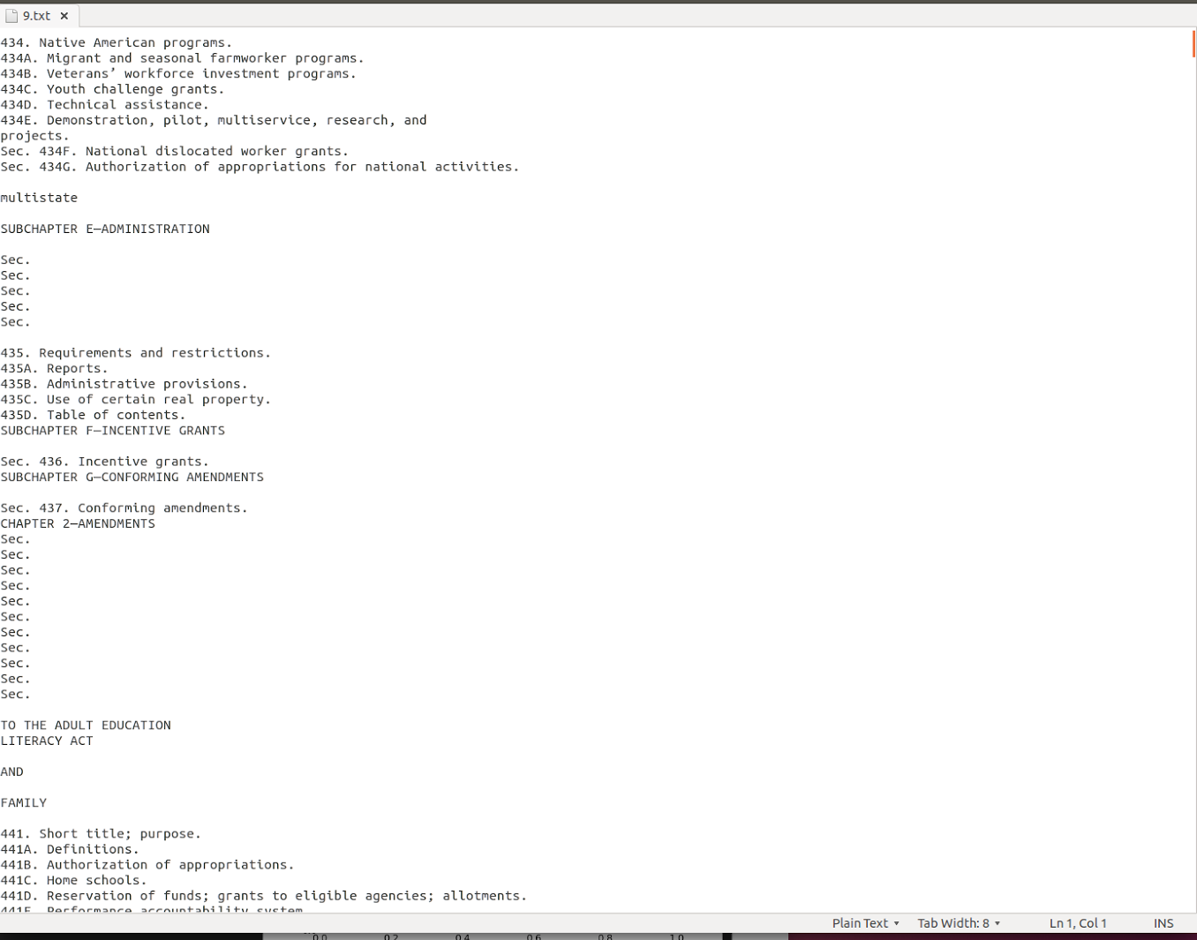
Challenges
On-line classification and eliminating information leakage
Data gathering, cleaning (see right)
Runtime
Tried to build second type of network with Bills as nodes and edges as senators
Failed because of size of network
Scale

