Slide 1
Congressional Outcomes
Greg Adams

Slide 2
Goals of the Project
Estimate Senatorial Influence: Which Senators add the most value?
Natural Language Processing
Corpus of 4200 bills
Predicting passage
Network Analysis
Ranking network centrality
Unsupervised learning (e.g. clustering)

Slide 3
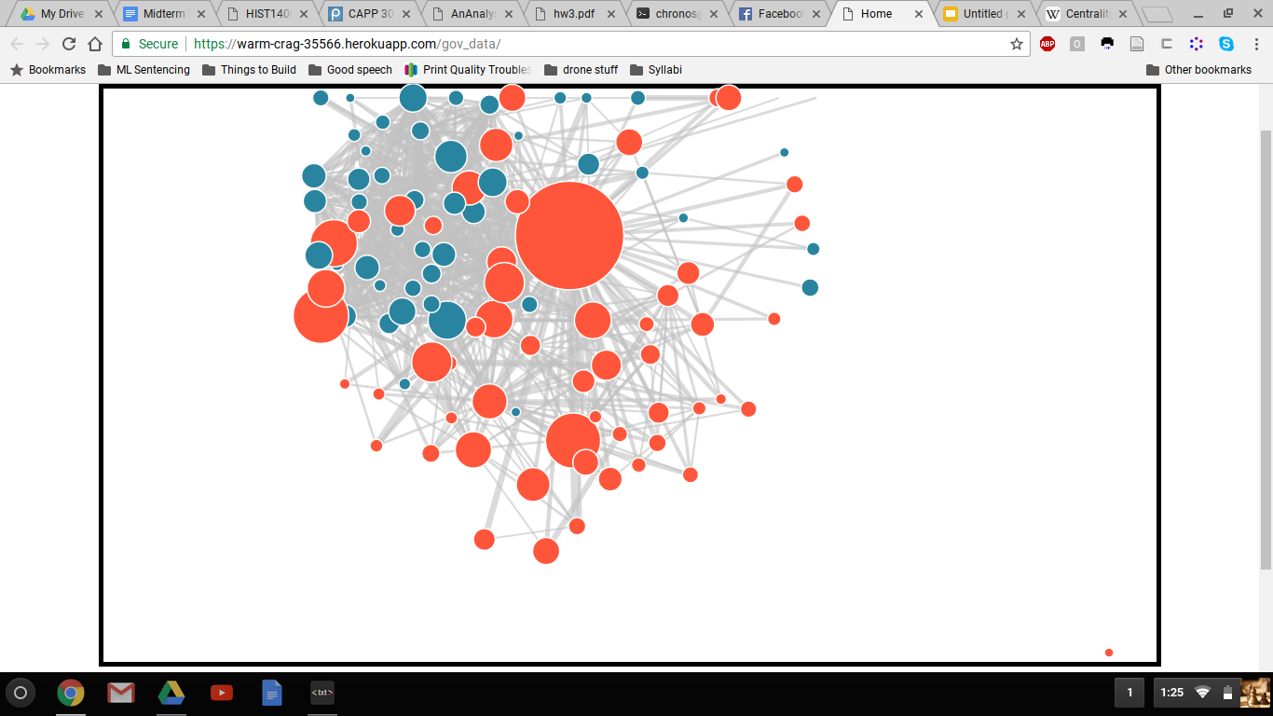
https://warm-crag-35566.herokuapp.com/gov_data/

Slide 4
Methods: Network Analysis + NLP
NLP classification for bills: passed/not-passed
Bills hosted on Congress.gov
Dataset of ~4,000 bills from 109th congress
Network analysis of cosponsorship
Leadership measured via co-sponsorships
Pagerank, raw number, degree centrality, etc.
Network given (from my CS122 project)
Meta-classification
Combining multiple models: outputs of previous models are inputs
Predict bill passage, measure marginal increase in probability

Slide 5
Structure of Project: Meta-classification
NLP
Model 1
Output 1
Meta-classification and analysis
~4,200 bills from 109th Congress
NLP
Model 2
Output 2
NLP
Model 3
Output 3
Network Model 1
Output 4
Network of co-sponsorships from 109th Congress
Network Model 2
Output 5
Network Model 3
Output 6

