Slide 1
Open Air Interface & FlexRIC
Installation
ECE 5984: 5G-Advanced, O-RAN & 6G
Virginia Tech

Slide 2
Helpful Commands
Changing directory (cd)
  Enter a directory: cd <directory name/path>
  Exit a directory: cd ..
  Exit multiple directories: cd ../../../..
List all files in current directory: ls
Open a file: vim <filename/path>
  Edit a file: Press i
  Stop editing a file: <Esc>
  Save a file: stop editing <Esc> and type :w
  Exit a file: Stop editing <Esc> and type :q
  Save and exit: Stop editing <Esc> and type :wq

Slide 3
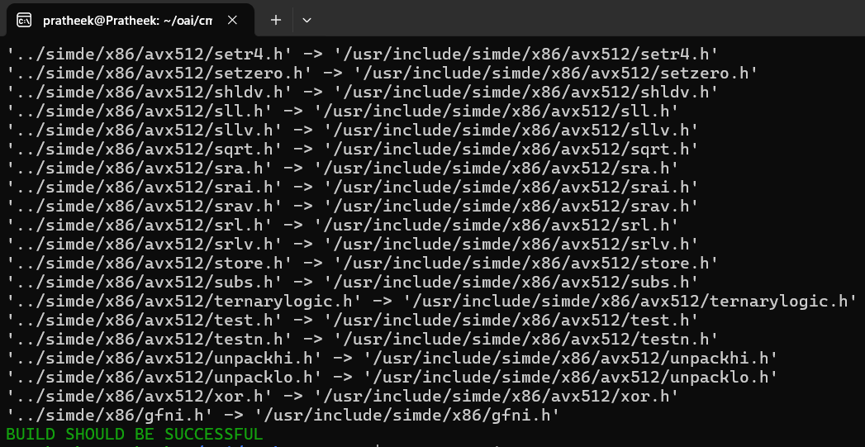
Install Dependencies
sudo apt-get update
sudo apt-get install git net-tools unzip
git clone https://gitlab.eurecom.fr/oai/openairinterface5g.git ~/openairinterface5g
cd ~/openairinterface5g/cmake_targets
./build_oai –I
cd

Slide 4
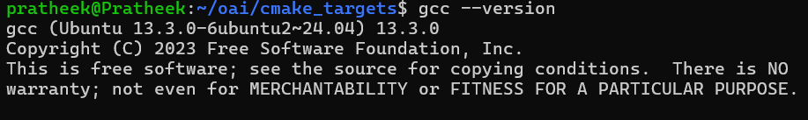

Install Dependencies (cont’d)
Check GCC Version
gcc --version
You should see GCC 12/13. If you see GCC 11, it’s not compatible.
Run only if you see GCC 11
sudo apt -y install gcc-10 g++-10
sudo update-alternatives --install /usr/bin/gcc gcc /usr/bin/gcc-10 10
sudo update-alternatives --install /usr/bin/g++ g++ /usr/bin/g++-10 10

Slide 5
Install OAI CN 5G
Reference: https://gitlab.eurecom.fr/oai/openairinterface5g/-/blob/develop/doc/NR_SA_Tutorial_OAI_CN5G.md?ref_type=heads
Install Docker
sudo apt update
sudo install -m 0755 -d /etc/apt/keyrings
curl -fsSL https://download.docker.com/linux/ubuntu/gpg -o /etc/apt/keyrings/docker.asc
sudo chmod a+r /etc/apt/keyrings/docker.asc
echo "deb [arch="$(dpkg --print-architecture)" signed-by=/etc/apt/keyrings/docker.asc] https://download.docker.com/linux/ubuntu "$(. /etc/os-release && echo "$VERSION_CODENAME")" stable" | sudo tee /etc/apt/sources.list.d/docker.list > /dev/null
sudo apt update
sudo apt install -y docker-ce docker-ce-cli containerd.io docker-buildx-plugin docker-compose-plugin
sudo usermod -a -G docker $(whoami)
sudo reboot
Note: Sometimes, when executing commands, you might encounter an error message similar to “command not found” or “unrecognized option”. This can be due to font inconsistencies between Windows (on which this ppt has been designed) and Linux. To resolve this, wherever there is a hyphen (“-”), delete it and retype it again manually.

Slide 6
OAI CN 5G Configuration files
wget -O ~/oai-cn5g.zip https://gitlab.eurecom.fr/oai/openairinterface5g/-/archive/develop/openairinterface5g-develop.zip?path=doc/tutorial_resources/oai-cn5g
unzip ~/oai-cn5g.zip
mv ~/openairinterface5g-develop-doc-tutorial_resources-oai-cn5g/doc/tutorial_resources/oai-cn5g ~/oai-cn5g
rm -r ~/openairinterface5g-develop-doc-tutorial_resources-oai-cn5g ~/oai-cn5g.zip
cd ~/oai-cn5g
sudo docker compose pull
Start OAI CN 5G Stop OAI CN 5G
cd ~/oai-cn5g cd ~/oai-cn5g
docker compose up -d docker compose down
Note: Sometimes, when executing commands, you might encounter an error message similar to “command not found” or “unrecognized option”. This can be due to font inconsistencies between Windows (on which this ppt has been designed) and Linux. To resolve this, wherever there is a hyphen (“-”), delete it and retype it again manually.

Slide 7
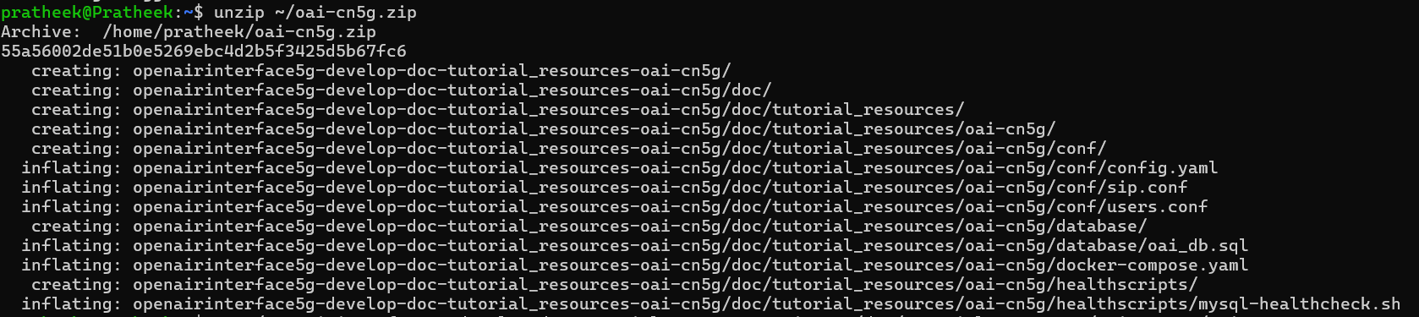
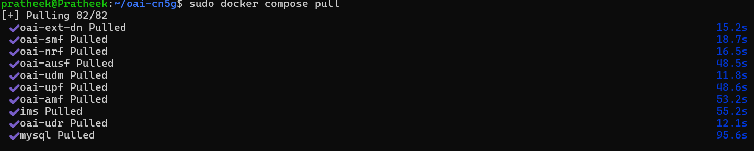

Slide 8
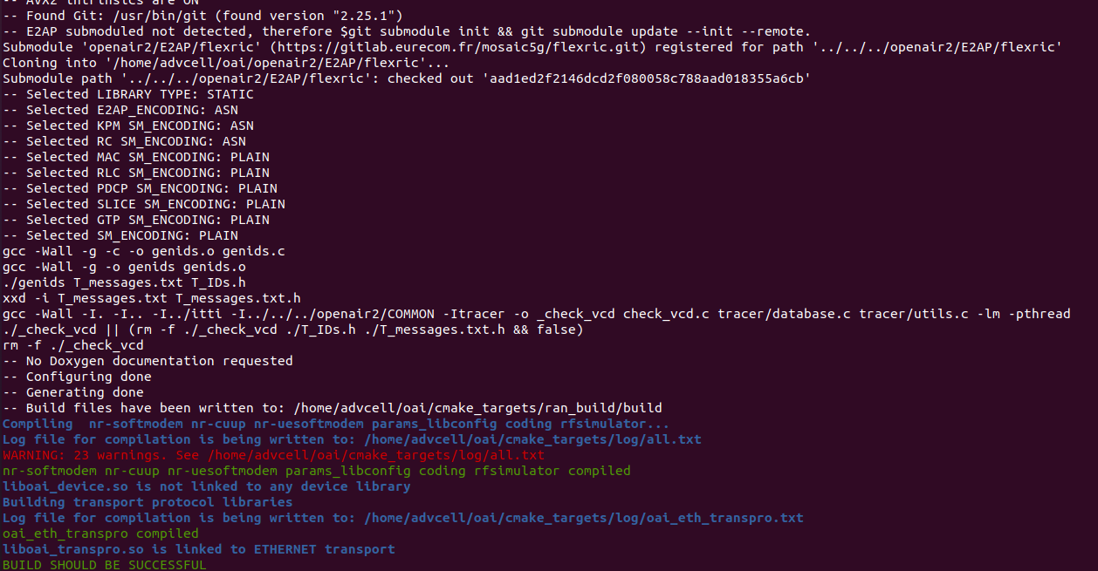
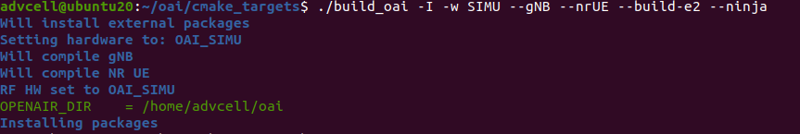
Install OAI RAN
Reference: https://gitlab.eurecom.fr/oai/openairinterface5g/-/tree/oran_jpn/openair2/E2AP?ref_type=heads
cd ~/openairinterface5g/cmake_targets
./build_oai -w SIMU --gNB --nrUE --build-e2 --ninja
You should see ASN encoding for E2AP, KPM SM & RC SM
Build should be successful
Note: Sometimes, when executing commands, you might encounter an error message similar to “command not found” or “unrecognized option”. This can be due to font inconsistencies between Windows (on which this ppt has been designed) and Linux. To resolve this, wherever there is a hyphen (“-”), delete it and retype it again manually.

Slide 9
Install OAI RAN (cont’d)
Run the following commands if
  You do not see the output in the red box outlined in the previous slide.
  The “flexric” directory in ~/oai/openair2/E2AP/flexric is empty.
cd ~/openairinterface5g/openair2/E2AP/
git submodule init
git submodule update
cd ~/openairinterface5g/cmake_targets/
./build_oai -w SIMU --gNB --nrUE --build-e2 --ninja
Note: Sometimes, when executing commands, you might encounter an error message similar to “command not found” or “unrecognized option”. This can be due to font inconsistencies between Windows (on which this ppt has been designed) and Linux. To resolve this, wherever there is a hyphen (“-”), delete it and retype it again manually.

