Slide 1
OAI: Run CN, RAN and UE Platform
ECE 5984: 5G-Advanced, O-RAN & 6G
Virginia Tech

Slide 2
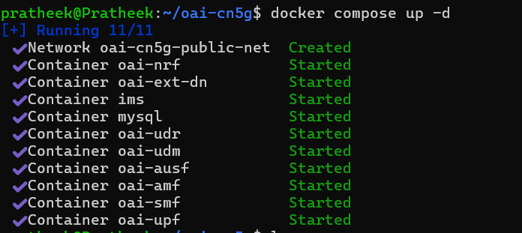
Run Core Network – Terminal 1
cd ~/oai-cn5g
docker compose up –d

Slide 3
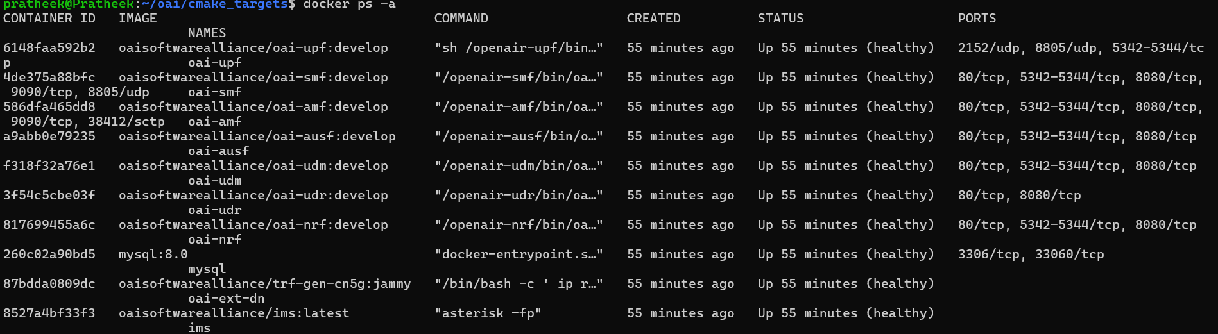
Check if all CN containers are healthy
docker ps -a
All containers should be “healthy”

Slide 4
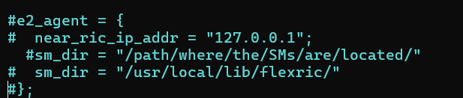
Run gNB – Terminal 2
To open a new ubuntu session terminal – open a new PowerShell terminal and type,
wsl –d Ubuntu
Edit the gNB configuration file to disable E2 agent (for now since we haven’t installed flexRIC yet).
cd ~/openairinterface5g/targets/PROJECTS/GENERIC-NR-5GC/CONF/
vim gnb.sa.band78.fr1.106PRB.usrpb210.conf
Comment out these lines at the end of the file as shown

Slide 5
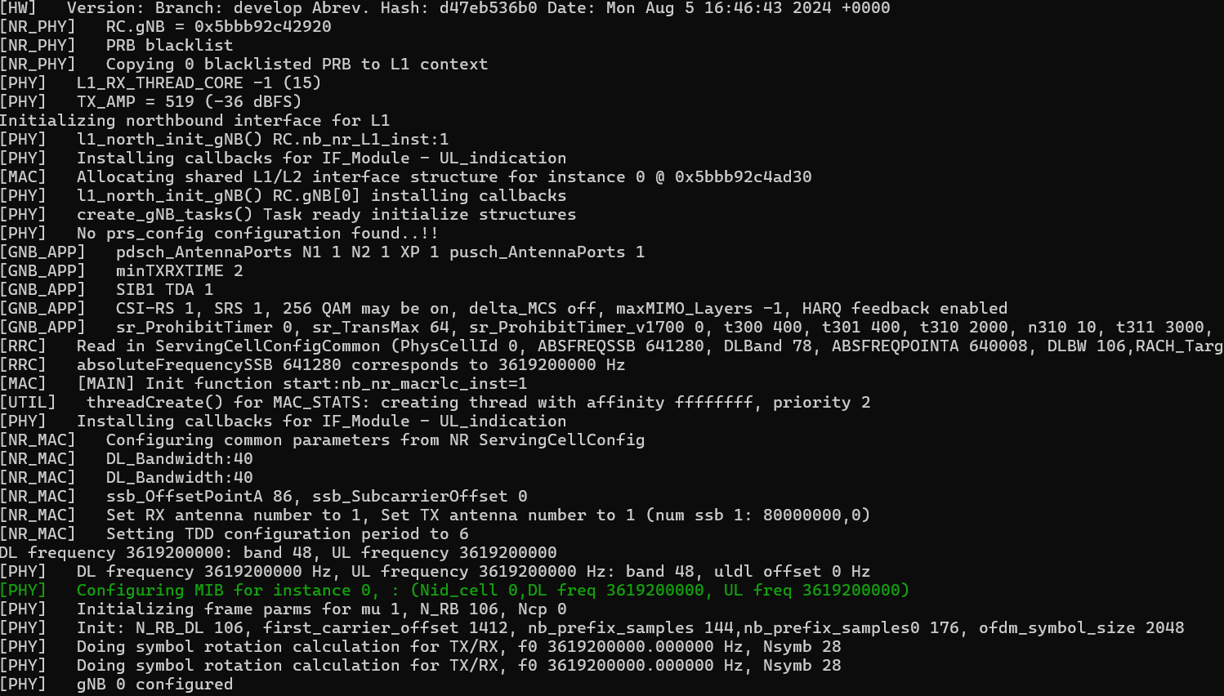
Run gNB – Terminal 2
cd ~/openairinterface5g/cmake_targets/ran_build/build
sudo ./nr-softmodem -O ../../../targets/PROJECTS/GENERIC-NR-5GC/CONF/gnb.sa.band78.fr1.106PRB.usrpb210.conf --gNBs.[0].min_rxtxtime 6 --rfsim
gNB configuration – Look for CSI-RS, SRS settings, MIB, DL/UL freq.

Slide 6
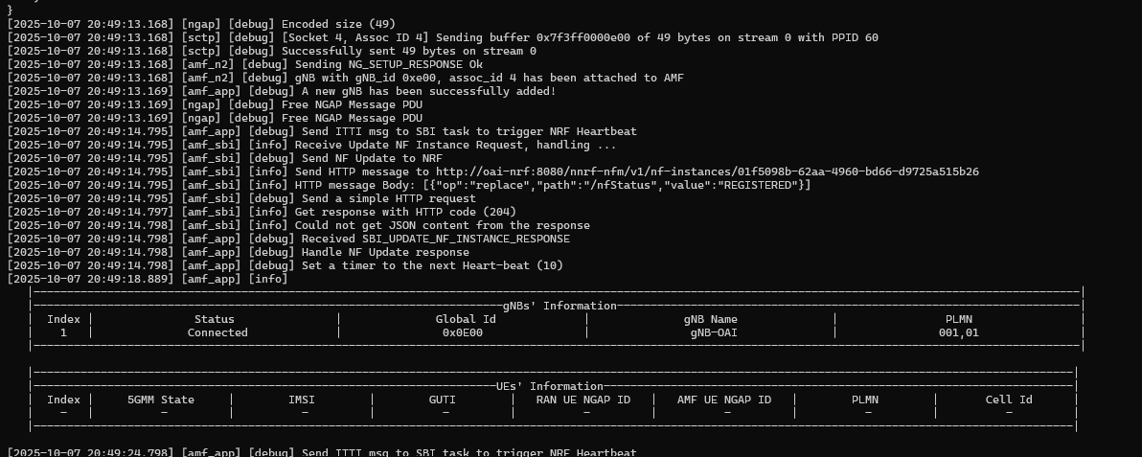
Check AMF logs in Core Network Terminal
docker logs oai-amf -f

Slide 7
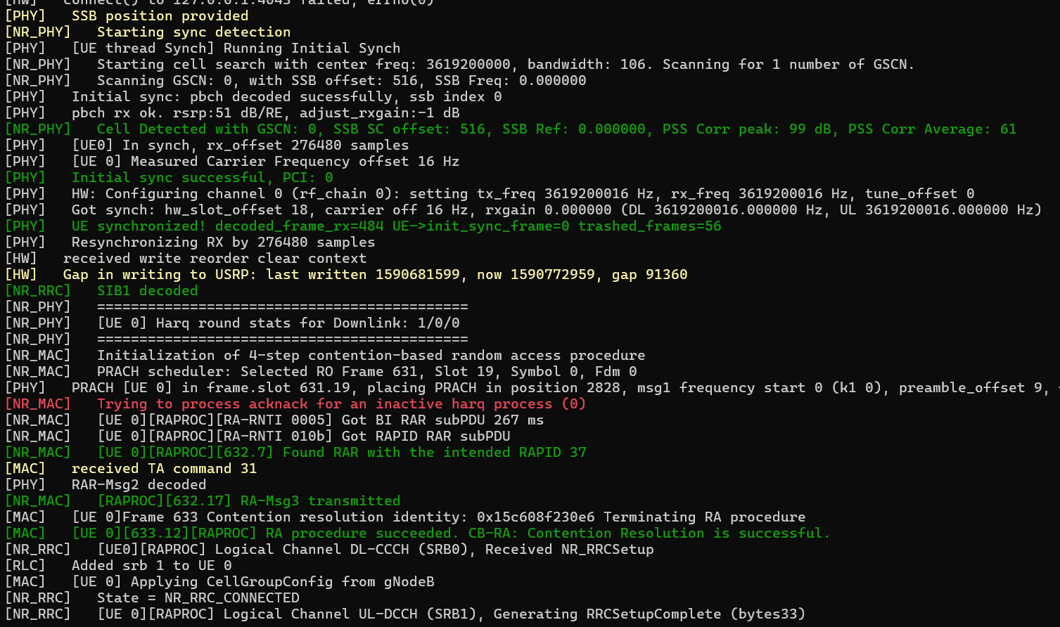
Run the UE – Terminal 3
cd ~/openairinterface5g/cmake_targets/ran_build/build
sudo ./nr-uesoftmodem -r 106 --numerology 1 --band 78 -C 3619200000 --uicc0.imsi 001010000000001 --rfsim
Check the AMF logs again and verify if the UE is “registered”.

Slide 8
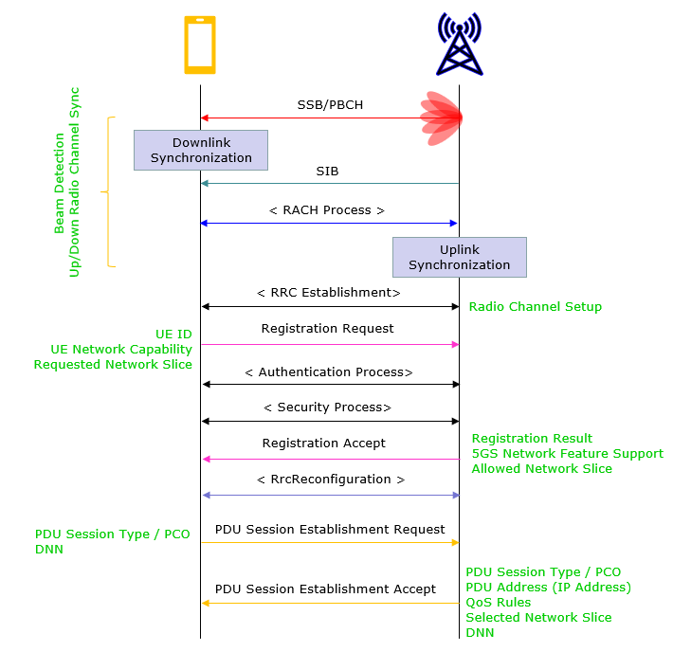
UE registration Call flow
Trace the UE registration with the gNB and CN
Source: sharetechnote.com

Slide 9
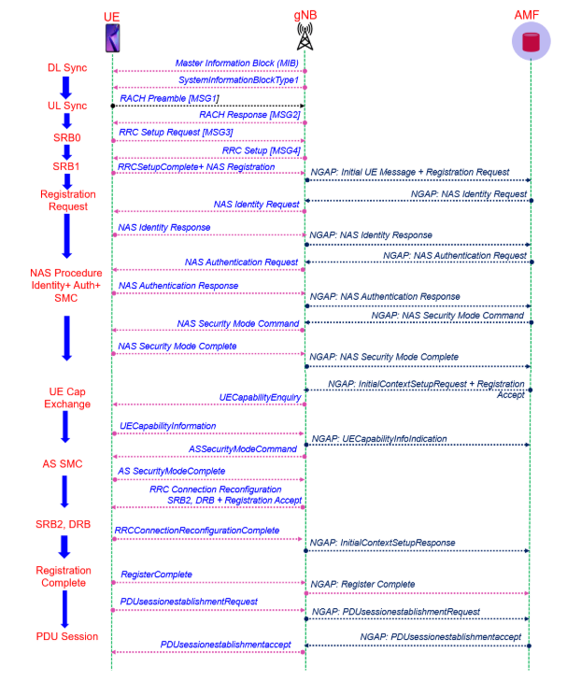
Detailed UE registration call flow
Source: techplayon.com

Slide 10
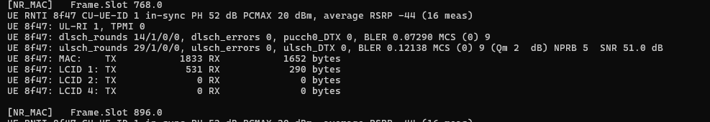
gNB output Interpretation
The scheduler periodically outputs statistics that can help you judge the radio channel quality.
In the first line,
  UE RNTI
  PH: Power Headroom - the amount of power the UE has left.
  RSRP: measured power of the DL reference signals at the UE.
  SINR: measured signal to interference and noise ratio of the SSB received at the UE.
LCID X shows the amount of MAC SDU/RLC PDU data for Logical Channel ID with ID X in transmit and receive directions.
  LCIDs 1 and 2 are mapped to SRBs 1and 2.
  LCIDs 4 and onward are mapped to DRBs 1 onward.
  If you have an LCID 4,it means you have a PDU session.

