Slide 1
RC xApp Implementation
ECE 5984: 5G-Advanced, O-RAN & 6G
Virginia Tech

Slide 2
Overview
Identify a RAN function to control.
  Addition/deletion of a DRB (QoE xApp).
  Release RRC Connection of a particular UE (RRC release xApp).
  Change PRB allocation of a network slice (Slicing xApp).
The RC xApp uses the data structures defined in E2SM-RC to communicate Control Messages to the E2 node.
Go over the basics of creating an xApp.
  xApp initialization.
  Connection to near-RT RIC.
Subscribing to messages from the RAN.
Sending messages to the RIC.
  Encoding messages
Decoding messages at the RAN (E2 Node).
Implement the logic to execute control action once message is received and successfully decoded.

Slide 3
E2SM-RC Services and Styles
Service Type | # Styles (v7.0) | Example Actions | Control Domain
Report | 4 | KPM stats, UE context | Monitoring
Insert | 8 | Pause + HO/DRB updates | Pre-decision triggers
Control | 11 | DRB QoS, Handover, CA, Beamforming | Real-time actuation
Policy | 9 | Slice PRB quota, HO offset | Conditional management
Query | 2 | UE/Node info retrieval | On-demand diagnostics

Slide 4
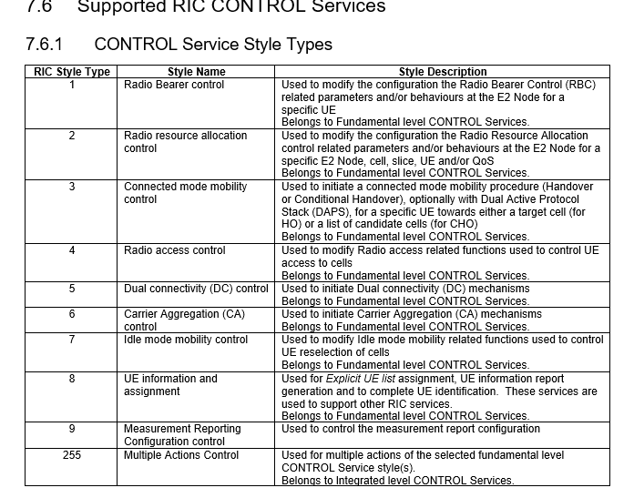
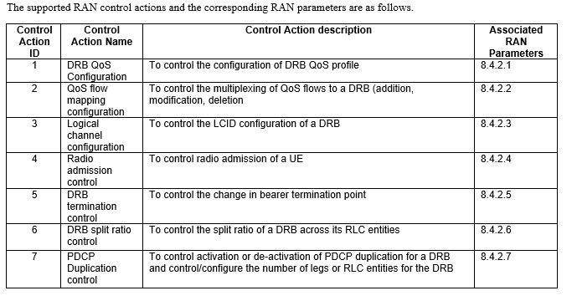
RC Control Service – Styles and actions

Slide 5
E2SM-RC Services and Styles (Detailed)
RIC Service | Service Style | Example Use Cases / Purpose | Supported Control / Report Actions
REPORT | Message Copy | Copy NI/RRC message exchanges with associated UE/E2 node info for analysis. | - Copy of RRC/NAS messages (DL/UL-DCCH)- Capture UE context (state, DRB IDs, QoS)
 | Call Process Outcome | Report results of call processing events or signaling outcomes. | - Report UE admission / release results- HO success/failure indicators
 | E2 Node Information | Provide node-level configuration and status data. | - Cell ID, PLMN, DU/CU configuration- Slice configuration summary
 | UE Information | Report UE-specific RRC/L2/L3 context and measurement info. | - UE RNTI, DRB QoS info, handover state, buffer status
INSERT | Radio Bearer Control Request | Temporarily pause call process to reconfigure radio bearers (QoS or DRB). | - Add/modify/delete DRB- Change DRB QoS profile (5QI, GBR, priority)- Logical channel (LCID) mapping
 | Radio Resource Allocation Request | Request for dynamic adjustment of scheduling parameters. | - Adjust DRX timers, SPS/CG configurations- Slice-level PRB quota changes- CQI/SRS configuration update
 | Connected Mode Mobility | Suspend to trigger optimized handover or conditional HO decision. | - Trigger HO / CHO / DAPS- Update HO preparation parameters
 | Radio Access Control Request | Modify RRC connection handling or access control parameters. | - RRC Connection Reject / Release- RACH backoff / barring control
 | Dual Connectivity | Manage Multi-RAT dual connectivity. | - Add/Modify/Release Secondary Node (SN)
 | Carrier Aggregation | Manage multi-carrier aggregation setup. | - CA initiation or modification
 | Idle Mode Mobility | Adjust reselection priorities or cell lists during UE idle mode. | - Modify intra/inter-frequency reselection priorities
 | Multiple Actions | Execute multiple actions in one transaction. | - Combine DRB + Mobility + Power actions in one control
CONTROL | Radio Bearer Control | Directly command DRB reconfiguration or QoS updates. | - Modify QoS flows- Add/delete DRBs- PDCP duplication control
 | Radio Resource Allocation | Fine-grained allocation of MAC/PHY resources. | - DRX/SPS/CG config- Slice PRB quota- CSI reporting and DMRS config
 | Connected Mode Mobility | Execute handover-related procedures. | - HO / CHO / DAPS execution- HO cancel, revert, or trigger new cell selection
 | Radio Access Control | Immediate RRC control at access layer. | - UE admission control- RRC reject/release decisions
 | Dual Connectivity | Control multi-node attachment. | - Activate / deactivate dual connectivity
 | Carrier Aggregation | Manage carrier assignment. | - Add / remove / reassign secondary cells
 | Idle Mode Mobility | Tune UE reselection in idle mode. | - Modify reselection parameters (A3/A5 events, thresholds)
 | UE Identification | Maintain or query explicit UE list. | - UE ID registration / update
 | Beamforming Configuration | Adjust beam selection / training. | - Switch GoB / non-GoB mode- Configure beam groups
 | Measurement Reporting (MR) Configuration | Change measurement configurations. | - Add / modify / delete MR configuration- Adjust measurement gaps
 | Multiple Actions | Execute several controls atomically. | - Simultaneous bearer, resource, and mobility control
POLICY | Radio Bearer Policy | Define static/conditional bearer management rules. | - QoS policy enforcement for DRBs, LCIDs
 | Radio Resource Allocation Policy | Apply scheduling / resource rules per slice or user group. | - PRB allocation policy- DRX, SR, SPS policy tuning
 | Connected Mode Mobility Policy | Define threshold-based mobility rules. | - Handover offset policy- DAPS enable conditions
 | Radio Access Policy | Manage access admission thresholds. | - Access barring policies
 | Dual Connectivity Policy | Control DC activation based on load or QoS. | - DC selection policy
 | Carrier Aggregation Policy | Define CA activation/release conditions. | - Per-slice or per-UE CA policy
 | Idle Mode Mobility Policy | Define cell reselection behaviors. | - Priority offsets / timers
 | Measurement Reporting Policy | Trigger-based measurement policy. | - Define MR gaps / events / filters
 | Beamforming Policy | Define beam usage or switching rules. | - GoB vs non-GoB usage per cell
QUERY | E2 Node Information Query | Request immediate node config. | - Cell parameters, slice data, load
 | UE Information Query | Retrieve specific UE context. | - RRC state, DRB stats, mobility state

Slide 6
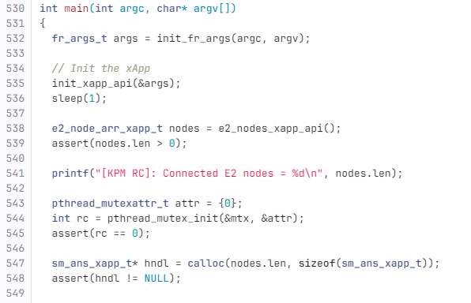
Creating an xApp
Let’s take a look at an existing xApp implementation which uses the KPM and RC service models.
We will be using the existing implementation and make modifications on top of that.
Open the xapp_kpm_rc.c file using
vim ~/flexric/examples/xApp/c/kpm_rc/xapp_kpm_rc.c
Initialize xApp API and connect to near-RT RIC
Get information regarding all the E2 nodes connected to the near-RT RIC and print the number of nodes connected.

Slide 7
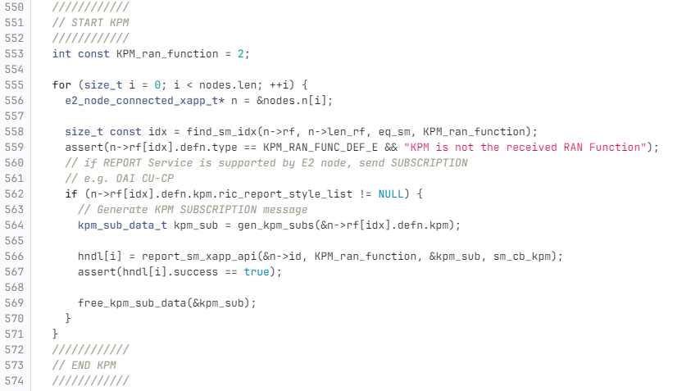
Receiving messages from the RAN
For each E2 node connected to the near-RT RIC, check if the KPM service model is supported
If KPM service model is supported, send a subscription request to the E2 node, so that the E2 node starts sending REPORT messages
Assign the report_sm_xapp_api function to the handle, so that sm_cb_kpm is called whenever a REPORT message is received. This function decodes the contents of the report and saves it in the database or prints it on the console.

Slide 8
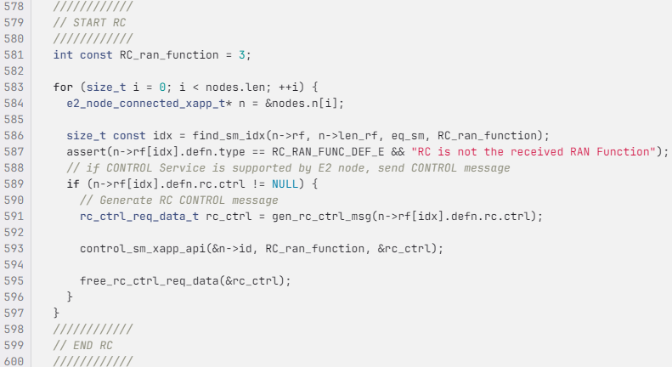
Sending messages to the RAN
For each E2 node connected to the near-RT RIC, check if the RC service model is supported.
If RC service model is supported, generate a CONTROL request and send it to the E2 node.

Slide 9
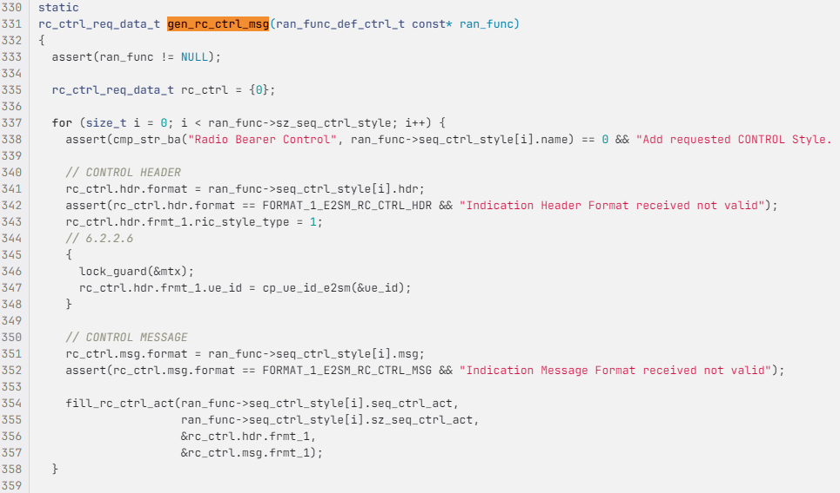
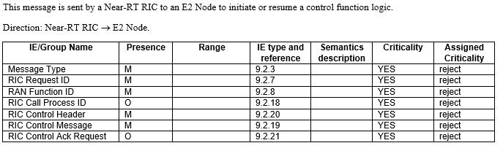
Contents of CONTROL Message

Slide 10
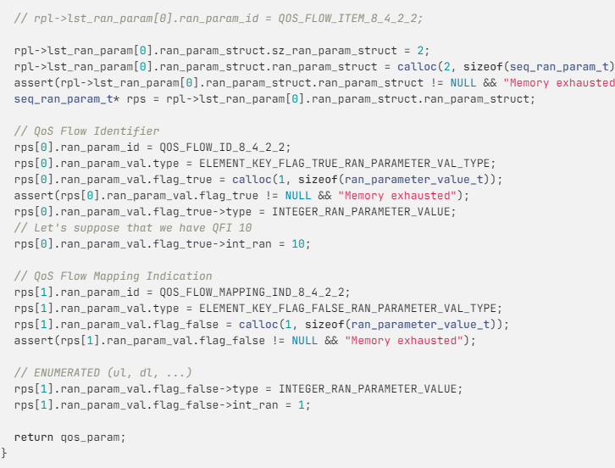
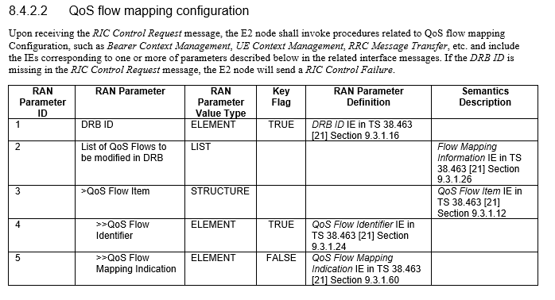
Filling qos parameters in control message

Slide 11
Generate RRC Release
We will reuse the rrc_gNB_generate_RRCRelease function defined in rrc_gNB.c that is used when the AMF issues a command to release a UE’s context.
The code executed when the gNB receives a context release command from the AMF can be found in ~/oai/openair2/RRC/NR/ directory. Open the rrc_gNB_NGAP.c file using,
vim ~/oai/openair2/RRC/NR/rrc_gNB_NGAP.c
In this file, look for the rrc_gNB_process_NGAP_UE_CONTEXT_RELEASE_COMMAND function (around line 1316).
We will reuse the logic defined here to generate a RRC release command when the gNB receives a RAN Control request.

Slide 12
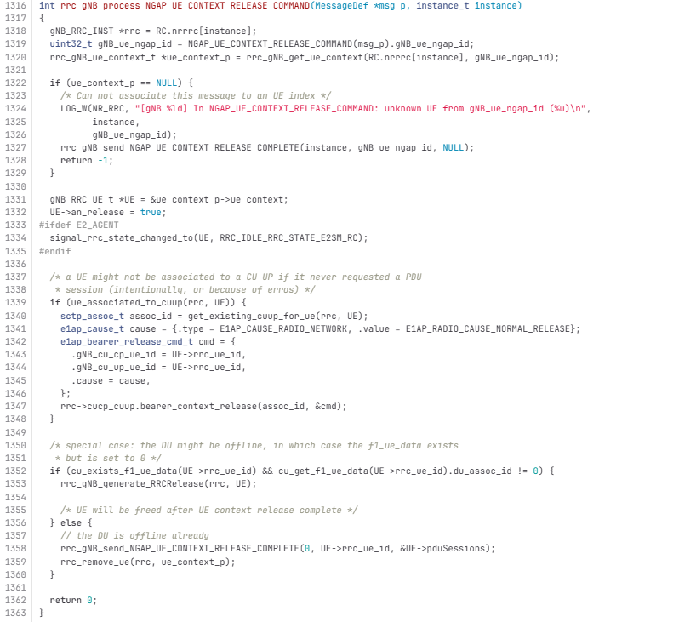
Generate RRC Release
Get UE context by specifying the UE ID.
If UE context does not exist, then nothing to do – send UE context release complete
Applicable for split CU-CP, CU-UP modules. E1 interface will have to be used for releasing bearer if PDU session exists.
Check if UE is connected to CU and DU and generate RRC release if both checks are true.

Slide 13
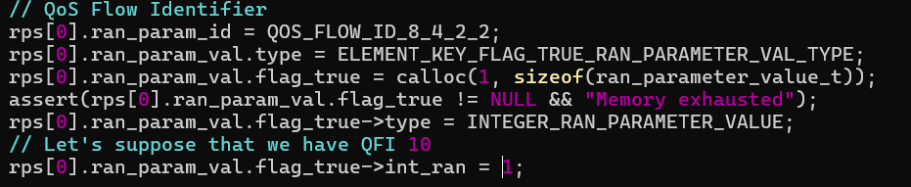
Changes to be made in FlexRIC – xapp_kpm_rc
In the xapp_kpm_rc.c file change qfi parameter to reflect UE ID (hardcoded).
  Basically, we are reusing the existing data structure to represent the parameter we want to encode.
  Since we will be having just one UE connected, use “1” as the UE ID value (as highlighted in the red box).
Build the flexric module again.

Slide 14
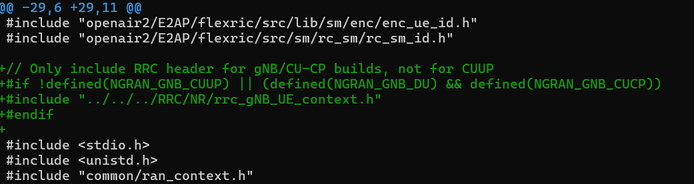
Changes to be made in OAI
On the RAN side, make the identified changes in
~/oai/openair2/E2AP/RAN_FUNCTION/O-RAN/ran_func_rc.c
In the beginning of the file, add the highlighted include statement.

Slide 15
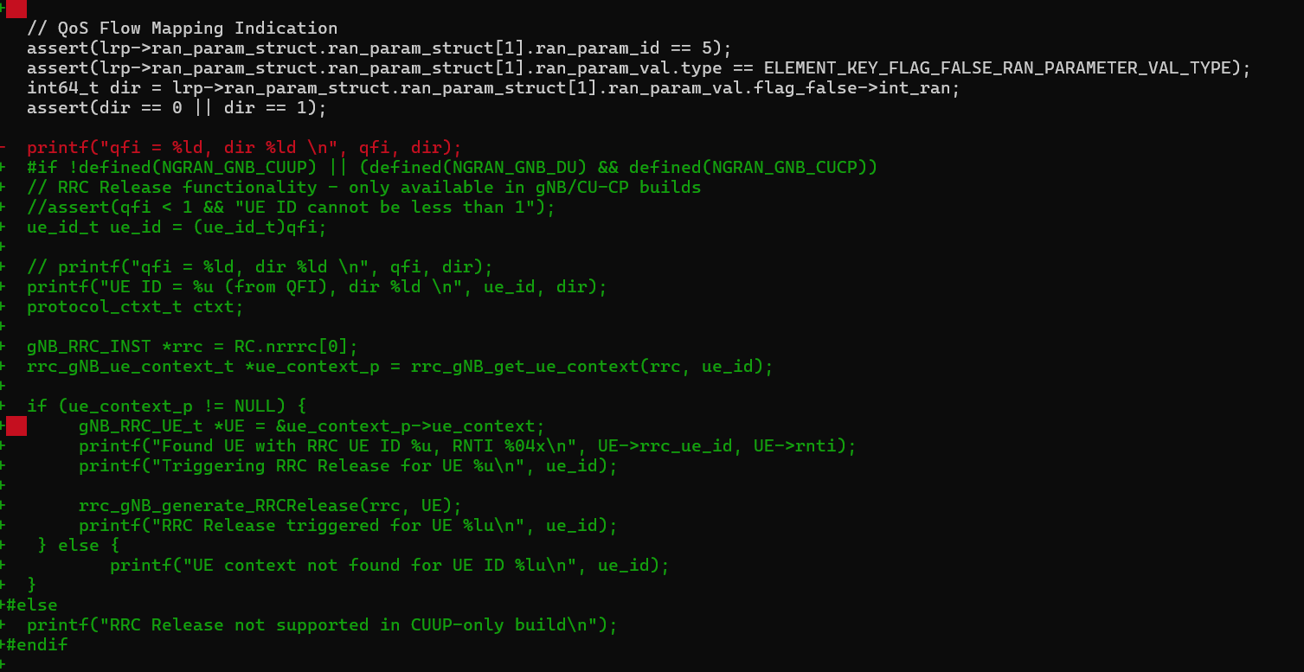
Changes to be made in OAI
Near the end of the file, look for the function write_ctrl_rc_sm, and add the highlighted lines of code inside the function (Around line 940).

Slide 16
#if !defined(NGRAN_GNB_CUUP) || (defined(NGRAN_GNB_DU) && defined(NGRAN_GNB_CUCP))
// RRC Release functionality - only available in gNB/CU-CP builds
//assert(qfi < 1 && "UE ID cannot be less than 1");
ue_id_t ue_id = (ue_id_t)qfi;
// printf("qfi = %ld, dir %ld \n", qfi, dir);
printf("UE ID = %u (from QFI), dir %ld \n", ue_id, dir);
protocol_ctxt_t ctxt;
gNB_RRC_INST *rrc = RC.nrrrc[0];
rrc_gNB_ue_context_t *ue_context_p = rrc_gNB_get_ue_context(rrc, ue_id);
if (ue_context_p != NULL) {
gNB_RRC_UE_t *UE = &ue_context_p->ue_context;
printf("Found UE with RRC UE ID %u, RNTI %04x\n", UE->rrc_ue_id, UE->rnti);
printf("Triggering RRC Release for UE %u\n", ue_id);
rrc_gNB_generate_RRCRelease(rrc, UE);
printf("RRC Release triggered for UE %lu\n", ue_id);
} else {
printf("UE context not found for UE ID %lu\n", ue_id);
}
#else
printf("RRC Release not supported in CUUP-only build\n");
#endif

