Slide 1
FlexRIC: Installation and Execution
ECE 5984: 5G-Advanced, O-RAN & 6G
Virginia Tech

Slide 2
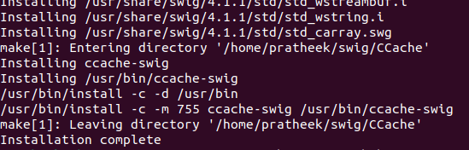
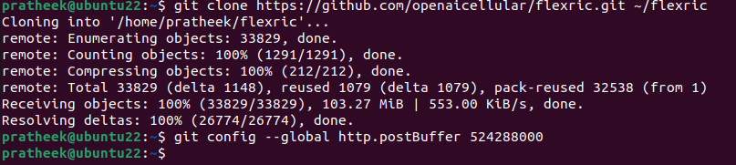
Install FlexRIC Dependencies
Open a Terminal
Install swig 4.1
sudo apt install libsctp-dev cmake-curses-gui libpcre2-dev
cd ~/
git clone https://github.com/swig/swig.git
cd swig
git checkout release-4.1
./autogen.sh
./configure --prefix=/usr/
make -j`nproc`
sudo make install
cd ~/
Clone the FlexRIC repository.
git clone https://gitlab.eurecom.fr/mosaic5g/flexric ~/flexric
cd ~/flexric
git checkout df754a85
Note: Sometimes, when executing commands, you might encounter an error message similar to “command not found” or “unrecognized option”. This can be due to font inconsistencies between Windows (on which this ppt has been designed) and Linux. To resolve this, wherever there is a hyphen (“-”), delete it and retype it again manually.

Slide 3
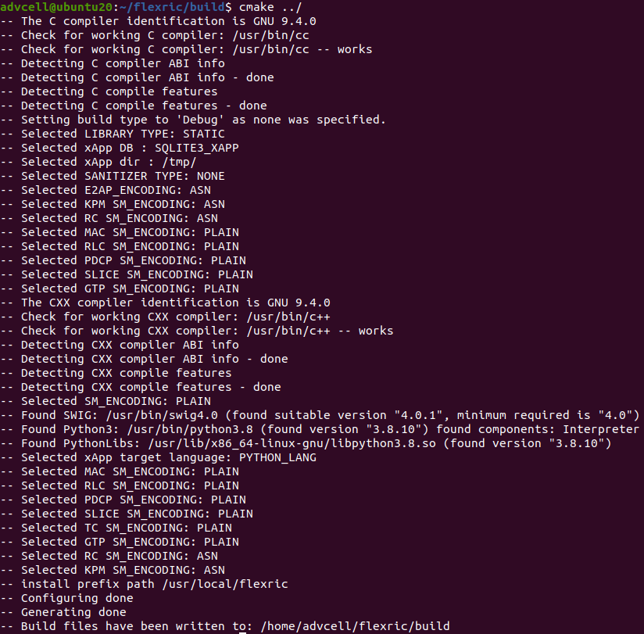
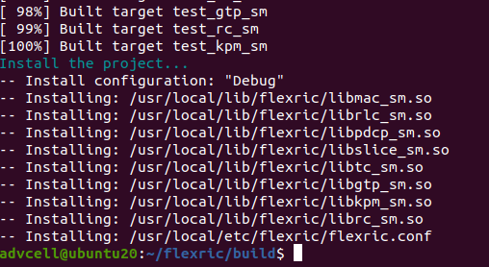
Install FlexRIC (Cont’d)
You should see ASN encoding for E2AP, KPM SM & RC SM
mkdir build
cd build
cmake ../
make -j`nproc`
sudo make install
cd ~/

Slide 4
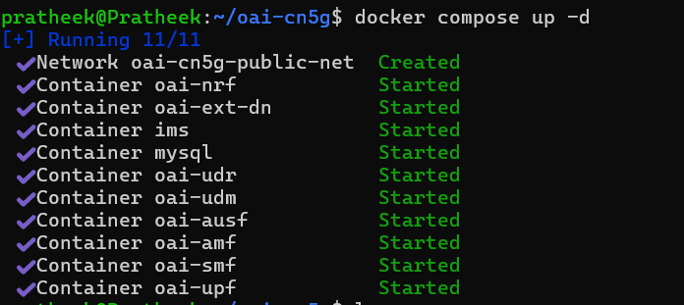
Run Core Network – Terminal 1
cd ~/oai-cn5g
docker compose up –d

Slide 5
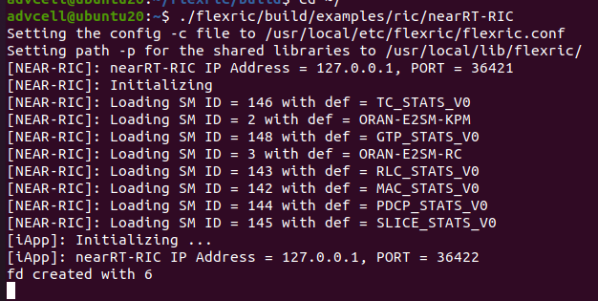
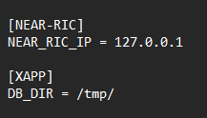
Run FlexRIC Near-RT RIC – Terminal 2
Open a New Terminal.
cd ~/
./flexric/build/examples/ric/nearRT-RIC
Near-RT RIC Console Output
We mainly need E2SM-RC and E2SM-KPM
Contents of flexric.conf file

Slide 6
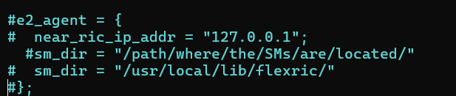
Start the gNB – Terminal 3
Edit the gNB configuration file to enable the E2 agent (for now since we haven’t installed flexRIC yet).
cd ~/openairinterface5g/targets/PROJECTS/GENERIC-NR-5GC/CONF/
vim gnb.sa.band78.fr1.106PRB.usrpb210.conf
Uncomment these lines at the end of the file. (Remove the # at the beginning of each line)
cd ~/openairinterface5g/cmake_targets/ran_build/build
sudo ./nr-softmodem -O ../../../targets/PROJECTS/GENERIC-NR-5GC/CONF/gnb.sa.band78.fr1.106PRB.usrpb210.conf --gNBs.[0].min_rxtxtime 6 --rfsim

Slide 7
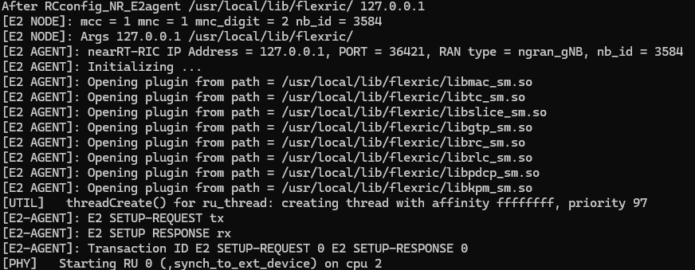
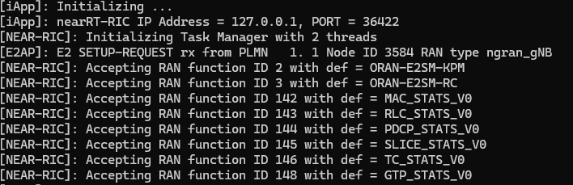
Run the gNB process – Terminal 3
Verify that the gNB received the E2 setup response.
gNB Console Output
Near-RT RIC Console Output

Slide 8
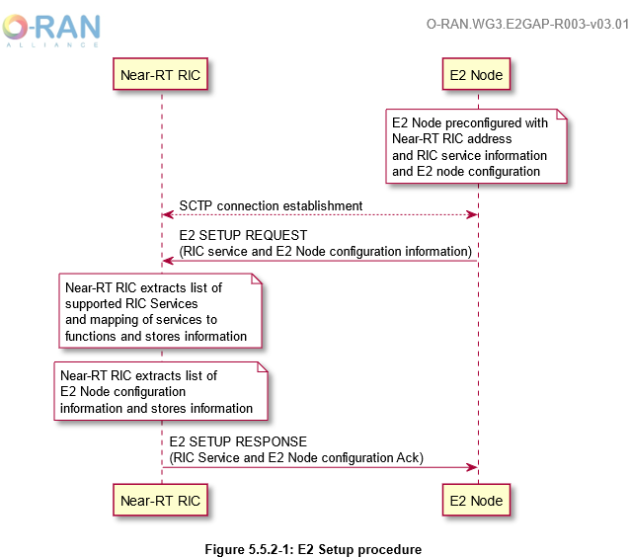
E2 Setup procedure

Slide 9
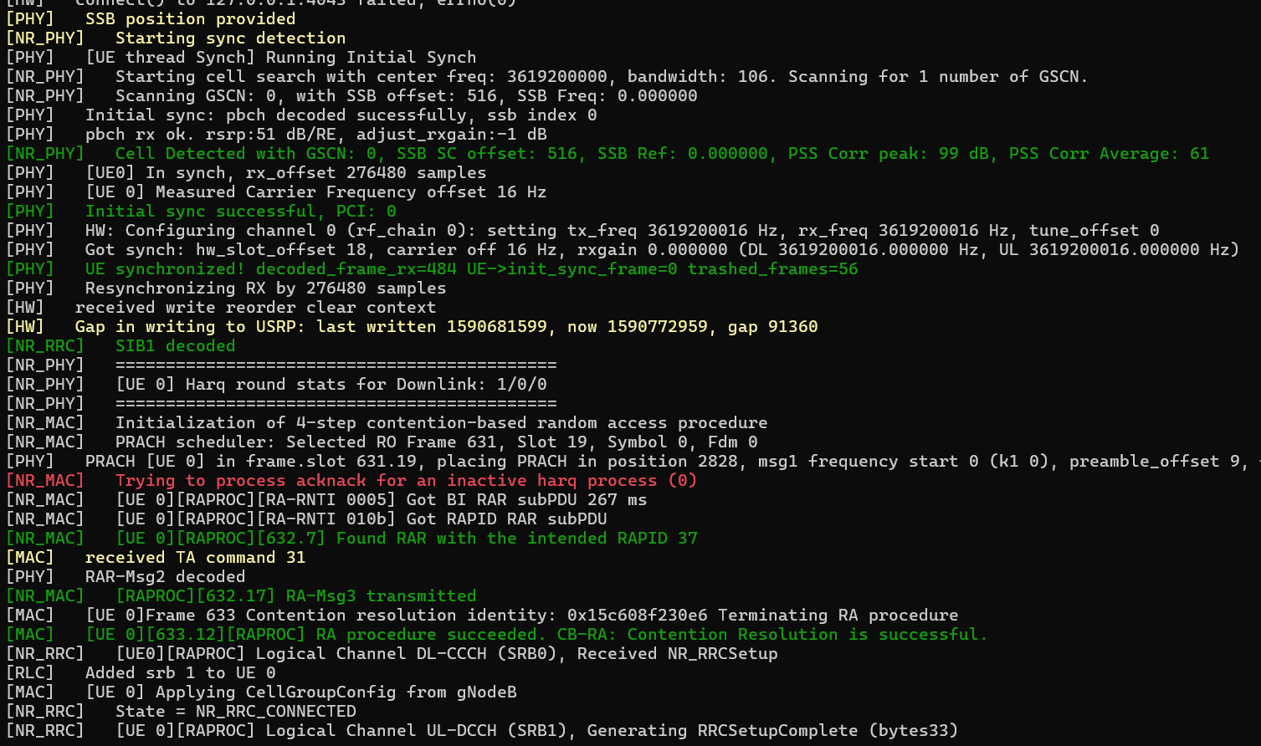
Run the UE – Terminal 4 and start Traffic – Terminal 5
cd ~/openairinterface5g/cmake_targets/ran_build/build
sudo ./nr-uesoftmodem -r 106 --numerology 1 --band 78 -C 3619200000 --uicc0.imsi 001010000000001 --rfsim
In terminal 5,
ping 192.168.70.135 -I oaitun_ue1
Output will be the same as what we observed previously, since the UE is not “aware” of the near-RT RIC.

Slide 10
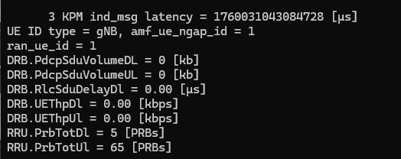
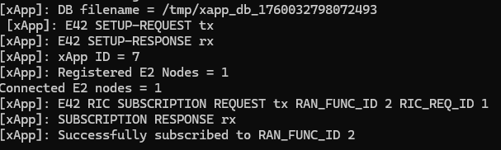
Start the KPM xApp – Terminal 6
KPM – Stands for Key performance metrics. This xApp is responsible for collecting metrics collected by the RAN and forwarding it to relevant xApps to help in RAN control
Per O-RAN specifications, 5G measurements supported by KPM are specified in 3GPP TS 28.552.
cd ~/flexric
./build/examples/xApp/c/monitor/xapp_kpm_moni
Metrics from 3GPP TS 28.552 that are supported in FlexRIC/OAI.
KPM xApp console output

Slide 11
Start the RC xApp – Terminal 6 (Do not use)
RC – Stands for RAN Control.
Implements REPORT Service Style 1 ("Message copy" - section 7.4.2) - aperiodic subscription for "RRC Message" and “UE ID”.
Aperiodic subscriptions for "UE RRC State Change", "RRC Message" copy (RRC Reconfiguration, Measurement Report, Security Mode Complete, RRC Setup Complete), and "UE ID" when RRC Setup Complete and/or F1 UE Context Setup Request detected
cd ~/flexric
./build/examples/xApp/c/monitor/xapp_rc_moni
RC xApp console output

