Slide 1
Windows Subsystem for Linux (WSL) Installation
This should be done only on a machine running Windows 10/11

Slide 2
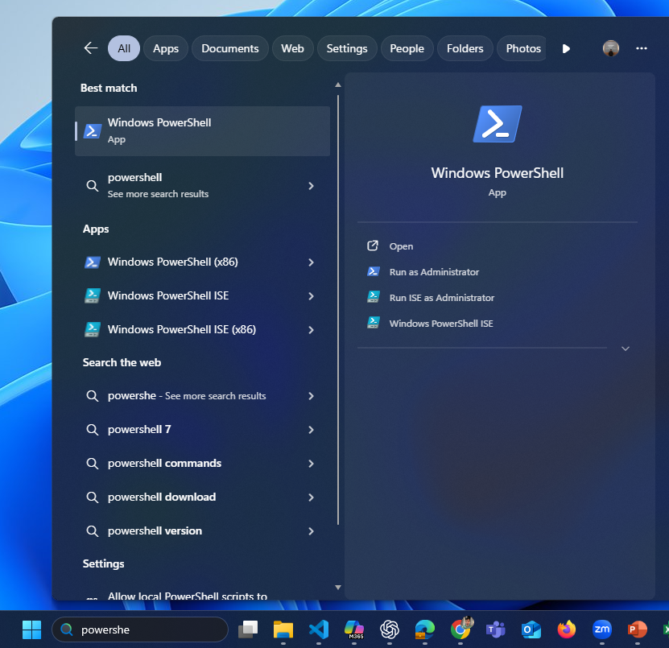
Open PowerShell Terminal
Search for “Windows PowerShell” in the start Menu and select “Run as Administrator”.

Slide 3
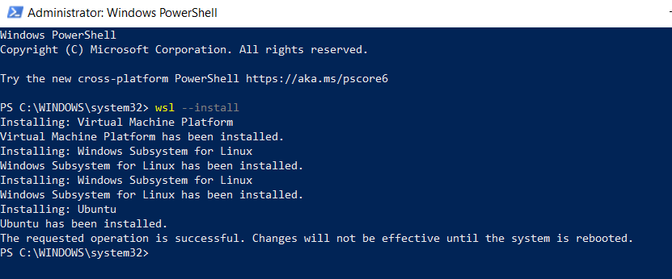
Run WSL Install Command
To install WSL, run
wsl --install.
Once done, reboot the system.

Slide 4
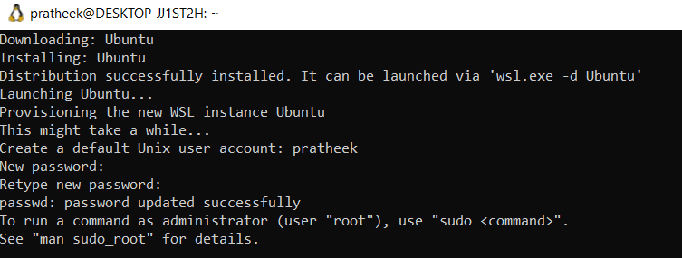
Check Ubuntu Installation
Once you reboot, Ubuntu Installation should start automatically.
If it does not, then open PowerShell in administrator mode again and run,
wsl --install -d Ubuntu
Set your username and password

Slide 5
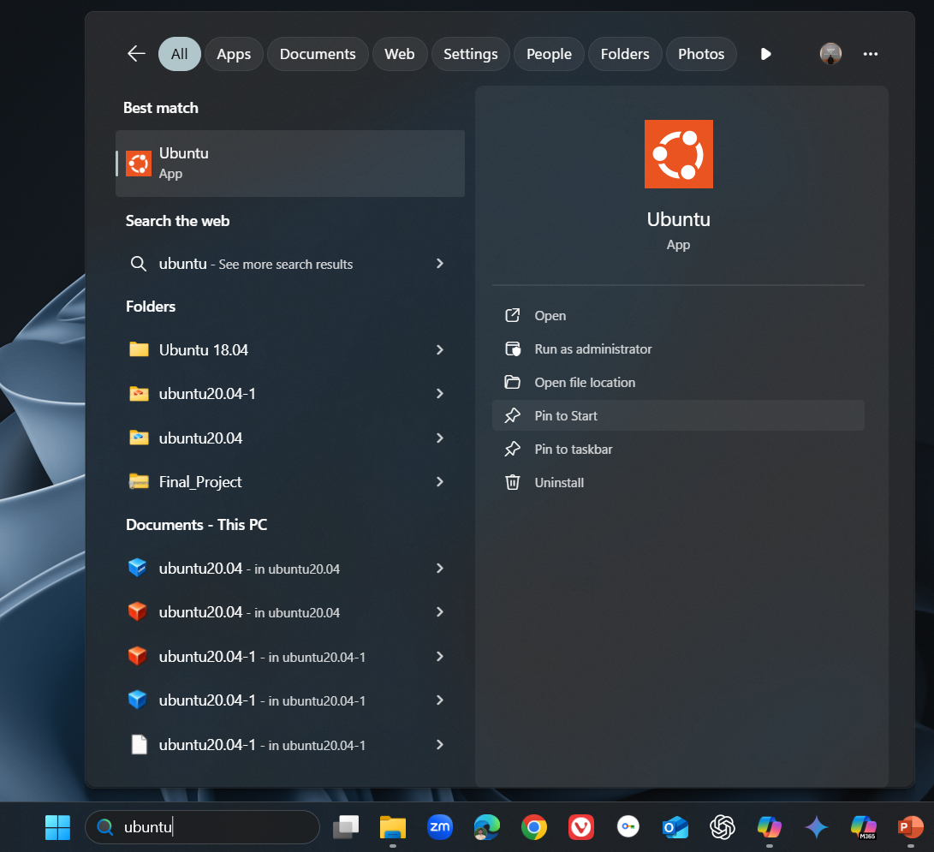
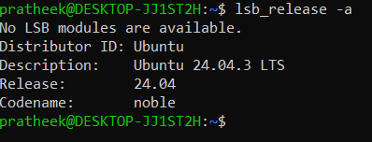
Verify Ubuntu Installation
Once done, close all the terminals.
In the start menu, search for ubuntu and open it.
Once the ubuntu terminal opens run,
lsb_release –a
You should see Ubuntu 24.04.3 LTS

