Slide 1

BI Project Customer Churn Analysis – Final
Grégory PINCHINAT
Email : gregpinchy@gmail.com
Phone : (509) 33 14 43 47

Slide 2
Problem
Our client is a Telecommunications company which has a massive market share, but also competitors trying to attract the customers.
The problem they’re facing is : Customers churning
The stakeholders impacted are:
The investors;
The board.
This problem is important to the organization, because customers that are churning are a potential source of decrease on the company’s revenues.

Slide 3
Methodology (1)
Python version 3 has been used as a programming language to extract the insights. The « Churn » dataset provided by the company was used to carry out the analysis. The variables, operations and results are stored in a Jupyter notebook, given in the annex.
A descriptive method was used with some inferences involving t-test comparisons on proportions. When said comparisons are made, a tuple of three values accompanies the chart where the first value represents the t-statistic calculated over the sample, the second represents the p-value and the last one represents the degrees of freedom.
The most important of the three is the p-value. If it is lesser than 0.05, then we will conclude that we have enough evidence to reject the null difference between the two proportions under study. Otherwise, we may not reject the null difference and simply assume it might be significant.

Slide 4
Methodology (2)
Also a Customer Segmentation was made in three customer profiles by using the K-Means Clustering Methodology (where K=3). The results are random, so by running the Jupyter notebook again, they might slightly change, but from our experience, there is not a great difference in the segmentation that come out every time.
And finally to summarize and generalize the results, a Logistic Regression Analysis has been run, allowing to better classify each customer given the actual dataset. The default solver, and regularization parameter (C=1) were left as are.

Slide 5
RESULTS

Slide 6
1.- CHURN

Slide 7
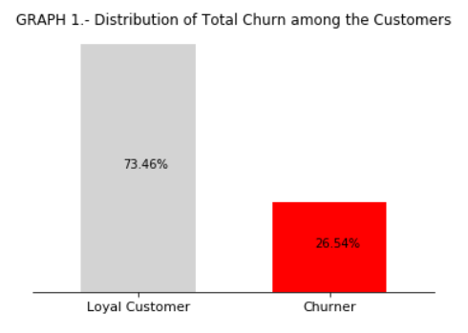
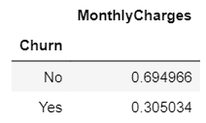
The impact of the Churn
The company has had a total of 7043 customers up to the past month and has lost about 26.54% of them, 1869 of them churning.
The Churn problem is significantly prejudicial to the business because it affects the monthly revenue generated by the charges customers are paying every month (see the pivot table under Graph 1)
If the current churning rate holds and the current number of customers doesn’t increase, then we should expect a sustained decrease of about 30% monthly in the revenue of the company.

Slide 8
2.- EXPLANATIONS BEHIND WHAT’S HAPPENING

Slide 9
2.-a) Explanation by the Demographics

Slide 10
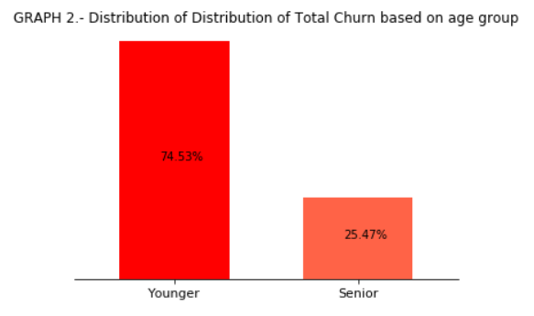
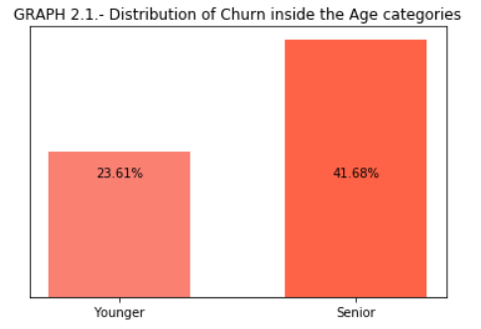
2.-a.1) Churn through the demographics – AGE
According to the data, 25.47% of the Total Churn only comes from the Seniors. But this is because the other company’s customers are mostly Youngsters. (Graph 2)
In fact, as we look inside each group separately, we discover another reality. The Younger customers tend to churn less: about 24 % of all the Youngsters churn while almost 42% of the Seniors churn monthly. (Graph 2.1)
So the company should expect the probability of churn as higher for their senior customers.

Slide 11
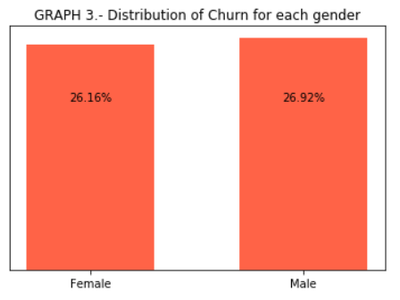
2.-a.2) Churn through the demographics – GENDER
The Gender of the customers doesn’t seem to affect their propensity to churn. Almost as many women as men have churned during the past month.
To test the non-significance of the difference, we’ve run a t-test on the difference of proportions. The results (p-value is the second value in the tuple beneath Graph 3) have not given us enough evidence to reject the hypothesis of null difference.
Therefore, we may state that the Gender has no real impact on the Churn, so far.

Slide 12
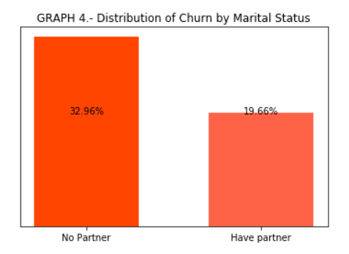
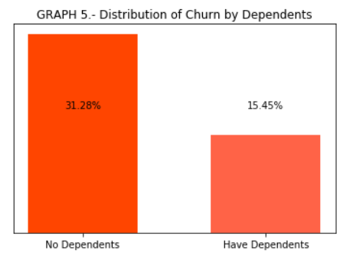
2.-a.3) Churn through the demographics – RELATIVES
About 32 percent of customers who don’t have any partner or dependents are prone to churn, while 20% of those who have a partner and 15% of those who have dependents churn.
Such results inform us that the distribution of the proportion of churn by the Relatives doesn’t change much, it’s practically the same whether it’s viewed from the Relationship perspective, or from the Dependents themselves.
They also tell us that the Marital status and the Dependents affect the churn the same.

Slide 13
2.-b) Explanation by Subscription to diverse Services offered by the company

Slide 14
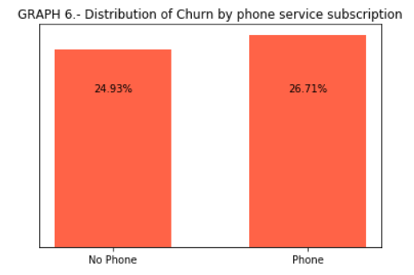
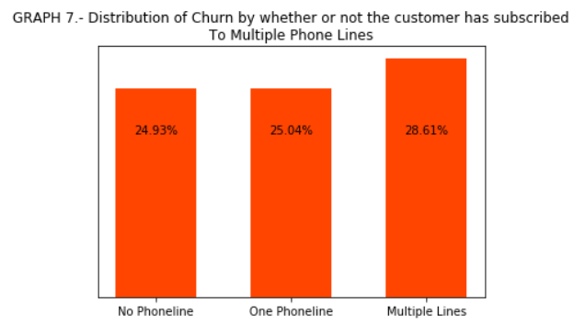

2.-b.1) Churn through the Services – PHONELINES
The customers who haven’t subscribed for any phone service churn about as much as those who have purchased at least one (between 25 and 27%).
But among those who have subscribed to our phoneline service, those who have purchased more than one phoneline tend to churn more (about 29% of them) than those who have purchased one or no phone at all.
Thus having bought multiple phonelines is an indicator that the customer is likely to churn.

Slide 15
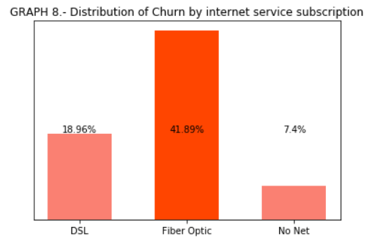
2.-b.2.) Churn through the Services – INTERNET
Among the people who bought internet services from us, those who churn the more are the Fiber-optic users (42% of them churn), followed by 19% of the DSL users. The rest of the Churn might be explained by services other than the Internet.
This might be because of the prices, since the DSL users pay an average 49$ monthly while the Fiber-optic users are paying an average 88$ monthly.
We might also want to check with the IT Department and the customer care service to see if there’s been any complaint about the quality of the Internet.
But what is sure is the Internet users account for a big deal of share out of the churn proportion observed.

Slide 16
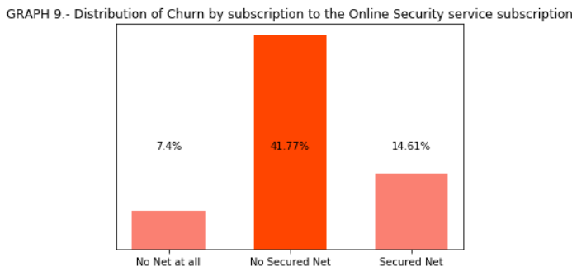
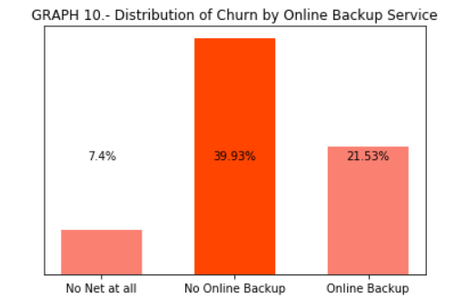
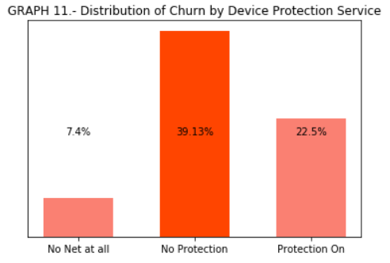
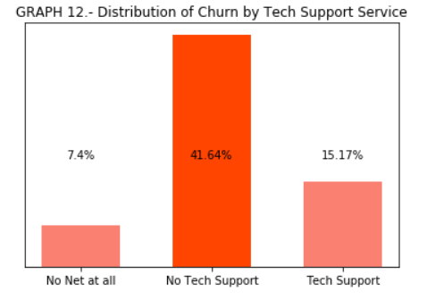
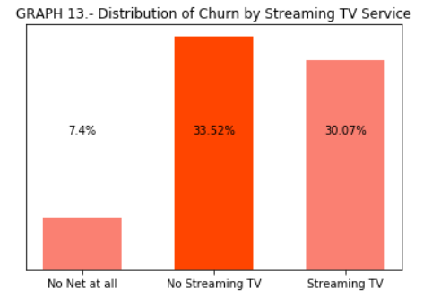
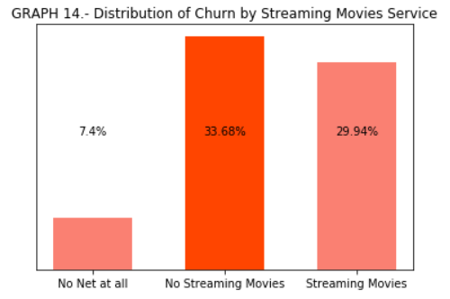
2.-b.2.) Churn through other Online Services (1) – SECURITY | BACKUP | PROTECTION | IT | STREAMING

Slide 17
2.-b.2.) Churn through other Online Services (2) – SECURITY | BACKUP | PROTECTION | IT | STREAMING
We are considering all these services together because the distribution of Churn relative to each of them has practically the same shape and varies with the same trend, as can be seen on the graphs from the previous slide.
We have already seen that people who have no internet at all churn less (7.4%) of them. This percentage hasn’t changed. But what all these graphs (graphs 9 thru 14) tell us is that when people do have internet and don’t have at least one of these online services with the company, then they will be more prone to churn (from 34 to 42% of them according to the past month data).
We could believe it is because they are paying quite high for these services: people who use at least of the company’s 6 online services pay monthly about 82$ in average. This is quite close to the average 88$ paid by the Fiber-optic users.

Slide 18
2.-b.2.) Churn through other Online Services (2) – SECURITY | BACKUP | PROTECTION | IT | STREAMING
So the Fiber-optic users are also those who can afford any of our online services. So maybe the DSL users might want to churn if other companies are offering them a full package (net + online service) at a better price.
Also maybe if they had online security on their bandwidth, or Data backed up on our servers, or that their computers were protected through our internet, or that they had real support from our IT Department, or could stream TV and online movies to enjoy, maybe they’d have more reasons to feel the need to keep on paying for the internet.
Actually, the graphs 9 thru 14 allow us to assume the right-above paragraph is true. Because we can observe a lower proportion of churn (between 15 and 30% only) among those who have internet and have purchased at least one of these online services.

Slide 19
2.-c) Explanation by Billing Information

Slide 20
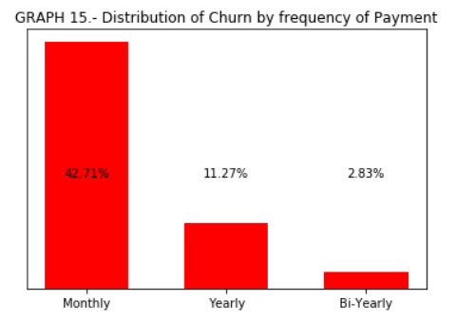
2.-c.1.) Churn by the Billing Info – PAYMENT FREQUENCY (1)
The customers who churn the most are the monthly contractors (42%). This makes sense because someone who pays for a service monthly either doesn’t intend to take any long-term commitment with the provider, or just can’t afford paying for it on the long-term.
The trend is negative. Meaning that the longer the contract lasts, the lesser the churn (11.27% for yearly contractors and 2.83% for bi-yearly contractors). Which also makes sense, because once the contract is paid, the customers would be the only ones to lose if they churned before the next term.

Slide 21
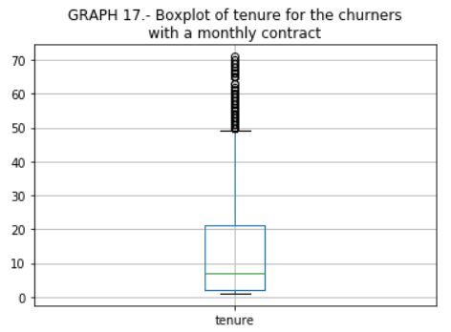
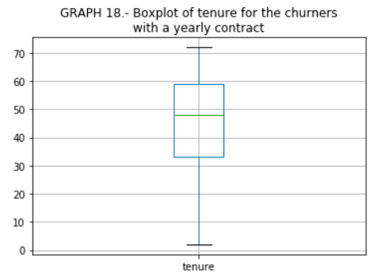
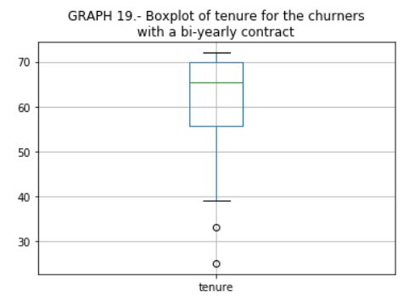
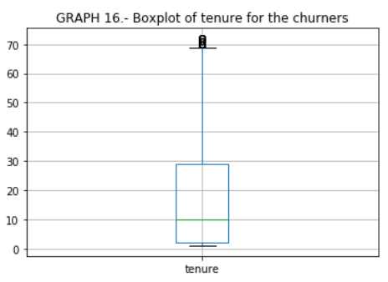
2.-c.1.) Churn by the Billing Info – TENURE & PAYMENT FREQUENCY (2)
These additional graphs show reinforce the existence of the negative trend we discussed in the previous slides, but also give us a more precise idea of how long we may expect a customers to stay with the company before deciding to churn:
50% of the churners churn on the 10th month. Of those 50%, the monthly contractors contribute the most to the churn with 50% of them churning after the 7th month of subscription. Then, the 50% of the yearly contractors churn around the 49th month, while bi-yearly ones do after 66th month and may stay until over the 70^{th.}

Slide 22
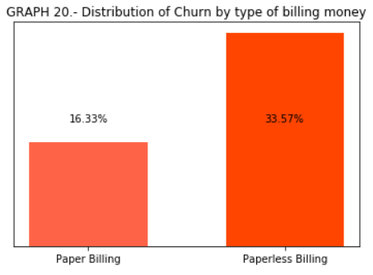
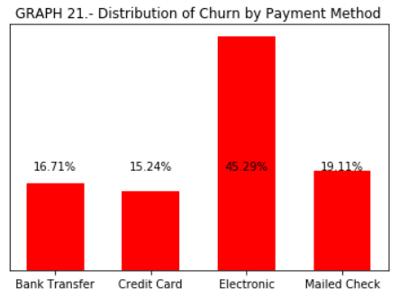
2.-c.2.) Churn by the Billing Info – BILLING MONEY & PAYMENT METHOD
Only 16.33% of the customers who pay with the means of paper churn, while 35.57% of the paperless billed customers churn. The company then should prioritize or encourage its customers to pay paperlessly.
The electronic mode of payment seems to favor churning (45% churn, which is 2 to 3 times more than the other payment methods)
We might want to reach to these customers thru the IT or customer care department to know whether the problem is technical.

Slide 23
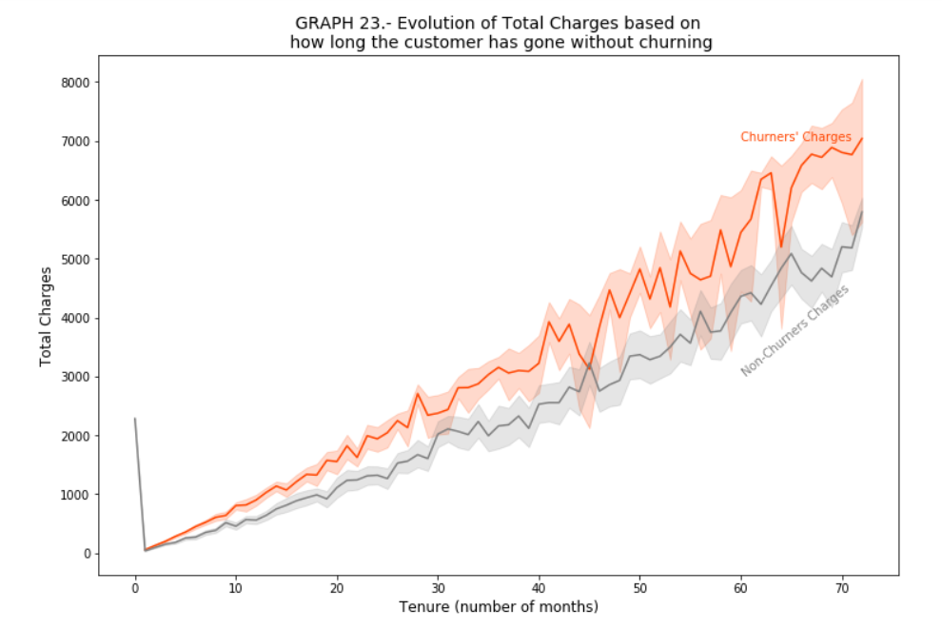
2.-c.3.) Churn by the Total Charges – Trend of charges over tenure periods
The churners’ charges remain always higher than the charges of the non-churners. So customers might be churning because of too much they’re paying.

Slide 24



BONUS : How long before the company loses all its customers and which demographics will it lose first?
By plugging in the values of N=7043 and p=0.2654, we find n=29 months, which is the tenure after which all current customers will have churned if nothing is done to change anything

Slide 25
CUSTOMER PROFILES
 | Senior Citizen | tenure | Monthly Charges | gender | Partner | Dependents | Phone Service | Multiple Lines | Internet Service | Online Security | Online Backup | Device Protection | Tech Support | Streaming TV | Streaming Movies | Contract Length | Paperless Billing | Payment Method | Churn
PROFILES
RISKY USERS | ✗ | 16.4 | 69.6 | M | F | ✗ | ✗ | ✓ | ✗ | Fiber | ✗ | ✗ | ✗ | ✗ | ✗ | ✗ | Monthly | ✓ | Electronic Check | 0.49
PREMIUM USERS | ✗ | 53.4 | 85.8 | M | F | ✓ | ✗ | ✓ | ✓ | Fiber | DSL | ✓ | ✓ | ✓ | ✓ | ✓ | ✓ | Yearly | Bi-Yearly | ✓ | Auto Bank Transfer | Auto Credit Card | 0.10
REGULAR USERS | ✗ | 30.5 | 21.1 | M | F | ✗ | ✗ | ✓ | ✗ | ✗ | -- | -- | -- | -- | -- | -- | Monthly | Bi-Yearly | ✗ | Mailed Check | 0.07

Slide 26
CASE STUDY : Premium Users
A Premium User is a customer who is most likely to be a Junior. They may be either Male or Female. They’re expected yield a 86$ monthly marginal revenue to the company. This type of customer usually has a partner, but no dependents. They often need more than one phone line.
They may use DSL or Fiber-optic internet service equally. They subscribe to each of our online services, namely: Online Security, Online Backup, Device Protection, Tech Support, Streaming TV and Streaming Movies.
Their contracts are likely to be reset yearly or bi-yearly. Their account (Credit Card or Bank account) is debited automatically. And about 10% of them may churn after 4 years and 5 months straight.
We currently have lost 10% of our customers, so right now we have only 2203 Premium Users who pay an average 85$ monthly. If we manage to increase this profile by 10% by offering the same service package to 221 customers, we will increase the company’s revenue by 18678.92$.

Slide 27
Variation of the Revenue following an increase in Premium users
We currently have lost 10% of our customers, so right now we have only 2203 Premium Users who pay an average $ 85 monthly.
Accounting for the Total Churn, the current Total Revenue of the company is $ 316,985.75 and the current Total Revenue yielded from Premium Customers is $ 186,197.00 (which is 59% of the company’s revenue).
If we manage to increase this profile by 10% by offering the same service package to 221 new customers, we will increase the company’s revenue by $ 18,678.92. That means the company’s revenue will be increased by 5.89% and the revenue yielded from Premium Users will be increased by 10.03%.

Slide 28
Characteristics of customers who churn at higher rate (1)
A Logistic regression analysis allows to see blatantly that the factors and conditions that make churn rates decrease are:
Higher tenure;
Higher monthly charges,
The use of DSL internet service rather than Fiber-optic,
Bi-yearly contract renewal, whatever the payment method is.

Slide 29
Characteristics of customers who churn at higher rate (2)
The Analysis of the customer segmentation shows that the most risky users are about 50% likely to churn, while the Premium users are just 10% likely to churn and Regular users have 7% probability of churning. The Risky users are mostly characterized by:
An average 16.4 months of tenure (the lowest);
Intermediate monthly charges (higher than the Regular and lower than the Premium);
No partner and no Dependents;
Use of Fiber-optic internet without any of our Internet services (from Online security to Streaming);
Monthly contract renewal.

Slide 30
Discussion & Recommendations (1)
Based on the Results of the Descriptive, the Customer Segmentation and the Logistic Regression Analyses, we recommand to:
The Marketing Team to create content that suits risky segment of current customers who are churning at higher rates.
Such customers have been with the company for below or around 16.4 months and they have applied mainly for a single-phone line service and high-speed internet.
But the Marketing Team should probably advertise by offering them to switch from Fiber to DSL, since DSL users are less likely to churn.
The Marketing Team might also want to offer them an incentive (such as a slight monthly reduction) that will encourage them to apply for a 2-year plan to limit even more their probability of churning.

Slide 31
Discussion & Recommendations to the Customer Service Team
Based on the Results of the Descriptive, the Customer Segmentation and the Logistic Regression Analyses, we recommand to:
The Customer Service Team to identify users who are about to churn by their profile: churners are usually new customers who use high-speed internet, pay less than or around $70 monthly charges (because they have subscribed to very few services), have no partner and no dependents, and have one yearly-paid or several monthly-paid contracts.
The Customer Service Team should reach out to these people by giving them reasons to apply to or by making compulsory a one-year contract plan for Users who classify as Regular or a Two-year contract plan for users who classify as Premium.
The solution above will imply the increase of the customers tenure, the constance of their monthly charges at least on a yearly basis, the sale of Internet and of online services to the customers who can afford them and who are interested in them.

Slide 32
References & Appendices
The Churn Dataset may be found here: https://www.kaggle.com/blastchar/telco-customer-churn/data#
The jupyter notebook is attached along with this powerpoint presentation.

