Slide 1

Making Manchester
a pioneer in youth voice
How 40k could ensure every child growing up in Manchester knows their voice matters
"I want every young person in Greater Manchester to know that civic leadership is for them"
Andy Burnham, Mayor of Greater Manchester
smartschoolcouncils.org

Slide 2
The ambition
Greater Manchester can ensure every child experiences real democracy in school
Not as a one-off
A permanent system, not a project that comes and goes
Not just for the confident few
Every pupil, every class, regardless of background or ability
Embedded in everyday school life
Civic infrastructure, as routine as any other lesson
A one-off investment of as little as 40k can enable this seismic shift.

Slide 3
The participation problem
Schools rarely teach the most important civic skill: how to speak up.
The old model
A better infrastructure
Only the confident few take part
v
Every class, every pupil
Self-selected, same voices every time
v
Built into the school routine
Most pupils never get involved
v
Does not rely on self-selection
Reinforces inequality
v
Works across all schools and settings
Participation doesn't need more encouragement. It needs a better infrastructure.

Slide 4
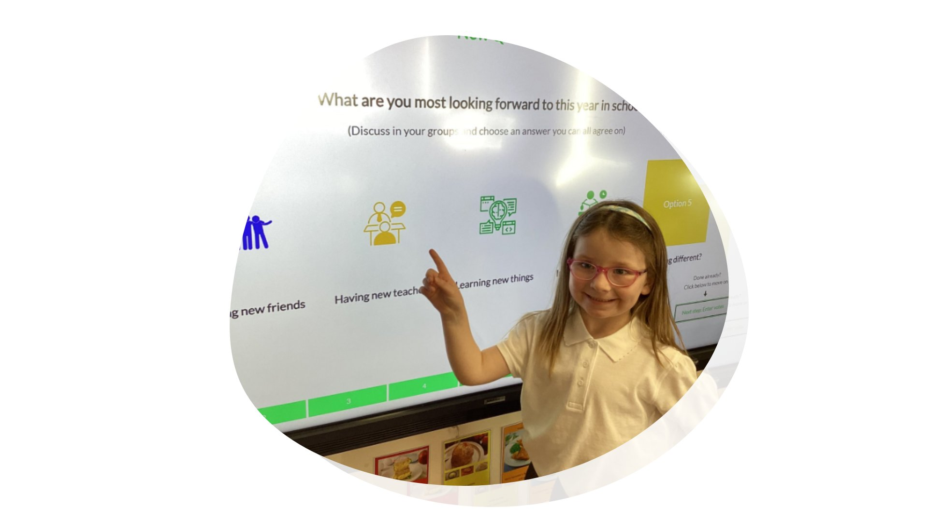
How it works
Every class, every week. Pupils lead. Teachers step back.
In practice
v
Pupils lead short, structured discussions
v
5 to 10 minutes per session
v
Ready-made questions or set your own
v
Every class takes part, not just reps
v
Results shared back to school leadership
"It's really nice to hear students who wouldn't ordinarily speak, want to not just interact in their groups, but also to lead as well."
Sarah, SEN secondary teacher, Greater Manchester

Slide 5
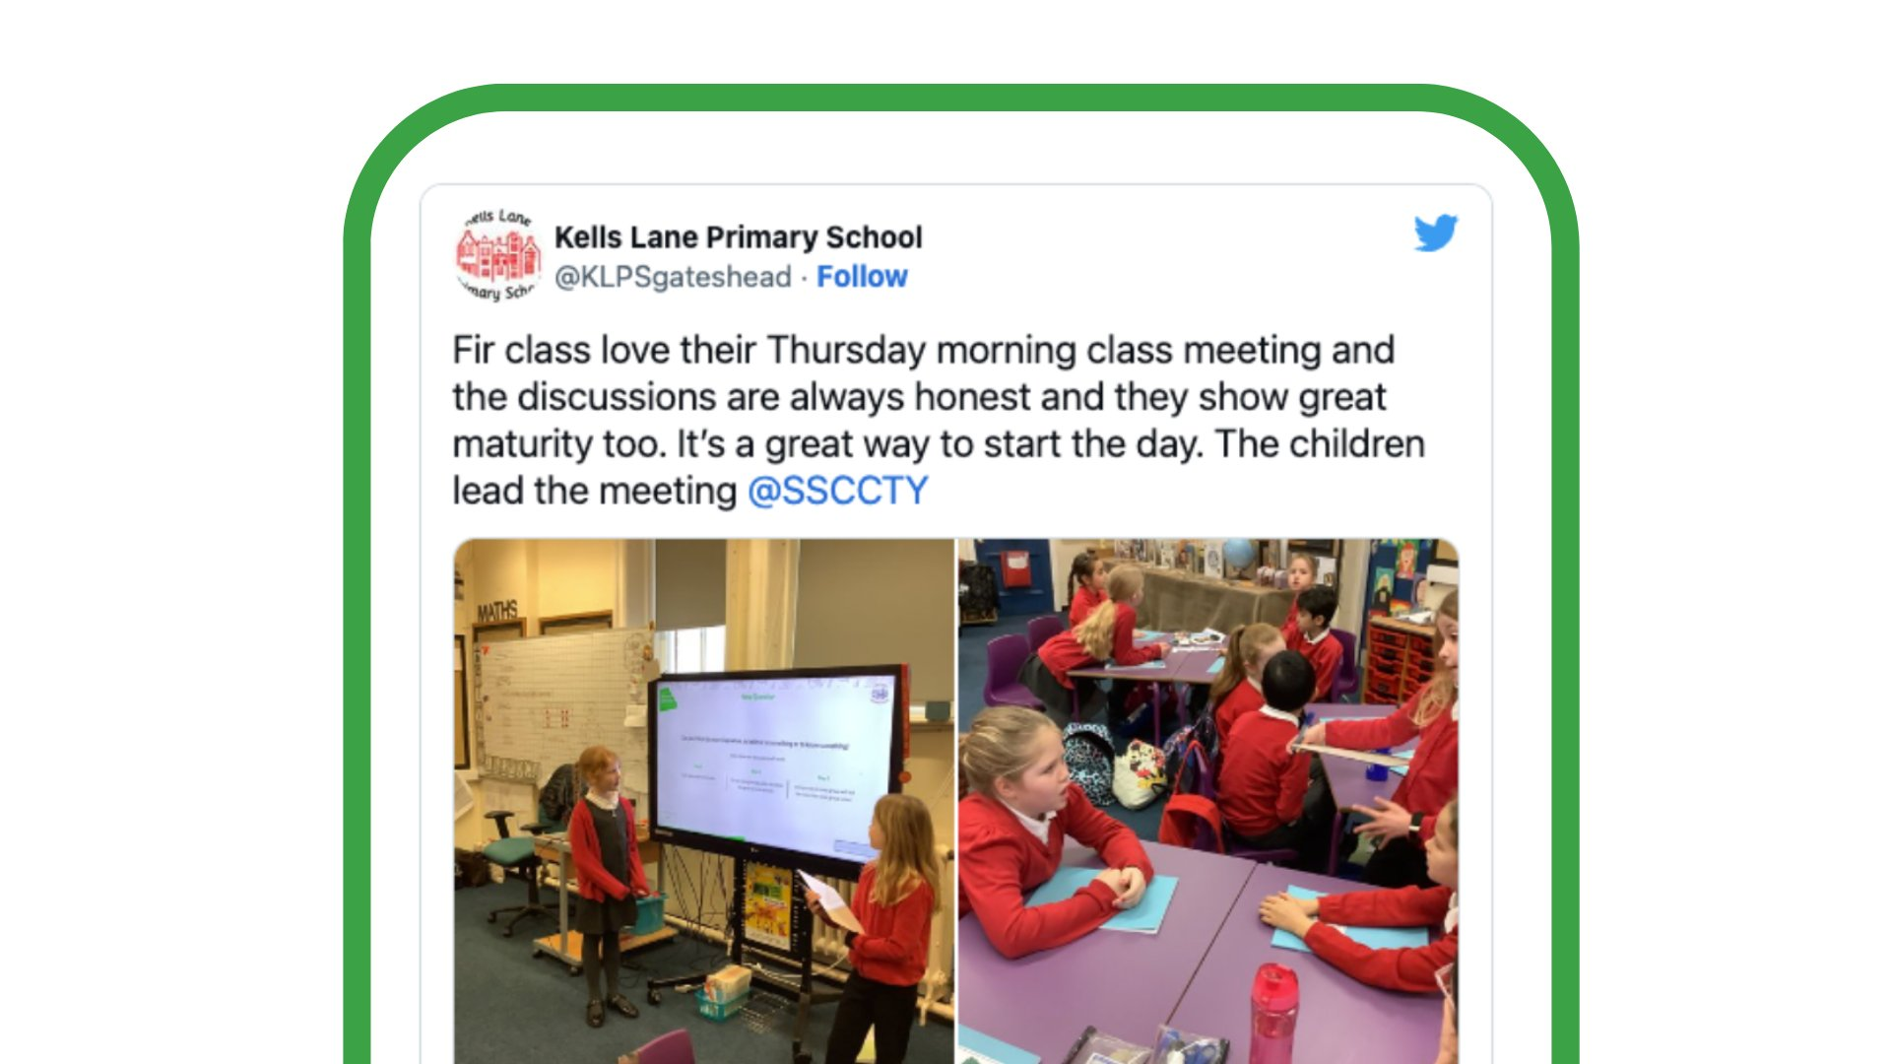
Proof at scale
This approach is already being implemented across all schools in Blackpool. And teachers in Greater Manchester describe tangible change.
SEN schools, Greater Manchester
"Through Smart School Council we were able to gauge pupil voice and now they've got a big summer house, gym equipment, swings, seesaws. It's made a genuine difference."
Katie, SEN trust advisor, Newbridge MAT, Greater Manchester
The split-question format makes structured debate accessible for every pupil, regardless of need.
"Fir class love their Thursday morning class meeting. The children lead the meeting." Kells Lane Primary School

Slide 6
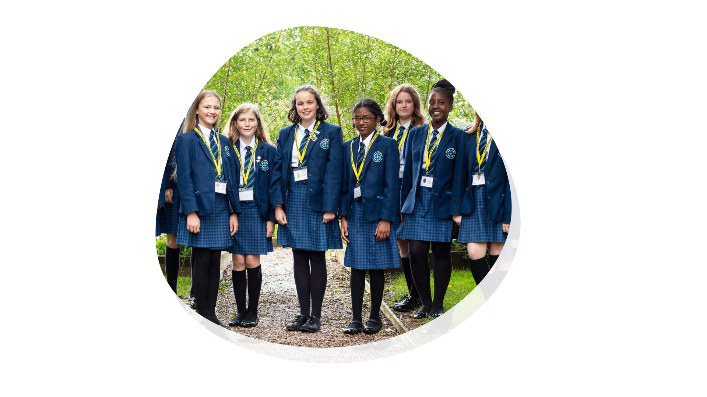
Why Greater Manchester is ready
This is not a new or untested approach.
750
100+
1,200
schools nationally
already in GM
GM schools potential
What teachers told us about Manchester
"There's something in the water in Manchester about speaking up and social justice. If we're doing class meetings in every classroom anyway, why can't we connect this up?"
Teacher, Greater Manchester

Slide 7
What teachers told us
We met with teachers from across Greater Manchester. Three things came through in every conversation.
1
2
3
We need pupil voice that reaches the children who don't usually speak
Pupils want to hear perspectives from across Greater Manchester, not just their own school
If leaders ask for views, they must come back and show what happened next
"I really dislike the rep being voted in. That's exactly the opposite of what we do here. And I think that's why it works."
"Being able to see how the city answered - that's really powerful. It connects them to outside their own little bubble."
"We need them to come back to us. Even if it's no - as long as they're giving an answer."
Nicola, literacy coordinator, St John Vianney, Greater Manchester
Becky W, assistant head, all-boys secondary, South Manchester
Nicola, literacy coordinator, St John Vianney, Greater Manchester

Slide 8
"
We spent a long time on it. We put it forward. That year group left and we didn't get anything back at all.
If we do this in Manchester, it has to be different. Young people deserve a response.
Nicola, literacy coordinator, St John Vianney, Greater Manchester

Slide 9
A programme, not just a platform
Teachers told us a package with milestones motivates far better than an open invitation.
Sept
Oct-Dec
Jan-Mar
Apr-Jun
July
1
2
3
4
5
Launch
Run
Build
Showcase
Report
Schools enrolled, teachers onboarded, first shared questions set
Weekly class meetings, city-wide themed questions, school sharing
Borough-level insights, adapted for primary, secondary, SEN
City event: students present to councillors, mayor responds publicly
Impact report to all schools. What was heard. What happens next.

Slide 10
The outcome
Every pupil in Greater Manchester
experiences democracy in school
Participation no longer depends
on confidence or volunteering
Inclusive, regular, structured, not self-selected or one-off
The children who never usually speak get to lead
Pupil voice becomes universal,
equitable, and routine
Schools meet existing expectations
more effectively
Embedded in everyday school life, not bolted on
Personal development, oracy, British Values, SMSC
Greater Manchester becomes the first city-region to build a civic infrastructure for young people, starting in schools.

Slide 11

Who we are
Smart School Councils is a registered charity (no. 1156110), founded to help every child find their voice.
750+
73%
100+
8
schools using SSC
renewal rate
schools in Greater Manchester
years running
Proudly supported by
Proudly supported by the
King Charles III Charitable Fund
"Smart School Councils are great. Anybody who sees it in action can only be inspired."
Alastair Campbell, Writer and Communications Expert
Member schools include:
Bramley Green Primary | Bernard's Academy | St John Vianney | Newbridge MAT | Beckfoot Allerton | Selworthy School | and 745 more

Slide 12
The ask
Help Greater Manchester build the classroom
infrastructure for inclusive civic participation.
A one-off 40k investment to enable a Greater Manchester-wide civic infrastructure for young people.
v
Support the programme in every school in Greater Manchester
v
Remove cost as a barrier to participation
v
Enable shared learning and place-wide rollout
v
Embed a sustainable system with accountability built in, not a time-limited project
We would love to launch this going into next academic year 26/27

