Slide 1
Stock Analysis Using Data Clustering
Shin, Gregory - Elnashar, Ashraf - Setzo, Gafei

Slide 2
Abstract
One of the main concepts in pattern recognition is clustering.
This technique is used as important knowledge discovery tools in modern machine learning process.
Clustering of high-performance companies is very important not only for investors, but also for the creditors, financial creditors, stockholders, etc.

Slide 3
Introduction
The stock market is a random, making it difficult to manage a successful portfolio
The purpose of any investor is to achieve a high return with low risk
Investing in companies stocks needs financial knowledge, profitable stock selection and efficient use of capital
Clustering or cluster analysis is the main method of classification.
Clustering is used to divide a data set into classes using the principle of maximizing the intra class similarity and minimizing inter class similarity.
It means that, clusters are formed so that objects which are similar are grouped together and objects that are very different fall into other clusters
Can we cluster to gain an edge to tell us when to invest and where to diversify?

Slide 4
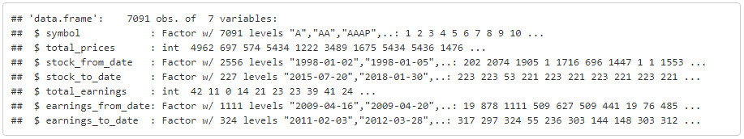
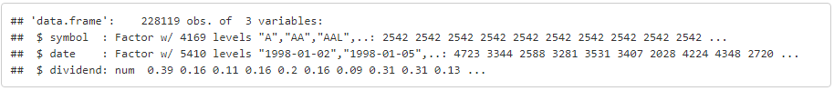
Data preprocessing
The dataset consists of the following attributes
Dataset Summary
Divide ends dataset

Slide 5
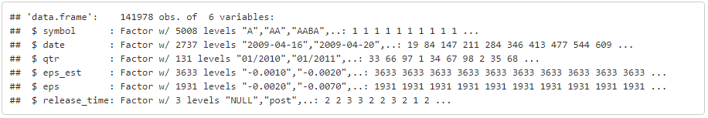
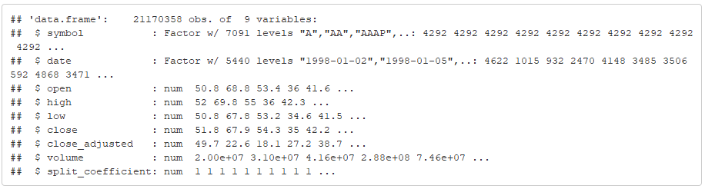
Data preprocessing
Stock Prices
The dataset consists of the following attributes
Earning Dataset
Dataset Stock Price

Slide 6
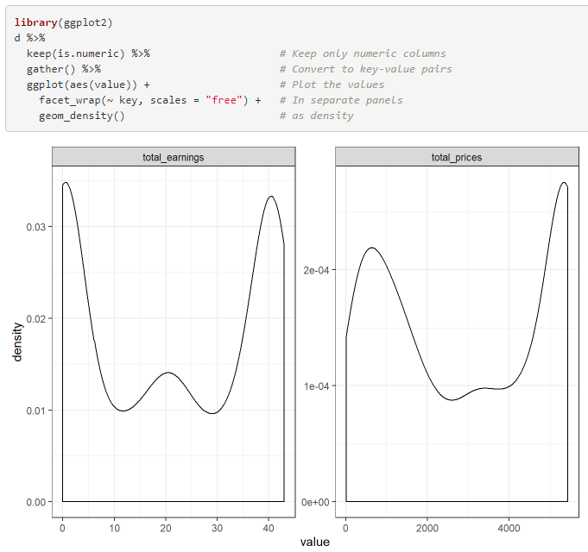
Data preprocessing
Total Price and Total Earning

Slide 7
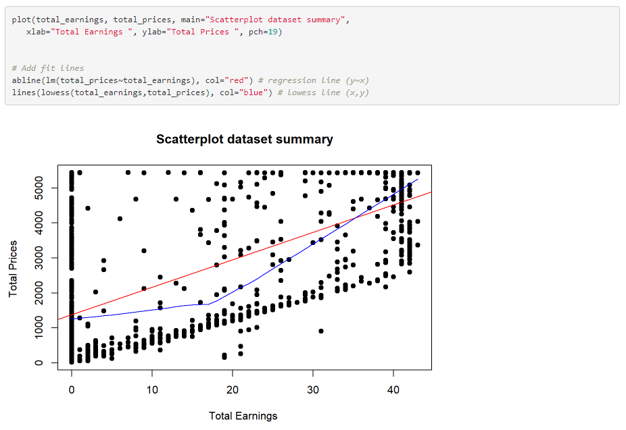
Data preprocessing
Total Price VS Total Earning

Slide 8
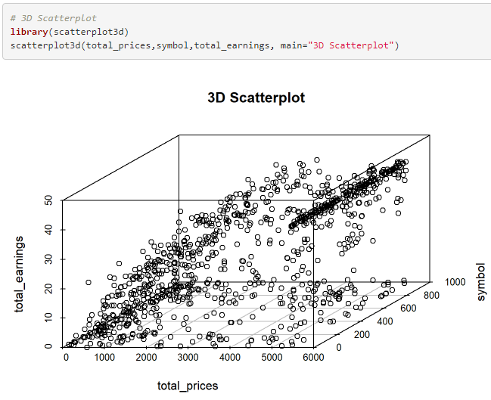
Data preprocessing
Total Price vs Total Earning

Slide 9
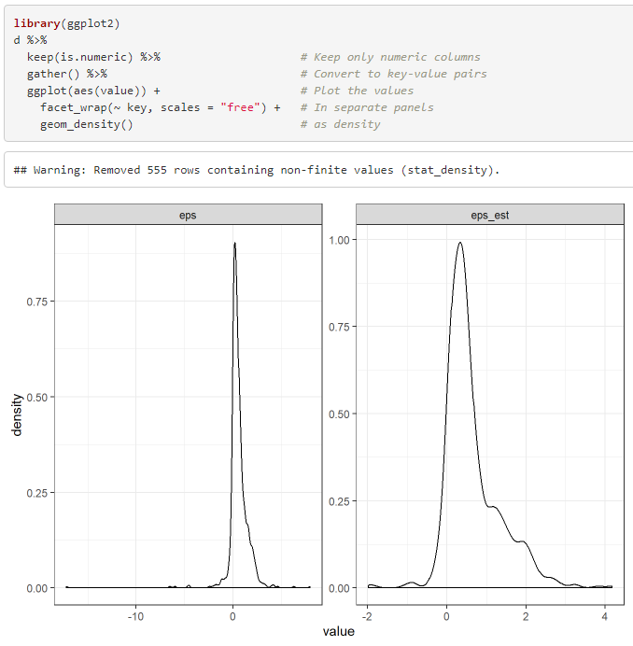
Data Preprocessing
Eps(Earning/Share) and Eps estimate

Slide 10
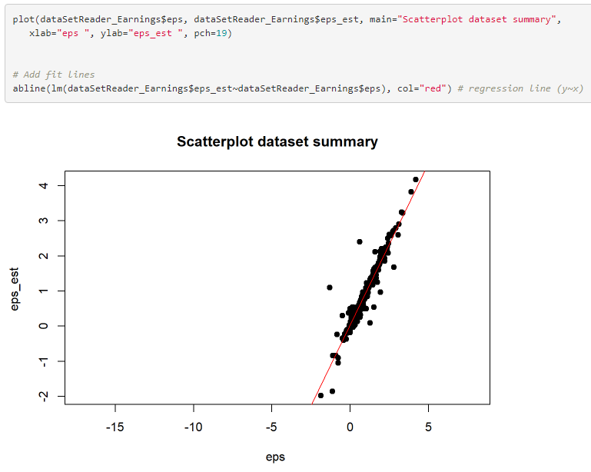
Data Preprocessing
Eps(Earning/Share) vs Eps estimate

Slide 11

Hierarchical Clustering and Stock Earnings

Slide 12
Questions and Objectives
Can hierarchical clustering be used to group stocks together based on performance?
Which algorithm will give the best results?

Slide 13
What Is Earnings Reporting?
Analysts make educated guesses on how well or how badly a stock’s shares will perform
Companies report earnings each quarter
How well or how poorly a stock matched expectations will affect how the stock is valued

Slide 14
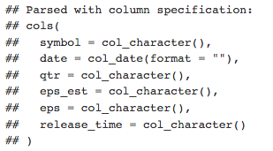
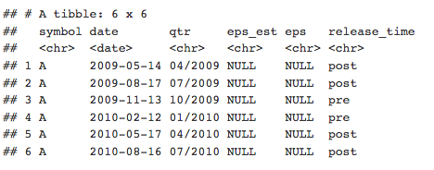
Additional Pre-Processing

Slide 15
Dendrogram Comparison

Slide 18
Optimal Clusters

Slide 19
Cluster Comparisons

Slide 20
Divisive

Slide 21
Agglomerative

Slide 22

K-means Clustering on Stocks for 2018
The Big Short, Paramount Pictures

Slide 23
K-Means Clustering for 2018
Can we gain an edge an identifying when is a good time to buy a stock?
Cluster based on how stocks move as an aggregate

Slide 24
K-Means –MORE Data Preprocessing
Data is split to only the year 2018
21 Million Observations down to only 1.5 million observations
Removed any stocks that had 0 volume
Implies no change in stock price
Focused on Adjusted Closing Price of stock
Interested in how stocks moved, day to day, or potentially, what’s a good trading day?

Slide 25
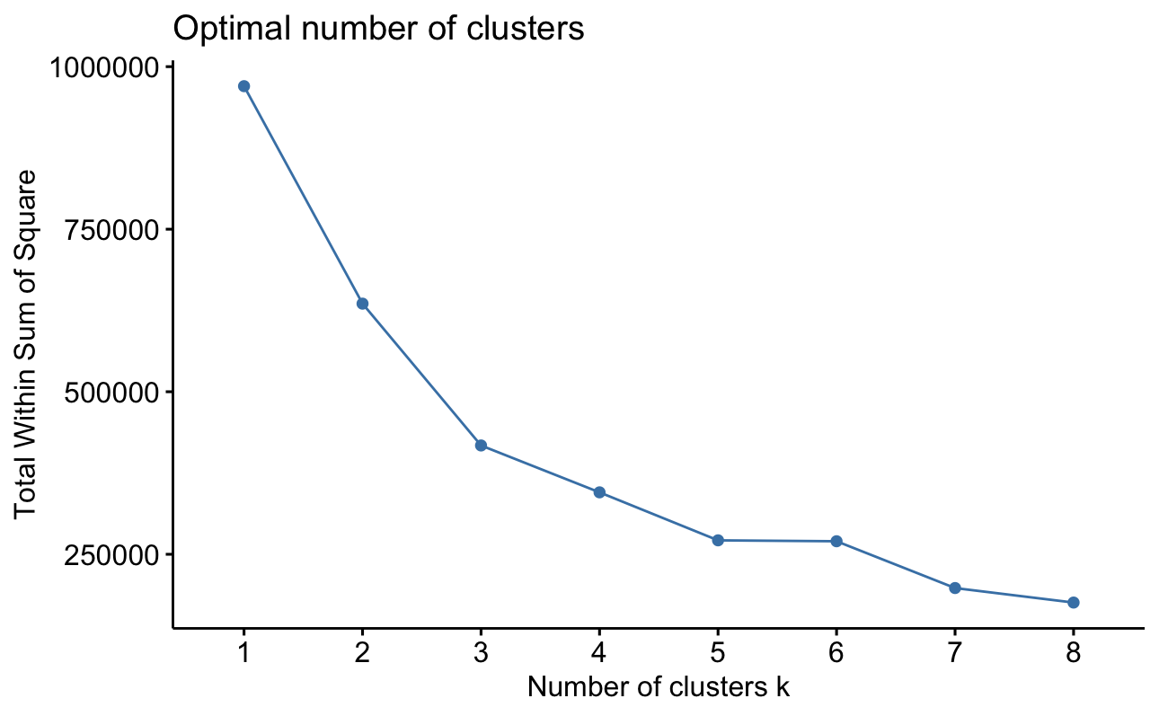
K-Means –Determining k size

Slide 26
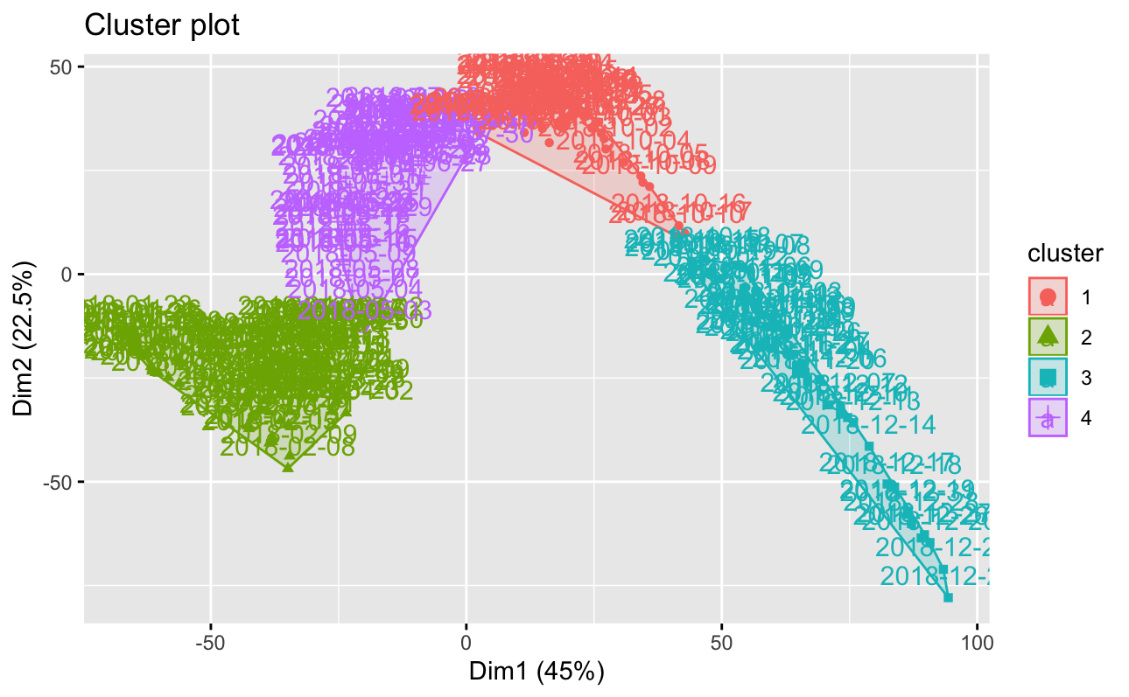
K-Means – k = 4

Slide 27
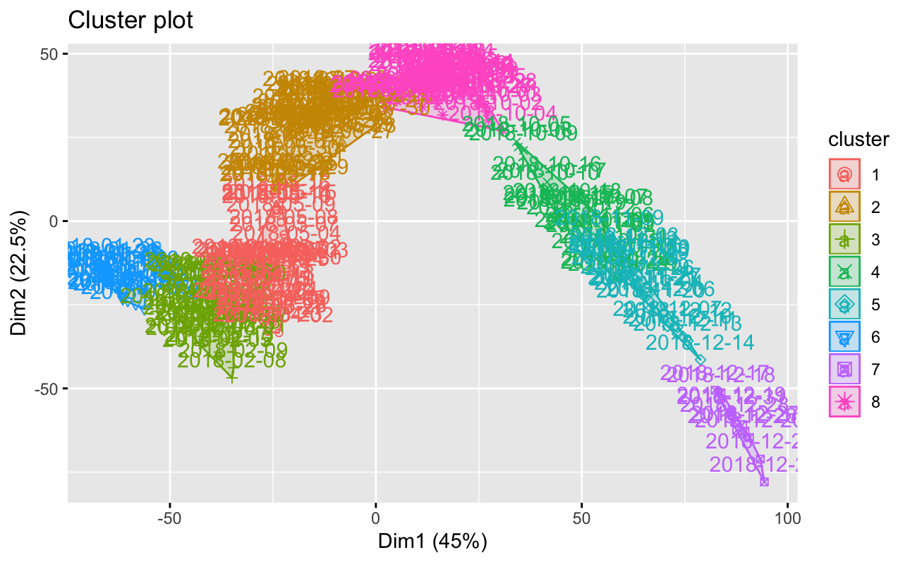
K-Means – k = 8

Slide 28
K-Means - Analysis
K-Means clusters showed which day in 2018 could be a gain or a loss
Clusters that trended up meant potential days that were profitable
Clusters that trended down meant potential trading that days that were not profitable

Slide 29
Conclusion
Depends on what you’re looking for
Divisive seems better at identifying expected performance
Agglomerative seems better at identifying above and below expected performance
Clustering can be used on stock earnings reports!

Slide 30
Thank you

