Slide 1

Fanduel Case Study
Presentation
Greg Sikorsky
May 20th, 2025

Slide 2
Objective
The Case Study asks to measure the impact of a CRM sportsbook promo given to targeted users on January 21st, 2020.
We have a Control Group that did not receive the promo, and their usage data over the same time frame.
We are assuming the goal of the promotion would be to spark key business metrics such as, generally speaking, engagement and revenue.
The following slides run through the explanation of the methodology behind the analysis, as well as the results using the provided data.
We will finish with recommendations for the CRM team as well as reflections on potential limitations of the study and possible alternative avenues to explore.

Slide 3
Methodology
Analysis Window: 2 weeks before and after the promotion went live.
Explanation: A larger sample would be preferred, however the data provided only accounts for that of approximately 16 days after the promotion, hence a two week period was chosen.
Difference in Differences approach to isolate the promotion impact.
First, we measure the change in GGR before and after the promo for the Target Group. Then, the same change is measure for the Control Group. Finally we subtract the Control Group’s change from the Target Group’s to isolate the impact cause by the promotion.
ΔGGR = (Target After -Target Before) - (Control After - Control Before)
We can then utilize this Differential GGR to calculate ROI
ROI tells us how much revenue was generated for every dollar spent on the promotion
The cost is the total Bonus awarded to the players
The return is the differential ROI divided by the total cost (Bonus)
Incremental GGR
ROI = —----------------------------------------------------
Total Bonus Awarded

Slide 4
Methodology continued
Through utilizing Python for a variety of descriptive statistics and visualizations, a story can be told with the data and the outcome of the promotion.
Key metrics include unique player count, handle, and ggr (gross gaming revenue).
Metrics are also broken down by both Target/Control groups as well as Value Tier.
And, of course, metrics are divided into the “before” and “after” ie. the two week periods before and after the promotion went live.
Data pre-processing note: It was determined that players that wagered greatly outside the normal amount should be removed for the sake of this experiment as they were greatly skewing the results.
Solution: removed players that were in the top 1% of handle.
I will make a recommendation around these high value bettors later in the presentation.

Slide 5
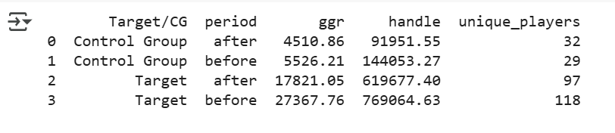
Summary Statistics
It is interesting to note that in the Target group, every key statistic decreased after the promotion went live.
Handle dropped by about $150,000 in the Target group and about $52,000 in the Control Group.
GGR dropped by about $9500 in the Target group and $1,000 in the Control Group
The number of unique players increased in the Control group by 3 and decreased in the Target Group by 21.

Slide 6
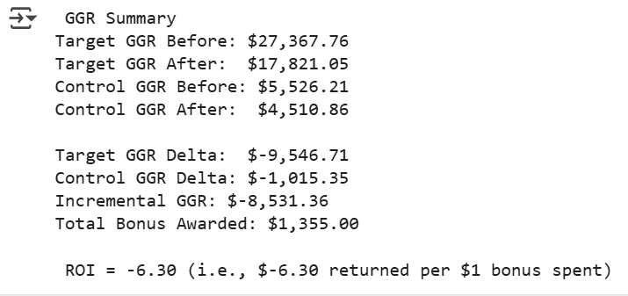
ROI Summary
ROI was negative for the promotion as a whole

Slide 7
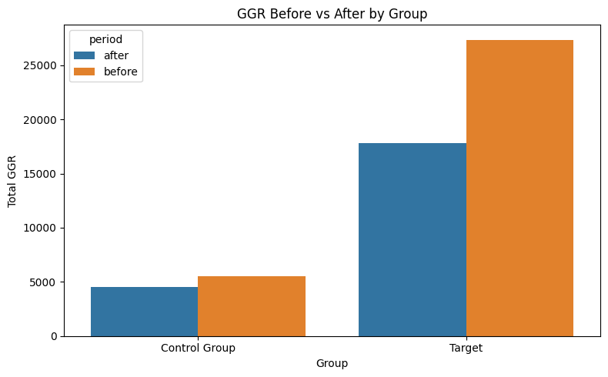
GGR before and after
GGR decreased in the targeted group

Slide 8
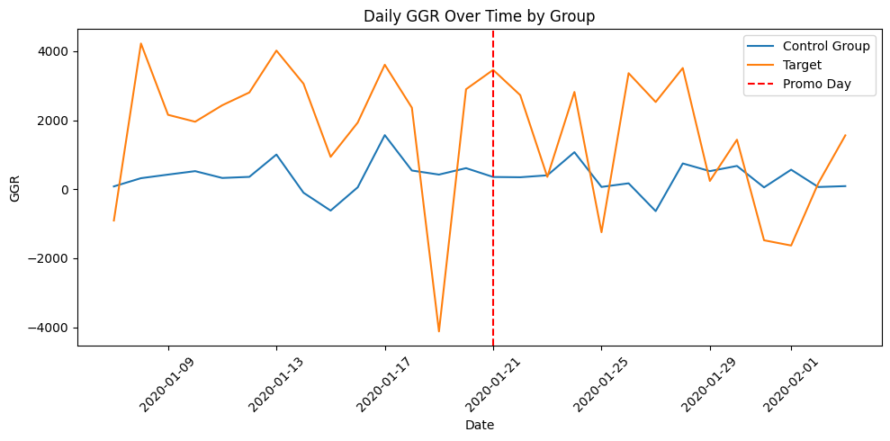
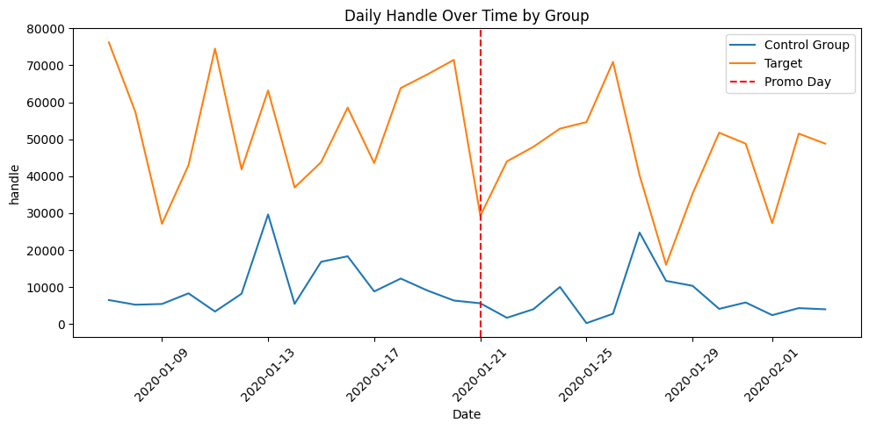
Daily GGR & Handle before and after
Players were doing slightly better in the weeks after the promo
Handle slightly declined in the Target group which is unexpected given the promo driving people to play more.

Slide 9
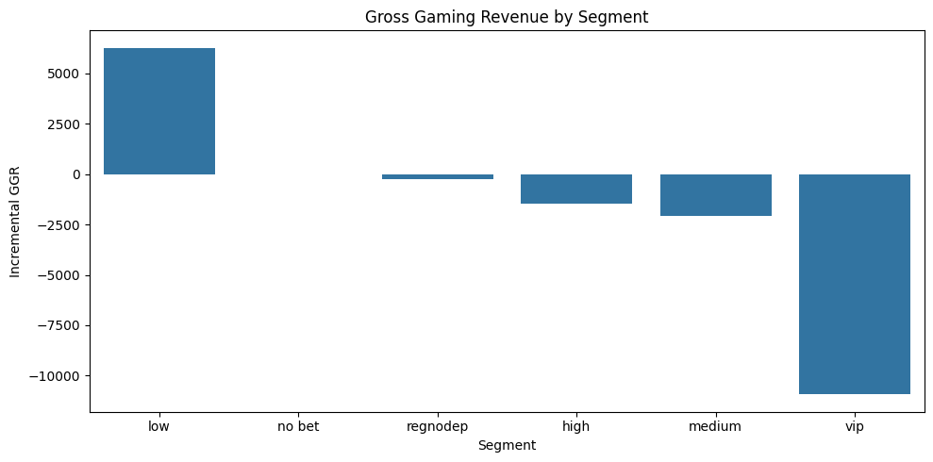
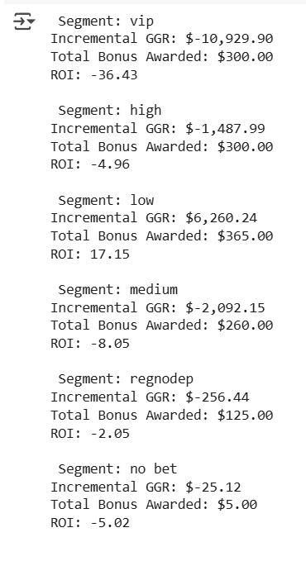
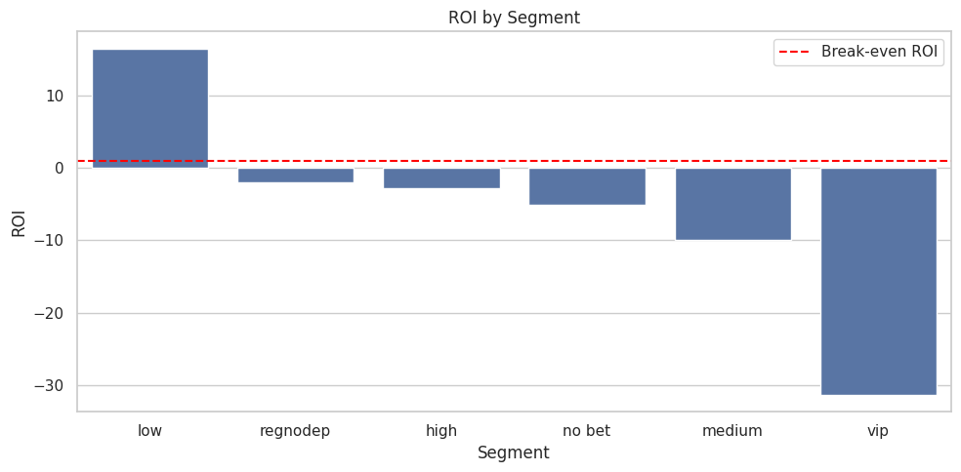
ROI & GGR By Segment
“Low” Value Tier accounted for the only positive ROI post promo

Slide 10
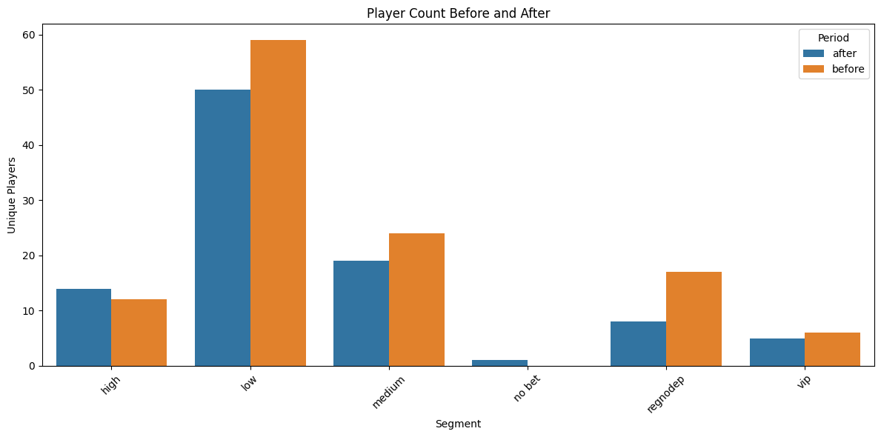
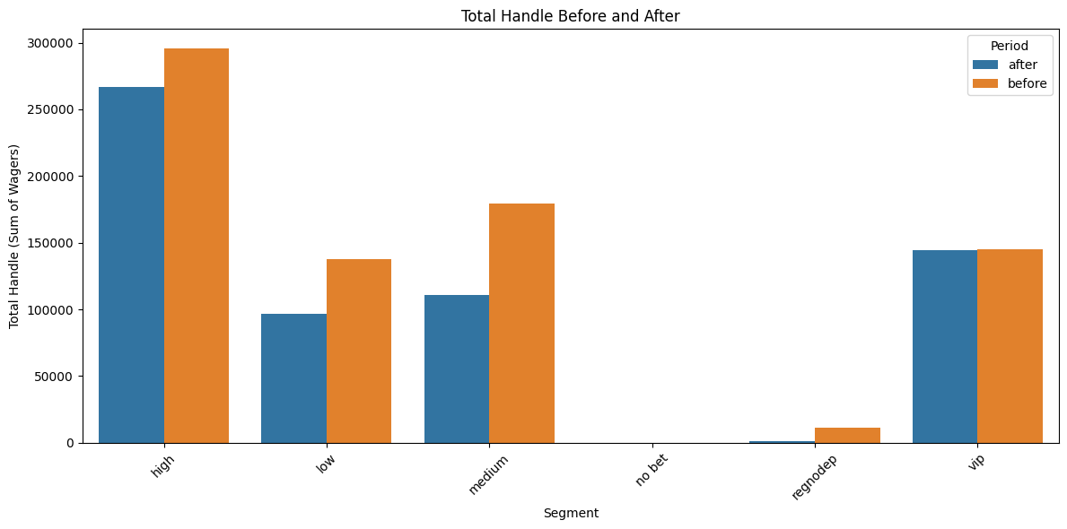
User Engagement Metrics by Segment
These charts are for targeted players only.
Unique player counts and handle both dipped slightly post promotion for most segments which is not what we would have expected.

Slide 11
Outlier Recommendation
I would like to further explain the rationale for the outlier exclusion proposed earlier.
One user, player id 1232188 won approximately ~$19,000 on January 28th, 2020, which was heavily skewing the results of the experiment to make the outcome seem even worse given his or her large win.
This user had been slightly inactive since mid December. However, after the promotion, this user turned in a extremely large handle of ~$446,000 across 4 different days of playing.
It could be worth examining whether promotions like this disproportionately affect these very large volume bettors.
This could be an opportunity for further examination and analysis.

Slide 12
Experiment Results & Possible Explanations
It is clear from the charts that the promotion did not produce the results that would have been expected and desired.
As evidence by the charts and stats show previously: Gross Gaming Revenue, Handle (when filtering out player 1232188) and Unique player count all slightly dipped in the two weeks after the promotion was launched compared to the two weeks prior.
Explanations:
Some users may simply spend the bonus instead of their own funds
Most of the users were in the “Low” value tier and may be infrequent bettors and hence not sensitive to promotions such as this
Promotion may not have matched the the behavior or interest (ex. A bonus bet on a sport the user is not interested in) of the users
Bonus was not a significant enough amount compared to average bet size/ bankroll to generate interest
The 2 week period post promotion may be too short of a timeframe to measure the impact
Was unclear on how bonus was to be obtained or there existed a bonus at all.
A major key here that would be useful for further investigations is whether users engaged with the promo. It is unclear from the data if users actually even user or were aware of the promo.

Slide 13
Recommendations to CRM team
The most profitable group from the promotion was the “Low” value tier. They generated about a 17% ROI, despite the lower handle post promotion. (slide 8)
Another group to examine would be the VIP group. Although they were by far the least profitable, including the outlier, the VIP group seemed to greatly increase their handle post promotion. GGR can be quite a high variance metric. (slide 8-9)
Similar to the previous point, and the outlier recommendation slide, further exploration of what promotions these wagering whales may sensitive to could yield a very large amount of both wagers and, in turn, profit.
Strategies to recommend to improve future promotions tests:
Experiment with tiered or staggered bonus structures to incentivize recurring activity.
Strategically select bettors chosen for both the Targeted and Control Groups.
Capture data around promotion visibility and engagement.

Slide 14
Limitations and Further Research
Perhaps the most key limitation from the study is the fact that GGR is a highly variable metric. In the gaming space, it is expect GGR would fluctuate given that the outcomes are not fully controllable. Assuming there is no issue regarding the lines being set, and enough bets/money are coming in, in the long run profitability will be ensured.
Other key metrics for this study would be the number of bets, the average value of bets, the session length, etc. These would help paint a better picture about user behavior before/after the promotion.
Certainly, as previously mentioned, this dataset and experimentation was subject to outlier sensitivity. Removing the top 1% handle bettor introduces subjectivity and might cut out genuine high-value behavior. Recall: Handle would have increased had said bettor been included
The limited observation window of just 2 weeks after the promo may not fully capture its impact
Additionally, this begs some further questions about the promo such as: How long users had to claim the promo? Was it only available for certain sports? Were users aware of promo? Etc.
Considering the promo was a one-time use, it may not encourage behavior over time or repeated engagement.
The Target & Control groups selections process is certainly another limitation simply because we are operating with limited information on how they were chosen. This could be skewing the results.

