Slide 1
Singletons Are Evil
Or, How Could Such A Simple Pattern Go So Bad?

Slide 2
Agenda
What, specifically is a Singleton?
Hey, that looks pretty useful, so why is it Evil?
Ok, ok, I get it. But what other options do I have?
Wait! I've already got a lot of Singletons! How do I cope?

Slide 3
What, specifically is a Singleton
  As defined by [GoF]:
  [A Singleton ensures] a class has only one instance, and provide[s] a global point of access to [that instance].

Slide 4
The Gamma Singleton
class Singleton
{
public:
static Singleton* Instance()
{
if (!instance) instance = new Singleton;
return instance;
}
//<other operations>
private:
Singleton();
Singleton(const Singleton&);
Singleton& operator=(const Singleton&);
~Singleton();
static Singleton* instance;
//<other data>
};
//in singleton.cpp
Singleton* Singleton::instance(0);

Slide 5
The Meyers Singleton
class Singleton
{
public:
static Singleton& Instance()
{
static Singleton instance;
return instance;
}
//<other operations>
private:
Singleton();
Singleton(const Singleton&);
Singleton& operator =(const Singleton&);
~Singleton();
//<other data>
};

Slide 6
Hey, that looks pretty useful, so why is it Evil?
It's really a global
It violates the Single Responsibility Principle
It statically couples classes
It can't be subclassed (easily)
It has concurrency issues
It has awkward syntax

Slide 7
Ok, ok, I get it. But what other options do I have?
Do you really need a singleton lifetime anyway?
Flyweight
Monostate

Slide 8
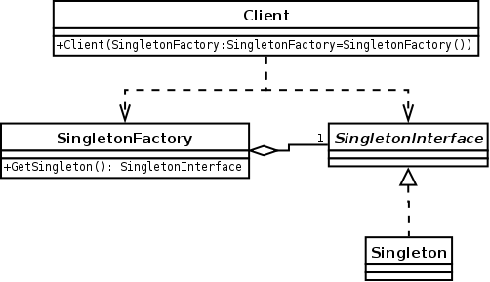
Flyweight

Slide 9
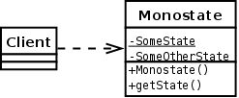
Monostate

Slide 10
Wait! I've already got a lot of Singletons! How do I cope?
State Savers
Constructor Injection

Slide 11
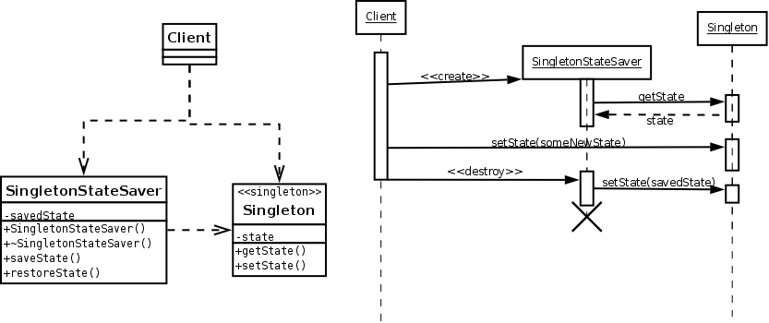
State Savers

Slide 12
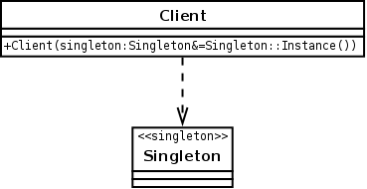
Constructor Injection

