Slide 1
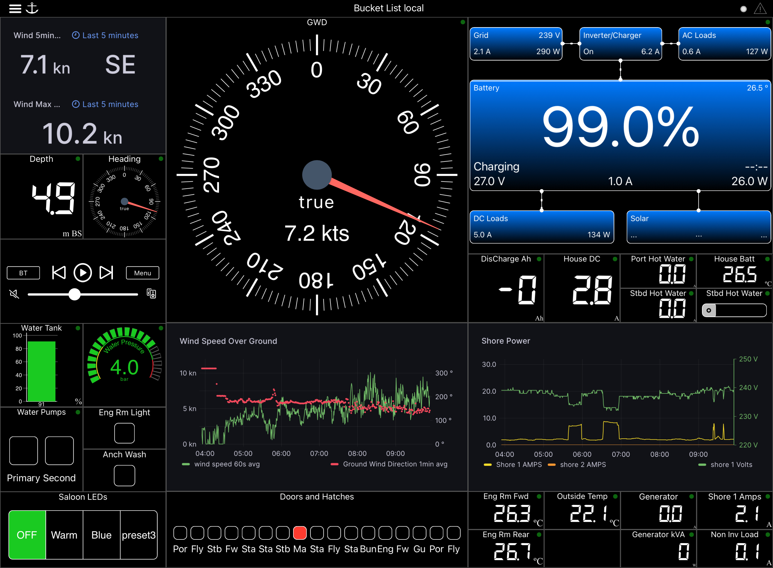
“Electrical Overview” Venus OS paths or individual paths
“Web ”
Grafana “stat” dashboard
“Switch w/Led ”
“Mini Fusion ”
“Fresh Water / Bar ”
“Web”
Grafana time series dashboard
http://<ip address>
- Capture IP address when Grafana in kiosk mode
- Disable show controls in WSK
“Pressure/ Circle ”
“Multi Switch”
“LED bank”

