Slide 1
Fujitsu
PFU Systems Group
June 3, 2011

Slide 2
CA Campaign Overview
Objective
The main objective of this campaign is to gain measurable market exposure and generate short-term leads while creating a longer-term funnel for the Channels via awareness & demand generation call to action techniques.
Target audience
Geographic Targets:
CA, NJ, NY, WA, FL, NV, UT
Verticals:
Mfg, IT, Financial Services, Legal
Functional roles including IS/IT/MIS DecisionMakers, Senior IT mgrs, C Level
250+ employees

Slide 3
Mardev-DM2 Lead Generation
Mardev-DM2’s definition of best practice lead generation:
‘The development and delivery of effective dialogue with individuals via integrated, relevant, personalised, timely and engaging content based upon their specific profile, behaviour and identified needs. The aim is to establish lasting and valuable relationships that result in greater revenue, profitability and a superior return on marketing investment.’

Slide 4
Recommended Tactical Plan

Slide 5
Recommended Tactical Plan
Campaign | Purpose
Initial Survey | Identify short-term and long-term pain points, immediate needs, etc.
White Paper (Email+Reminder) | Route leads - Gauge engagement and audience interest
White Paper 2 (Email+Reminder) | Route leads - Gauge engagement and audience interest
Webinar | Generate additional engagement to determine interest and move audience along in the buying cycle
White Paper 3 (Email+Reminder) | Route leads - Gauge engagement and audience interest

Slide 6
Understanding Prospect Growth Planning - Survey
Stage 1: Survey deployed to target audience selected from Mardev-DM2 Global Database (up to 10 questions)
Key Insights Learned from Survey
2011 Solutions
Short-term pain points
Immediate needs
Mardev-DM2
Global
Database
Solutions
Survey
Survey respondents profiled to gauge interest & identify and target prospects for dynamic lead generation program in next stage.

Slide 7
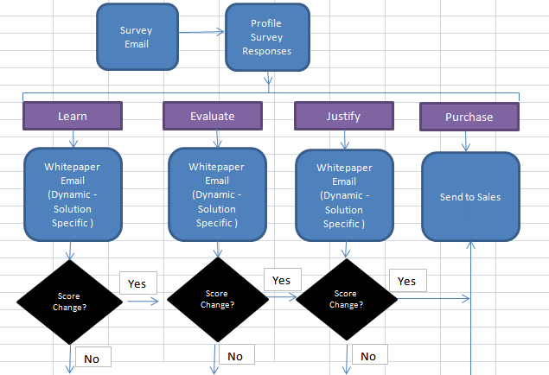
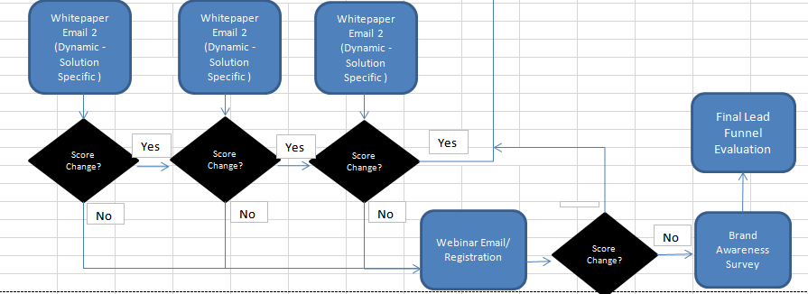
Demand Generation Workflow
Stage 2:
Dynamic lead generation program: Emails sent to target segments of Mardev-DM2 global database based on the profiles from stage 1 to create/gauge interest from each prospect group
All email traffic will be routed to a custom hypersite.
All engagement activities will be routed through a Lead Scoring Model to determine the quality of the lead.

Slide 8
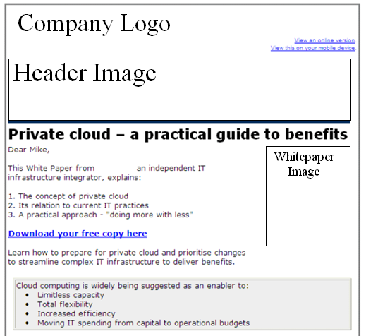
Sample Dynamic Message – Cloud Comp. Example (Learn)

Slide 9
Scoring Leads

Slide 10
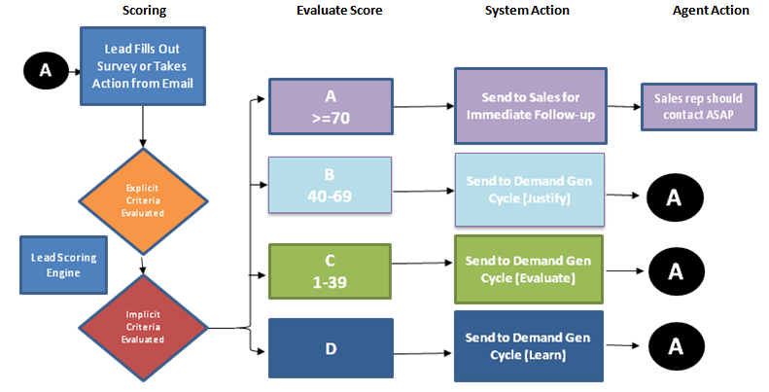
Lead Scoring Process Steps
10

Slide 11
Evaluating Explicit Scores
Profile Fit
Category | Ranking | Weighting | Field Values | Tier | Score | Max Score |  | Profile Fit
Pain / Need / Solution Interest | 1 | 30% | Field Value 1 | Tier 1 | 30 | 30 |  | A | 75 - 100
 |  |  | Field Value 2 | Tier 1 | 30 |  |  | B | 50 - 74
 |  |  | Field Value 3 | Tier 1 | 30 |  |  | C | 25 - 49
 |  |  | Field Value 4 | Tier 2 | 15 |  |  | D | 0 - 24
 |  |  | Field Value 5 | Tier 3 | 8
Job Role | 1 | 30% | Field Value 1 | Tier 1 | 30 | 30
 |  |  | Field Value 2 | Tier 1 | 30
 |  |  | Field Value 3 | Tier 1 | 30
 |  |  | Field Value 4 | Tier 2 | 15
 |  |  | Field Value 5 | Tier 3 | 8
Industry | 2 | 20% | Field Value 1 | Tier 1 | 20 | 20
 |  |  | Field Value 2 | Tier 1 | 20
 |  |  | Field Value 3 | Tier 2 | 10
 |  |  | Field Value 4 | Tier 2 | 10
 |  |  | Field Value 5 | Tier 3 | 5
11

Slide 12
Evaluating Implicit Scores (Activity)
Key Elements in Evaluating Activity
Recency
Activity Type
Engagement
Category | Ranking | Weighting | Time Frame | Score | Max Score |  | Engagement
High Touch Event Participation | 1 | 30% | < 6 Months | 30 | 30 |  | 1 | 75 - 100
 |  |  |  |  |  |  | 2 | 50 - 74
 |  |  |  |  |  |  | 3 | 25 - 49
Form Submission | 2 | 25% | 3 days | 25 | 25 |  | 4 | 0 - 24
 |  |  | 7 days | 15
 |  |  | 30 days | 8
Visited High Value Web Content | 3 | 20% | 3 days | 20 | 20
 |  |  | 7 days | 10
 |  |  | 30 days | 5
3+ Website Visits | 4 | 15% | 3 days | 15 | 15
 |  |  | 7 days | 8
 |  |  | 30 days | 4
Email Click Through | 5 | 10% | 3 days | 10 | 10
 |  |  | 7 days | 5
 |  |  | 14 days | 2
 |  |  | Total Possible |  | 100
12

Slide 13
Implementation

Slide 14

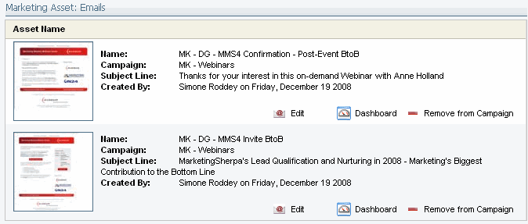





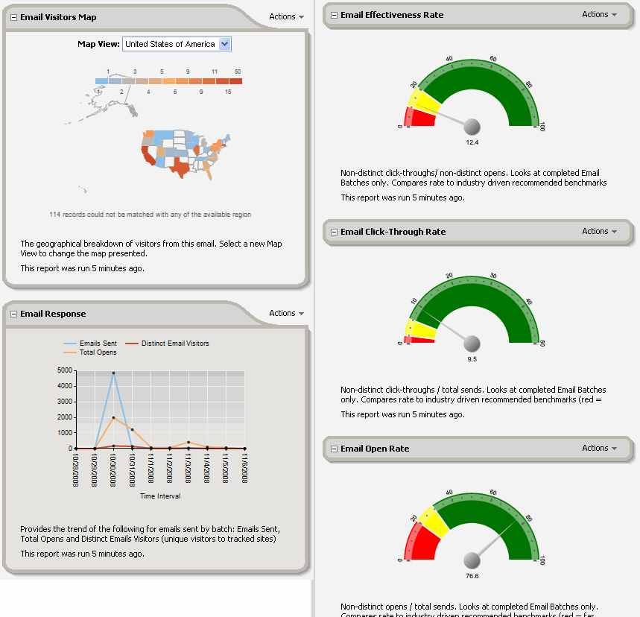


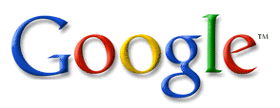




The Buyer’s Journey
3
4
Cleanse Data
Plan Campaigns
2
5
Target & Segment
Trigger Events
1
Profile Prospects
6
Automate Programs
13
Measure &
Optimize Marketing
7
Execute Across Channels
8
Capture
12
9
Provide Sales Intel
Score
10
landing page
form
11
Alert Sales
Route
website
Notes:
These areas or inter-dependent on one another; the whole is greater than the sum of the parts. For example, without functionality for normalizing data, segmentation loses focus, lead scoring accuracy suffers and reporting is less precise.
This slide shows the relationship between these major areas of functionality in a linear fashion, starting with Eloqua’s contact management capabilities. (click)
CONTACT MANAGEMENT:
KEY DIFFERENTIATOR: Today, Eloqua is the only marketing automation platform on the market that provides a comprehensive suite of contact and data management tools. You need a solution that matches your data, not the other way around. Building specific, targeted segments can substantially increase conversion rates and contact management is key to that.
If you struggle with normalizing information (like VP to Vice President), appending data (like sticking that missing zero back on the front of your new England zip codes), replacing values in one with those from another (like automatically making an account owner the contact owner) or managing complex data relationships (like segmenting lists based on prior product purchases or campaign memberships), then Eloqua is the only choice for your business. (click).
CAMPAIGN MANAGEMENT:
These foundational tools are key to reaching the right prospects with the right message over the right channels. And this is where Eloqua’s campaign management tools shine. Use our Eloqua campaigns feature (TEAM ONLY) to associate multiple assets to a single campaign for ‘roll-up reporting’. Eloqua’s workflow automation solution, Program Builder, is the brains behind the operation. Use this intuitive, graphical UI (KEY DIFFERENTIATORS)to set event triggers (like website visits or downloads) and automate any marketing process. And not just demand generation campaigns. Free trial download programs; event communications; cross-sell and upsell campaigns; customer affinity and loyalty marketing, reference programs. At Eloqua we even have an Eloqua program for managing our HR recruiting campaigns.
KEY DIFFERENTIATORS:
email deliverability – In some ISP analysis, Eloqua’s reputation score is more than double those of vendors like Marketo, Manticore and Market2Lead. And If your email goes to junk mail 20% of the time, you are wasting a lot of time and money and potentially losing revenue opportunities.
More ways to reach your buyers - Eloqua supports the widest range of communication channels in the industry. In addition to email, you can touch your prospects (in a blast or triggered by activity) using direct mail, voicemail, RSS, SMS, Microsites, or any combination. Sports franchises like the Trailblazers and 76ers are aggressive users of SMS to upsell ticket packages. Our Forex trading customers like FXCM embed RSS feeds on personalized microsites to cross-sell financial data. Bella Pictures sends personalized postcards to convert wedding planners to their photography offerings. Which combination will work best for your customers?
Batch signatures - Maximize open rates through personalizing the “from name” on emails, improving campaign performance. Customers using batch signatures have seen open rates increase by 30% and clickthroughs by 300%.
International character support - Everywhere in the Application. Without consistent international character support, you limit your ability to personalize, accurately track, and segment on your data.
Eloqua supports throughout contacts/company data, filtering/automation rules, form submissions, reporting/exports, emails headers/content, landing pages and CRM Integration calls
LEAD MANAGEMENT
Eloqua’s lead management capabilities are best of breed. And that starts with a robust out-of-the-box integration with your sales force automation. Eloqua supports the broadest set of certified integrations on the market today, backed by a wide range of options for non-standard integration
Eloqua’s CRM Integration supports best practices for list segmentation, privacy/opt-outs, and data quality. These include:
• Sync contact-company hierarchies from CRM, allowing you to strategically segment your data (on more than contact data).
• 2-way sync opt-out between Eloqua and CRM allows sales team to comply with opt-out status of contacts.
• Use update rules to ensure that you’re only updating the right fields, rather than overwriting it all
When your prospect responds to a campaign, Eloqua is there to capture and act on that response – in a variety of ways. Forms, landing pages, microsites (Hypersites) all provide means of capturing and monetizing the impact of your campaigns – from webinars to whitepapers to Google adwords.
Use Eloqua Hypersites to personalize your interactive marketing campaign. Drive prospects to personalize URLs like Eloqua.com/BobSMith. Greet them by name and provide relevant content based on their title, industry, pain or any other contact field value.
Convert and Take Action. Our forms engine is intuitive and powerful, giving you dozens of ways to take action on a single form submission. For example, redirect the prospect to another page, send an auto responder, add them to a nurturing campaign, alert sales, add to a contact group.
KEY DIFFERENTIATOR: Score your leads to separate tire kickers from potential buyers. Use Eloqua’s more powerful and flexible features to match your specific business needs. Some examples:
Score accounts as well as contacts (for named account sales programs),
Have multiple scores for multiple product lines, divisions or functions.
Use our data quality tools to effectively score on job title (95% of titles are non-standard form entries and therefore hard to score without normalization)
Score prospects based on any website visit (competitors require a form submission)
Insulet uses Eloqua to automatically update multiple scores on each contact based on various product offerings.
KEY DIFFERENTIATOR: Get your leads to the right people FAST. According to MIT, Rapid follow-up is critical to generating qualified leads. Their Response Management Study (2007) found that the ideal response time is within the first hour! To help crack the 60 minute barrier, Eloqua offers more powerful lead routing options than any other vendor on the market, including: Named account matching,
State/Country Standardization,
Geographic routing,
Industry-specific assignment (government, military)
SuccessFactors uses Eloqua to route inbound inquiries to more than 250 sales reps in under one hour with 99% accuracy.
SALES ENABLEMENT
Once you get leads to sales reps, what do they do with them? Eloqua offers a suite of sales productivity tools to help reps track their hot leads, initiate marketing-approved campaigns, and have the right conversation with the right prospect.
The Eloqua Sales ToolKit includes:
KEY DIFFERENTIATOR: Eloqua Prospect Profiler – an intuitive graphical summary of prospect activity available in your CRM system. Profiler provides a visual summary of website visits, form submissions, email opens, click-throughs and search activity . In seconds, busy sales professionals get real time visibility into their prospects’ online activity - before they pick up the phone.
Eloqua for Microsoft® Outlook® An easy-to-use plug-in that enables marketing to create email templates with real-time tracking that sales can access and send directly through Outlook.
Web Visit Alerts - Real-time email alerts when hot prospects visit your website
Auto Email Reports – Any standard prospect activity report can be sent directly to a sales rep’s inbox to help them you track important contacts, companies or hot leads.
MEASURE AND OPTIMIZE
Once you’ve executed a campaign how do you measure your results?
Eloqua’s Marketing Measurement tools include hundreds of reports on marketing asset performance, campaign results, database health and website conversions. These can be viewed individually, pro-actively sent to teams or displayed in an Eloqua Dashboard. Example dashboards and reports include:
Contact or Contact Group dashboards – How complete is your prospect database? How often are you contacting them, how active are your segments?
Database health dashboards – what is the growth rate of your database? Unsubscibe/bounceback rates? What is your ration of active to inactive contacts? Where are you sourcing your prospects?
Campaign Dashboards – what is your campaign conversion rates and funnel performance? Which campaign assets perform the best?
CMO dashboard – how many leads are your campaigns driving into the pipeline? What are your most popular campaigns? Which websites, keywords, or social media outlets are your most prolific referrers to your website?

Slide 15

Measure & Optimize
14
Measure &
Optimize Marketing

Slide 16
Pricing

Slide 17
Pricing Estimate
Activity/Service |  | Q3, 2011 | Notes
Fixed Costs
DecisionMaker Email Data Lease |  | $9,000 | 25% discount off list pricee for email data based on 20,000 data contacts
Campaign planning & scoping; campaign process flow development; Value proposition & copy support. Best practise support. Telemarketing script support, advanced tracking. |  | $10,200 | $2,500 per month includes Eloqua license fee for database size of upto 20,000 names
1x surveys | 1 @ $825/survey | $825
3x email campaigns.** | 3 @ $520/deployment | $1,560 | Set-up of email creatives with dynamic content + 2 tests per
 |  |  | Any changes that require more than 1 hour of programming time will be billed separate @ $150 per hour with prior approval.
Webinar |  | $10,000
Project Management support |  | Incl
1 Hypersite – Develop, Maintain and host ** |  | $1,500 | $500 per hypersite per month
Co-Dynamic Lead Scoring & Custom Reporting |  | $1,725 | Any changes that require more than 1 hour of programming time will be billed separate @ $150 per hour with prior approval.
Asset Development |  | N/A | Leverage Fujitsu asset library
Total Costs |  | $34,810

