Slide 1

Nameplates For Industry Lead Nurture Program Overview
April 23, 2012

Slide 2
NFI Program Overview
Objectives:
Nurture NFI’s profiled prospects to help expedite their evaluation process and to communicate the benefits of NFI’s offerings by driving demand and capture interest over a period of time with prospects, by observing the detailed digital footprint of the non responder and nurture their interest via targeted emails.
Target Segments:
Segment A
Segment B
Segment C
35 -Industrial Machinery & Equipment
50 –Wholesale Trade – Durable Goods
All Additional SICs
36 –Electronic & Other Electric Equipment
73 – Business Services
38 –Instruments & Related Products

Slide 3
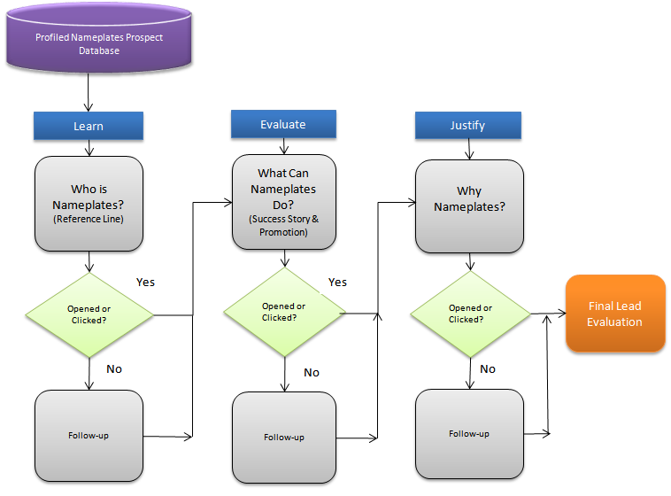
NFI Lead Nurture Flow
Emails sent to target segments of
the NFI prospect list to create/gauge interest from each prospect group.

Slide 4
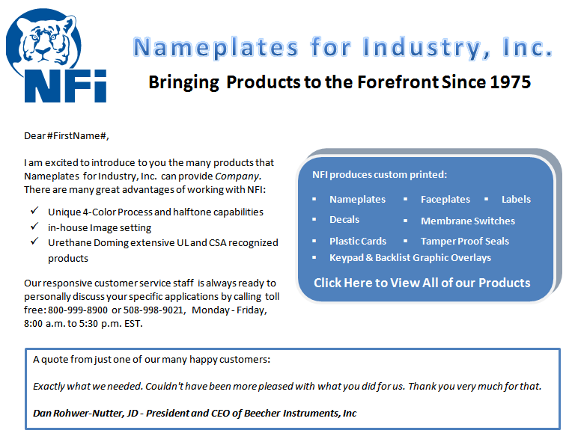
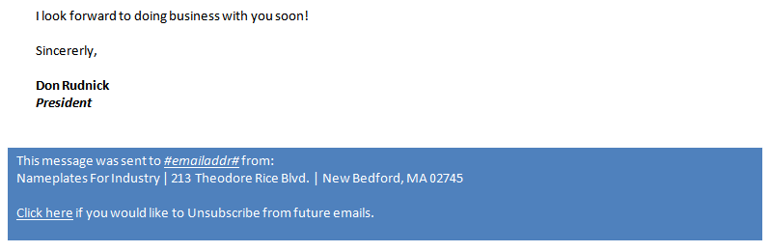
Sample Email

Slide 5
Reporting & Analysis
NFI will be provided with the following information:
Program overview/email stats (48 hours after each email + follow-up have gone out)
A list of all records (after completion of the program) that have had activity including:
Their Source
Activity detail (# of activities, and which emails/links they had activity on)
A list of the bounced records in order for NFI to “clean” their database (after completion of the program)

