Slide 1

March 6, 2012

Slide 2
mardevdm2 Global Business & Vision
Mardevdm2 Global Business & Vision
A division of Reed Elsevier – one of the world’s largest listed professional media companies, with revenues of $8B, 50% of which is generated online.
Reed employs approx. 35,000 people in 50 countries.
mardevdm2 is one of the world’s leading providers of business information & marketing services.
mardevdm2 mission: to solve clients’ demand generation needs by leveraging state-of-the-art technologies coupled with our best practices that enable us to deliver the right message, at the right time using the right marketing channel to the right audience while quantifying our approach.

Slide 3
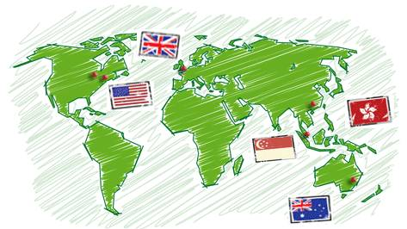
mardevdm2 Global Business & Vision
Mardevdm2 Global Business & Vision
New York
London
Chicago
Singapore
Australia

Slide 4










mardevdm2 Prominent B2C Clients
our clients
Testimonials DWA have been using mardevdm2 for a few years now and have always found them to be a highly professional organisation. They have a quick turn around time on all requests, and have always been really pleasant to work with. The entire team is well briefed on each campaign, thus ensuring we always have a point of contact. They have enabled us to be quite specific with our requests and have always given good results, which is why we continue to use them. Pippa Hollebone - DWA
I have known and worked with the mardevdm2 team for over 10 years now, from both client and agency perspectives and I would rank them highly for their knowledge of both the IT market and the DM industry. They understand the business and are responsive, knowledgeable and a pleasure to deal with. Gary Kemp – Connection2
Mardevdm2 lets you get closer to potential customers, delivering your message directly to their in-tray, their inbox or their direct line. They continue to provide Just Media with quality accurate data: mardevdm2 data is the key to a successful campaign with their team consistently ensuring that data not only complies with industry standards and legal requirements but is also clean, accurate and works with our requirements. Counts are consistently accurate and fulfilled within 24 hours. Chris Ellis - Just Media

Slide 5
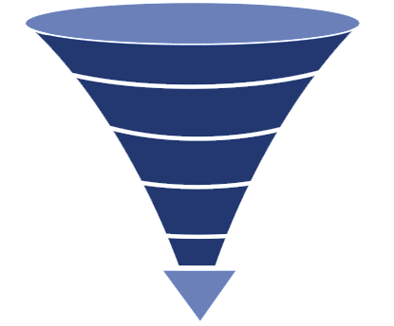
mardevdm2 Marketing Services
Mardevdm2 specializes in end-to-end marketing services that range from marketing strategy to ideation, development and execution of marketing plans.
In addition, the team provides technical and analytical support for demand generation programs through marketing automation, from planning through implementation and analysis, to better leverage and scale integrated marketing communications to maximize return on investments. Our approach:
Addressing prospect needs based on their online behaviour and where they are in the buying cycle
Allowing prospects to pick their route based on preferred channel and engagement and not pushing them down a predefined path
Ensuring measurability and accountability at every step
Utilizing technology to ensure we produce reactive, transparent, fully optimized campaigns
Profile Audience
Build Target Database
Score
Lead Gen
Nurture
SQLs

Slide 6
PBIG Objectives - Overview
Build a Segmented Prospect Database
Gain better insights from current clients
What do best clients look like? Where are the sweet spots?
Where do they procure information? i.e. Marketing Channel Preference
What are their pain points? i.e. Resonating Messaging & Positioning strategy
Targets –
Professional organizations, Endowments, Pension Plans, Referrals, etc.
Automation
Leverage in-house infrastructure and teams, current 3rd Party partnerships and other technologies such as marketing automation platform to create a seamless client journey
Analytics - Metrics & Reporting
Ability to track and quantify each tactic to derive learnings that will then be used to tweak marketing strategy, in real-time, for optimal RoMI.

Slide 7
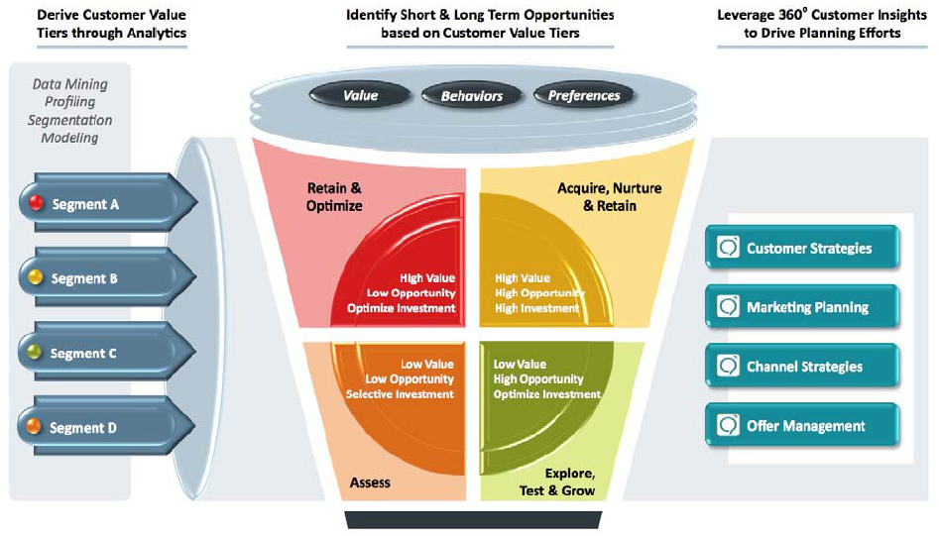
mardevdm2 – Strategic Recommendation

Slide 8
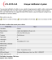


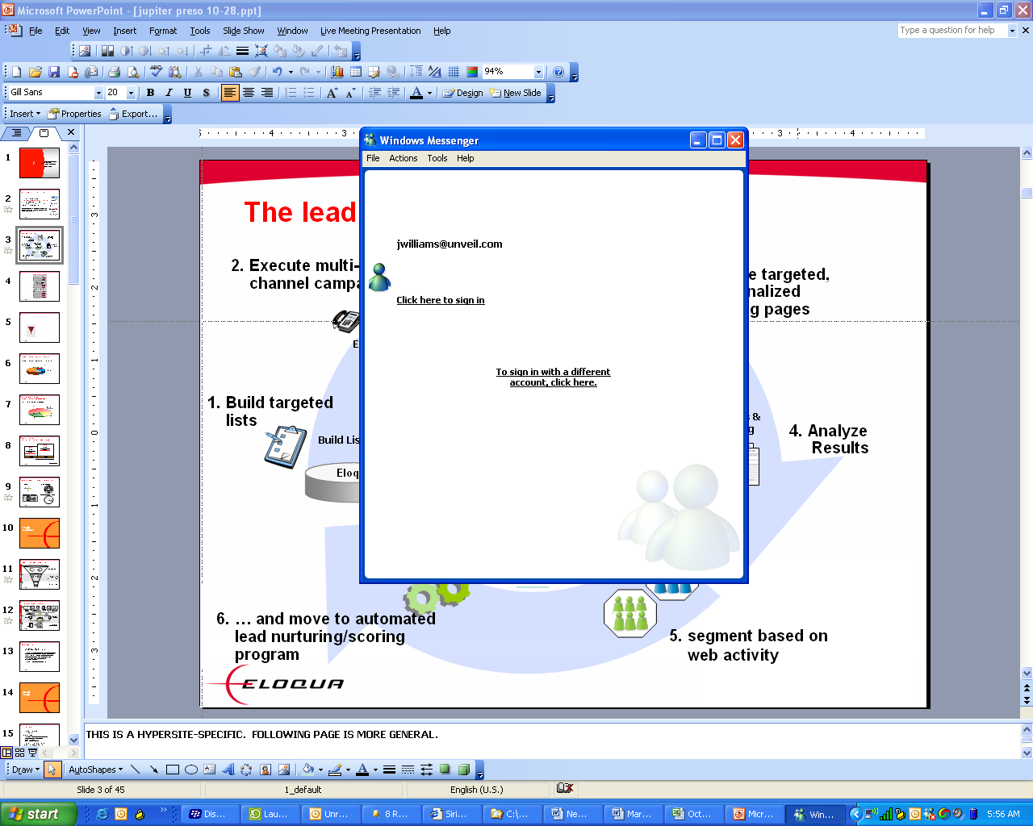




mardevdm2 - Overall Tactical Topology
Marketing Intelligence Dashboard
Command & control
Event-based, multi-step, multi-channel automation
Marketing Automation
marketing email
Individual Marketing channels
sales email
Social Media
direct mail
advertising
keyword search
Web forms
telemarketing
landing pages
CRM
Segmentation, Profiling, and Analytics
Common analytics platform across all marketing channels

Slide 9
Step 1 - Build a segmented Prospect database
Who?
Target Audience based on:
Profiled current PBIG clients including profiling past behavior
Niche segments such as Pension Plans, etc.
What?
To determine target prospects, perform:
Segmentation Analyses
Targeting
Social Media Monitoring (“Listening”)
How?
RFM Analysis, Cluster Analysis
Use 3rd party databases such as EquilarAtlas & Wealth Engine
Listening on Social Media – Comp. Intel & Brand Reputation
Why?
. Develop a persona for each segment:
.Sources of wealth, Business Assoc.,
.Philanthropical interests, Board/Club memberships,
Family members, Political Affiliations, etc.
. Identify Preferred Marketing Channels with
appropriate positioning for each target segment
. Optimize ROI on 3rd Party Data Usage

Slide 10
Sample Report – RFM Analysis
EMPLOYEE SIZE
SCORE ASSIGNMENT
Score | Rank | Total # Policies | Total $
5 | High | Over 100 | Over $25,000
4 | Mid | 20 - 99 | $10K-$25K
3 | Mid | 5-19 | $5K-9K
2 | Low | 2-5 | $1K-$4k
1 | Low | 1 | Under $1,000

Slide 11
Sample – RFM Analysis contd.

Slide 12
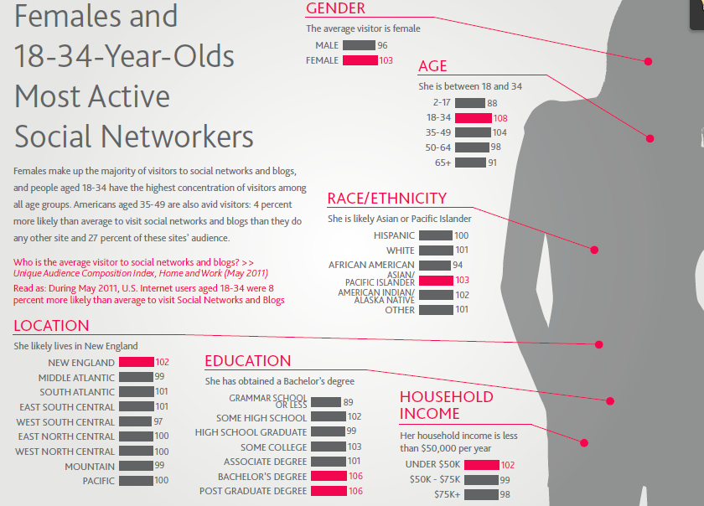
Sample Report - Virtual Persona

Slide 13
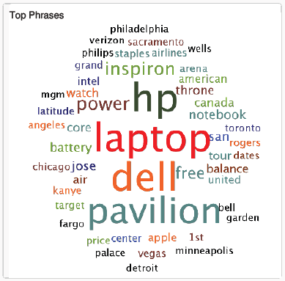
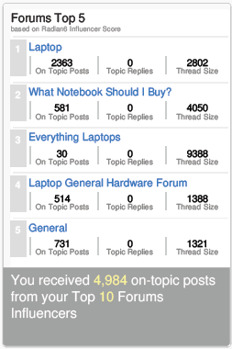
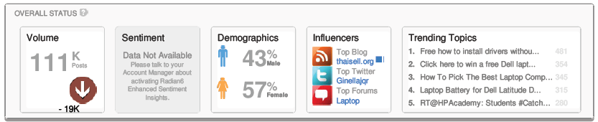
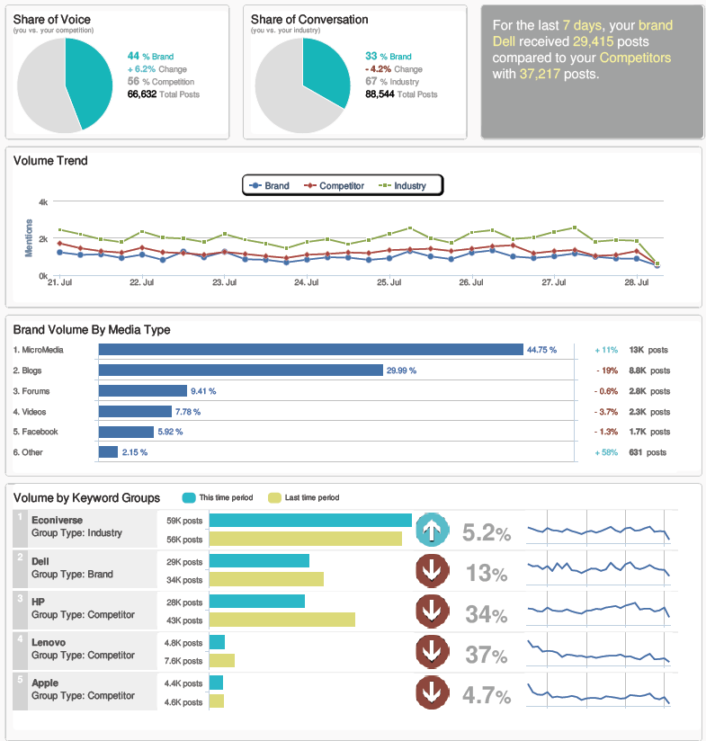
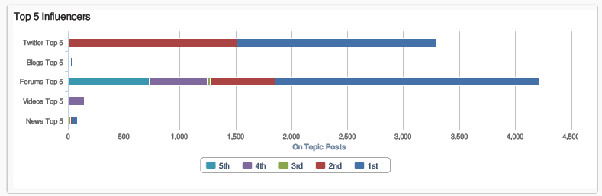
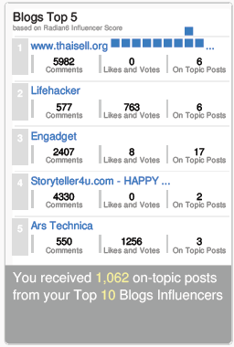
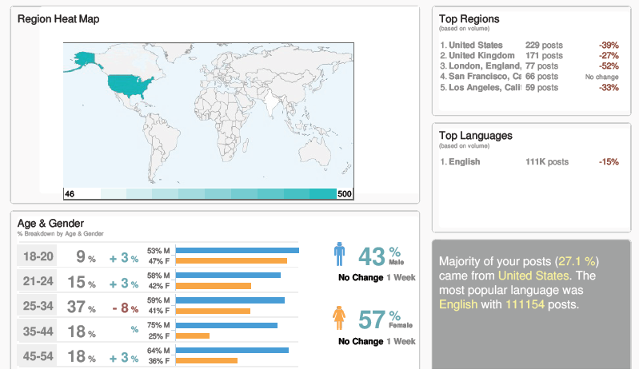
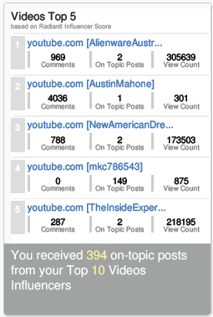
Sample - Social Media Monitoring Report

Slide 14
Build a segmented Prospect database, cont.
Based on the learnings from Segmentation Analysis, compile a Prospect Database via:
Lists Rental
Generating warm leads via communications with 3rd party lists
Vendor Partners
Using website content syndication, newsletter ads, social engagement, promote various PBIG assets to create warm leads. Call-to-action will be to drive traffic to a custom landing page to fill a form.
Professional Networks
Developing partnerships with organizations such as accounting firms, tax organizations, and the like to create a referrer network.
Customer Referrals
Utilize existing client-base to promote PBIG services to colleagues, friends and family.

Slide 15


Step 2 - Content Strategy
Interest
Learn
Evaluate
Justify
Purchase
Marketing Qualified Lead (MQL)
Sales Accepted Lead (SAL)
Sales Qualified Lead (SQL)
Suspect
Inquiry
$$
Marketing validates quality of interest.
Marketing nurtures through buying process
Marketing nurtures to sales ready
Call Center Validates sales ready lead
Sales closes revenue opportunity.

Slide 16
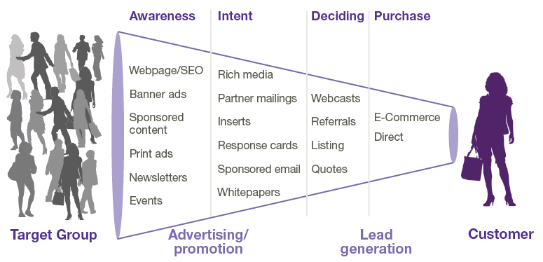
Step 3 - Channel Strategy
Define Opportunities to Accelerate Sales
Customer Buying Process
Marketing validates interest
(MAL)
Marketing nurtures to sales ready
(MQL)
Sales accepts ownership
(SAL)
Sales validates BANT criteria
(SQL)
Sales closes revenue opportunity
($$)
The process you need that together, we support
Sales & Marketing Process:
Notes:
The key is to really understanding the opportunities we have to pull those levers. Ideally, the more opportunities we have, the more control we have over demand creation.
The first step requires us to define and document the stages a buyer (many organizations refer to this as “lead”) moves through in our sales and marketing processes. These stages make up an Integrated Sales and Marketing Funnel (ISMF). In this example, we have adopted the lead stage definitions from Sirius Decisions. Your organization may define different labels, different number of stages, etc. – but conceptually every sales process has stages that move the buyer from awareness, to evaluation, to purchase. A level of refinement on those stages empower us to communicate most effectively.
Suspect: A potential buyer that has no or outdated level of qualification. For example, a list upload used as targets for a campaign, or an inactive segment of individuals already in the database..
Inquiry: A potential buyer who has explicitly expressed initial interest. For example, a Form submission, a booth visit, an inbound Call/Email, etc. The big idea here is to differentiate a raw response to a qualified lead.
MQL: A potential buyer who has met the baseline marketing qualification criteria that has been defined in a sales and marketing. The concept of a SLA between sales and marketing helps many organizations to create an objective feedback loop on lead quality – as well as ensure that “no lead is left behind” (i.e. no follow-up).
SAL: A potential buyer who has been validated by sales and is being worked by sales. By initiating an SLA with the notion of sales acceptance, accountability on lead quality is distributed across both marketing and sales functions.
SQL: A potential buyer who has been associated to a forecasted purchase. In other words, the sales cycle.
Customer: A potential buyer who has been associated to closed revenue and fits within the definition of an active customer.
The key is to document clearly the stages of your buying cycle for a specific product or solution and get buy-in from all key stakeholders. And, then map your customer’s purchase process to your internal selling process. The benefits include:
Improved opportunities to segment and target communications to potential buyers
Increased sales and marketing alignment
Improved visibility into impact on Customer Lifetime Value
16

Slide 17
Step 4 - Lead Generation
Generate Leads & Measure Channel Effectiveness
Methodology:
Based on the personas created, mardevdm2 will develop a custom journey for each target segment
Entails a series of communications that map the prospect’s buying cycle to the PBIG in-house asset library using the persona’s preferred marketing channel
Uses dynamic content and personalization
Real-time online tracking to ascertain each prospect’s position in the buying cycle to determine appropriate “next steps” and “appropriate content” for each individual
Triggered communications/lead flow based on scoring
Expected Outcome/Benefits:
The end-user experience will promptly identify online behavior that will be scored based on the depth of engagement. Based on the level of engagement, a prospect will be automatically forwarded to an advisor or be kept in a nurture cycle to create more indepth engagement. This approach will create a resonating campaign that will most definitely impact response rates and add structure and depth to PBIG’s positioning in the targeted marketplace.

Slide 18
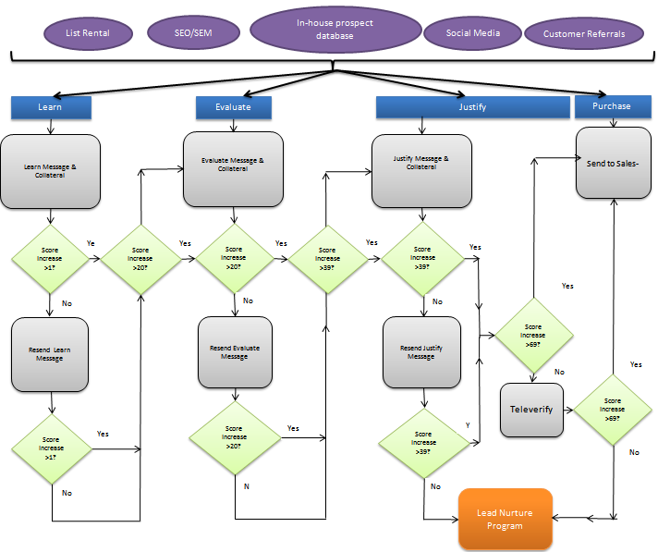
Sample Lead Generation Flow

Slide 19
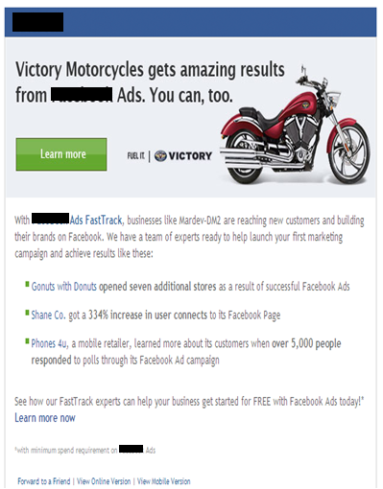
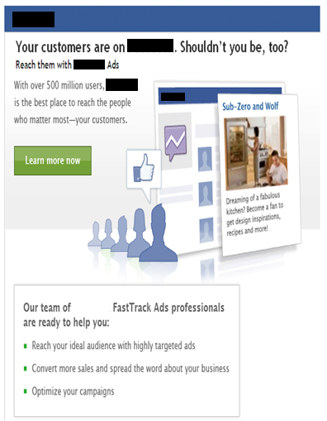
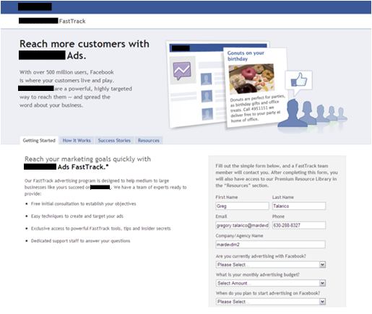
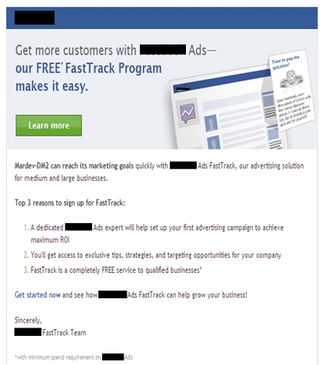
Sample custom client journey via dynamic content based emails

Slide 20

Step 4 - Lead Nurture
Nurture prospects to help expedite their evaluation process and to continue to communicate the benefits of PBIG’s offerings by continuing to drive demand and capture interest over a period of time with prospects, by observing the detailed digital footprint of the non responder and nurture their interest via targeted emails, social engagements, SEM/SEO…
Methodology:
Prospects that showed interest but did not convert in the Lead Generation stage will funnel through a custom and dynamic lead nurture process
Communications that help prospects along in their educational journey by providing relevant content (such as white papers or webinars or invitiations to events) that are the best fit for their situation across a multitude of channels
Anticipate the needs of the buyer based on who they are (using profile characteristics) and
where they are at in the buying process
Expected Outcome/Benefits:
Generate a steady flow of marketing qualified leads based on engagement content mapped to a buying-cycle across a plethora of marketing channels.
Improve conversion to qualified leads
Increase quality of leads passed to the Advisors
Nurture dormant leads and re-engage

Slide 21
Lead Scoring
The overall goal of lead scoring is to look at your leads and understand whether they are the right person (explicit scoring) and/or are showing the right level of interest (implicit scoring).
With this information, we can treat your leads accordingly.

Slide 22
Lead Scoring - Evaluating Explicit Scores
Profile Fit:
Information that we know about a prospect (through forms…)
The demographics that tells us we want to do business with this person.
Profile Fit
Category | Ranking | Weighting | Field Values | Tier | Score | Max Score |  | Profile Fit
Annual Income | 1 | 30% | $250k+ | Tier 1 | 30 | 30 |  | A | 75 - 100
 |  |  | $200k-$250k | Tier 1 | 30 |  |  | B | 50 - 74
 |  |  | $100k-$200k | Tier 1 | 30 |  |  | C | 25 - 49
 |  |  | $50k-$100k | Tier 2 | 15 |  |  | D | 0 - 24
 |  |  | $25k-$50k | Tier 3 | 8
Job Role | 1 | 30% | Firefighter | Tier 1 | 30 | 30
 |  |  | Peace Officer | Tier 1 | 30
 |  |  | Teacher | Tier 1 | 30
 |  |  | Teacher’s Aide | Tier 2 | 15
 |  |  | Traffic Officer | Tier 3 | 8

Slide 23
Lead Scoring - Evaluating Implicit Scores (Activity)
Engagement: Behavior such as web visits and responsiveness to promotions, etc.
The activity that tells us this person may want to do business with us.
Key Elements in Evaluating Activity
Recency
Activity Type
Engagement
Category | Ranking | Weighting | Time Frame | Score | Max Score |  | Engagement
High Touch Event Participation | 1 | 30% | < 6 Months | 30 | 30 |  | 1 | 75 - 100
 |  |  |  |  |  |  | 2 | 50 - 74
 |  |  |  |  |  |  | 3 | 25 - 49
Form Submission | 2 | 25% | 3 days | 25 | 25 |  | 4 | 0 - 24
 |  |  | 7 days | 15
 |  |  | 30 days | 8
Visited High Value Web Content | 3 | 20% | 3 days | 20 | 20
 |  |  | 7 days | 10
 |  |  | 30 days | 5
3+ Website Visits | 4 | 15% | 3 days | 15 | 15
 |  |  | 7 days | 8
 |  |  | 30 days | 4
Email Click Through | 5 | 10% | 3 days | 10 | 10
 |  |  | 7 days | 5
 |  |  | 14 days | 2
 |  |  | Total Possible |  | 100

Slide 24
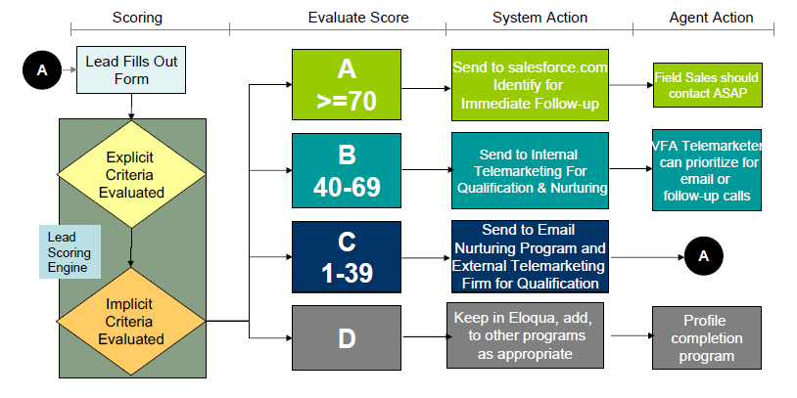
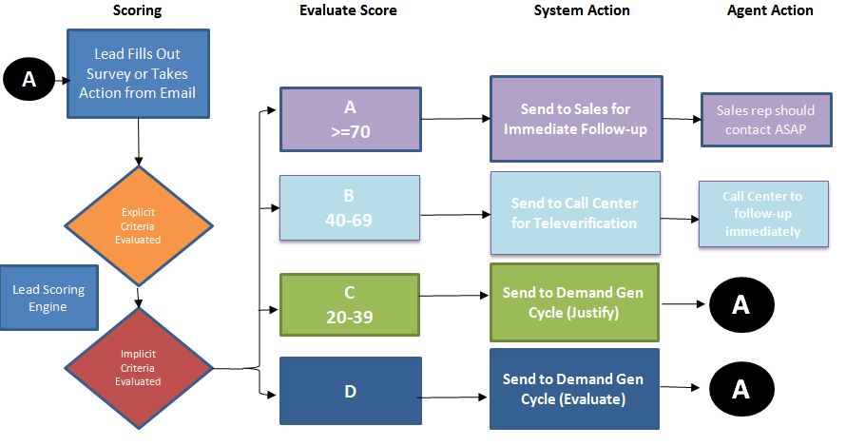
Lead Scoring - Process Steps

Slide 25
Step 1 & 5 - Measurement & Reporting
mardevdm2 will track the effectiveness of each channel, for instance – SEO, SEM, online ads, emails, events, websites, enewsletters, etc.
Depending on current in-house bandwidth availability around analytics, mardevdm2 will work with PBIG to set up appropriate dashboards including Attribution Reports as well as enhance the reporting available in Eloqua to create custom dashboards.
In addition, ongoing “custom” mardevdm2 reports will determine overall ROI + ROI by channel w.r.t Cost Per Conversion, Cost per Acquisition, etc. and allow us to
Track the Effectiveness of each Channel
Optimize marketing spend via funnel management
Enhance the overall RoMI

Slide 26
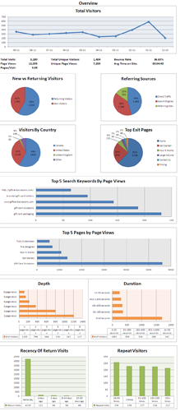
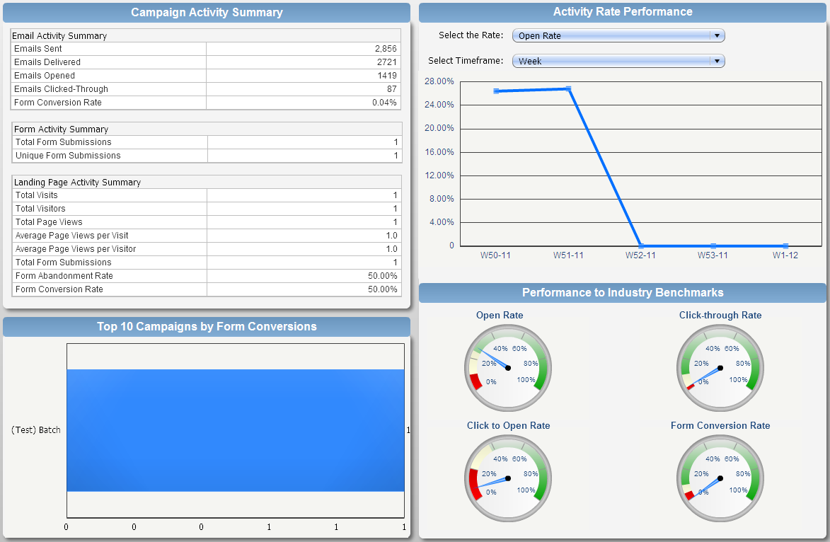
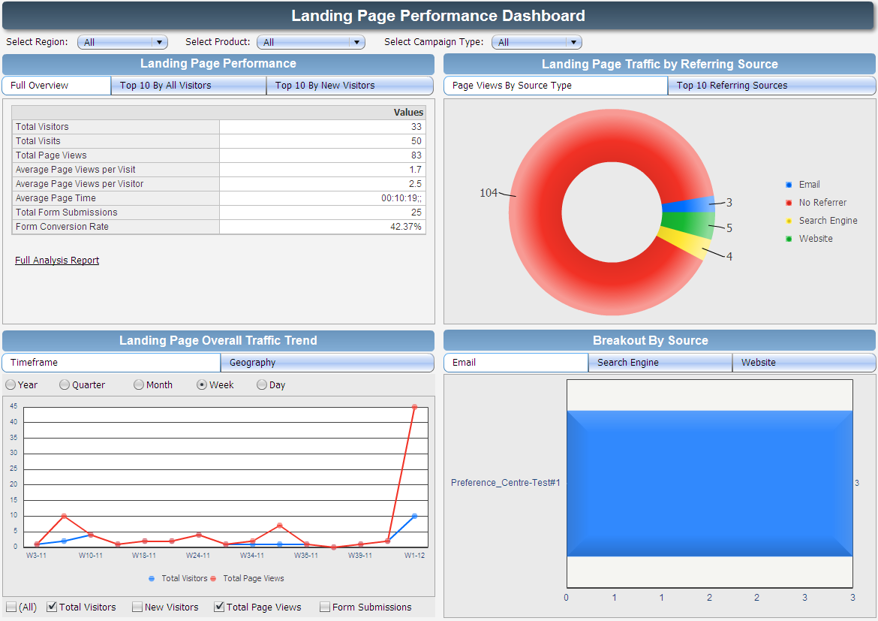
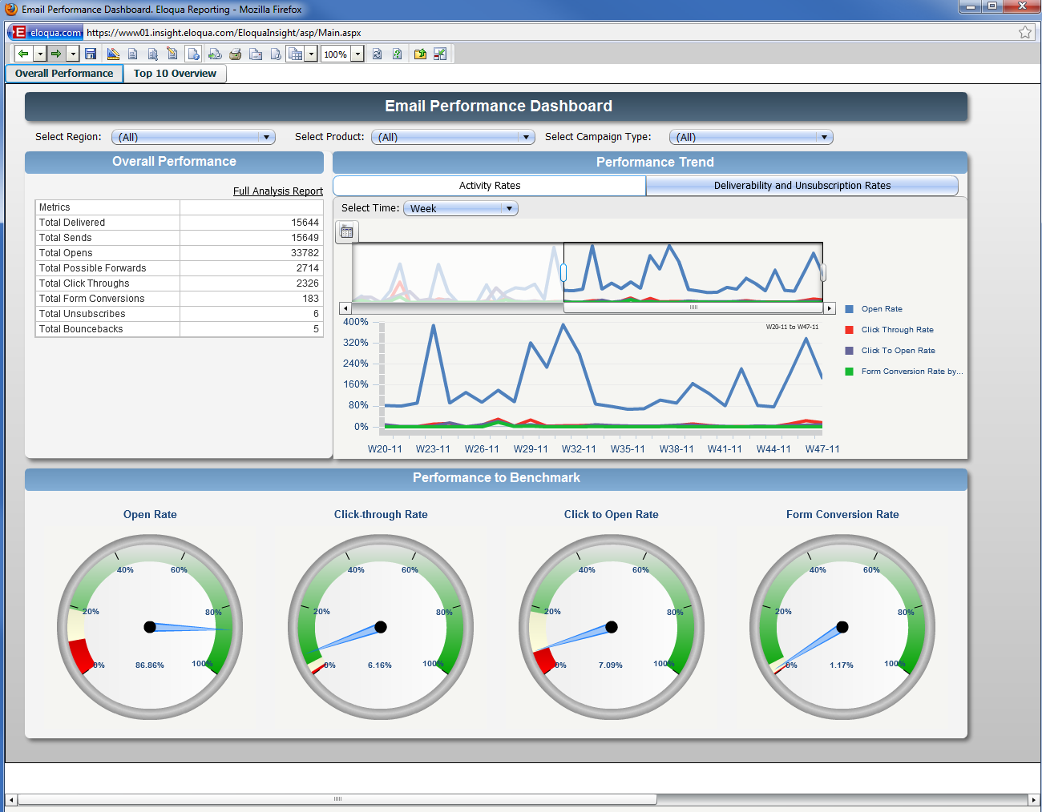
Custom Eloqua Dashboards

Slide 27
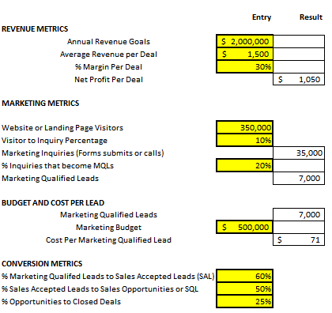
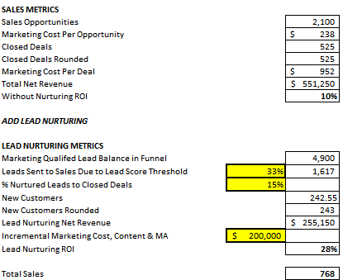
Sample Demand Generation Dashboard

Slide 28
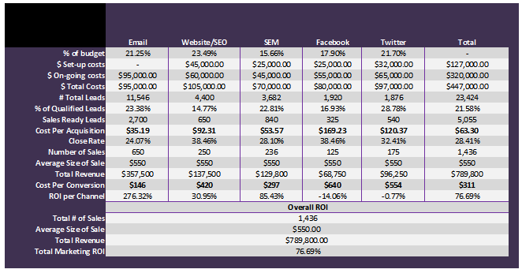
Evaluate Program & Channel Effectiveness - ROI Analysis

Slide 29
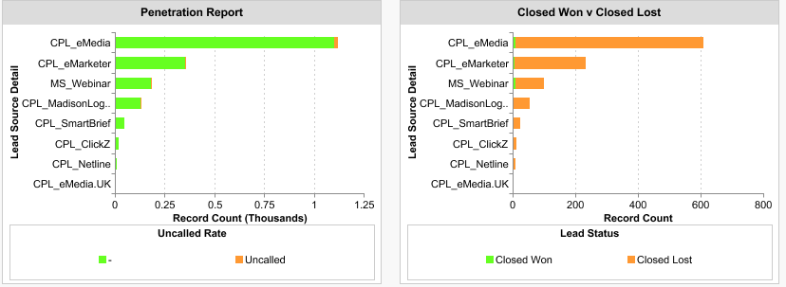
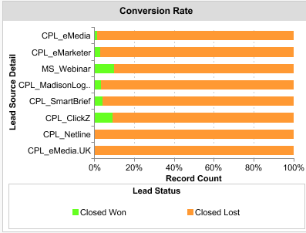
Lead Source Performance Review

Slide 30
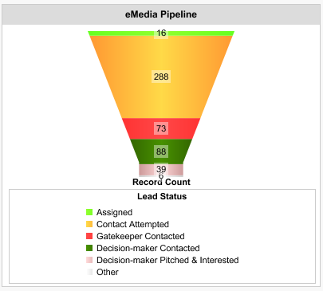
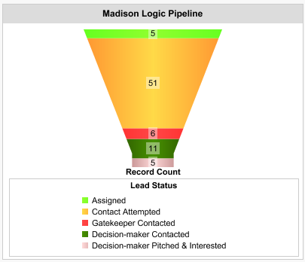
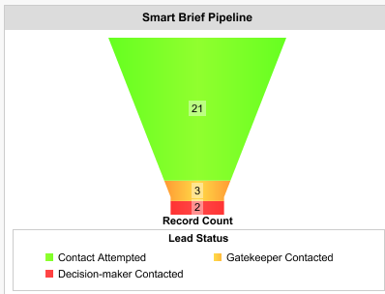
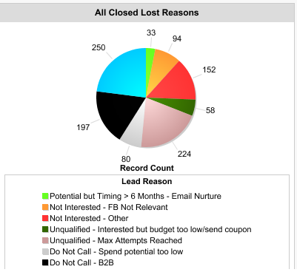
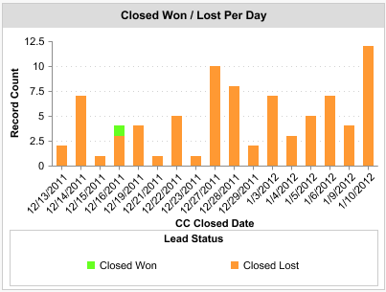
Lead Source Performance Review, Cont.

Slide 31
Attribution Model: ROI by channel
Awareness
Information
Conversion
Marketing Source | Total Revenue | Total Spend | ROI
Banner Ads | 10,264.29 | 5,000.00 | 105.29%
Search | 28,965.00 | 30,000.00 | -3.45%
Email | 14,146.43 | 12,000.00 | 17.89%
Direct Mail | 7,617.86 | 20,000.00 | -61.91%
Telemarketing | 5,135.71 | 15,000.00 | -65.76%
Social Media | 20,587.50 | 5,000.00 | 311.75%
Website/Microsite | 49,181.31 | 50,000.00 | -1.64%
Case Studies/Whitepapers | 37,201.90 | 10,000.00 | 272.02%

Slide 32
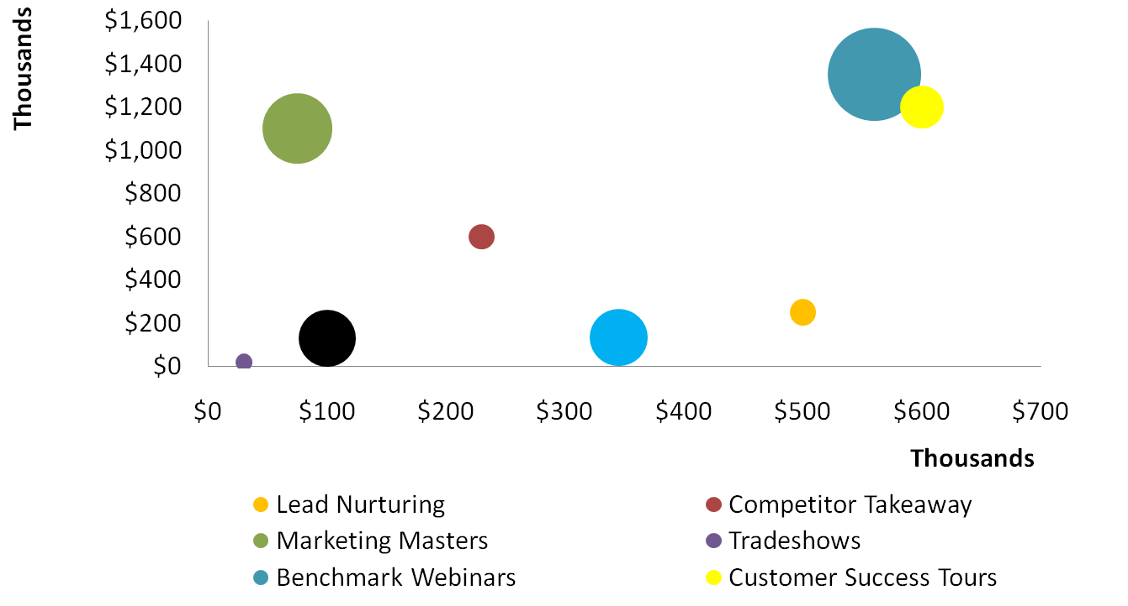
ROI: Best Performing Campaigns
ROI: best performing campaigns
Which campaigns had the
Best ROI (bigger is better)
Revenue Attributed
To First Source
Search
Banner Ads
Social Media
Direct Mail
Email
Case Studies/White papers

Slide 33
ROI: Best Performing Campaigns
Which campaigns Sourced
deals that closed?
Revenue Attributed
To First Source
Search
Banner Ads
Social Media
Direct Mail
Email
Case Studies/White papers

Slide 34
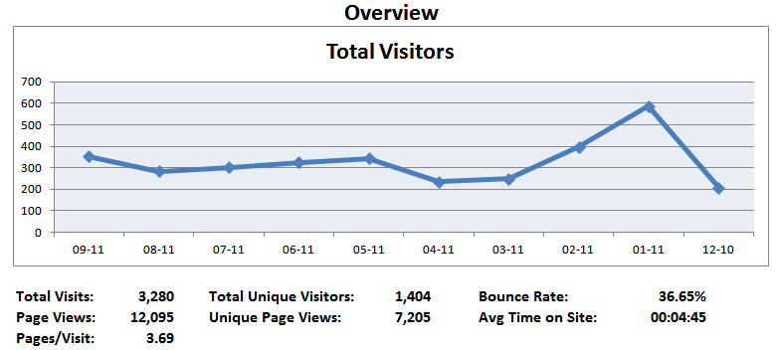
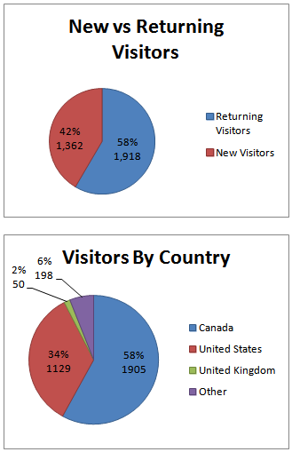
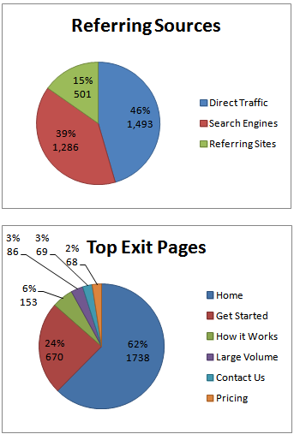
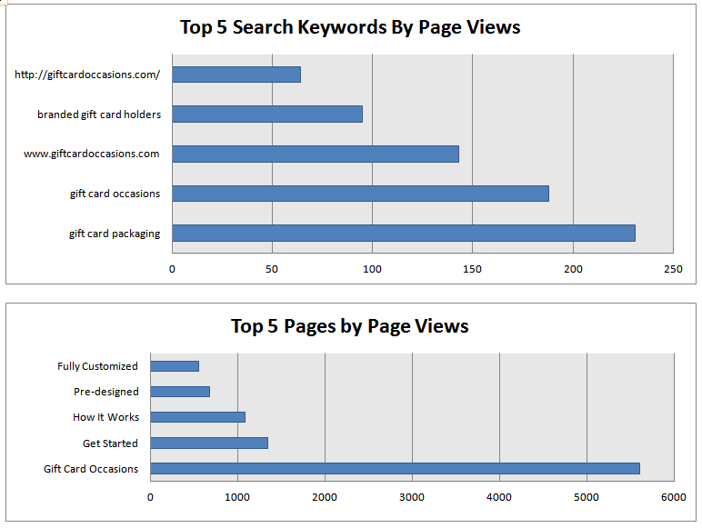
Web Analytics Reporting

Slide 35
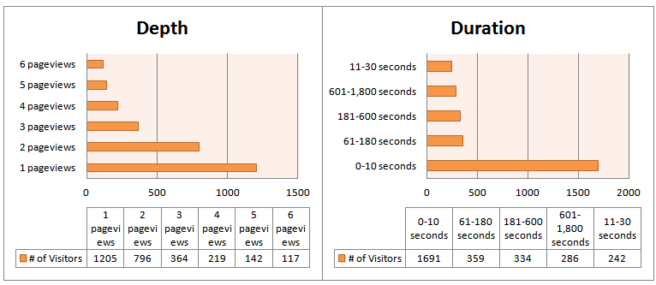
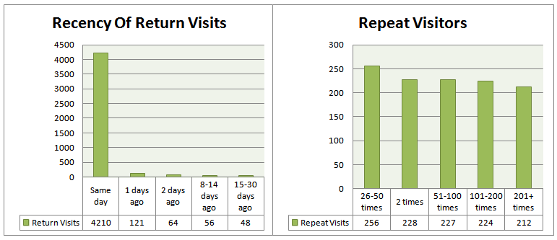
Web Analytics Reporting, Cont.

