Slide 1
Shelf Plus Proposal
February 2012

Slide 2
Shelf Plus’s Goals
Strategic:
New Customer Acquisition
Cross selling into current customer base

Slide 3
Tactical Goals and Objectives
Build a prospect Database
Based on data from salesleadsinc.com and Industrial Reports
Add up to 8-10 contacts based on specific job titles and functions
Lead Generation
Generate SQL leads through comprehensive nurture program
Create a custom journey for each target segment
Real-time online tracking
Lead Nurture
Nurture current prospects within house file
Nurture prospects from the new database
Engage with Current customers

Slide 4
Building a Prospect Database
Who?
Target Audience based on:
Profiled Shelf Plus Customer/Prospect list
3rd Party Trigger Event data
From?
To determine what prospects to go after by utilizing:
mardevdm2 or 3rd party data
salesleadsinc.com
Industrial Reports
How?
Spreadsheet of leads from Shelf Plus
data enhancement – up to 8-10 contacts added per company based on titles and/or job functions
Upload into Eloqua for lead generation programs
Why?
This audience is base on trigger events such as
Moving or expanding location
Adding new Equipment
New Product Lines
Experiencing a space problem
Experiencing an inventory control problem

Slide 5
Lead Generation
Generate Immediate Leads & Measure Channel Effectiveness
Methodology:
Based on the demographics, mardevdm2 will create a custom journey for each target segment
Entails a series of email campaigns that map the prospect’s buying cycle to the Shelf Plus in-house asset library
Uses dynamic content and personalization
Real-time online tracking to ascertain each prospect’s position in the buying cycle to determine appropriate “next steps” and “appropriate content” for each individual
Triggered communications/lead flow based on scoring
Expected Outcome/Benefits:
The end-user experience will promptly identify short-term sales-ready opportunities and funnel those not ready to buy into the “Nurture” program. This approach will create a resonating campaign that will most definitely impact response rates and add structure and depth to Shelf Plus’s positioning in the targeted marketplace.

Slide 6
Lead Generation - Flow

Slide 7
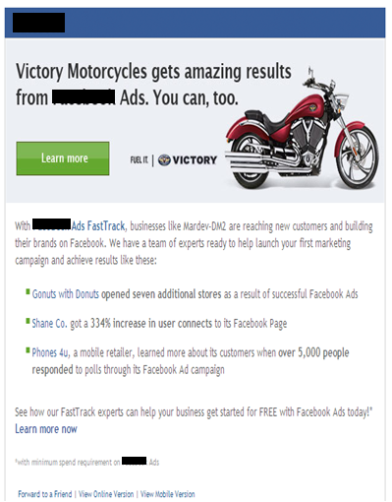
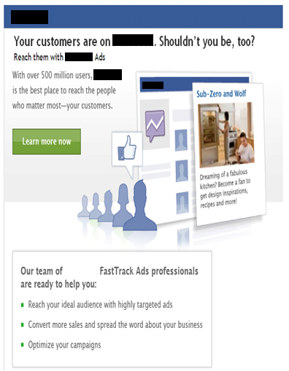
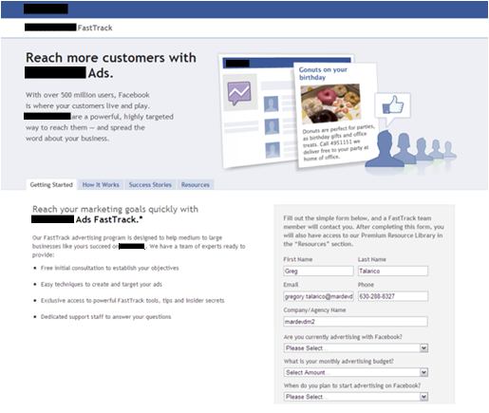
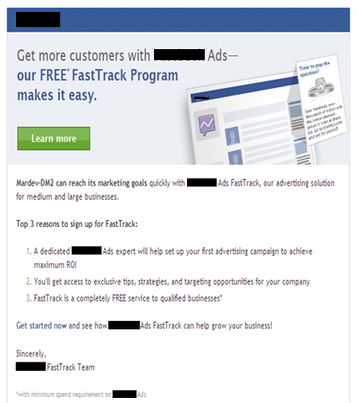
Lead Generation – Sample custom client journey via dynamic content based emails

Slide 8

Lead Nurture
Nurture leads that have not converted to help expedite their buying process and to continue to communicate the benefits of Shelf Plus’s offerings by continuing to drive demand and capture interest over a period of time with prospects, by observing the detailed digital footprint of the non responder and nurture their interest via targeted emails, social engagements, SEM/SEO…
Methodology:
Leads from each prospect bucket will funnel through a custom and dynamic lead nurture process
Communications that help prospects along in their educational journey by providing relevant content (such as white papers or webinars) that are the best fit for their situation across a multitude of channels &
Anticipate the needs of the buyer based on who they are (using profile characteristics like title, role, industry, etc.) and
where they are at in the buying process
Expected Outcome/Benefits:
Generate a steady lead flow to sales reps based on engagement content mapped to a buying-cycle across a plethora of marketing channels.
Improve conversion to qualified leads
Increase quality of leads passed to Sales
Nurture dormant leads and re-engage
Nurture current customers for new products or upgrades

Slide 10
Lead Scoring
The overall goal of lead scoring is to look at your leads and understand whether they are the right person (explicit scoring) and/or are showing the right level of interest (implicit scoring).
With this information, we can treat your leads accordingly. This next outline is a starting point with trigger events and title as the beginning scoring categories. Activity will be the next set of scoring used.

Slide 11
Lead Scoring - Evaluating Explicit Scores
Profile Fit:
Information that we know about a prospect (through forms…)
The demographics that tells us we want to do business with this person.
Profile Fit
Category | Ranking | Weighting | Field Values | Tier | Score | Max Score |  | Profile Fit
Trigger Event | 1 | 30% | Moving | Tier 1 | 30 | 30 |  | A | 75 - 100
 |  |  | Expanding | Tier 1 | 30 |  |  | B | 50 - 74
 |  |  | New Product Lines | Tier 1 | 30 |  |  | C | 25 - 49
 |  |  | Space Issue | Tier 2 | 15 |  |  | D | 0 - 24
 |  |  | Inventory Control | Tier 3 | 8
Job Title, Job Function | 1 | 30% | Plant Manager | Tier 1 | 30 | 30
 |  |  | Engineers | Tier 1 | 30
 |  |  | Operations | Tier 1 | 30
 |  |  | Managers | Tier 2 | 15
 |  |  | Traffic Officer | Tier 3 | 8

Slide 12
Lead Scoring - Evaluating Implicit Scores (Activity)
Engagement: Behavior such as web visits and responsiveness to promotions, etc.
The activity that tells us this person may want to do business with us.
Key Elements in Evaluating Activity
Recency
Activity Type
Engagement
Category | Ranking | Weighting | Time Frame | Score | Max Score |  | Engagement
High Touch Event Participation | 1 | 30% | < 6 Months | 30 | 30 |  | 1 | 75 - 100
 |  |  |  |  |  |  | 2 | 50 - 74
 |  |  |  |  |  |  | 3 | 25 - 49
Form Submission | 2 | 25% | 3 days | 25 | 25 |  | 4 | 0 - 24
 |  |  | 7 days | 15
 |  |  | 30 days | 8
Visited High Value Web Content | 3 | 20% | 3 days | 20 | 20
 |  |  | 7 days | 10
 |  |  | 30 days | 5
3+ Website Visits | 4 | 15% | 3 days | 15 | 15
 |  |  | 7 days | 8
 |  |  | 30 days | 4
Email Click Through | 5 | 10% | 3 days | 10 | 10
 |  |  | 7 days | 5
 |  |  | 14 days | 2
 |  |  | Total Possible |  | 100

Slide 13
Lead Scoring - Process Steps
Lead Fills Out Form, Download or Takes Action from Email
A
 | Scoring |  |  | Evaluate Score |  |  | System Action |  |  | Agent Action
 | Explicit Criterai Evaluated
A
>=70
Send to Sales for Immediate Follow-up
Sales rep should contact ASAP
Explicit Criteria Evaluated
B
40-69
Send to Demand Gen Cycle (Justify)
Transparency to SP Sales
Lead Scoring Engine
C
20-39
Send to Demand Gen Cycle (Evaluate)
A
Implicit Criteria Evaluated
D
Send to Demand Gen Cycle (Introduction)
A

Slide 14
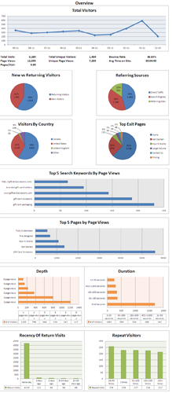
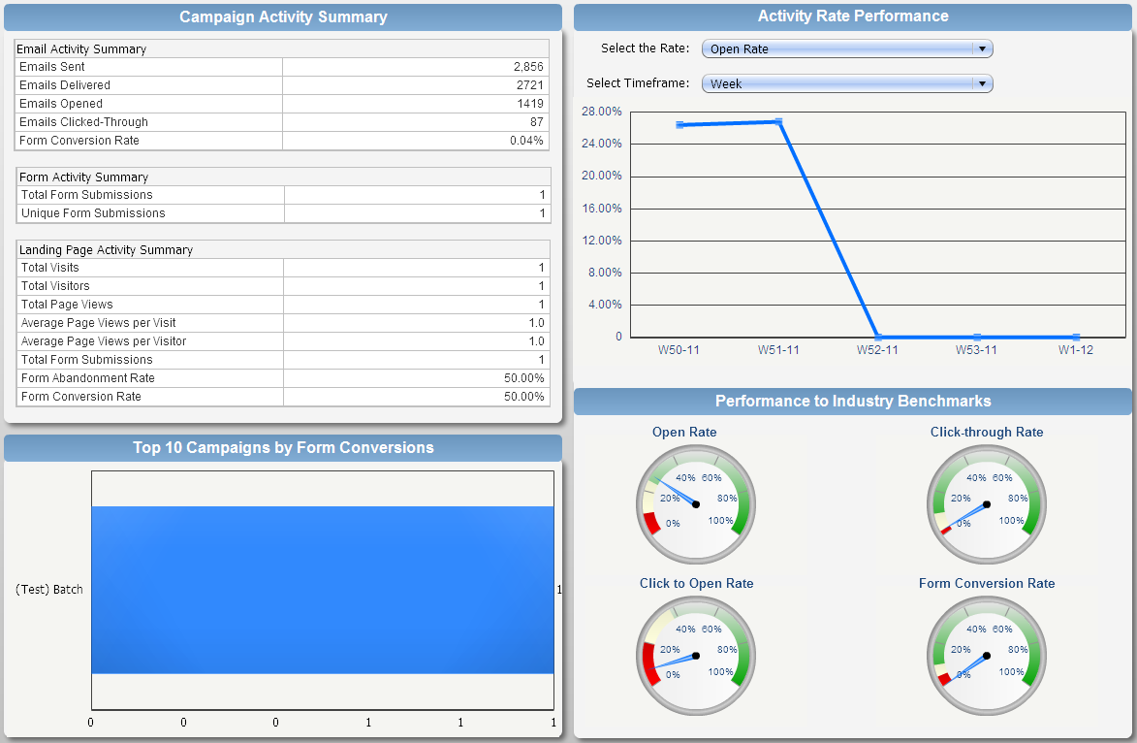
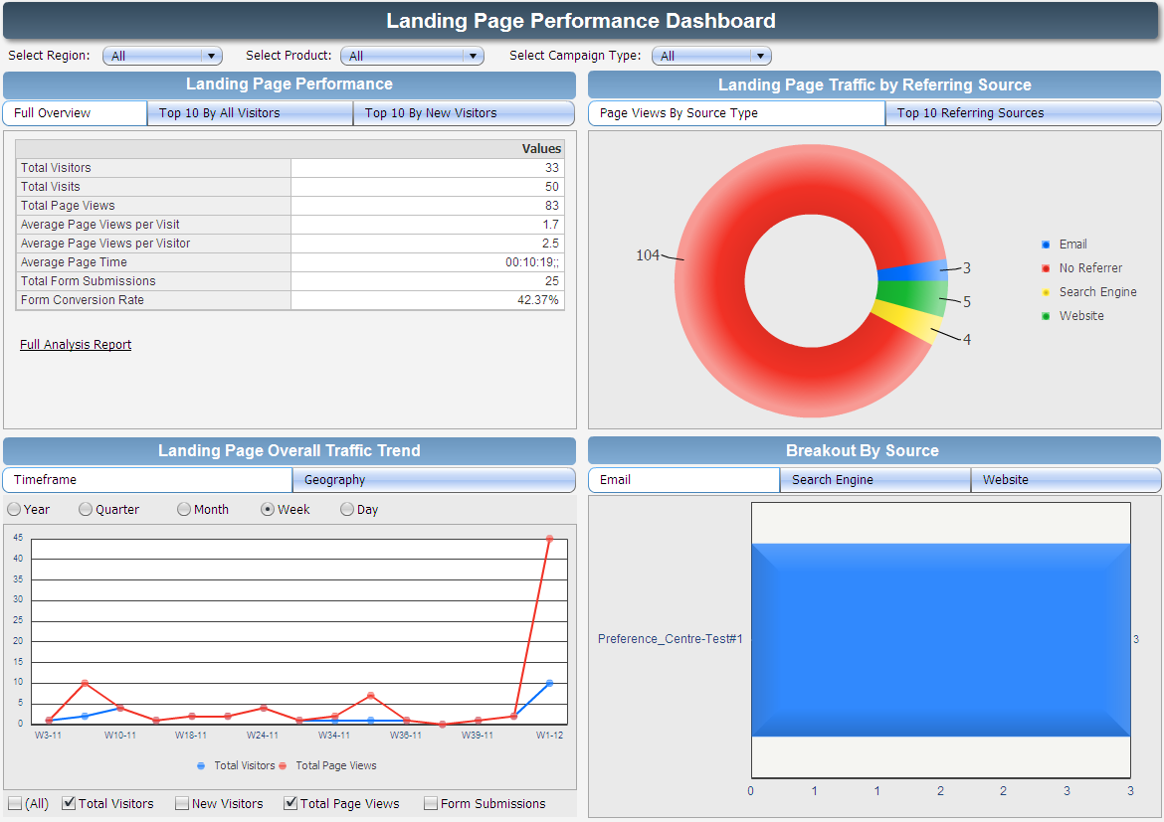
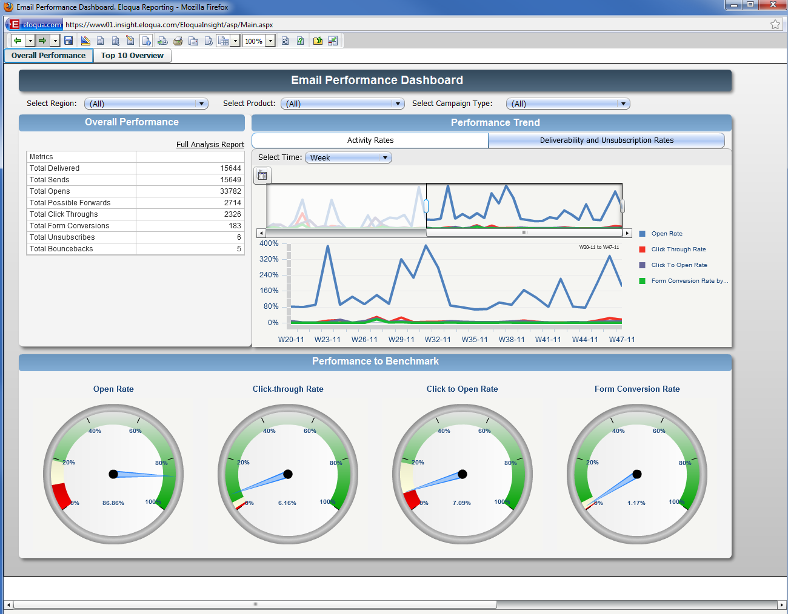
Custom Eloqua Dashboards

Slide 15
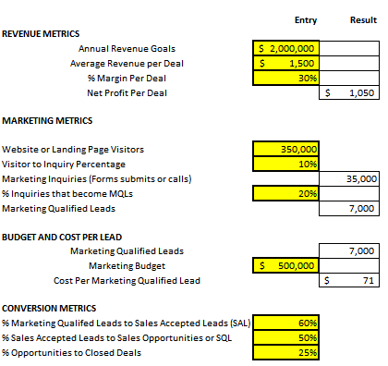
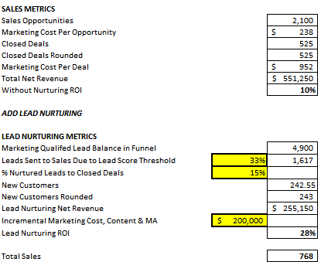
Sample Demand Generation Dashboard

Slide 16
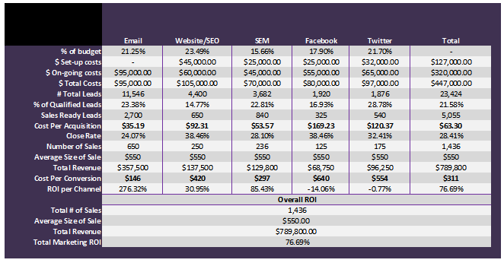
Evaluate Program & Channel Effectiveness - ROI Analysis

Slide 17
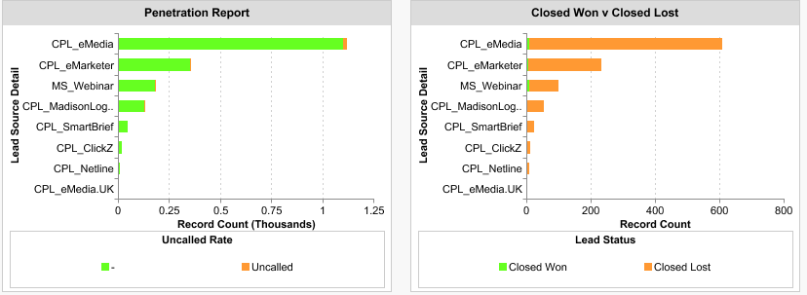
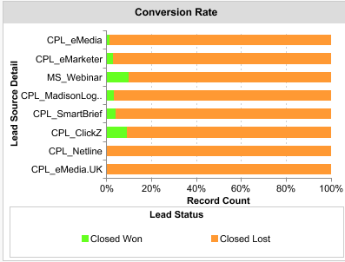
Lead Source Performance Review
Sample Reports
Shelf plus lead sources to be evaluated
Sales Leads Inc (new)
with mardevdm2 data enhancement
Industrial Reports (new)
with mardevdm2 data enhancement
Vendor Leads
Current Prospect Database
Current Clientele

Slide 18
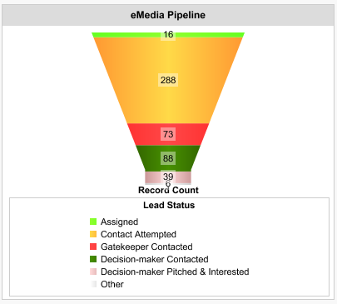
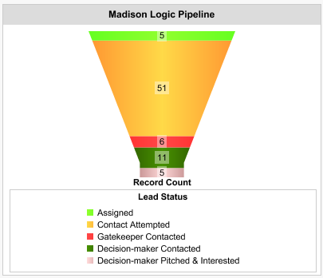
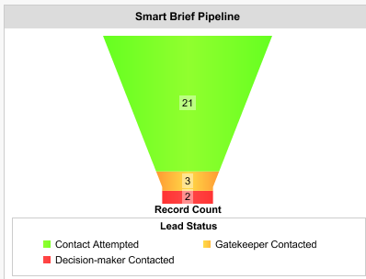
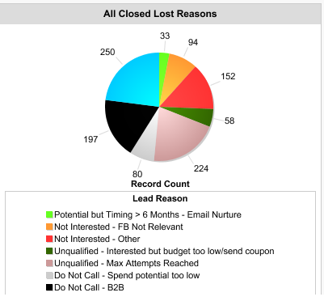
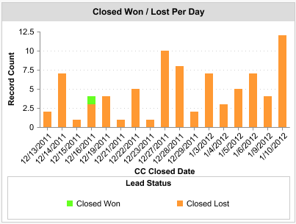
Lead Source Performance Review, Cont.
* Custom reporting based on needs. (post Sales Force integration

Slide 19
Email Best Practices
The most effective way to maximize conversion rates is to provide recipients with content that is relevant to them. We can customize each email message/landing page to the interests of each customer/prospect.
Maximize Open Rates:
Ensure maximum “Inbox” Delivery by:
Monitor/Maintain the Shelf Plus SenderScore Rating & Blacklist status
Ensure all messages are optimized to “avoid” being filtered by ISPs and delivery software
Utilize A/B testing to determine which subject lines perform the best and which subjects/topic resonate with the individual segments
Through the use of personalization and maximizing the space “above the fold” in the body of each email we have demonstrated higher performance to our clients. Testing will be done on smaller statistically representative sets of the customer/prospect pool.
Maximize Response Rates:
Ensure all messages are optimized to ensure they render appropriately on all major email viewers
Utilize A/B testing to determine which message/copy performs the best and which subjects/topic resonate with the individual segments
Identify which link placement is performing the best as well as which content, and highlight these
The profiling in Stage 1 will allow us to “segment” the data and serve dynamic content to “customize” the messages for each individual based on their profile, thus making the content/message specific to their interests/needs.

Slide 20
Contact Information
Sales
Wendy Siegmeier, Business Development
Wendy.siegmeier@mardevdm2.com
630.288.8315
Strategy
Bridgid Johnson, Client Solutions Manager
Bridgid.johnson@mardevdm2.com
630.288.8324
Bridgid Johnson has more than 10 years of experience in Email and Online marketing strategies and technology. Her online marketing expertise includes strategy, planning, project management, implementation/programming, compliance, best practices, and emerging technologies.
In her role with mardevdm2, Bridgid is responsible for global demand generation client solutions. She manages a global team that provides technical and analytical support for demand generation programs through marketing automation, from planning through implementation and analysis, to better leverage and scale integrated marketing communications to maximize return on investments.
Technical
Greg Talarico, Client Solutions Analyst
Greg.talarico@mardevdm2.com
630.288.8327
Greg Talarico is experienced within the marketing industry and his 7 year experience stems from operations, logistics and project management within the IT, Financial Services, Retail and Higher Education industry.
In his role with mardevdm2, Greg is responsible for providing dedicated support for demand generation campaigns, which ranges from client set-up/programming to ongoing reporting and analytical advice. He holds a BA in Economics, Mathematics and Computer Science from the University of Illinois.

Slide 21
Technical Communication Flow
Set Up – Shelf Plus, Client Solutions & Sales
Prerequisite lists (what is needed to begin and who is responsible)
Content Mapping for dynamic content based emails
Eloqua Instance set up, tracking, reporting
Contact information needed/wanted for optimal demographics
Scoring set up.
Implementation – Shelf Plus & Client Solutions
Look and feel of emails, hypersite
Parameters for prospects to move within nurture program (scoring)
Email Deployment and testing
Dynamic content strategy

Slide 22
Technical communication continued….
Reporting – Client Solutions
Pre-Sales Force
Custom Dashboards in Eloqua with a link for you to review in real time
Reports on campaign, demographics, ROI, etc via Excel once a month approximately 1 week after email campaign
Track the Effectiveness of each Channel
Optimize marketing Spend via funnel management
Increase Sales Conversions
Post Sales Force Integration (after pilot)
Custom Dashboards in Eloqua and Sales Force which will show real time data/results
Continuous real time two-way updates on leads, lead activity, stages and opportunities
Meetings - Shelf Plus, Client Solutions & Sales
Initial conversations will happen daily or as needed during set up and initial implementation.
Weekly meeting during 90 day Pilot Program with all parties
Review results, reporting, strategy
Answer questions and concerns

Slide 23
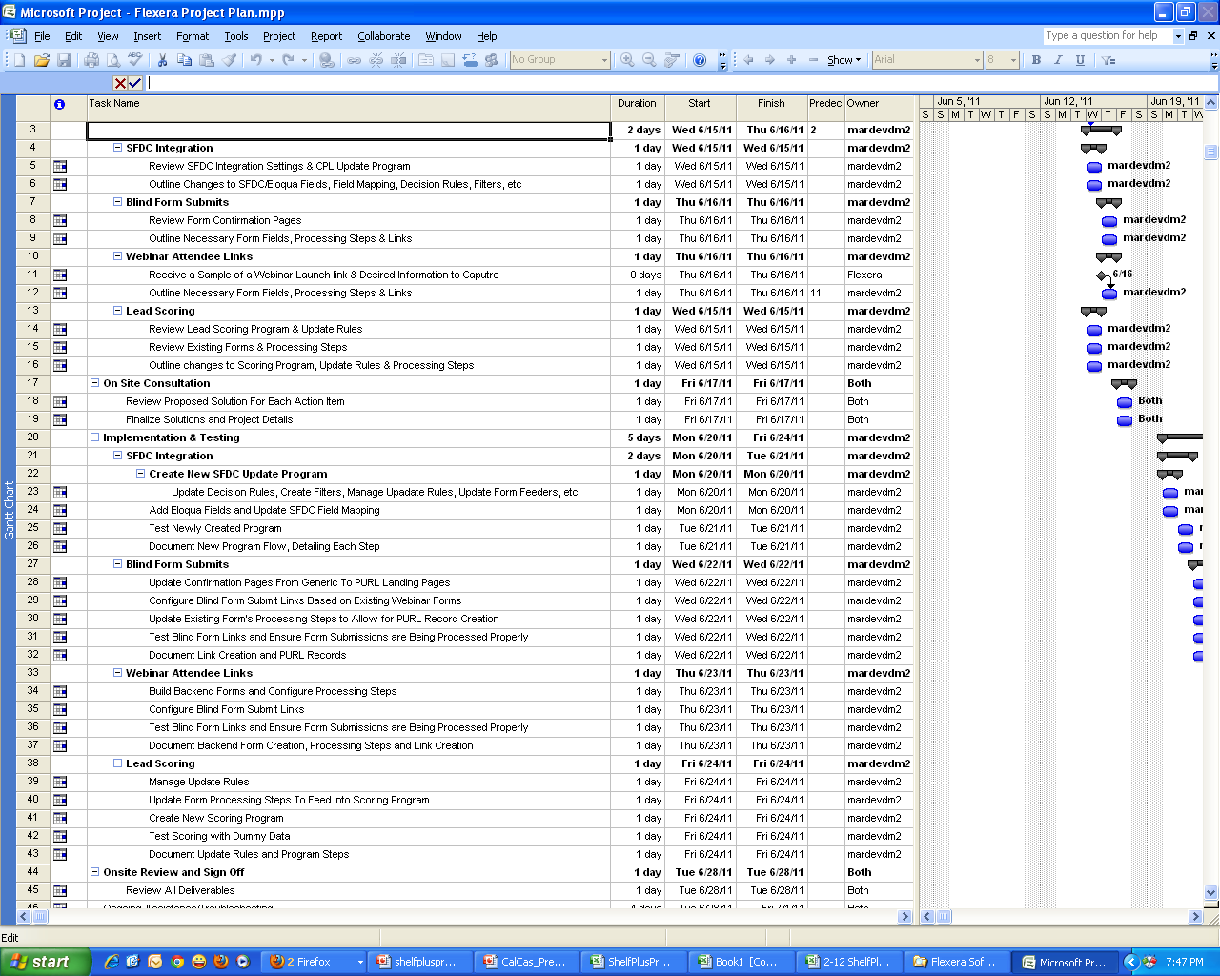
Sample Project Plan

Slide 24
Activity/Service | Cost | Notes
FIXED COSTS
Campaign planning & scoping; campaign process flow development; Value proposition & copy support. Best practice support, advanced tracking. | $ 8,700 | $2,500 per month includes Eloqua license fee for database size of 10,001-25K
Lead generation: New database creation, data enhancement, 3 email campaigns and reminders*+ scoring | $ 5,000 | Set-up of email creative’s with dynamic content + 2 tests per (data included) With the projected trigger company information we will provide up to 8-10 contacts per company
 |  | *Any changes that require more than 1 hour of programming time will be billed separate @ $150 per hour with prior approval.
Prospect Lead Nurture Program Development & Ongoing Support | $ 5,000 | 3 email deployments of dynamic content and reminders + scoring+ engagement strategy
Current Customer Nurture Program | $ 5,000 | 3 email deployments of dynamic content and reminders + scoring+ engagement strategy
1 Hypersite – Develop, Maintain and host ** | $ 3,000 | **ShelfPlus will be providing content
Tracking & Custom Reporting | $ 3,500 | Custom dashboards + ROI analysis
Total Fixed Costs | $ 30,200
VARIABLE COSTS
CPL | $125 Per Lead | Lead – this is a prospect that has engaged in at least 2 activities e.g. website visit, downloads etc

Slide 25







Testimonials
DWA have been using mardevdm2 for a few years now and have always found them to be a highly professional organisation. They have a quick turn around time on all requests, and have always been really pleasant to work with. The entire team is well briefed on each campaign, thus ensuring we always have a point of contact. They have enabled us to be quite specific with our requests and have always given good results, which is why we continue to use them. Pippa Hollebone - DWA
I have known and worked with the mardevdm2 team for over 10 years now, from both client and agency perspectives and I would rank them highly for their knowledge of both the IT market and the DM industry. They understand the business and are responsive, knowledgeable and a pleasure to deal with. Gary Kemp – Connection2
Mardevdm2 lets you get closer to potential customers, delivering your message directly to their in-tray, their inbox or their direct line. They continue to provide Just Media with quality accurate data: mardevdm2 data is the key to a successful campaign with their team consistently ensuring that data not only complies with industry standards and legal requirements but is also clean, accurate and works with our requirements. Counts are consistently accurate and fulfilled within 24 hours. Chris Ellis - Just Media

