Slide 1
March 23, 2012

Slide 2
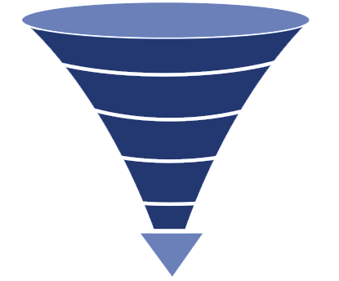
mardevdm2 Marketing Services
Mardevdm2 specializes in end-to-end marketing services that range from marketing strategy to ideation, development and execution of marketing plans.
In addition, the team provides technical and analytical support for demand generation programs through marketing automation, from planning through implementation and analysis, to better leverage and scale integrated marketing communications to maximize return on investments. Our approach:
Addressing prospect needs based on their online behaviour and where they are in the buying cycle
Allowing prospects to pick their route based on preferred channel and engagement and not pushing them down a predefined path
Ensuring measurability and accountability at every step
Utilizing technology to ensure we produce reactive, transparent, fully optimized campaigns
Profile Audience
Build Target Database
Score
Lead Gen
Nurture
SQLs

Slide 3
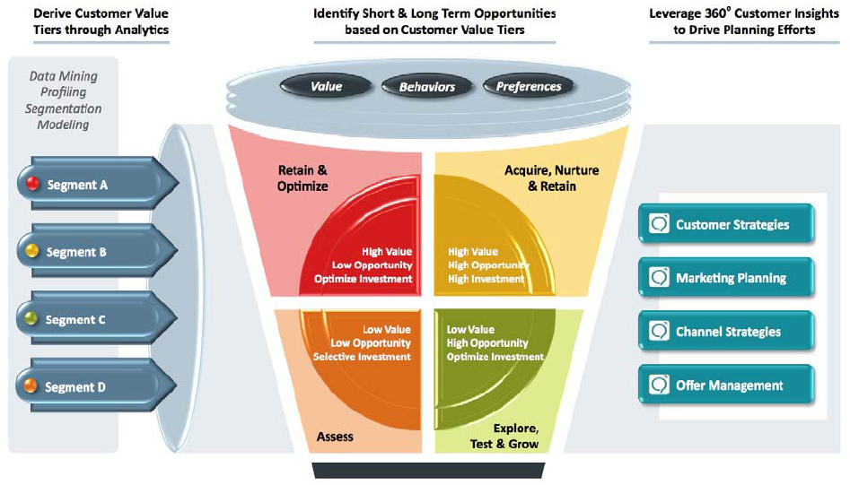
mardevdm2 – Strategic Recommendation

Slide 4
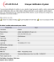


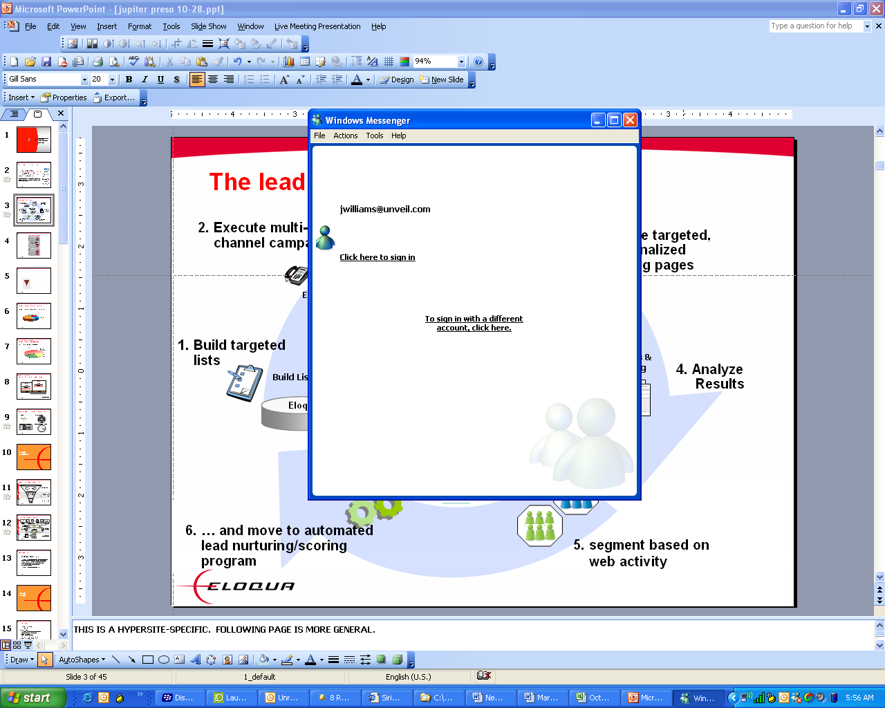




mardevdm2 - Overall Tactical Topology
Marketing Intelligence Dashboard
Command & control
Event-based, multi-step, multi-channel automation
Marketing Automation
marketing email
Individual Marketing channels
sales email
Social Media
direct mail
advertising
keyword search
Web forms
telemarketing
landing pages
CRM
Segmentation, Profiling, and Analytics
Common analytics platform across all marketing channels

Slide 5


Content Strategy
Interest
Learn
Evaluate
Justify
Purchase
Marketing Qualified Lead (MQL)
Sales Accepted Lead (SAL)
Sales Qualified Lead (SQL)
Suspect
Inquiry
$$
Marketing validates quality of interest.
Marketing nurtures through buying process
Marketing nurtures to sales ready
Call Center Validates sales ready lead
Sales closes revenue opportunity.

Slide 6
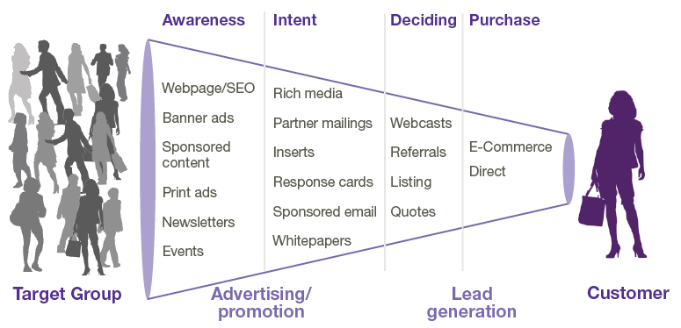
Channel Strategy
Define Opportunities to Accelerate Sales
Customer Buying Process
Marketing validates interest
(MAL)
Marketing nurtures to sales ready
(MQL)
Sales accepts ownership
(SAL)
Sales validates BANT criteria
(SQL)
Sales closes revenue opportunity
($$)
The process you need that together, we support
Sales & Marketing Process:
Notes:
The key is to really understanding the opportunities we have to pull those levers. Ideally, the more opportunities we have, the more control we have over demand creation.
The first step requires us to define and document the stages a buyer (many organizations refer to this as “lead”) moves through in our sales and marketing processes. These stages make up an Integrated Sales and Marketing Funnel (ISMF). In this example, we have adopted the lead stage definitions from Sirius Decisions. Your organization may define different labels, different number of stages, etc. – but conceptually every sales process has stages that move the buyer from awareness, to evaluation, to purchase. A level of refinement on those stages empower us to communicate most effectively.
Suspect: A potential buyer that has no or outdated level of qualification. For example, a list upload used as targets for a campaign, or an inactive segment of individuals already in the database..
Inquiry: A potential buyer who has explicitly expressed initial interest. For example, a Form submission, a booth visit, an inbound Call/Email, etc. The big idea here is to differentiate a raw response to a qualified lead.
MQL: A potential buyer who has met the baseline marketing qualification criteria that has been defined in a sales and marketing. The concept of a SLA between sales and marketing helps many organizations to create an objective feedback loop on lead quality – as well as ensure that “no lead is left behind” (i.e. no follow-up).
SAL: A potential buyer who has been validated by sales and is being worked by sales. By initiating an SLA with the notion of sales acceptance, accountability on lead quality is distributed across both marketing and sales functions.
SQL: A potential buyer who has been associated to a forecasted purchase. In other words, the sales cycle.
Customer: A potential buyer who has been associated to closed revenue and fits within the definition of an active customer.
The key is to document clearly the stages of your buying cycle for a specific product or solution and get buy-in from all key stakeholders. And, then map your customer’s purchase process to your internal selling process. The benefits include:
Improved opportunities to segment and target communications to potential buyers
Increased sales and marketing alignment
Improved visibility into impact on Customer Lifetime Value
6

Slide 7

Lead Nurture
Nurture prospects to help expedite their evaluation process and to continue to communicate the benefits of PBIG’s offerings by continuing to drive demand and capture interest over a period of time with prospects, by observing the detailed digital footprint of the non responder and nurture their interest via targeted emails, social engagements, SEM/SEO…
Methodology:
Prospects that showed interest but did not convert in the Lead Generation stage will funnel through a custom and dynamic lead nurture process
Communications that help prospects along in their educational journey by providing relevant content (such as white papers or webinars or invitiations to events) that are the best fit for their situation across a multitude of channels
Anticipate the needs of the buyer based on who they are (using profile characteristics) and
where they are at in the buying process
Expected Outcome/Benefits:
Generate a steady flow of marketing qualified leads based on engagement content mapped to a buying-cycle across a plethora of marketing channels.
Improve conversion to qualified leads
Increase quality of leads passed to the Advisors
Nurture dormant leads and re-engage

Slide 8
Lead Scoring
The overall goal of lead scoring is to look at your leads and understand whether they are the right person (explicit scoring) and/or are showing the right level of interest (implicit scoring).
With this information, we can treat your leads accordingly.

Slide 9
Lead Scoring - Evaluating Explicit Scores
Profile Fit:
Information that we know about a prospect (through forms…)
The demographics that tells us we want to do business with this person.
Profile Fit
Category | Ranking | Weighting | Field Values | Tier | Score | Max Score |  | Profile Fit
Annual Income | 1 | 30% | $250k+ | Tier 1 | 30 | 30 |  | A | 75 - 100
 |  |  | $200k-$250k | Tier 1 | 30 |  |  | B | 50 - 74
 |  |  | $100k-$200k | Tier 1 | 30 |  |  | C | 25 - 49
 |  |  | $50k-$100k | Tier 2 | 15 |  |  | D | 0 - 24
 |  |  | $25k-$50k | Tier 3 | 8
Job Role | 1 | 30% | Firefighter | Tier 1 | 30 | 30
 |  |  | Peace Officer | Tier 1 | 30
 |  |  | Teacher | Tier 1 | 30
 |  |  | Teacher’s Aide | Tier 2 | 15
 |  |  | Traffic Officer | Tier 3 | 8

Slide 10
Lead Scoring - Evaluating Implicit Scores (Activity)
Engagement: Behavior such as web visits and responsiveness to promotions, etc.
The activity that tells us this person may want to do business with us.
Key Elements in Evaluating Activity
Recency
Activity Type
Engagement
Category | Ranking | Weighting | Time Frame | Score | Max Score |  | Engagement
High Touch Event Participation | 1 | 30% | < 6 Months | 30 | 30 |  | 1 | 75 - 100
 |  |  |  |  |  |  | 2 | 50 - 74
 |  |  |  |  |  |  | 3 | 25 - 49
Form Submission | 2 | 25% | 3 days | 25 | 25 |  | 4 | 0 - 24
 |  |  | 7 days | 15
 |  |  | 30 days | 8
Visited High Value Web Content | 3 | 20% | 3 days | 20 | 20
 |  |  | 7 days | 10
 |  |  | 30 days | 5
3+ Website Visits | 4 | 15% | 3 days | 15 | 15
 |  |  | 7 days | 8
 |  |  | 30 days | 4
Email Click Through | 5 | 10% | 3 days | 10 | 10
 |  |  | 7 days | 5
 |  |  | 14 days | 2
 |  |  | Total Possible |  | 100

Slide 11
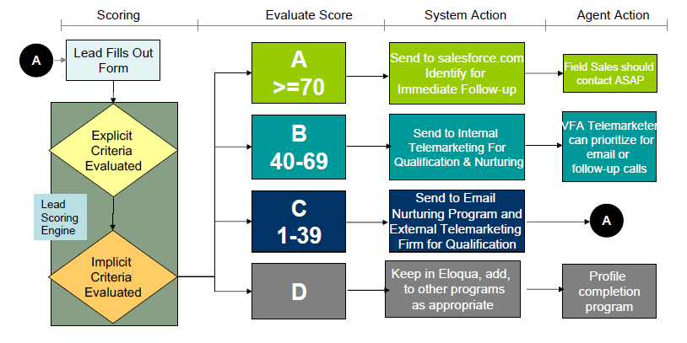
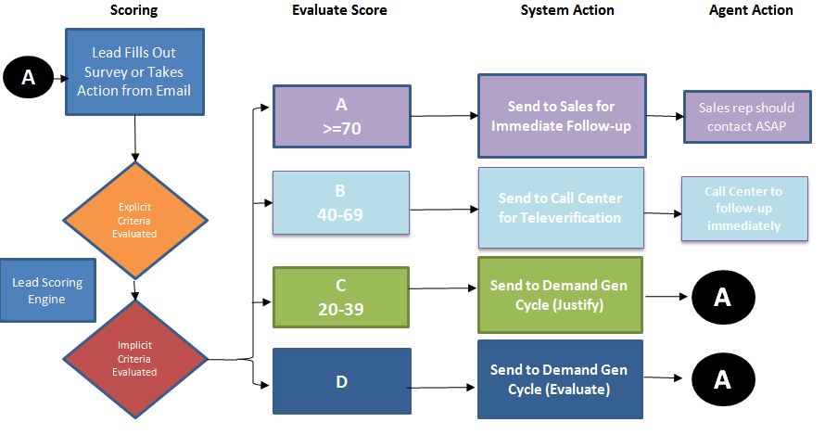
Lead Scoring - Process Steps

Slide 12
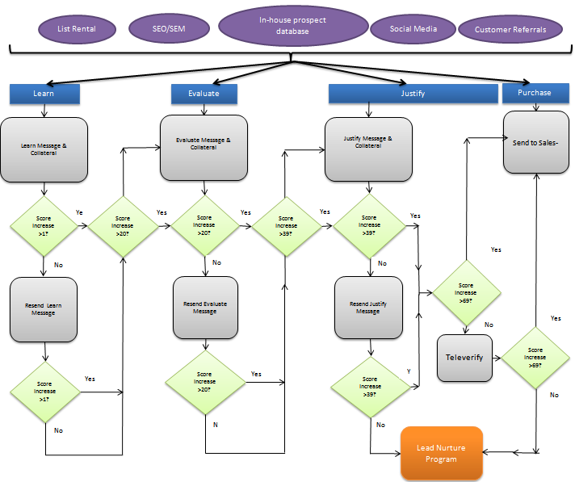
Sample Lead Nurture Flow

Slide 13
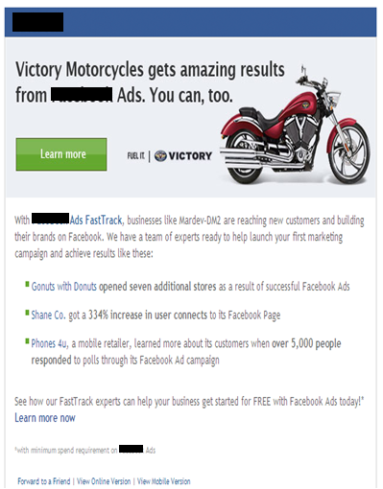
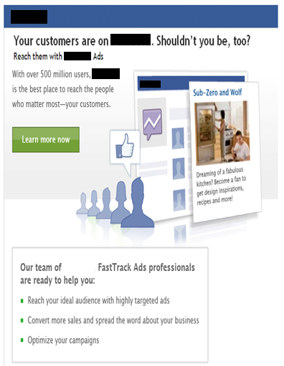
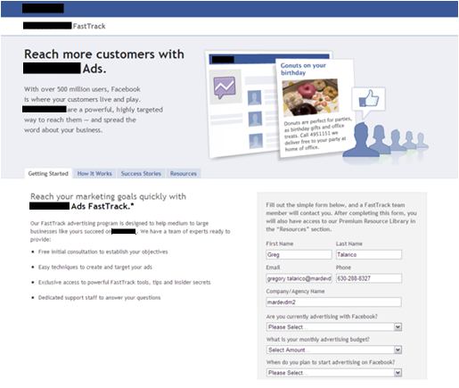
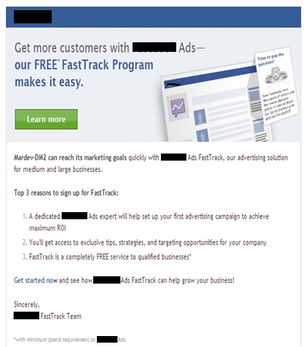
Sample custom client journey via dynamic content based emails

Slide 14
Measurement & Reporting
mardevdm2 will track the effectiveness of each channel, for instance – SEO, SEM, online ads, emails, events, websites, enewsletters, etc.
Depending on current in-house bandwidth availability around analytics, mardevdm2 will set up appropriate dashboards including Attribution Reports as well as enhance the reporting available in Eloqua to create custom dashboards.
In addition, ongoing “custom” mardevdm2 reports will determine overall ROI + ROI by channel w.r.t Cost Per Conversion, Cost per Acquisition, etc. and allow us to
Track the Effectiveness of each Channel
Optimize marketing spend via funnel management
Enhance the overall RoMI

Slide 15
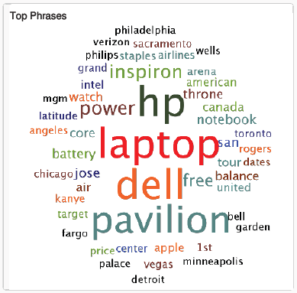
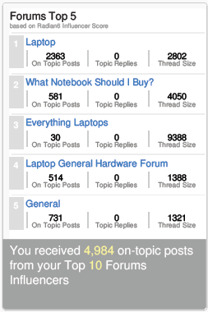
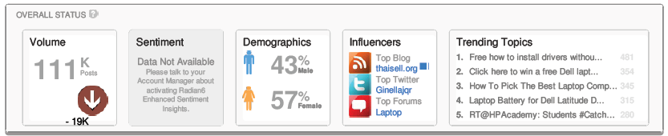
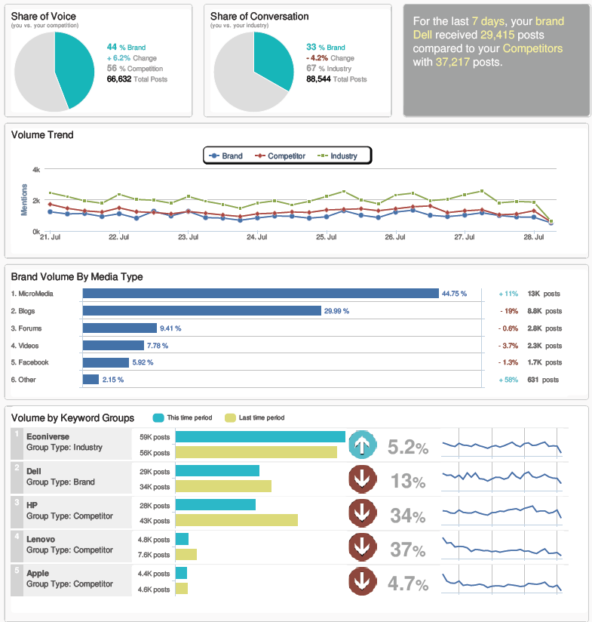
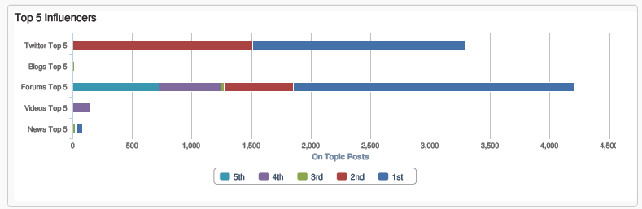
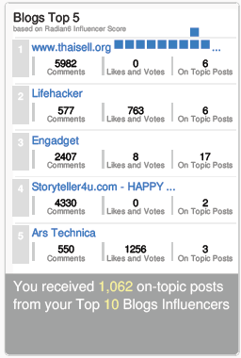
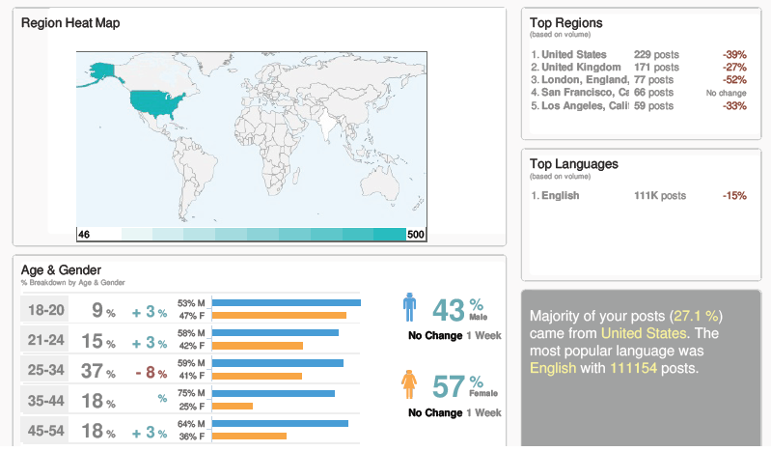
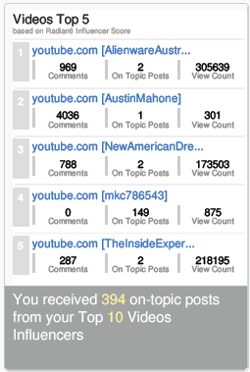
Sample - Social Media Monitoring Report

Slide 16
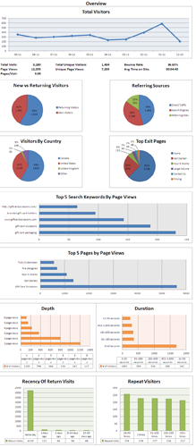
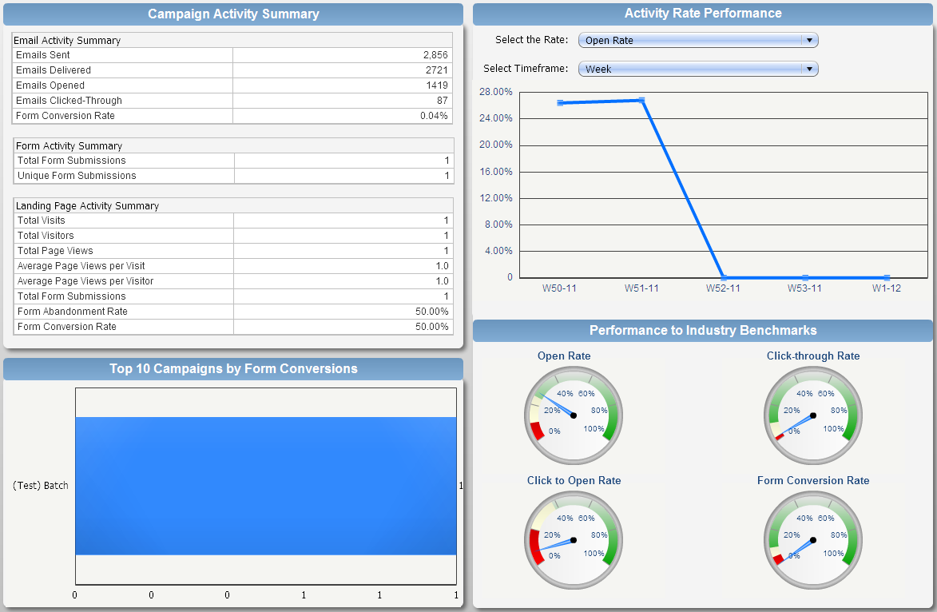
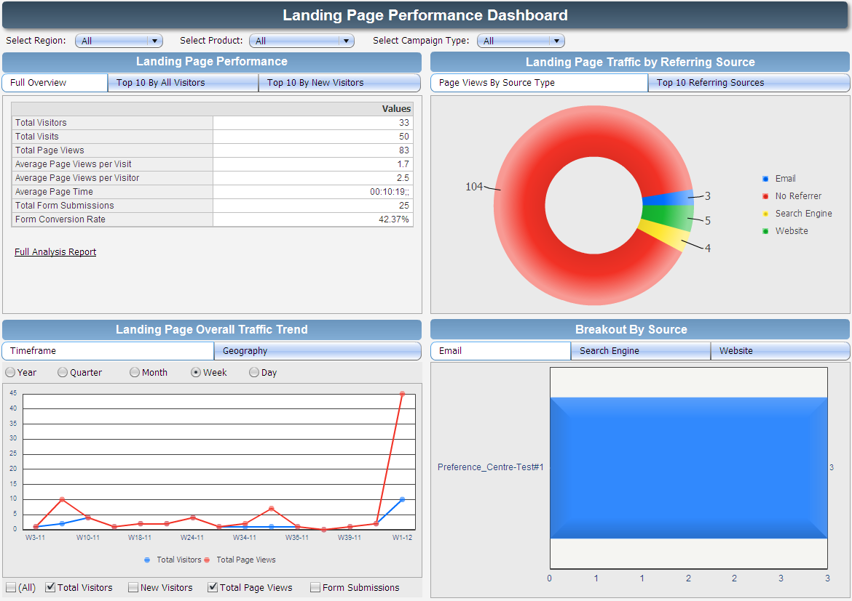
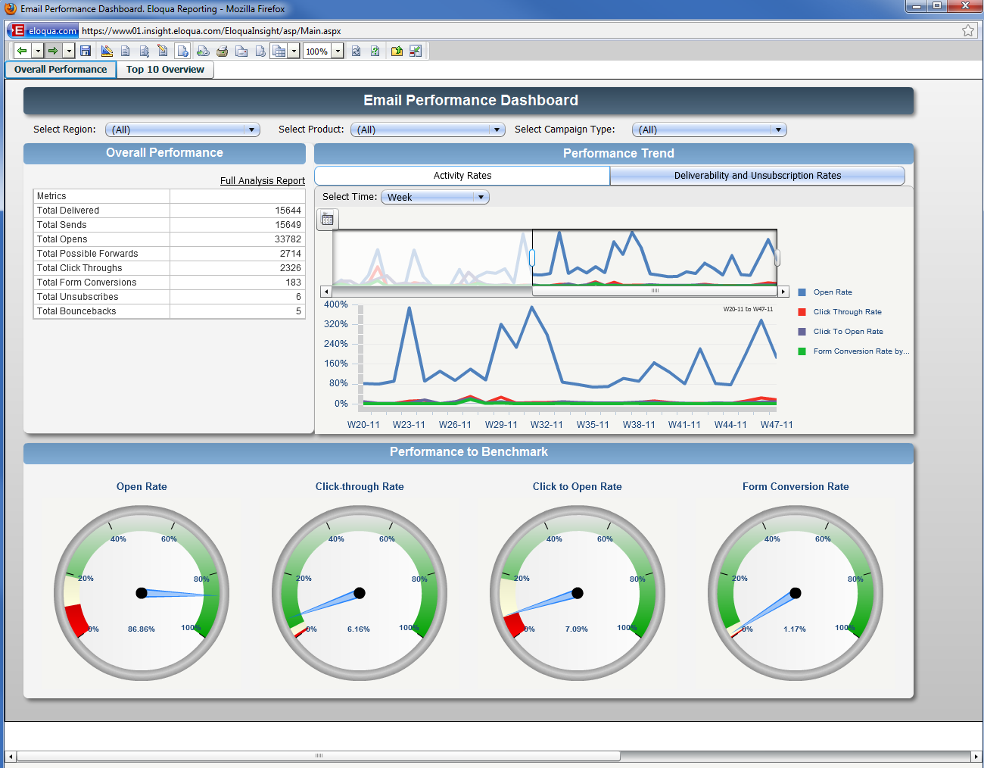
Custom Eloqua Dashboards

Slide 17
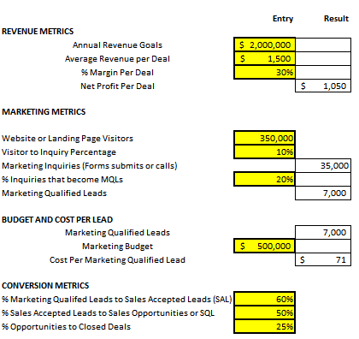
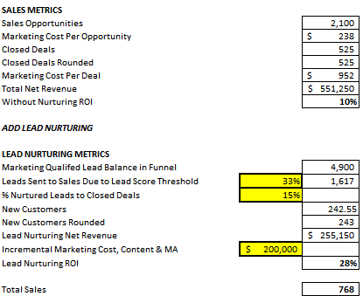
Sample Demand Generation Dashboard

Slide 18
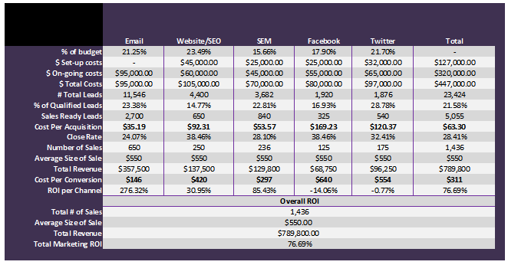
Evaluate Program & Channel Effectiveness - ROI Analysis

Slide 19
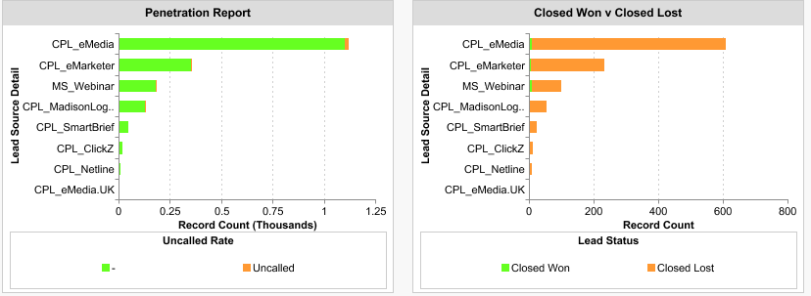
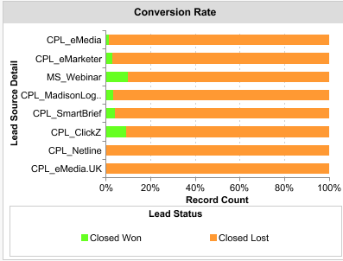
Lead Source Performance Review

Slide 20
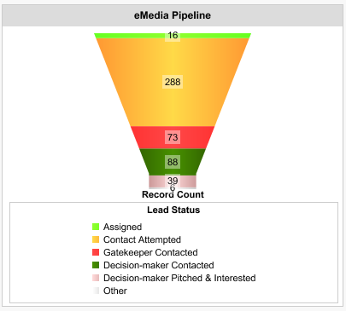
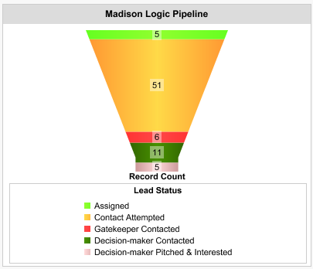
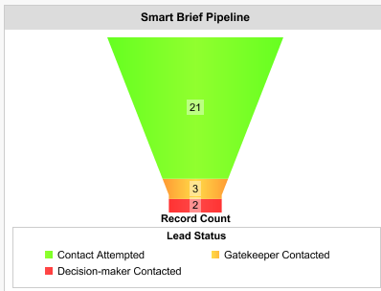
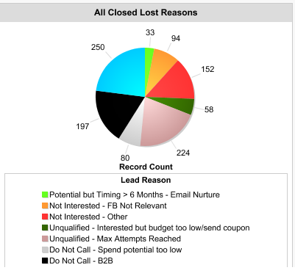
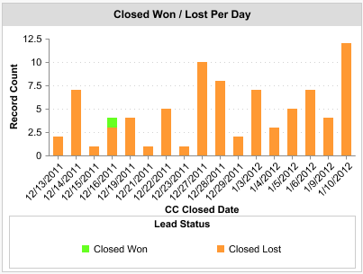
Lead Source Performance Review, Cont.

Slide 21
Attribution Model: ROI by channel
Awareness
Information
Conversion
Marketing Source | Total Revenue | Total Spend | ROI
Banner Ads | 10,264.29 | 5,000.00 | 105.29%
Search | 28,965.00 | 30,000.00 | -3.45%
Email | 14,146.43 | 12,000.00 | 17.89%
Direct Mail | 7,617.86 | 20,000.00 | -61.91%
Telemarketing | 5,135.71 | 15,000.00 | -65.76%
Social Media | 20,587.50 | 5,000.00 | 311.75%
Website/Microsite | 49,181.31 | 50,000.00 | -1.64%
Case Studies/Whitepapers | 37,201.90 | 10,000.00 | 272.02%

Slide 22
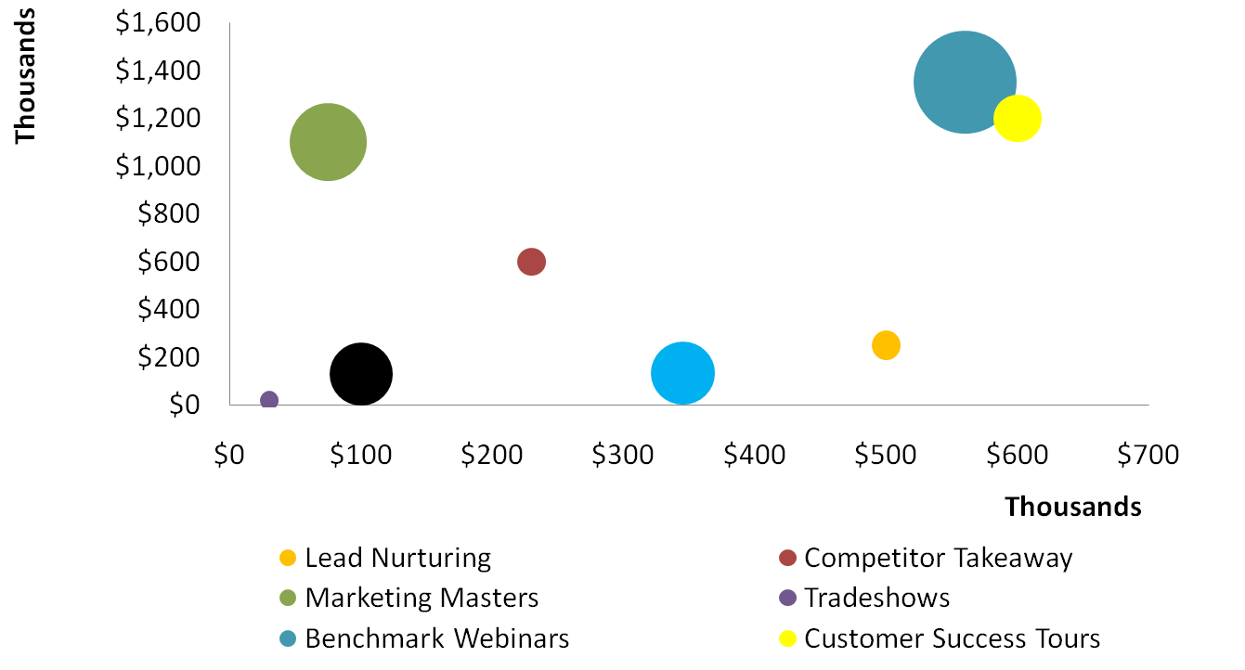
ROI: Best Performing Campaigns
ROI: best performing campaigns
Which campaigns had the
Best ROI (bigger is better)
Revenue Attributed
To First Source
Search
Banner Ads
Social Media
Direct Mail
Email
Case Studies/White papers

Slide 23
ROI: Best Performing Campaigns
Which campaigns Sourced
deals that closed?
Revenue Attributed
To First Source
Search
Banner Ads
Social Media
Direct Mail
Email
Case Studies/White papers

Slide 24
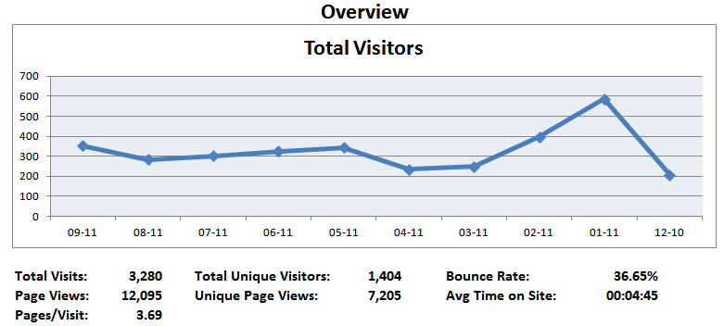
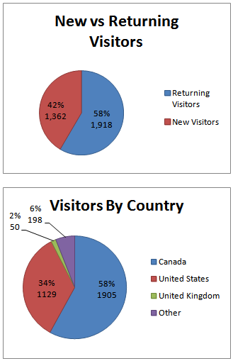
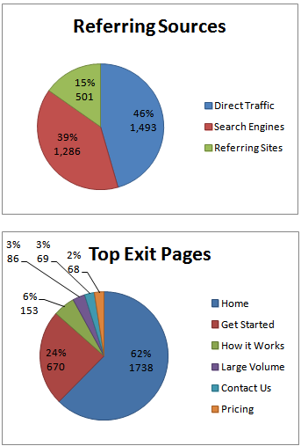
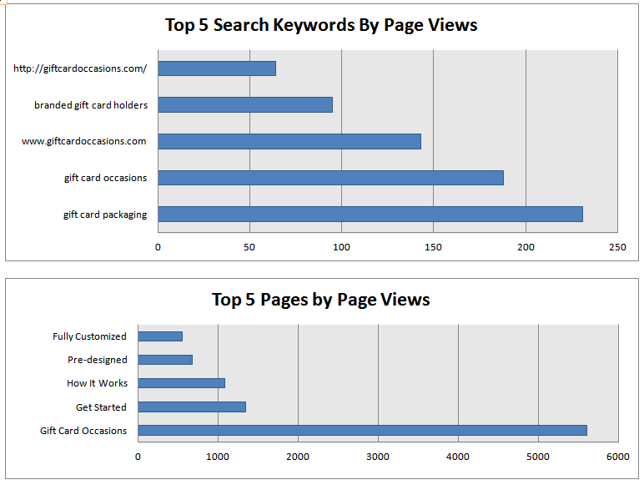
Web Analytics Reporting

Slide 25
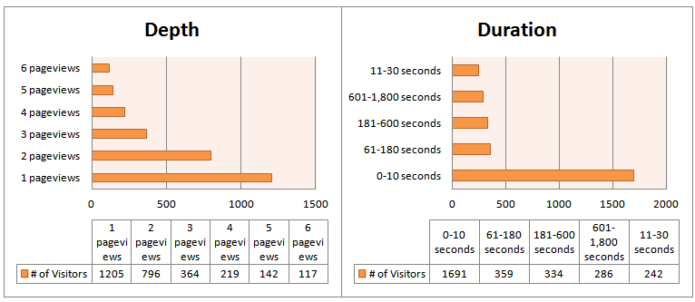
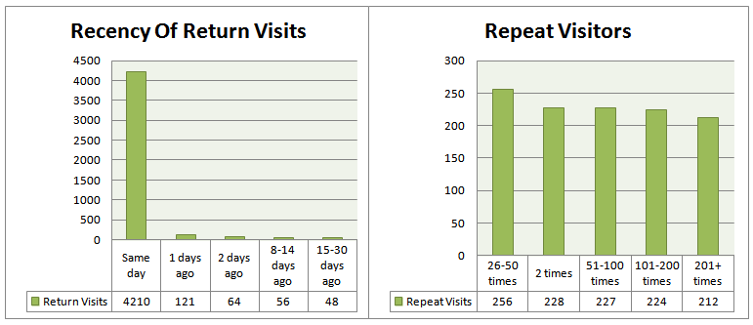
Web Analytics Reporting, Cont.

