Slide 1
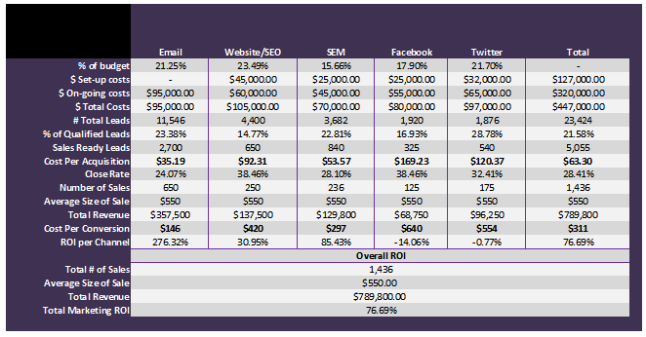
Evaluate Program & Channel Effectiveness - ROI Analysis

