Slide 1
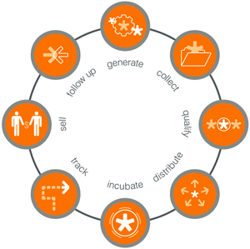
The Power of Demand Generation
Customer Behavior
& Buying Cycle
www.mardevdm2.com

Slide 2
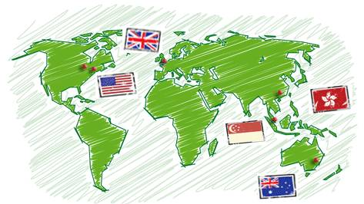
Mardevdm2 Global Business & Vision
New York
London
Chicago
Singapore
Australia

Slide 3
Mardevdm2 Global Business & Vision
A division of Reed Elsevier – one of the world’s largest listed professional media companies, with revenues of $8B, 50% of which is generated online.
Reed employs approx. 35,000 people in 50 countries.
Mardevdm2 is one of the world’s leading providers of business information & marketing services.
Mardevdm2 mission: to solve clients’ prospecting, lead generation and business development needs by leveraging:
A range of highly responsive named B2B contacts.
An unrivalled online community of B2B decision makers.
Our worldwide brand portfolio.
Expertise in demand generation services.

Slide 4
Addressing Client Challenges
Achieve deep prospect & customer insight for targeting
Identify your most ‘desirable’ prospects
To listen and be heard by building ‘valuable’ relationships with customer or groups
Raise the brand above the noise of the competition
Effective multi-channel marketing for touchpoint
Do more with less & scale up operations
Simplify management, tracking & reporting
Maximize ROI & deliver incremental revenue

Slide 5


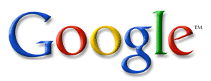



The New Evaluation Process: Self Education
Marketing
Sales
Reading your email campaigns
Visiting the website
Responding to offline
Campaigns
Information Requests
Watching a video

Slide 6




Complete Marketing Process Management
Contact Management
Campaign Management
Data Profiling
Data Cleanse/Append
Data Acquisition
Real-time Data Mgmt
Segment/Permission Mgmt
Batch & Blast Communication
Segmentation Marketing
Event-triggered Marketing
One-to-one Personalization
Real-time, Multi-channel Marketing
High
Quality
Data
Marketing Effectiveness
Lead Management
Tactical Metrics
Segment Analysis
Conversion Metrics
Pipeline and Influenced Revenue
Lead Management
Lead Scoring
Lead Routing
Lead Nurturing
Real Time Lead Alerts

Slide 7
…a partner for the long-term
Right Time
Right Message
Right Channel
True
Personalization
One to One
Behavior-Driven
Segment
Customer-Driven
Batch and Blast
Product-Driven
7

Slide 8
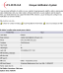


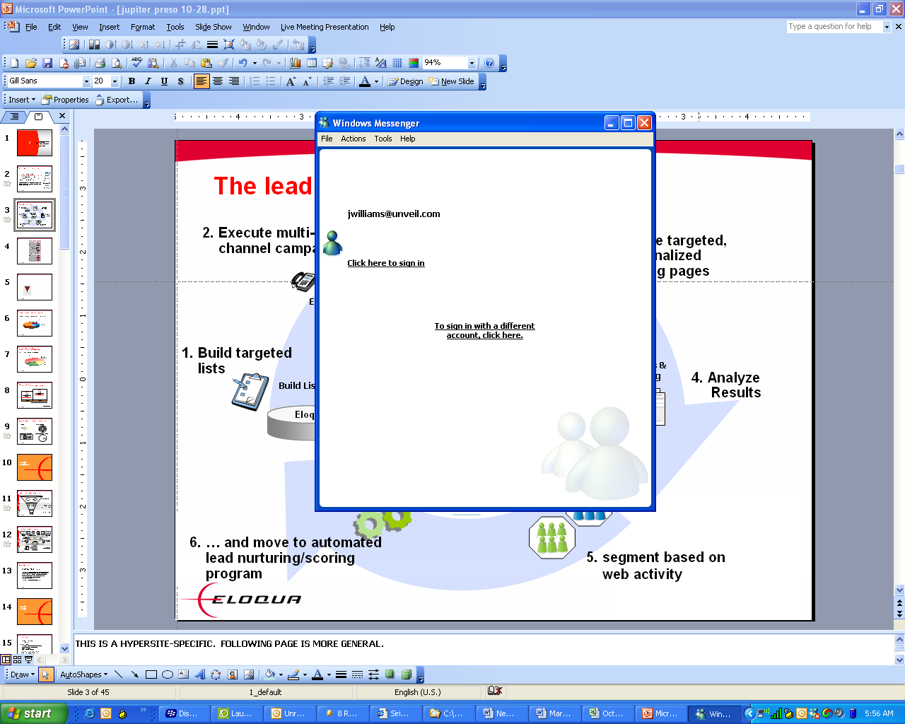



Integrated demand generation platform
Marketing Intelligence Dashboard
Command & control
Event-based, multi-step, multi-channel automation
Marketing Automation
marketing email
Individual Marketing channels
sales email
chat
direct mail
advertising
keyword search
Web forms
telemarketing
landing pages
CRM
Segmentation, Profiling, and Analytics
Common analytics platform across all marketing channels

Slide 9

Integrated Data and Marketing Services Platform
AUDIENCE DATA
LEAD GENERATION CAMPAIGN ADVICE
AUTOMATED LEAD GENERATION PACKAGES
ENGAGING CONTENT
LEAD MEASUREMENT & ROI REPORTING
Global B2B Data
Media, Digital Audience
Data cleansing, management
Data enhancement & profiling
Predictive Modelling to identify new prospects
Cold data supply
Strategy & Planning
Campaign/Media Optimisation
Campaign End to end process design
Getting Sales onboard
Graded Lead Definition
Lead Scoring
Lead Flow Management
Multi-channel e-marketing (SEO/PPC/ Social/email/ e-nurturing)
Automated campaigns
Microsite: Build, Design, Optimize & Hosting
Behavioural Tracking & Scoring
Real time email/ telemarketing link up
Real time reports
Creative services
Content Origination
Content Re-purposing
Content library
Event Hosting
Event Management
Lead Creation & Management
Lead Scoring & Nurturing
TM scripting and set up for pre-sales qualification
Lead Analysis & Optimisation
Real time Reporting/ Dashboards

Slide 10
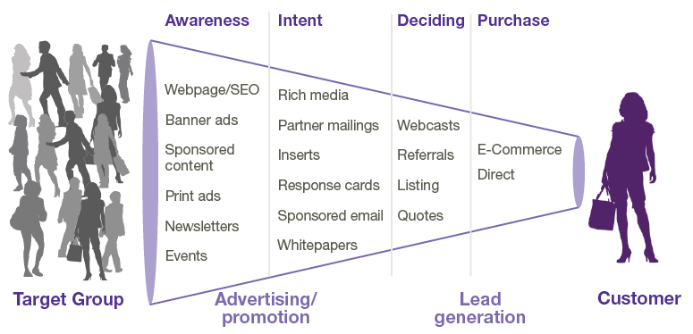
Define Opportunities to Accelerate Sales
Customer Buying Process
Marketing validates interest
(MAL)
Marketing nurtures to sales ready
(MQL)
Sales accepts ownership
(SAL)
Sales validates BANT criteria
(SQL)
Sales closes revenue opportunity
($$)
The process you need that together, we support
Sales & Marketing Process:
Notes:
The key is to really understanding the opportunities we have to pull those levers. Ideally, the more opportunities we have, the more control we have over demand creation.
The first step requires us to define and document the stages a buyer (many organizations refer to this as “lead”) moves through in our sales and marketing processes. These stages make up an Integrated Sales and Marketing Funnel (ISMF). In this example, we have adopted the lead stage definitions from Sirius Decisions. Your organization may define different labels, different number of stages, etc. – but conceptually every sales process has stages that move the buyer from awareness, to evaluation, to purchase. A level of refinement on those stages empower us to communicate most effectively.
Suspect: A potential buyer that has no or outdated level of qualification. For example, a list upload used as targets for a campaign, or an inactive segment of individuals already in the database..
Inquiry: A potential buyer who has explicitly expressed initial interest. For example, a Form submission, a booth visit, an inbound Call/Email, etc. The big idea here is to differentiate a raw response to a qualified lead.
MQL: A potential buyer who has met the baseline marketing qualification criteria that has been defined in a sales and marketing. The concept of a SLA between sales and marketing helps many organizations to create an objective feedback loop on lead quality – as well as ensure that “no lead is left behind” (i.e. no follow-up).
SAL: A potential buyer who has been validated by sales and is being worked by sales. By initiating an SLA with the notion of sales acceptance, accountability on lead quality is distributed across both marketing and sales functions.
SQL: A potential buyer who has been associated to a forecasted purchase. In other words, the sales cycle.
Customer: A potential buyer who has been associated to closed revenue and fits within the definition of an active customer.
The key is to document clearly the stages of your buying cycle for a specific product or solution and get buy-in from all key stakeholders. And, then map your customer’s purchase process to your internal selling process. The benefits include:
Improved opportunities to segment and target communications to potential buyers
Increased sales and marketing alignment
Improved visibility into impact on Customer Lifetime Value
10

Slide 11








Closed Loop Marketing
Reporting & Analysis
Deeper, Intelligent Insight
Increased Productivity
Higher Response Rates
Right Message, Right Time
Actionable, Better Decisions
Triggered Automation
Digital Profiling
Personalized Campaigns
Targeting & Segmentation
Notes:
11

Slide 12
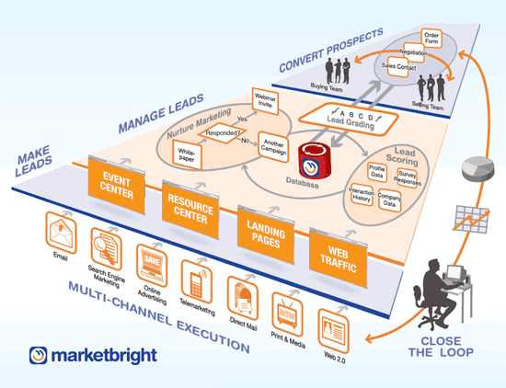
Marketing Automation Methodology
12

Slide 13
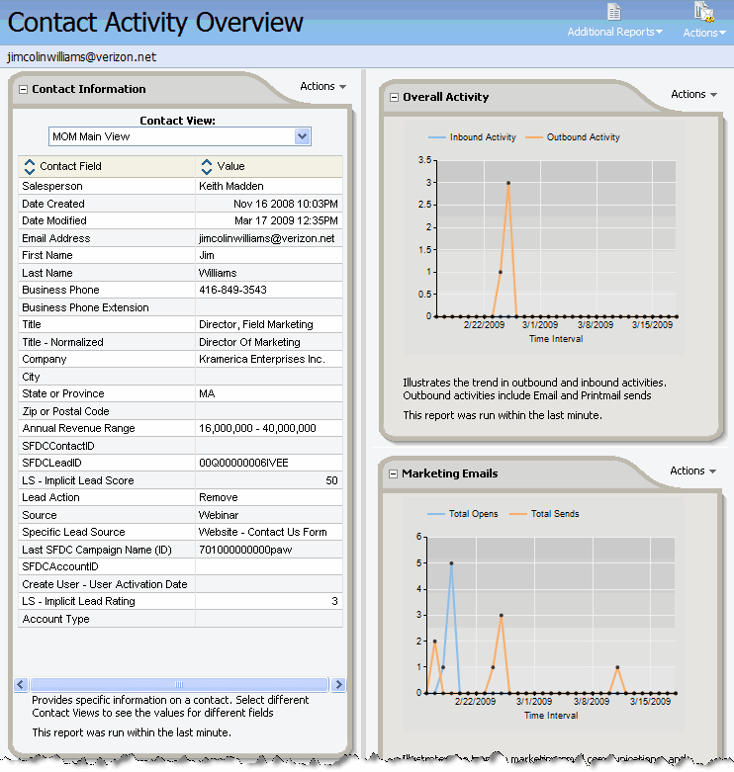



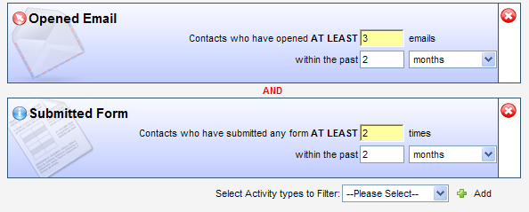
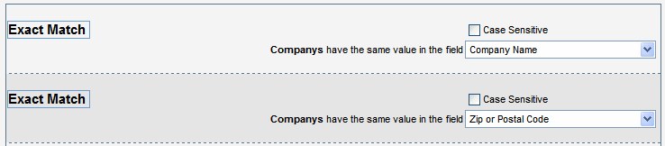
The Marketer’s Process and Tools
3
Target & Segment
2
Cleanse Data
1
Profile Prospects

Slide 14

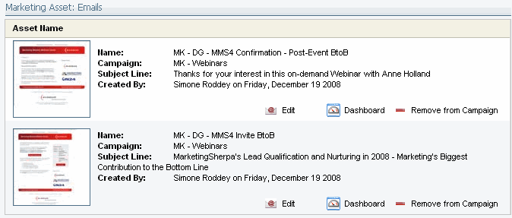

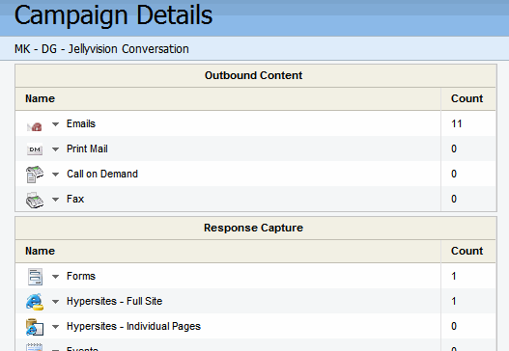
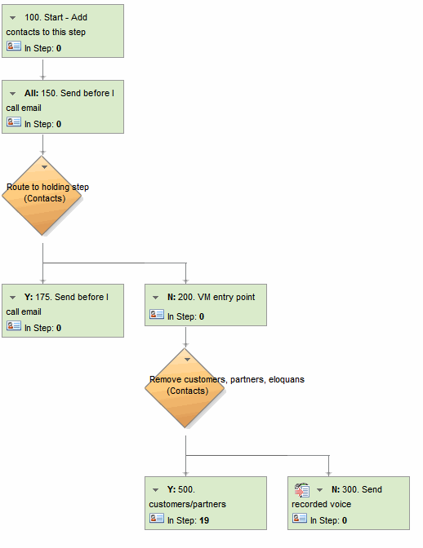

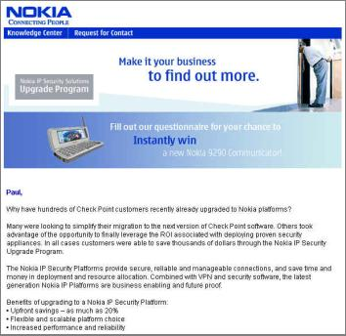
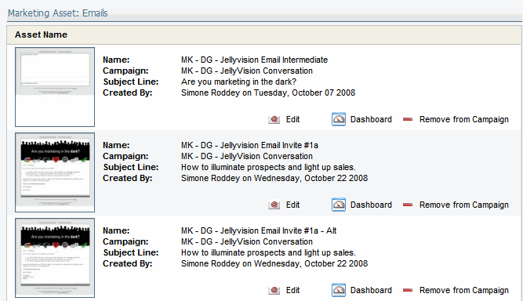


The Marketer’s Process and Tools
4
Plan Campaigns
5
Trigger Events
6
Automate Programs
7
Execute Across Channels

Slide 15
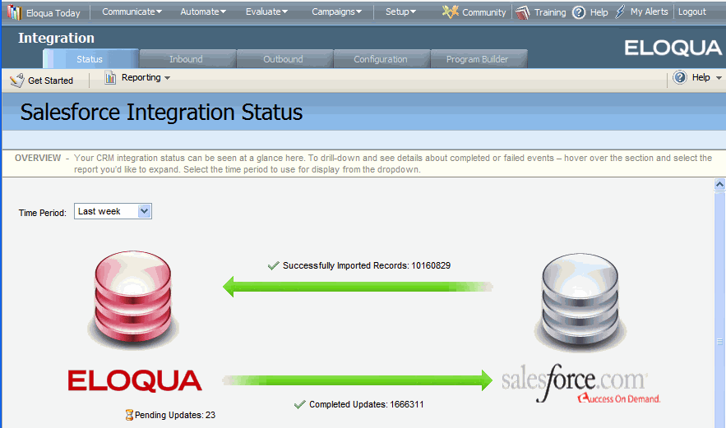

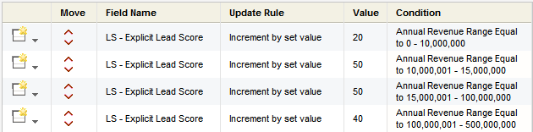

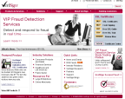
The Marketer’s Process and Tools
8
Capture
9
Score
10
landing page
form
Route
website

Slide 16
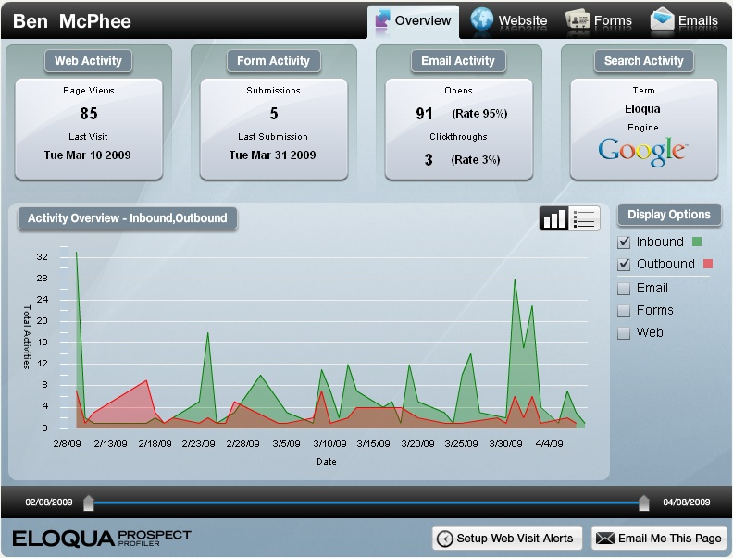
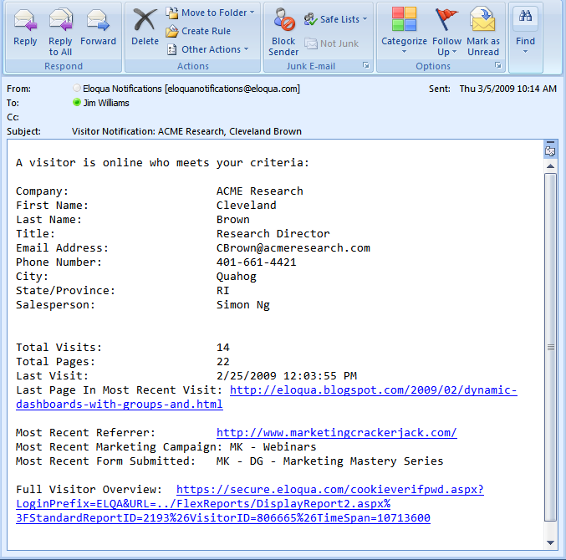
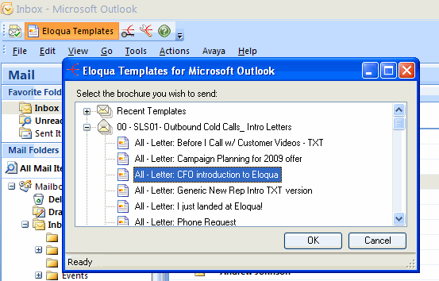
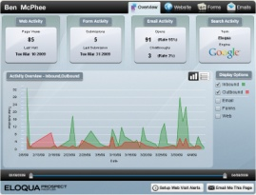

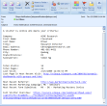
The Marketer’s Process and Tools
13
Enable Sales
Campaigns
12
Provide Sales Intel
11
Alert Sales

Slide 17
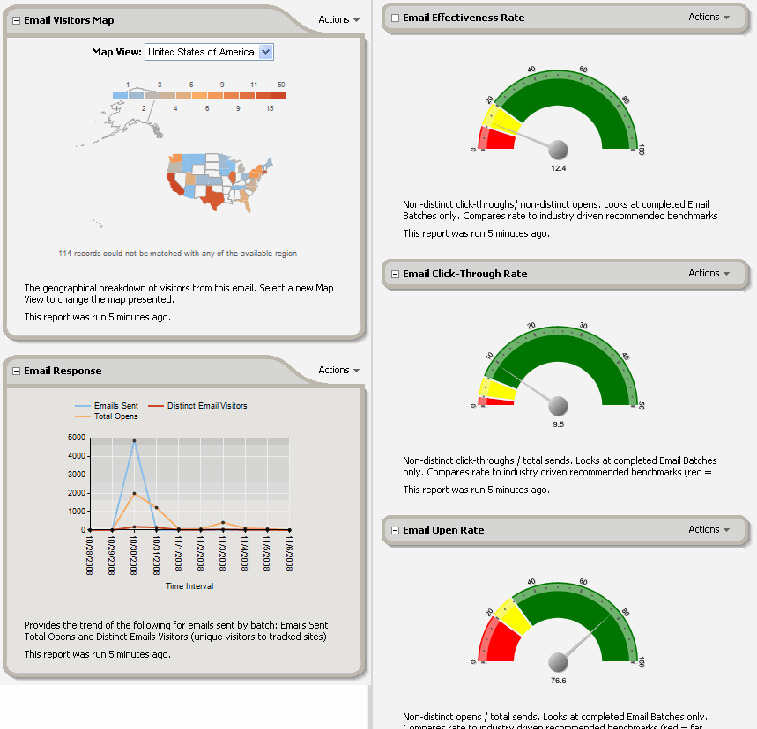


The Marketer’s Process and Tools
14
Measure &
Optimize Marketing

Slide 18

The Marketer’s Process and Tools
3
4
Cleanse Data
Plan Campaigns
2
5
Target & Segment
Trigger Events
1
Profile Prospects
6
Automate Programs
14
Measure &
Optimize Marketing
7
Execute Across Channels
8
13
Provide Sales Intel
Capture
9
12
Enable Sales Campaigns
Score
10
landing page
form
11
Alert Sales
Route
website

Slide 19
Why work with mardevdm2?
Data Depth:
our B2B contact info facilitates targeted & personalized multi-touch campaigns
unrivalled data hygiene = accurate campaigns
Demand Generation:
strictly best practice demand & lead generation
working with industry experts
we use pull & push, online & offline strategies to maximize lead delivery & ROI (incl. social media)
Accredited security & business continuity policies
We can run closed loop, integrated campaigns OR work with existing 3rd parties

