Slide 1
MOSAIC
Multi-customer Orchestration System for Adaptive Intake and Continuous Delivery
From business need to governed
solution dossier—in minutes, not days.
Business user -> GitHub Copilot App -> governed analysis -> 23-file dossier -> human decisions.
Before
With MOSAIC
Business value
Repeated discovery, copied notes and inconsistent handoffs.
Adaptive intake, approved evidence and one review package.
Less preparation and rework; experts focus on decisions.
Scale the expertise. Keep the accountability.
Notes:
MOSAIC means Multi-customer Orchestration System for Adaptive Intake and Continuous Delivery. It is AI-first business process automation and orchestration for the solution-engineering lifecycle, not merely a chatbot or document generator. In GitHub Copilot App, a business user describes a problem, requirement or opportunity in plain language. Adaptive intake asks relevant questions to clarify outcomes, scope, affected people, constraints and success measures. After explicit approval, MOSAIC acquires approved evidence, normalizes facts and unknowns, analyzes requirements and risks, compares exactly three options, prepares a proposed design and delivery-readiness plans, validates the package, and hands it to qualified people for decisions. The durable result is a 23-artifact dossier covering the business context, scope, requirements, assumptions, unknowns, risks, alternatives, proposed architecture, implementation, verification, interfaces, security, deployment and rollback, operations and adoption, measurement, evidence, validation, transcript, audit trail and meeting materials. This replaces repeated discovery, scattered research and reconstructed handoffs with one governed process. MOSAIC does not approve, implement or deploy the proposed customer solution. People still select the architecture, approve the exact dossier revision and authorize delivery. One isolated installation per customer supports the multi-customer distribution model. Reuse the process and controls, not restricted customer information. The executable reference uses prewritten scenario analysis; actual App evidence remains limited to saved instructions and source-tool calls. Cost, effort, reporting quality and lifecycle efficiency are evaluation targets, with illustrative planning economics on slide 3.

Slide 2
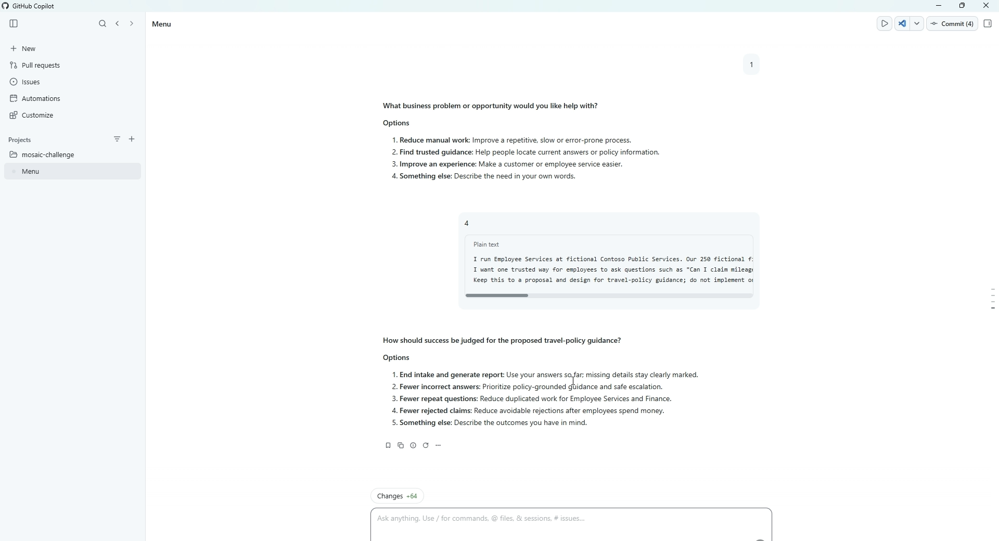
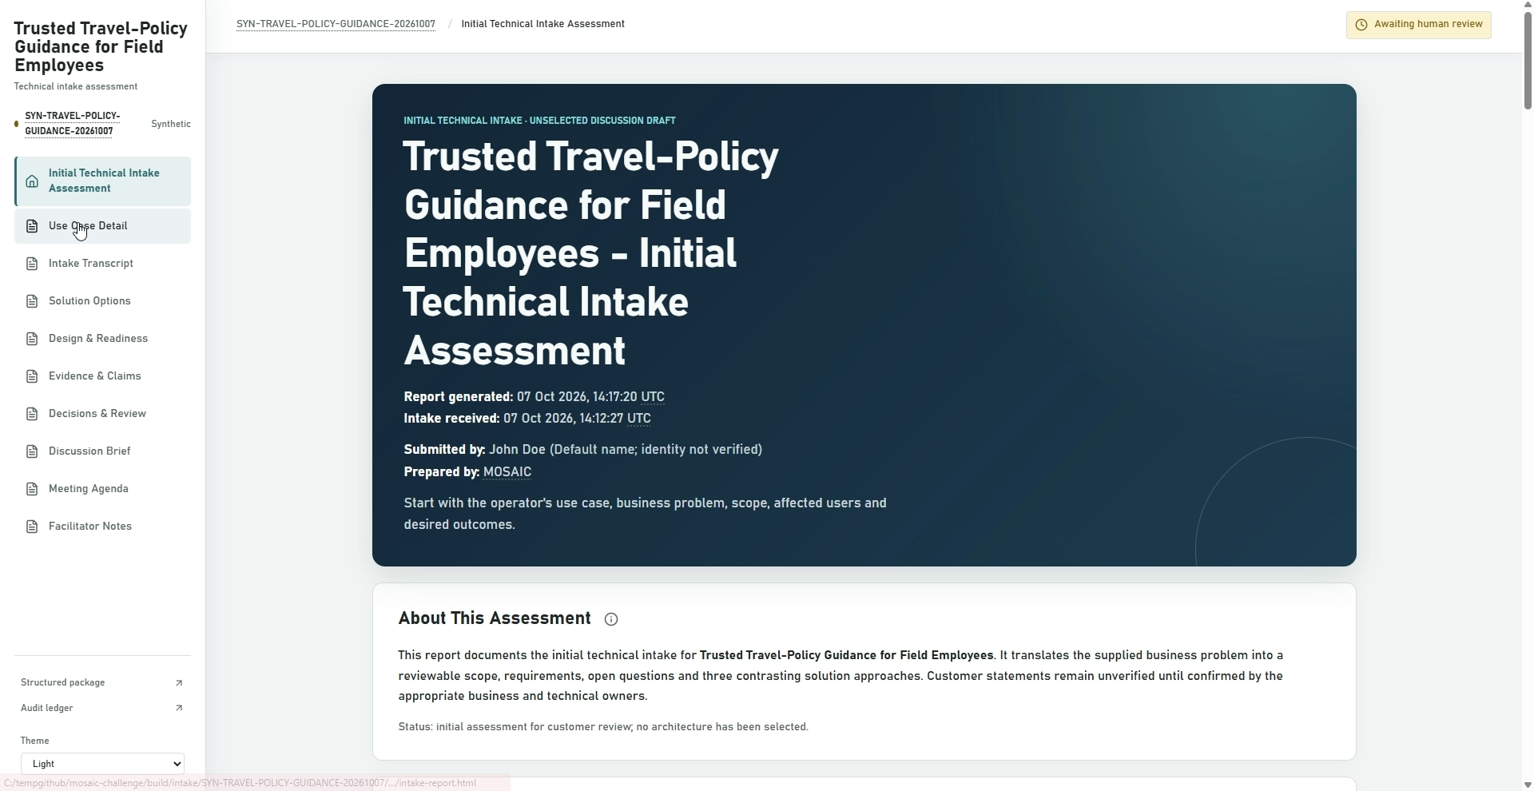
One governed flow, proven in the App.
Synthetic example: trusted travel-policy guidance for 250 field employees.
AUTHENTIC APP INTAKE
AUTHENTIC GENERATED OUTPUT
GitHub Copilot App: plain-language request -> adaptive intake.
Generated dossier: unselected discussion draft -> awaiting human review.
1 INTAKE
2 GOVERN
3 PREPARE
4 REVIEW
Need, scope
+ risks
Approved evidence
+ bounded plan
Three options
+ 23 files
Select architecture;
approve revision later
Authentic 2:55 recording. Architecture selection and design approval remain separate.
Notes:
Both images are lossless crops from the entrant's authentic 2 minute 55.57 second contest recording captured on October 7, 2026. The left frame shows the selected MOSAIC Orchestrator in GitHub Copilot App accepting the fictional Contoso travel-policy request and presenting an adaptive follow-up with End intake and generate report as option 1. The right frame shows the generated browser dossier from the same recorded run, labeled unselected discussion draft and awaiting human review. The workflow accepts a plain-language need, preserves unknowns, discloses a bounded generation plan, acquires only approved synthetic evidence, and prepares exactly three contrasting options plus the 23-artifact package: ten HTML pages, nine Markdown reports and four JSON records. An authorized customer role must first select the architecture. The selected full dossier then requires separate approval against its exact revision. The reference records neither decision and releaseAuthorized remains false. No solution is implemented, deployed or approved.

Slide 3
Adoption motion and expected value.
Illustrative planning model—not measured savings or a customer forecast.
96 hours
16 hours
80 hours
Manual preparation
Retained human review
Potential effort saved: 83%
At $200/hour: $16,000 gross capacity per request.
$1.6M at 100 requests/year, before additional effort and operating costs.
Adoption: synthetic proof -> customer benchmark -> isolated rollout -> scale.
Customer-specific evidence, templates, roles and approval rules.
Scale the expertise. Keep the accountability.
Notes:
The value follows from reducing repeated intake and design preparation, not from removing accountable judgment. ECO-001 is the entrant-provided internal planning brief, economic inputs on pages 4, 13-15 and 21-22; the confidential source remains outside Git. The planning range is 48-144 manual hours, with a 96-hour midpoint and assumed retained review of 16 hours. Base arithmetic: 96-16=80 hours returned; 80/96=83.33%; 80*$200/hour=$16,000 gross capacity per eligible request. At an illustrative 100 eligible requests/year, this is 8,000 hours and $1.6 million of gross capacity before additional effort and costs. The displayed base case assumes no other retained effort. Account for actual coordination, correction and exception effort, plus platform, integration, governance, support and operating costs. Do not double-count retained review costs or call released capacity cash savings. Review-time sensitivity at 24/16/8 hours gives 72/80/88 hours returned. These are not measured MOSAIC outcomes, a customer forecast, staffing commitments or a Copilot-versus-Claude benchmark. MOSAIC is designed for adoption from small businesses through large enterprises. Each isolated customer can supply its own evidence policy, terminology, report templates, required document profile, reviewer roles and approval rules while baseline controls remain non-removable. The contest reference demonstrates shared templates, customer-configured roles and document compatibility checks; arbitrary zero-code customization is not claimed. Reuse spans account teams, customer success, solution sales and developers. GitHub's documented issue, instruction, change and review surfaces provide workflow fit; Claude Code supports overlapping patterns. Sources: docs/evaluation-plan.md#planning-economics, docs/adoption-playbook.md, https://docs.github.com/en/copilot/how-tos/github-copilot-app and https://code.claude.com/docs/en/desktop (product documentation accessed September 15, 2026).

