Slide 1

Material Purchase Request Form for Demand-Driven Acquisitions
Morgan Library

Slide 2
Demand-Driven Acquisition (DDA) materials
Mostly print books and items
CSU patrons (current students, faculty and staff) request
CSU library purchases

Slide 3
Workflow Overview
Library staff load DDA records into the library catalog.
A CSU patron selects a DDA item and logs in with their CSU eID.
If the item is available in Prospector, the patron can choose to borrow the item from Prospector.
Otherwise, the patron can request the item via an online form.
The request form sends an email to library Collections and Contracts staff.
Library staff purchase the item, update the catalog record, and notify the patron that the item is available for checkout.

Slide 4
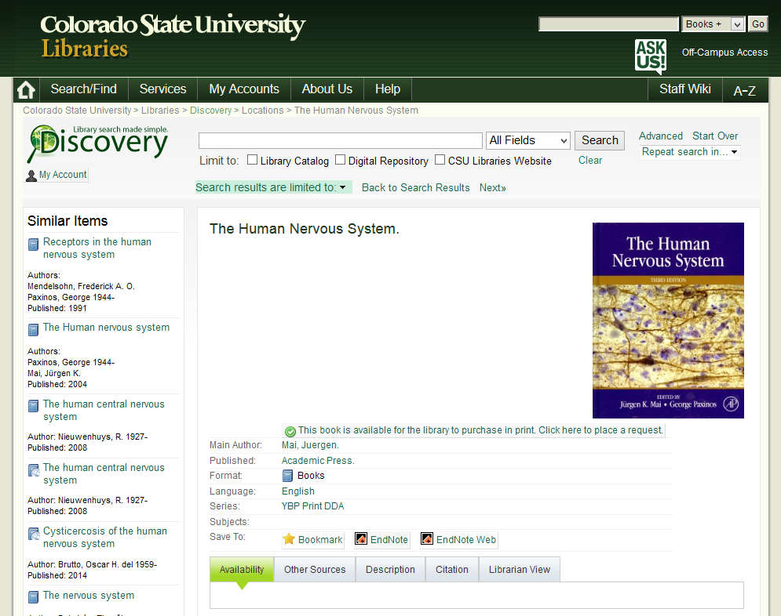

Slide 5
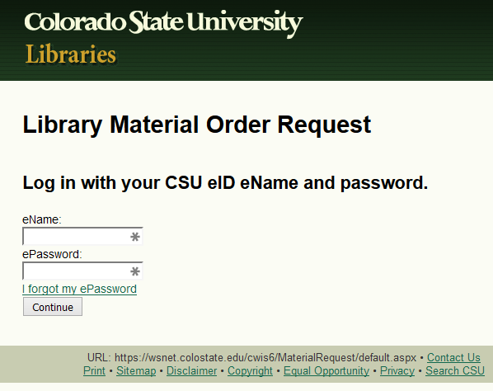

Slide 6
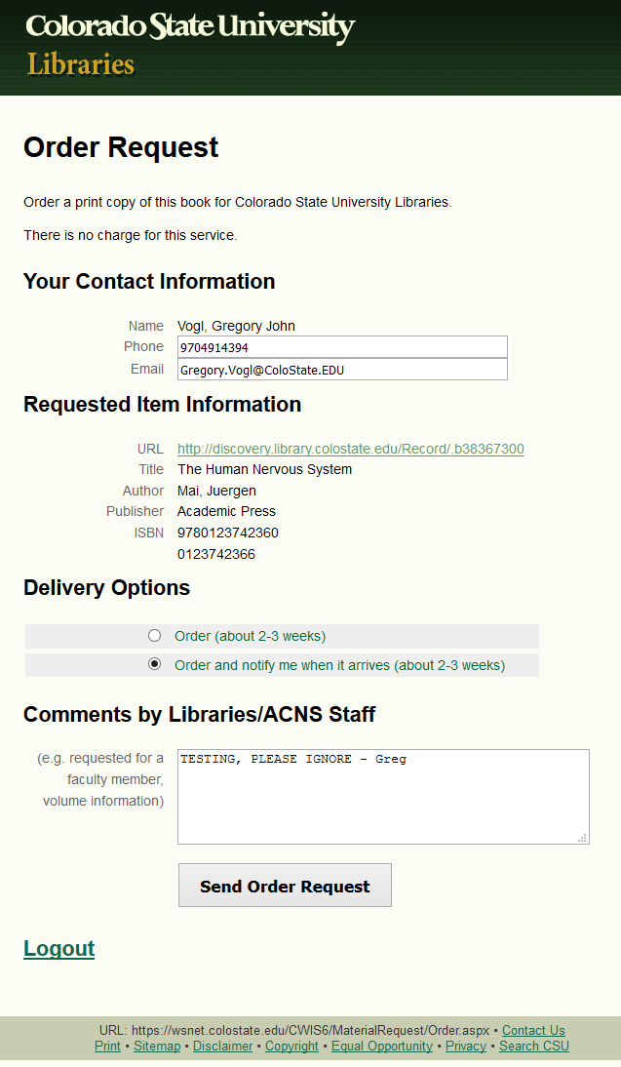

Slide 7
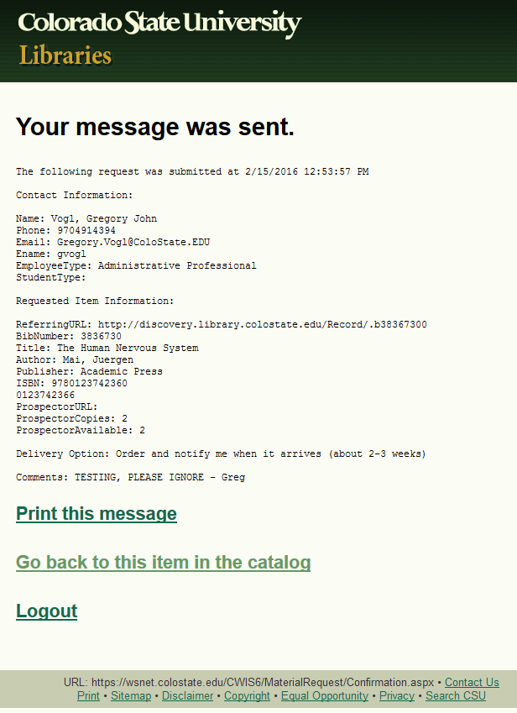

Slide 8
Software Components
Sage (CSU library catalog)
Innovative Millennium, WebPAC Pro, to be replaced by Alma in 2016-7)
Prospector (regional library catalog)
Discovery
(Web-scale discovery tool, customized VuFind beta (0.8, 2009), running Solr 1.4, Java 1.6, PHP, to be replaced by Primo in 2016-7)
SQL server databases
CSU eID database with Person table, and Request database with Request table (accessed using Linq to SQL)
WebAuth
(ASP.NET C# application and library for CSU login via eID, to be replaced by Shibboleth in 2016)
Material Purchase Request Form
(ASP.NET C# application created in 2011)

Slide 9
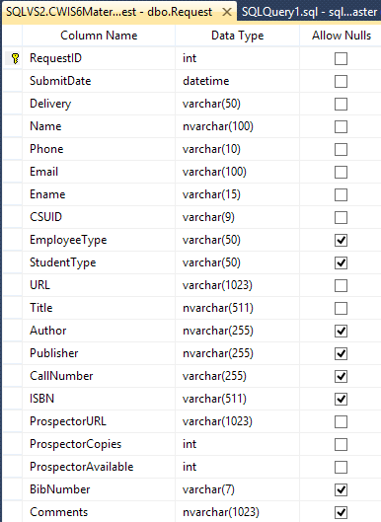

Slide 10
Catalog Integration
In the MARC record of each DDA item, the 856u field contains the request URL http://librequest.colostate.edu.
In Discovery indexing of Sage records, items with type are given a library location of "Books Purchased Upon request"
In search results and record views in Sage (via JavaScript) and in Discovery (via JavaScript and Smarty templates), if 856 u is the request URL, a button links to the request form.
DDA items do not have a bib number in Prospector, so Prospector request links use an ISBN search.
The request URL is an alias to the server hosting the application, which the application redirects to the actual URL of the production application: https://wsnet.colostate.edu/cwis6/MaterialRequest/

Slide 11
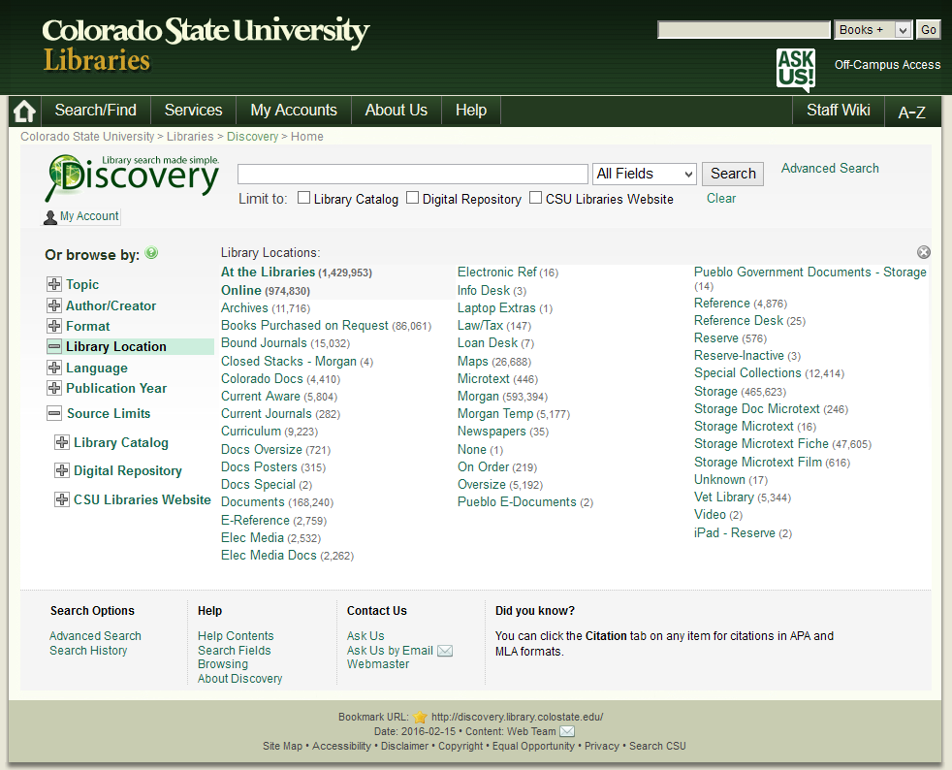

Slide 12
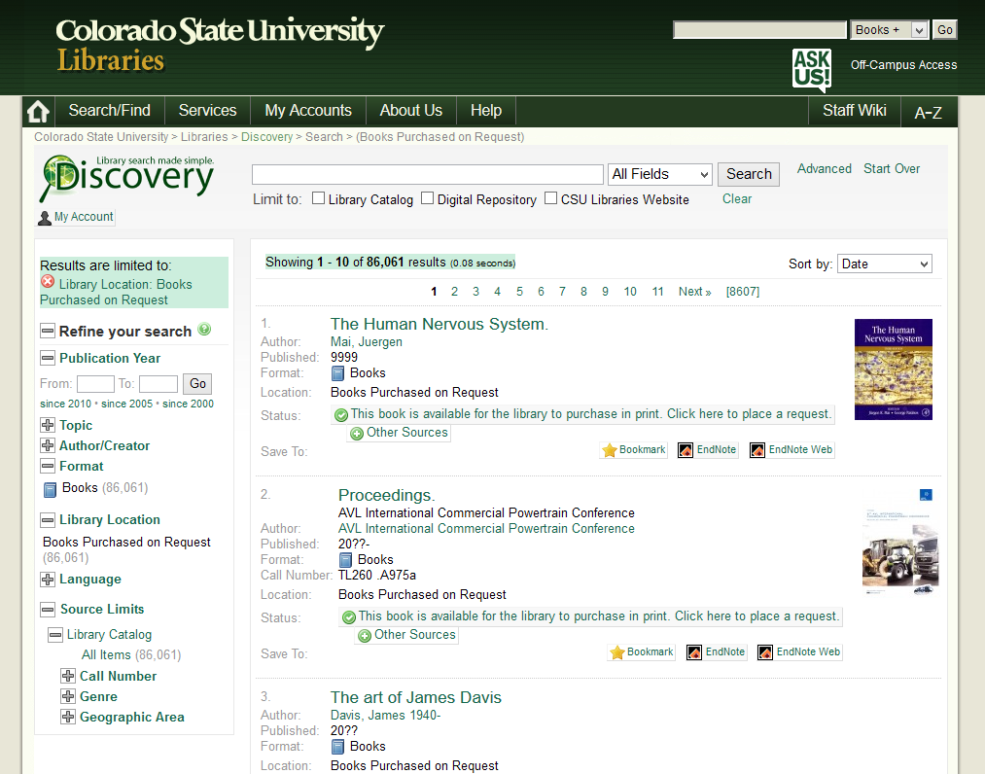

Slide 13
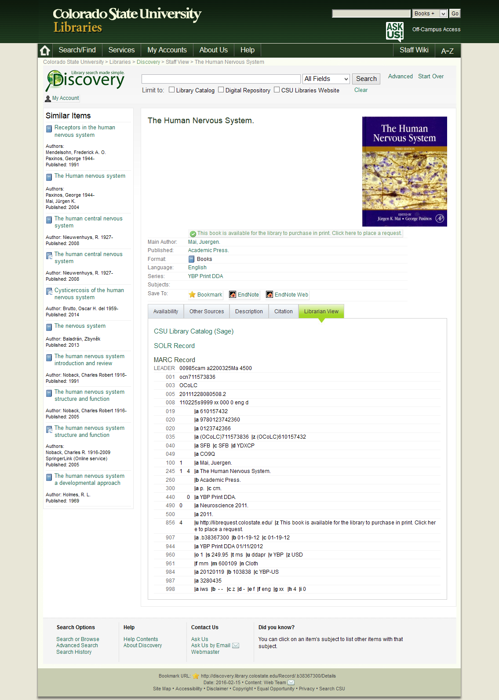

Slide 14
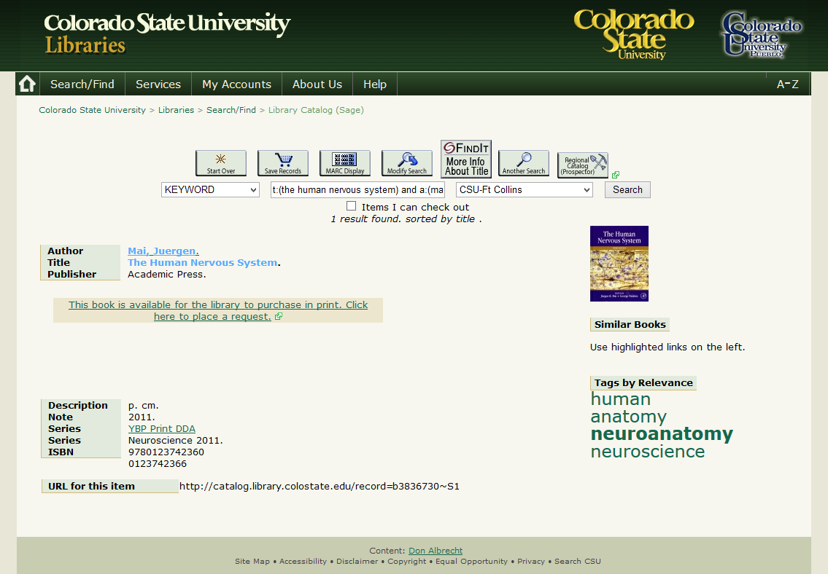

Slide 15
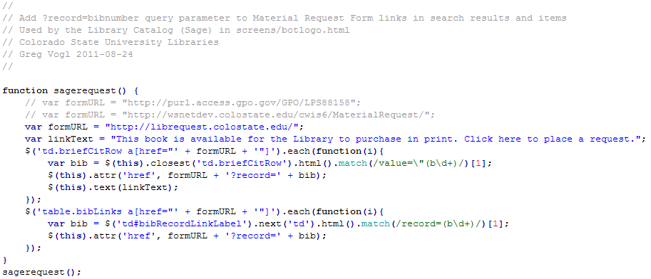

Slide 16
Application Workflow: Catalog Record
The referring URL of the record is passed to the form upon login.
The bib number is extracted from the referring URL using a regular expression. Sage: record=b1234567 Discovery: Record/.b1234567X
The bib number is looked up in Discovery's Solr database for details, including title, author, publisher and ISBNs.

Slide 17
Application Workflow: Prospector Record
If the item is in Discovery, its first ISBN is used to search classic Prospector.
If the item is in Prospector, item details, non-CSU copies, and available copies are counted by screen-scraping the holdings rows from the classic Prospector availability page.
If copies are available, the user can select from links to request from Prospector, view availability in Prospector, or request order for CSU.

Slide 18
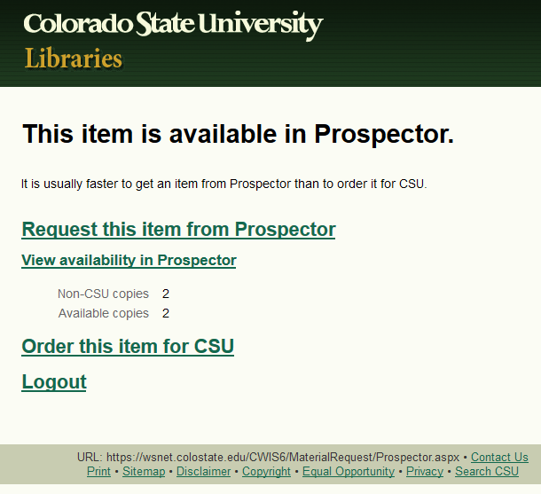

Slide 19
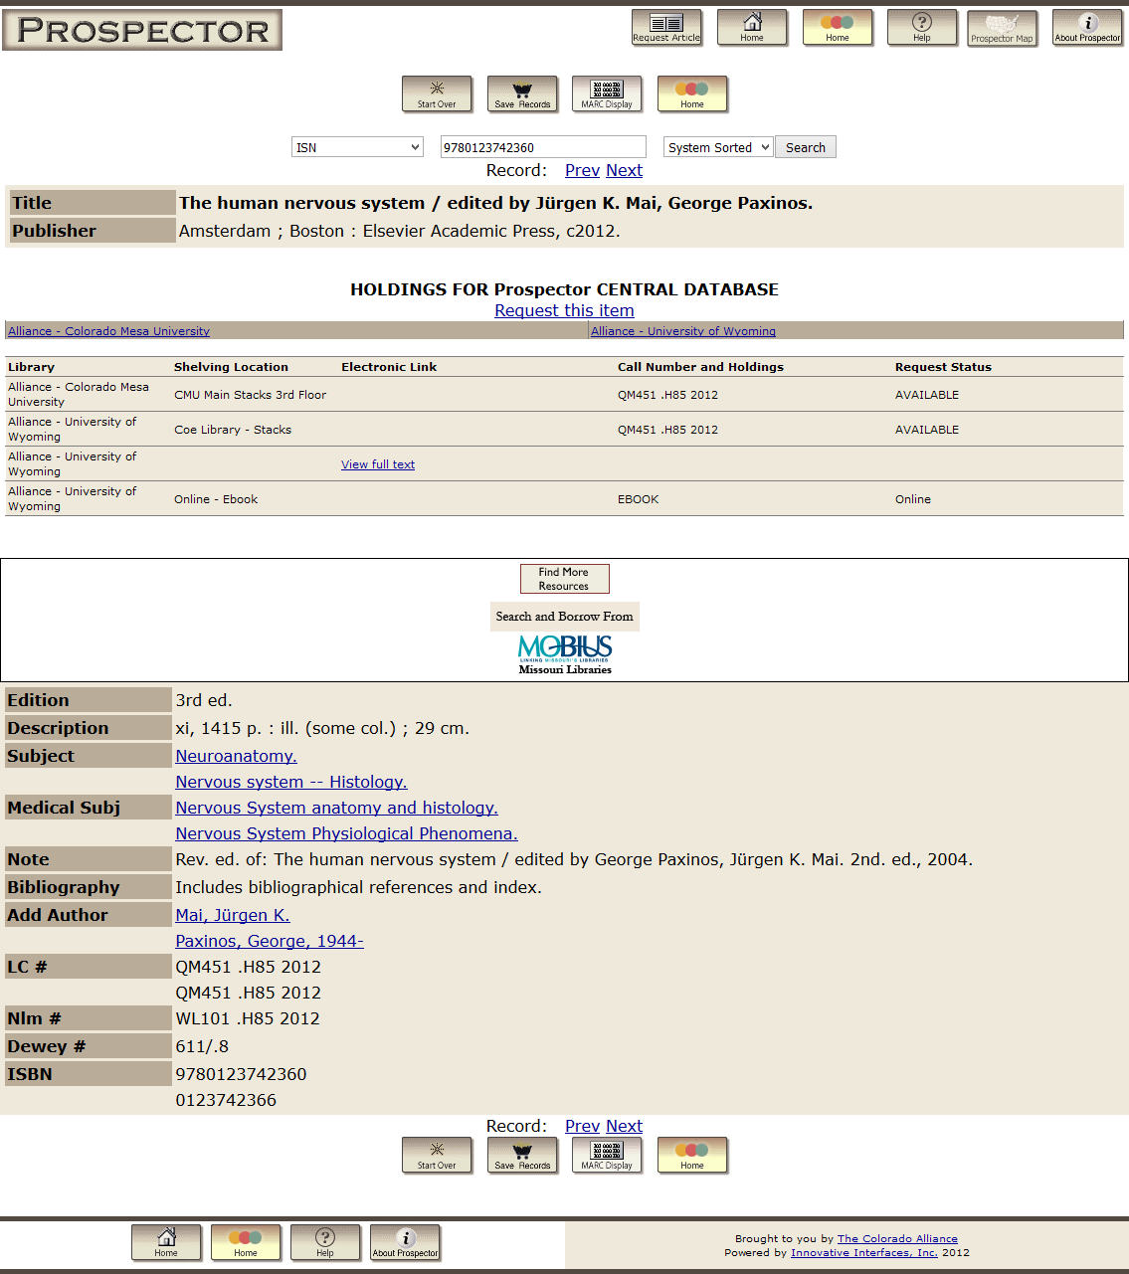

Slide 20
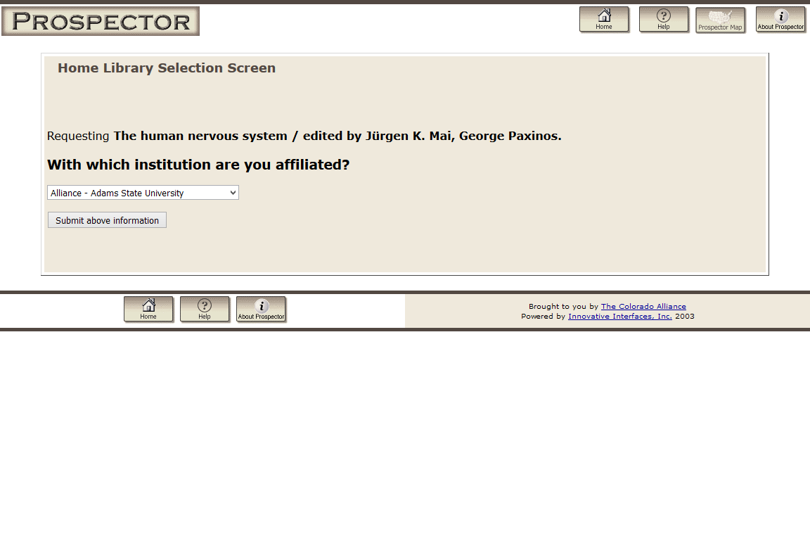

Slide 21
Application Workflow: Order Form
If no copies are available, or the user selects Order, they see their contact information, requested item information, and delivery options.
If the user is a library staff member, they can also provide details about the request, such as the identity of a patron making the request.
If the user clicks Order, a confirmation message is composed.
The message is logged to the Material Request database.
The message sent via email to the patron. (The Collections and Contracts staff email is a BCC recipient.)
The message is displayed on a confirmation page, with options to print, return to the catalog item, or log out.

Slide 22
More Information
Source code, slides, screenshots
https://github.com/gregvogl/MaterialRequest
Contact
Greg Vogl Middleware Developer Academic Computing and Networking Services (970) 491-4394 Gregory.Vogl@colostate.edu

