Slide 1

Material Purchase Request Form for Demand-Driven Acquisitions
Morgan Library

Slide 2
Demand-Driven Acquisition (DDA) materials
Print books
Requested by CSU patrons (current students, faculty, staff)
Purchased by CSU library staff

Slide 3
Workflow Overview
Library staff load DDA records into the library catalog.
A CSU patron selects a DDA book and logs in with their CSU eID.
If the book is available in Prospector, the patron can choose to borrow the book from Prospector.
Otherwise, the patron can request the book via an online form.
The request form sends an email to library Collections and Contracts staff.
Library staff purchase the book, update the catalog record, and possibly notify the patron that the book is available for checkout.

Slide 4
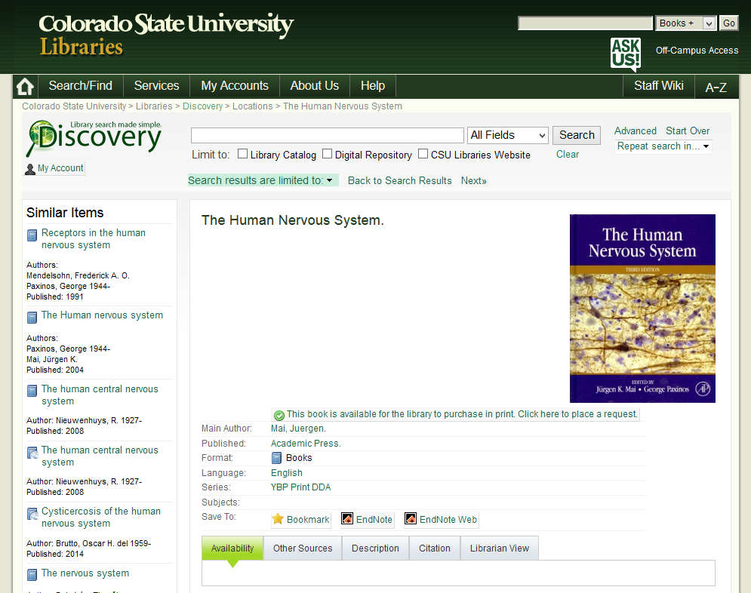
Library Catalog (Discovery) – DDA item with request link

Slide 5
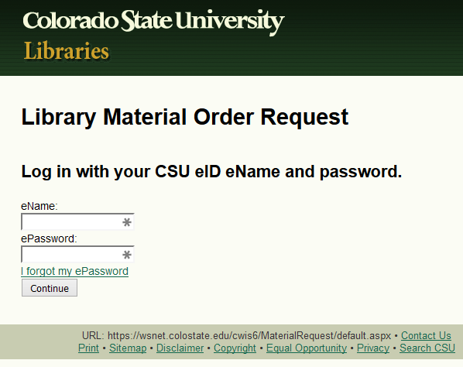

Slide 6
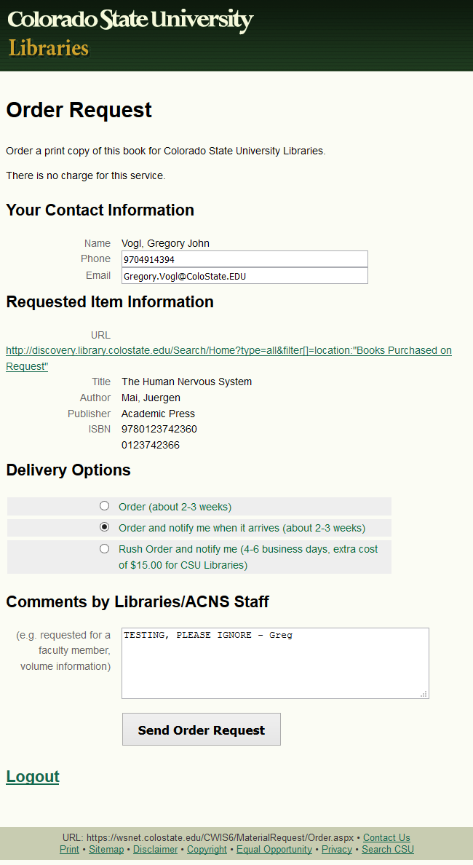

Slide 7
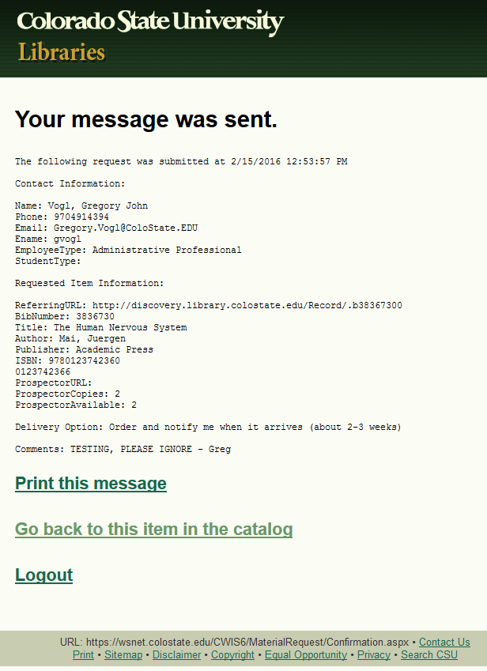

Slide 8
Software Components
Sage (CSU library catalog)
Innovative Millennium, WebPAC Pro, to be replaced by Alma in 2016-7)
Prospector (regional library catalog)
Discovery
(Web-scale discovery tool, customized VuFind beta (0.8, 2009), running Solr 1.4, Java 1.6, PHP, to be replaced by Primo in 2016-7)
SQL server databases
CSU eID database with Person table, and Request database with Request table (accessed using Linq to SQL)
WebAuth
(ASP.NET C# application and library for CSU login via eID, to be replaced by Shibboleth in 2016)
Material Purchase Request Form
(ASP.NET C# application created in 2011)

Slide 9
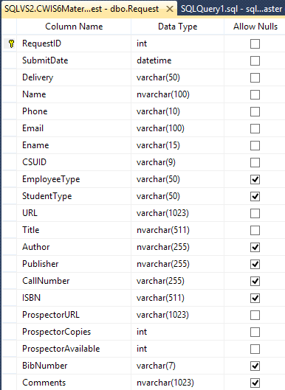
SQL Server Request table for logging purchase requests

Slide 10
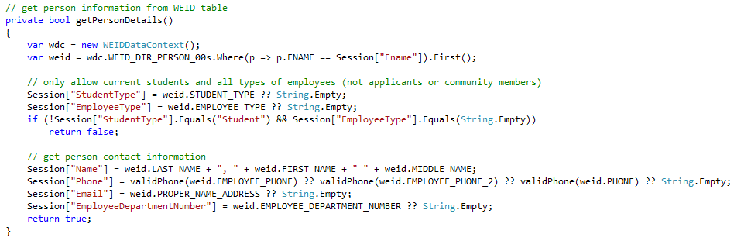
Material Request – AuthProcess.aspx.cs - get person details from WEID database table

Slide 11
Catalog Integration
In the MARC record of each DDA book, the 856u field contains the request URL http://librequest.colostate.edu.
In Discovery display of Sage records, books with a location code of iws (MARC 998a) are given a library location of “Books Purchased on Request”.
In search results and record views in Sage (via JavaScript) and in Discovery (via JavaScript and Smarty templates), if 856 u is the request URL, a button links to the request form. (856 z contains the text of the button.)
DDA records do not have a bib number in Prospector, so Prospector request links use an ISBN search.
The request URL is an alias to the server hosting the application, which the application redirects to the actual URL of the production application: https://wsnet.colostate.edu/cwis6/MaterialRequest/

Slide 12
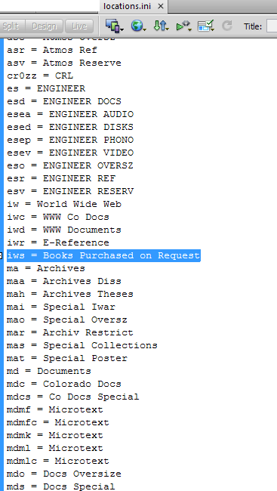
Discovery configuration file locations.ini (iws = Books Purchased on Request)

Slide 13
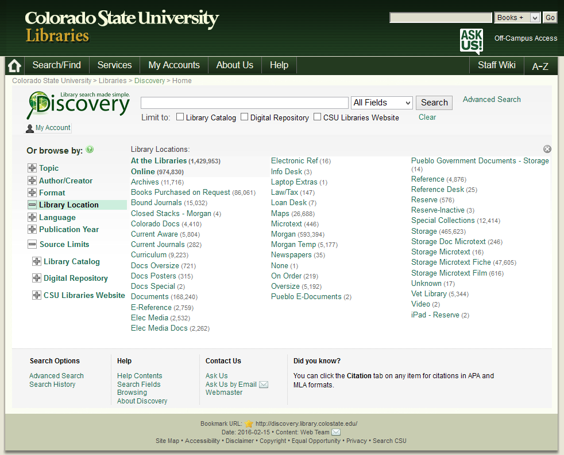
Library Catalog (Discovery) home page with location “Books Purchased on Request”

Slide 14
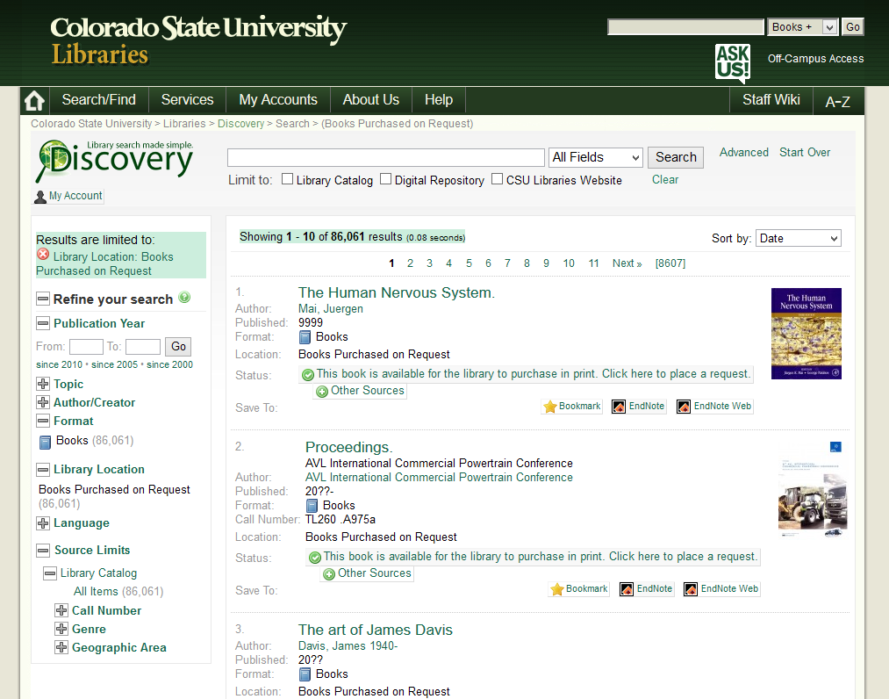
Library Catalog (Discovery) DDA facet and search results with request link

Slide 15
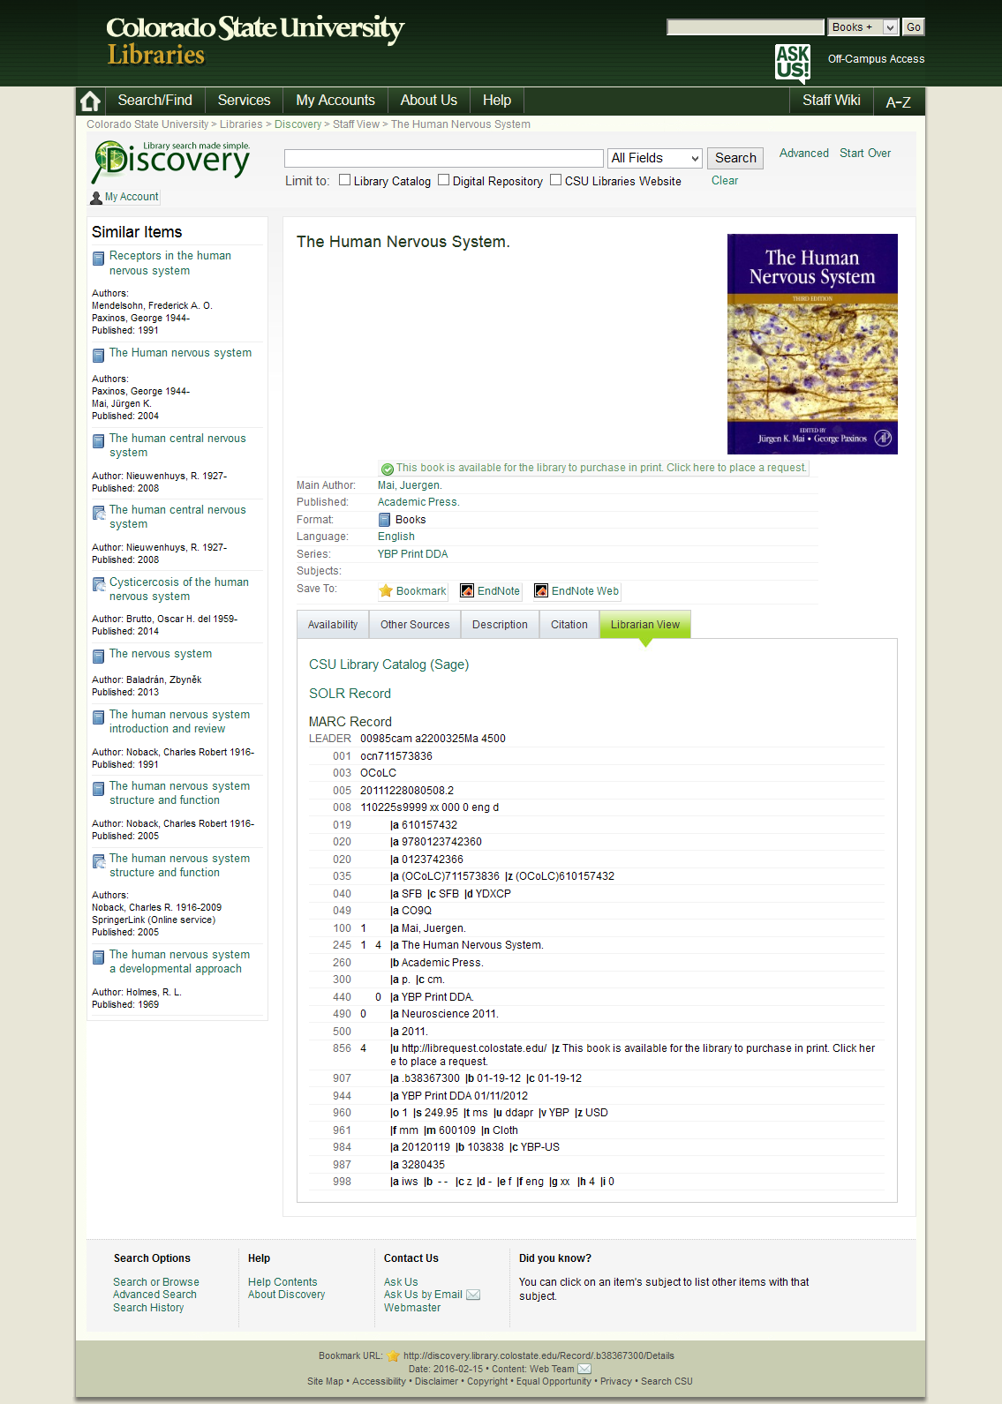
Library Catalog (Discovery) MARC view with request link, 856 and 998 fields

Slide 16
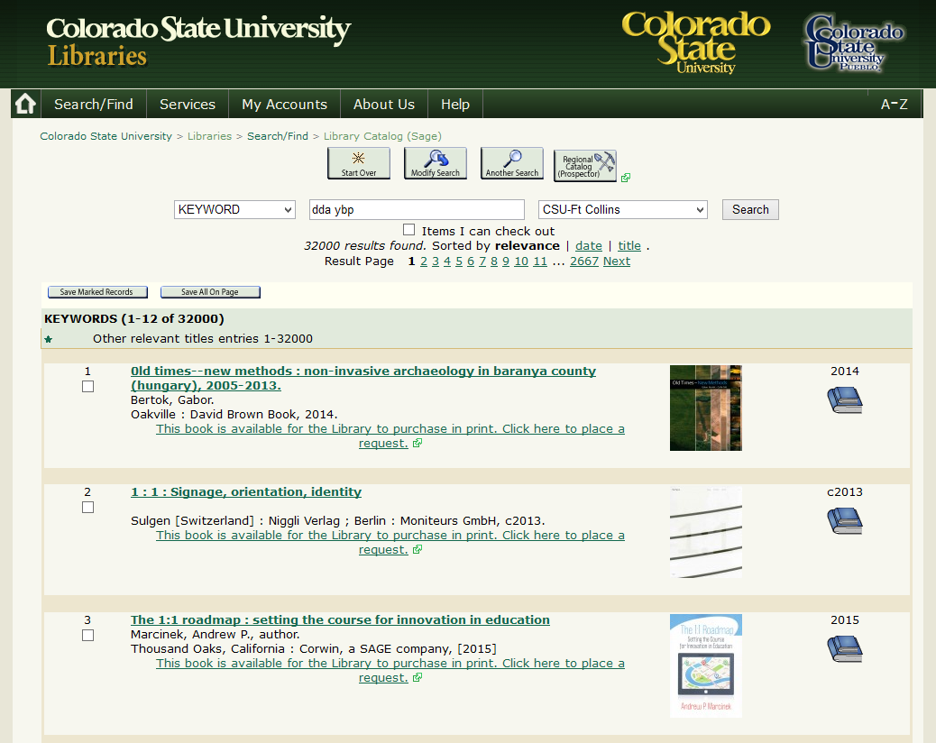
Library Catalog (Sage) search results with request link

Slide 17
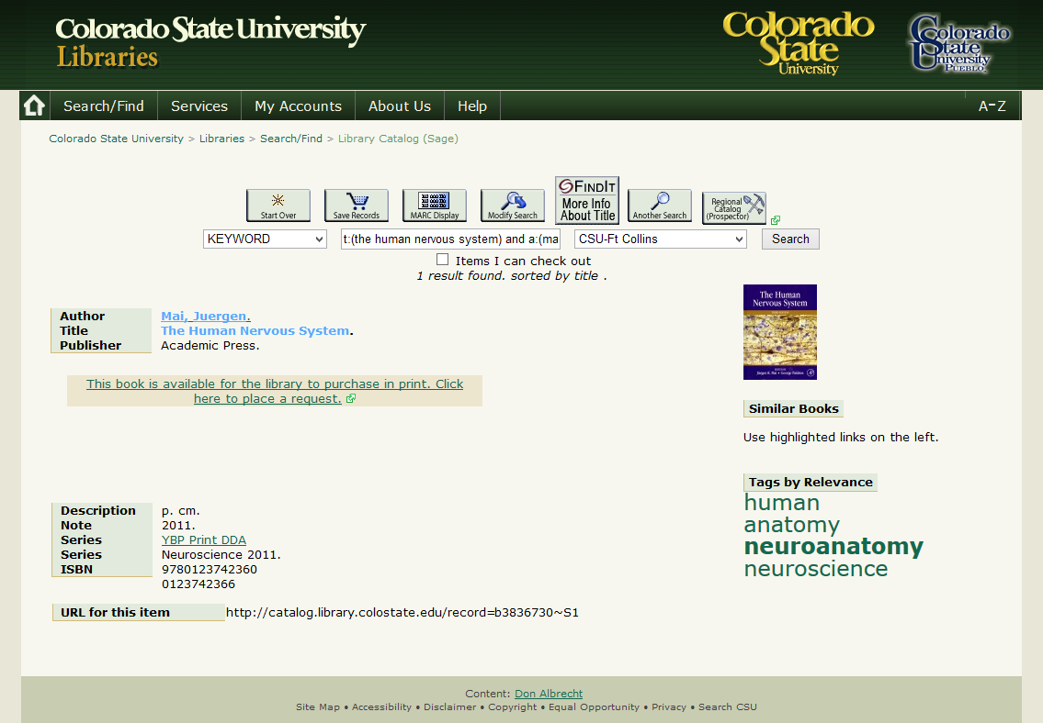
Library Catalog (Sage) item with request link

Slide 18
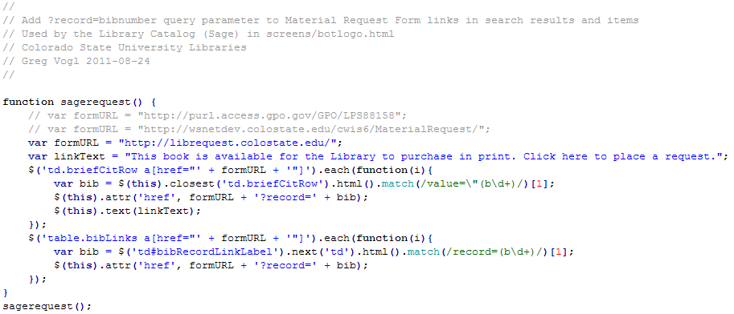
sagerequest.js – jQuery script to add bib number to DDA request links

Slide 19
Application Workflow: Catalog Record
The referring URL of the record is passed to the form upon login.
The bib number is extracted from the referring URL using a regular expression. Sage: record=b1234567 Discovery: Record/.b1234567X
The bib number is looked up in Discovery's Solr database for details, including title, author, publisher and ISBNs.

Slide 20
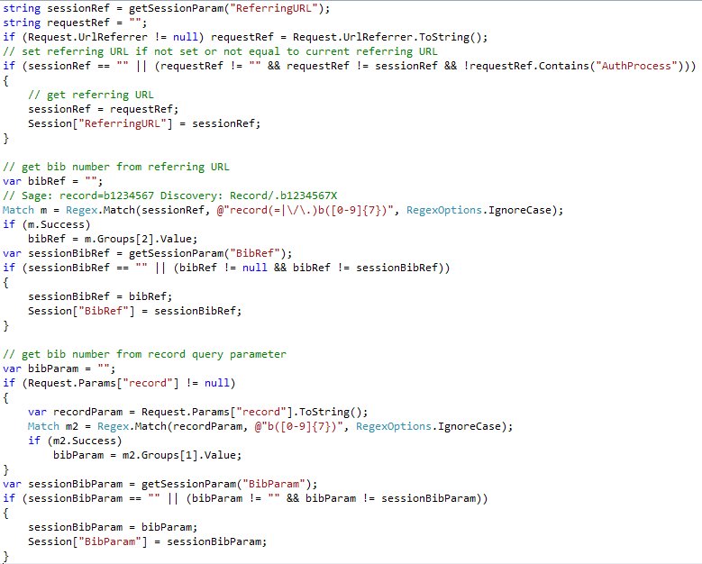
Material Request – AuthProcess.aspx.cs – get bib number from referrer or query string

Slide 21
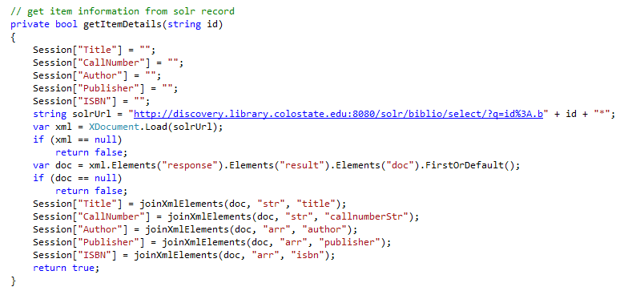
MaterialRequest - Authprocess.aspx.cs – get item details from Solr query results

Slide 22
Application Workflow: Prospector Record
If the book is in Discovery, its first ISBN is used to search classic Prospector.
If the book is in Prospector, book details, non-CSU copies, and available copies are counted by screen-scraping the holdings rows from the classic Prospector availability page.
If copies are available, the user can select from links to request from Prospector, view availability in Prospector, or request order for CSU.

Slide 23
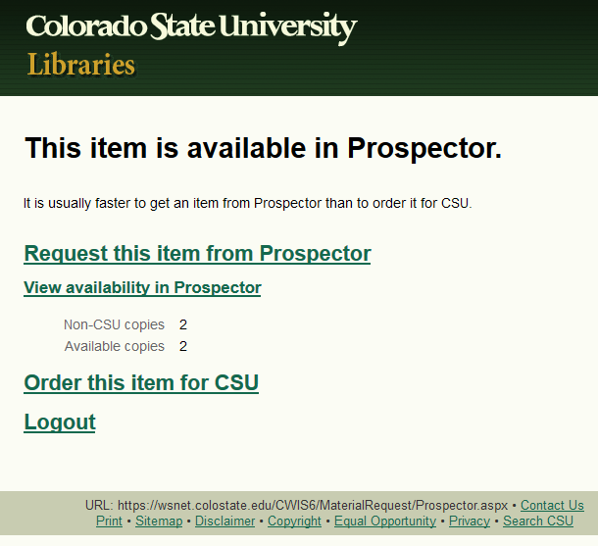

Slide 24
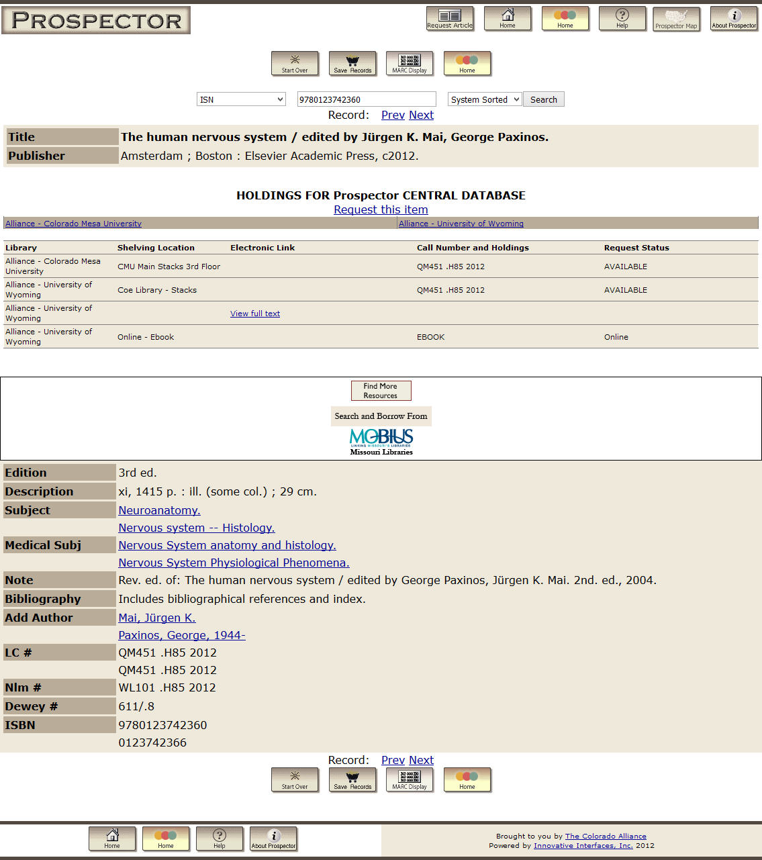
Prospector availability

Slide 25
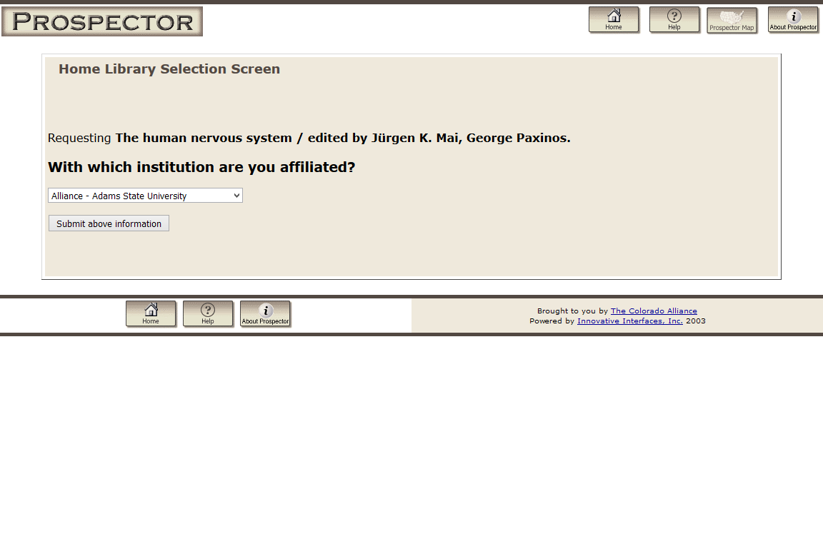
Prospector request

Slide 26
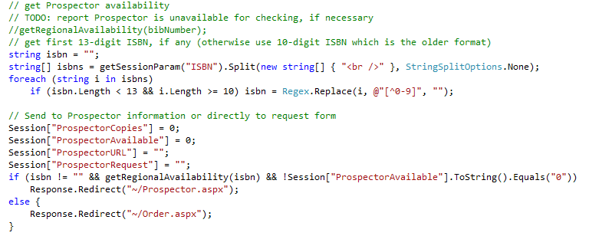
Material Request - AuthProcess.aspx.cs - Prospector availability

Slide 27
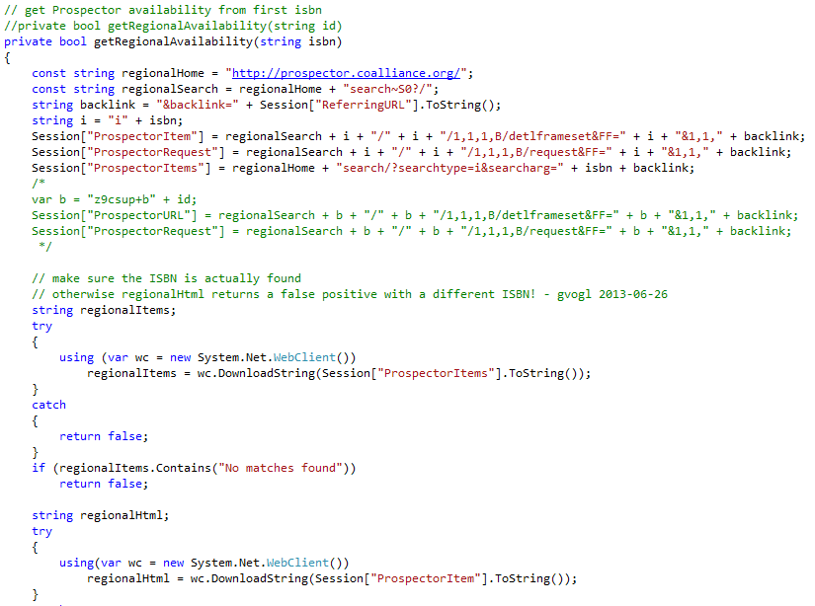
Material Request - AuthProcess.aspx.cs - Prospector links (items, item, request)

Slide 28
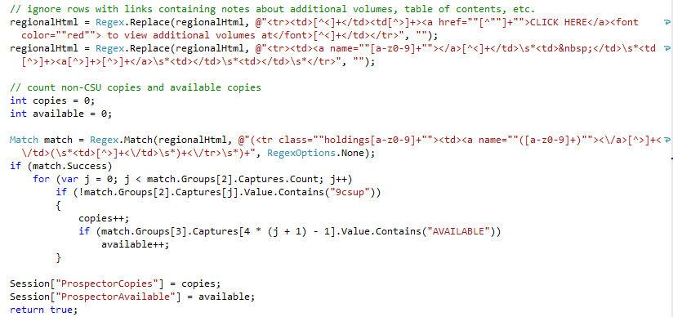
Material Request - AuthProcess.aspx.cs - Prospector availability counts

Slide 29
Application Workflow: Order Form
If no copies are available, or the user selects Order, they see their contact information, requested book information, and delivery options (order, order and notify me when it arrives, or rush order).
Library staff members can also provide comments or details about the request, such as the identity of a patron making the request.
If the user clicks Order, a confirmation message is composed.
The message is logged to the Material Request database.
The message sent via email to the patron. (The Collections and Contracts staff email is a BCC recipient.)
The message is displayed on a confirmation page, with options to print, return to the catalog record, or log out.

Slide 30
More Information
Source code, slides, screenshots
https://github.com/gregvogl/MaterialRequest
Contact
Greg Vogl Middleware Developer Academic Computing and Networking Services (970) 491-4394 Gregory.Vogl@colostate.edu
February 25, 2016

